Slide 1
Baking bread – the steps

Slide 2
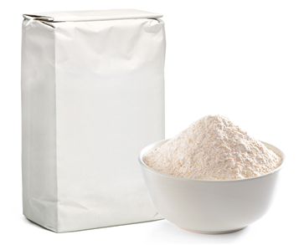
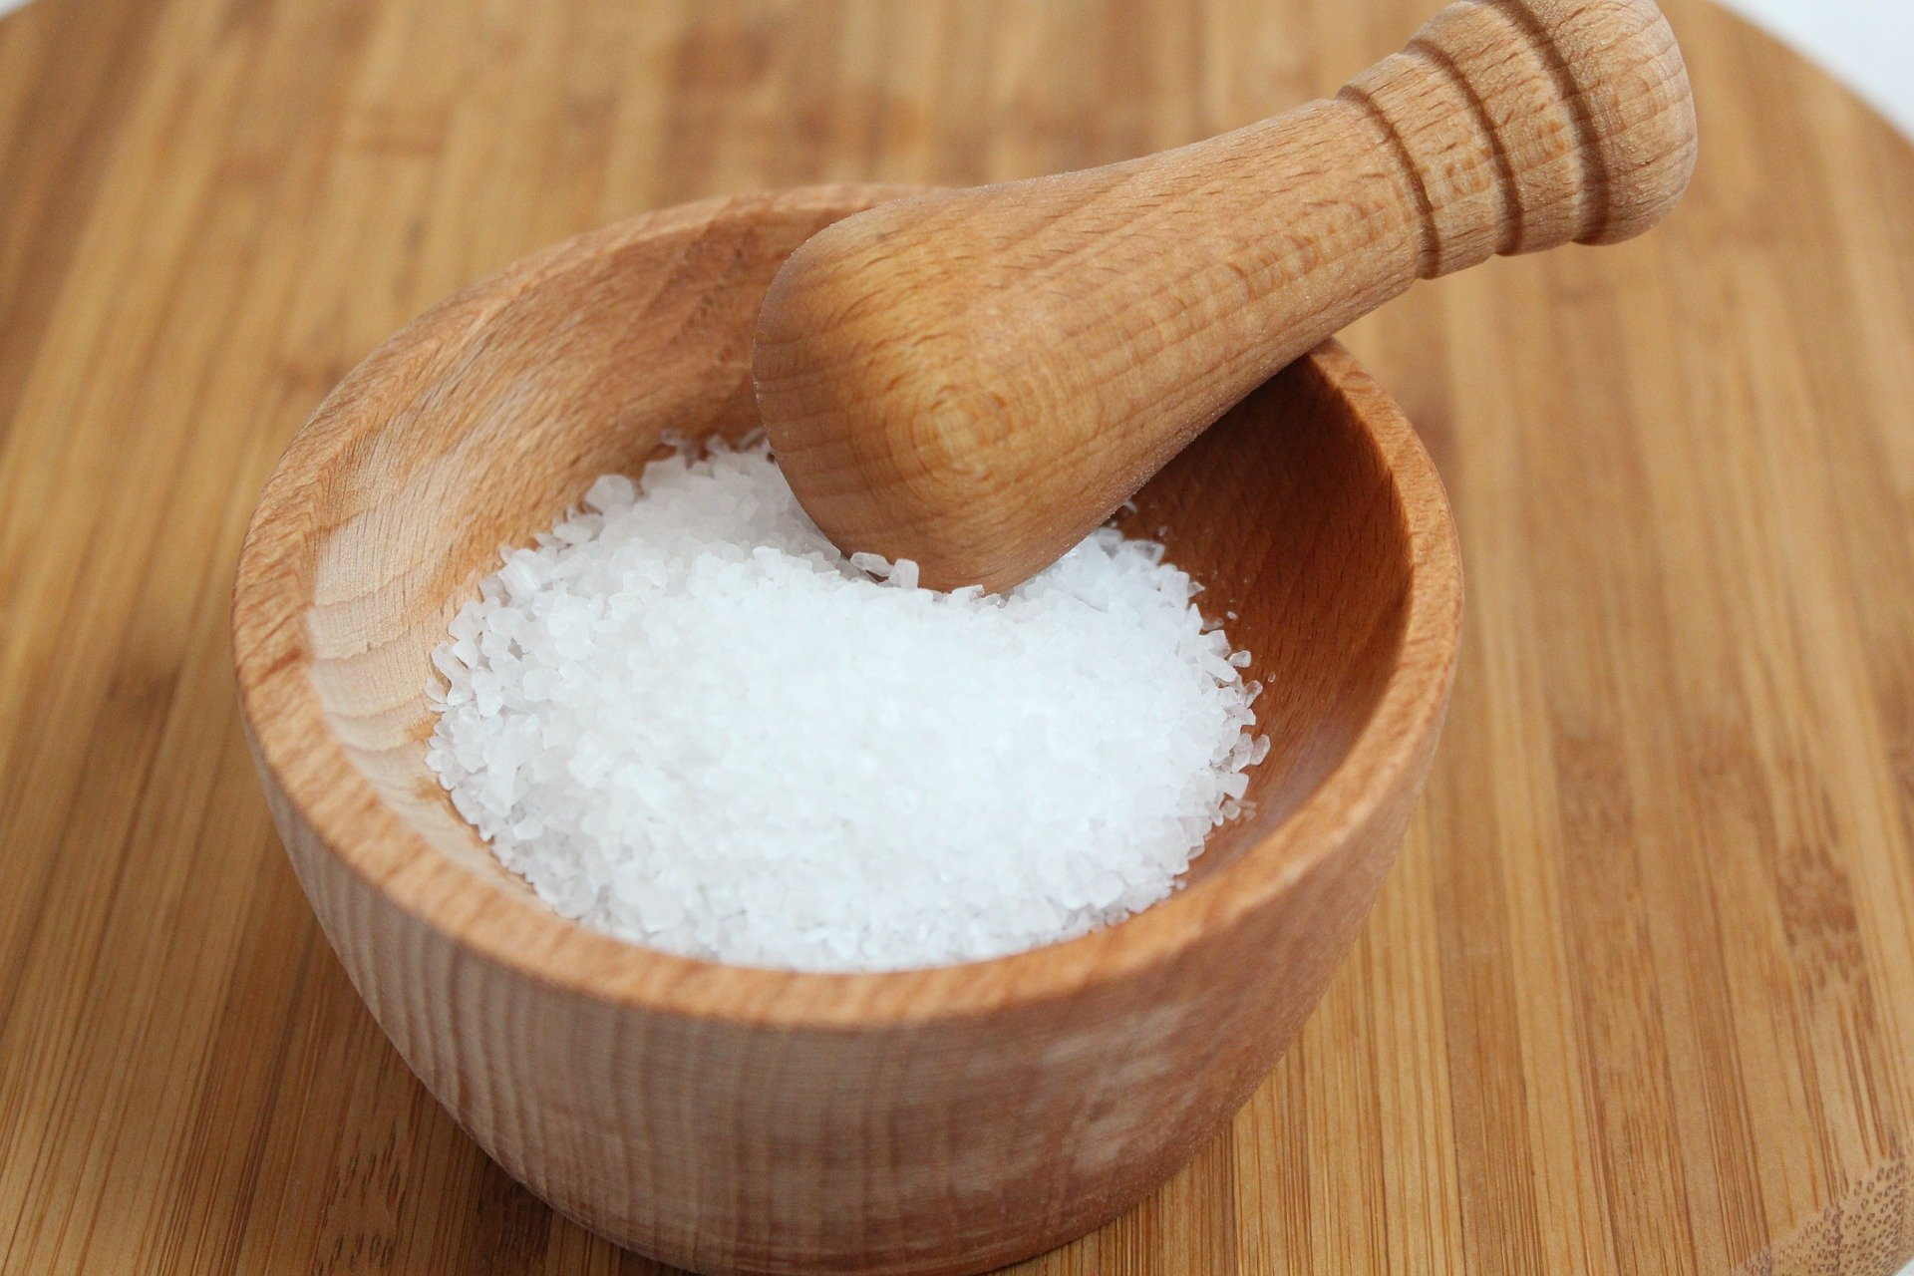
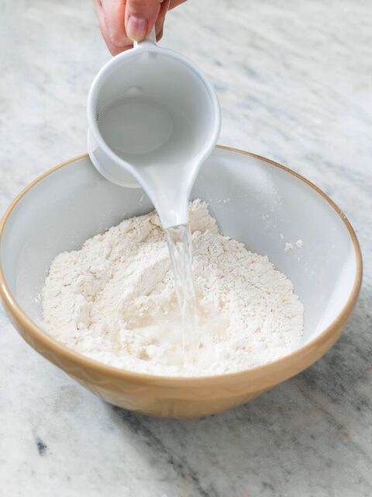
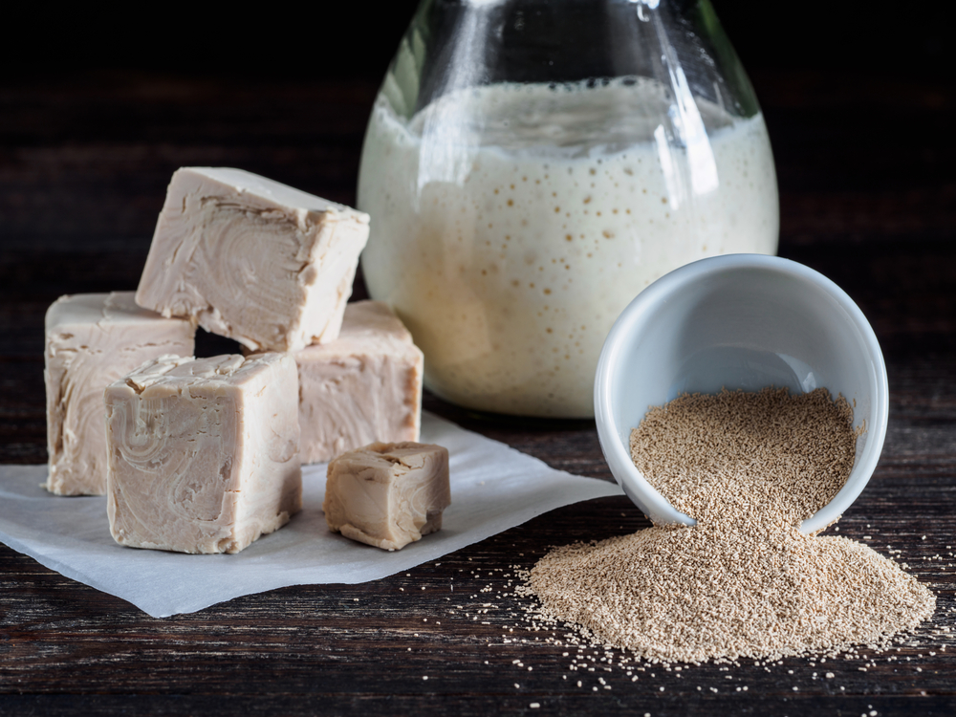
Ingredients
Flour
Yeast
Salt
Water

Slide 3
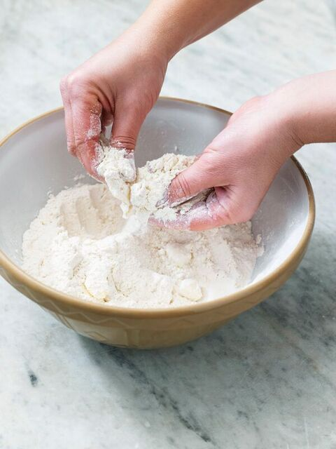
Stage 1
Measure the ingredients.
Add the flour into a bowl.
Stir in the salt.
Sprinkle in the fast acting yeast.

Slide 4
Stage 2
Add the water.
Combine to form a soft dough.

Slide 5
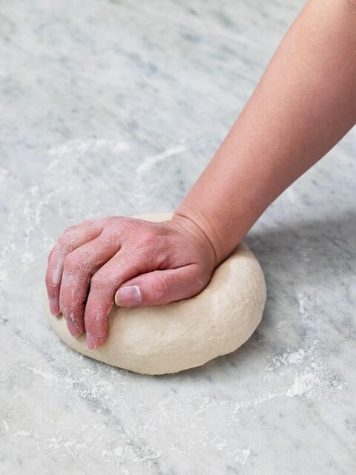
Stage 3
Knead the dough on a floured work surface for 5-10 minutes.
The dough should be smooth and elastic.

Slide 6
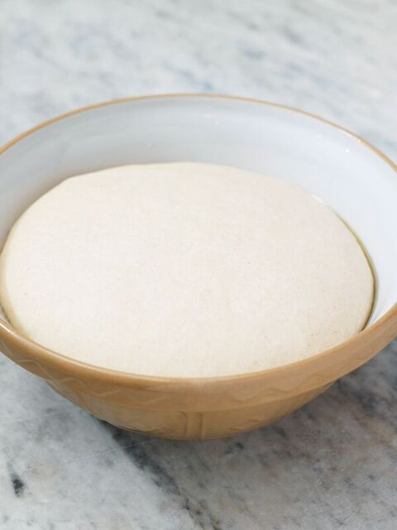
Stage 4
Allow the dough to prove in a warm place.
The dough should double in size.

Slide 7
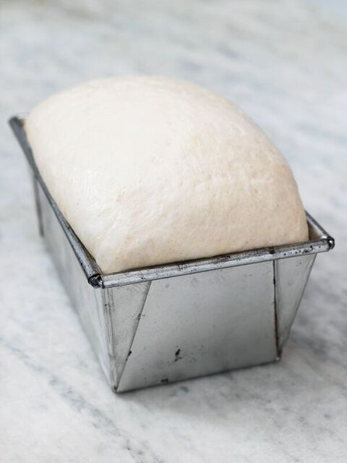
Stage 5
Place the dough in a baking tin or shape into a loaf or rolls on a baking sheet.
Bake in the pre-heated oven.

Slide 8
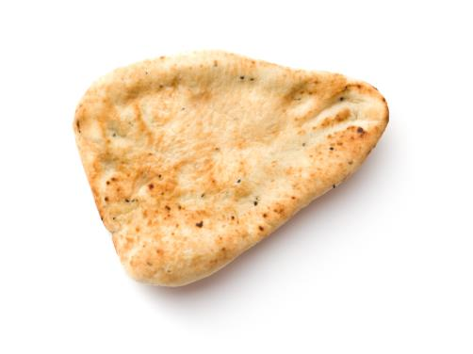
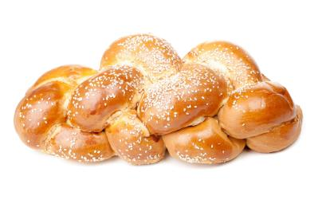
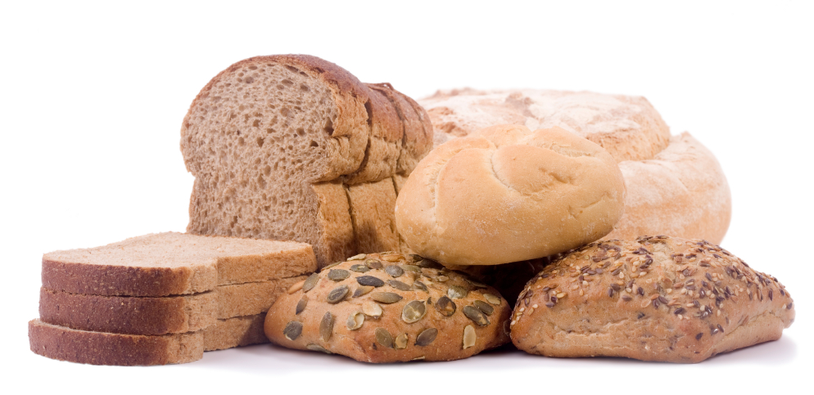
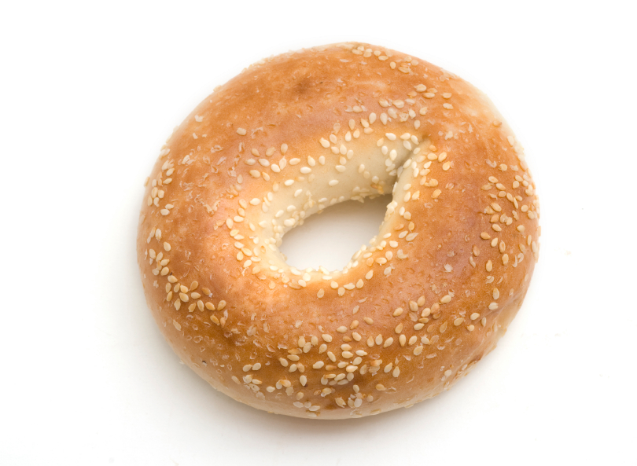
Different types of bread
Name 10 different types of bread.

Slide 9
Baking bread – the steps
For further information, go to:
www.foodafactoflife.org.uk

