Slide 1
Different types of bread

Slide 2
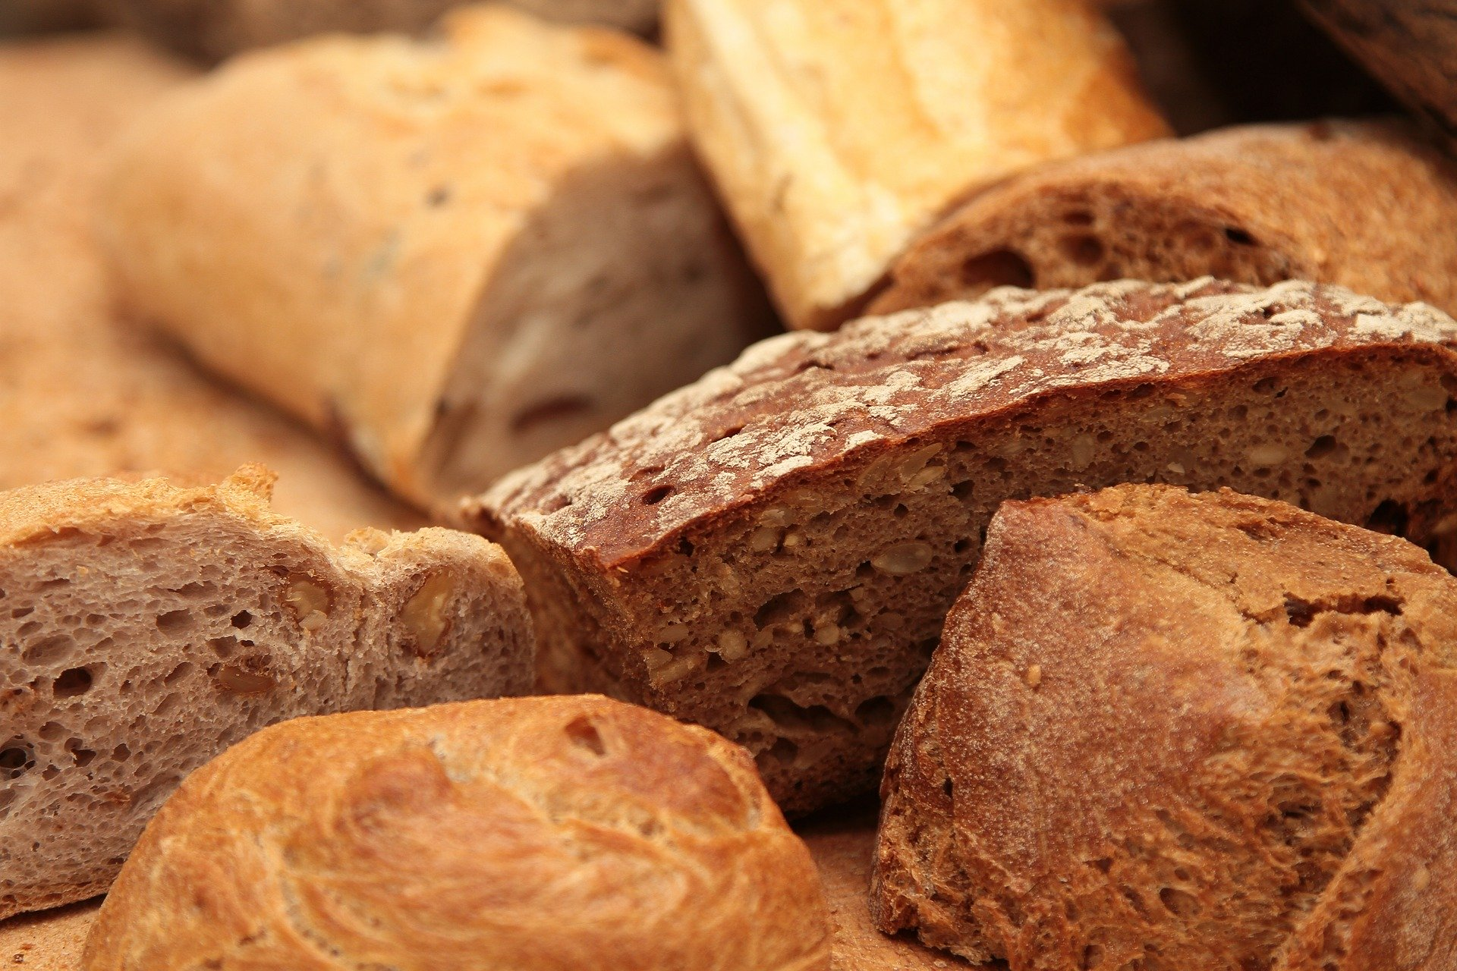
Bread traditions around the world
Bread forms a staple part of the diet for a number of people around the world. However, the way this bread is made, prepared and eaten can differ depending on different countries and cultures.
Some types of bread you may have had before but others you may not have seen.

Slide 3
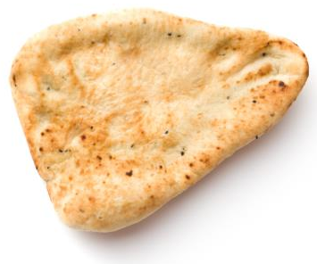
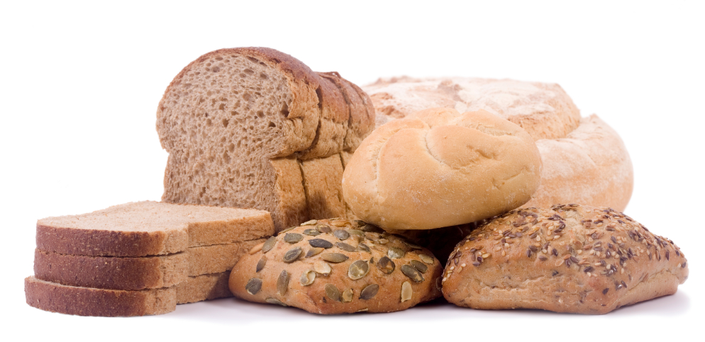
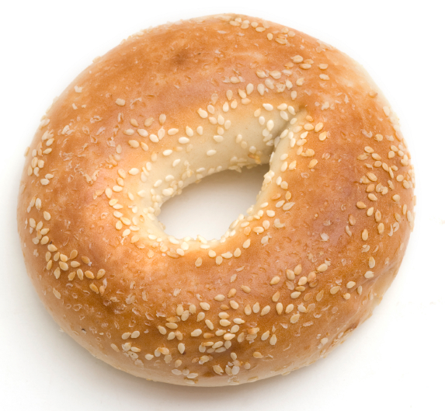
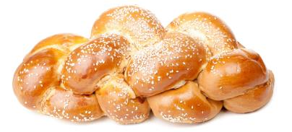
Different types of bread
There are lots of different types of bread that we eat throughout the UK.
List as many types of bread as you can.

Slide 4
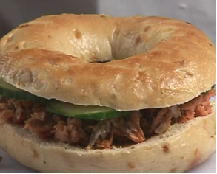
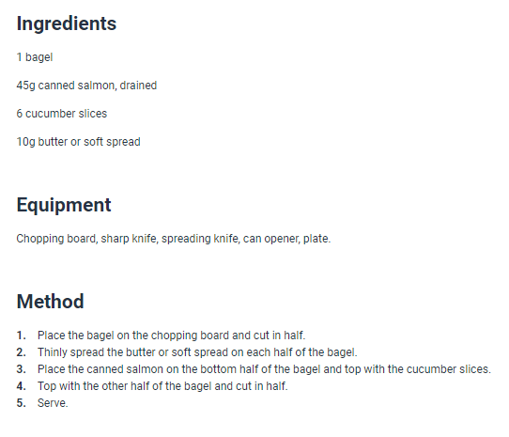
Bagel
It is likely that you have seen, and maybe had a bagel at some point.
These are commonly eaten in a number of western countries but the bagel actually originated in Poland.
You can use a number of different toppings on bagels – why not try the Salmon and cucumber bagel recipe on this slide?

Slide 5
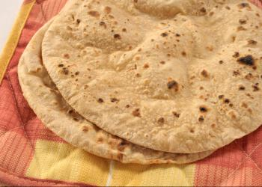
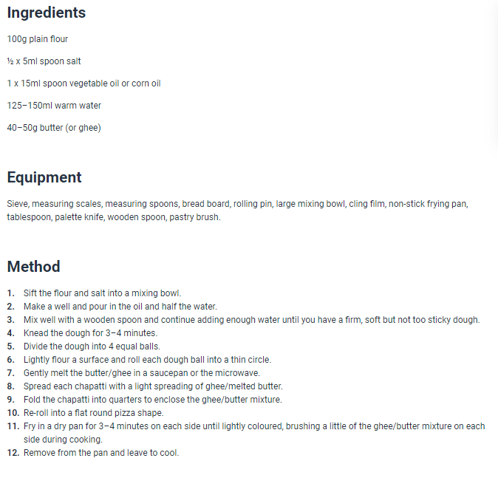
Chapatti
Chapatti is a type of toasted flat bread that is popular in India.
Chapattis are made with flour, salt, oil, water and butter and are made by frying.
You can make your own Chapatti using the recipe on this slide.

Slide 6
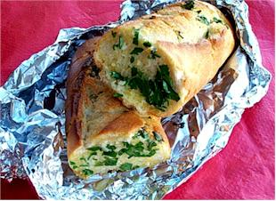
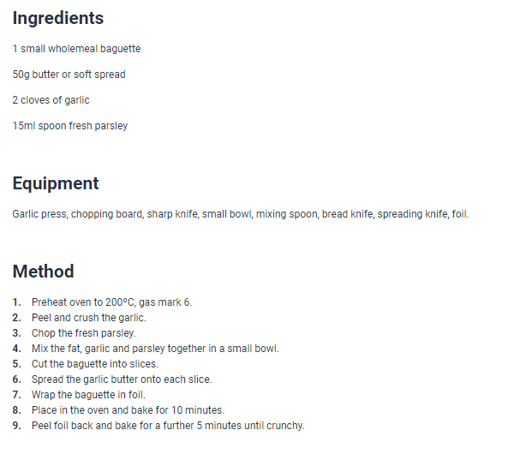
Garlic bread
Garlic bread is commonly consumed in the UK, often as a starter or a side of Italian meals.
It is most commonly in the form of a flatbread or a baguette.
You can make your own garlic bread using the recipe on this slide.

Slide 7
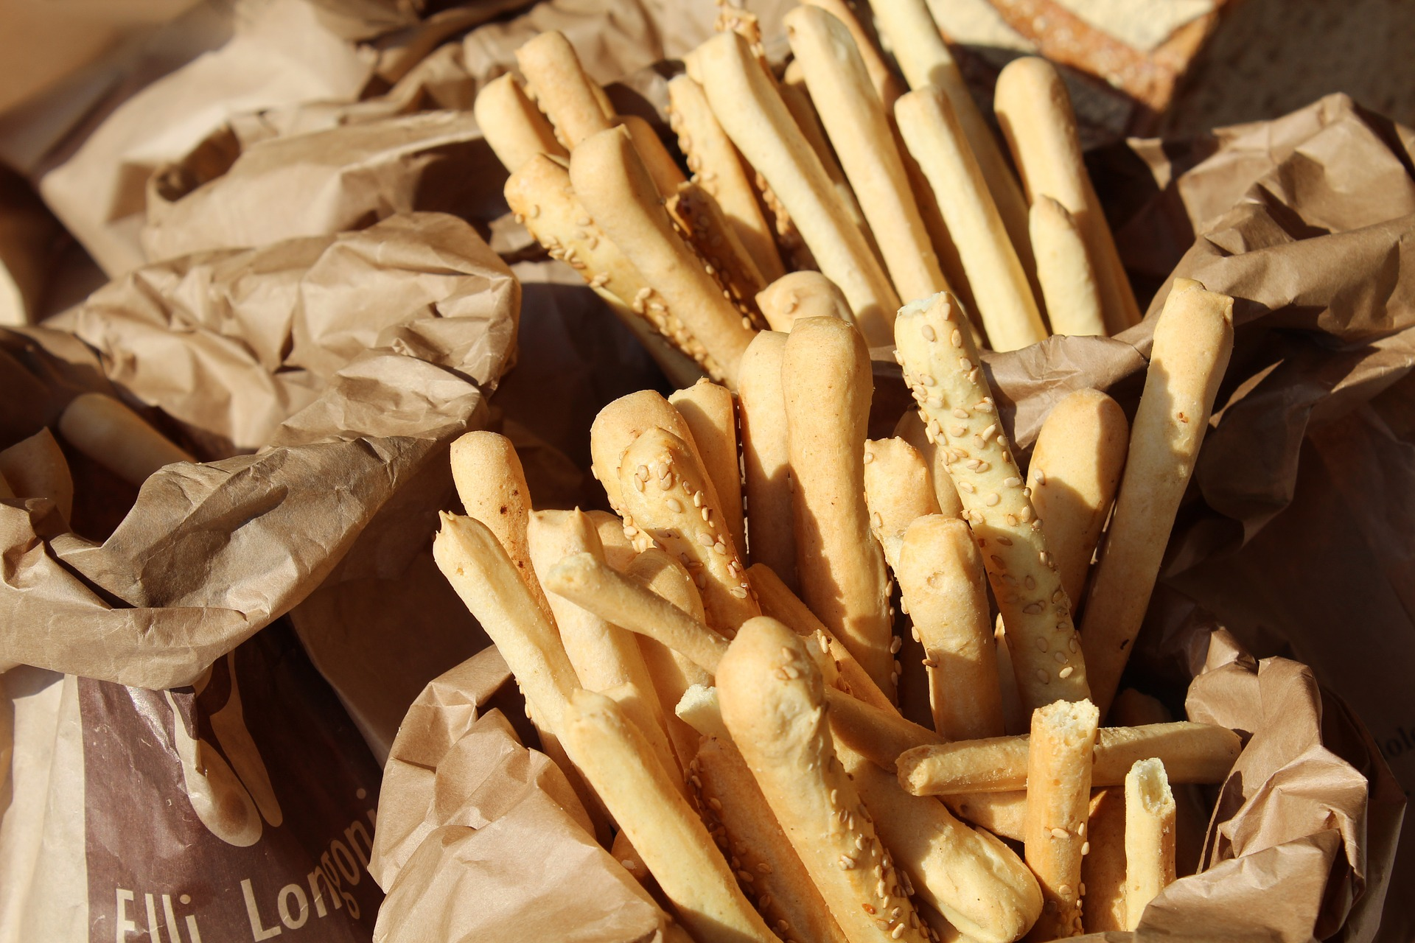
Grissini
You may not think of Grissini as a type of bread, but it is actually a type of bread stick that originally comes from Italy.
Grissini is often offered before the start of a meal and can be flavoured with a number of different herbs.
What would be your favourite flavouring for a breadstick?

Slide 8
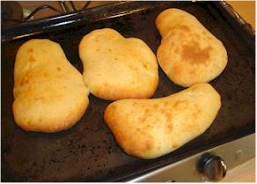
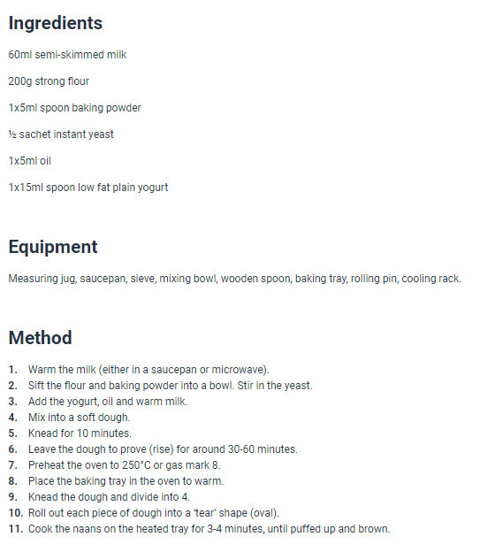
Naan
Naan bread is an oven-baked flatbread that originates in Asia.
One of the most commonly eaten naan bread is the peshwari which is made with coconut, dried fruit and sugar.
You can make your own Naan bread using the recipe on this slide.

Slide 9
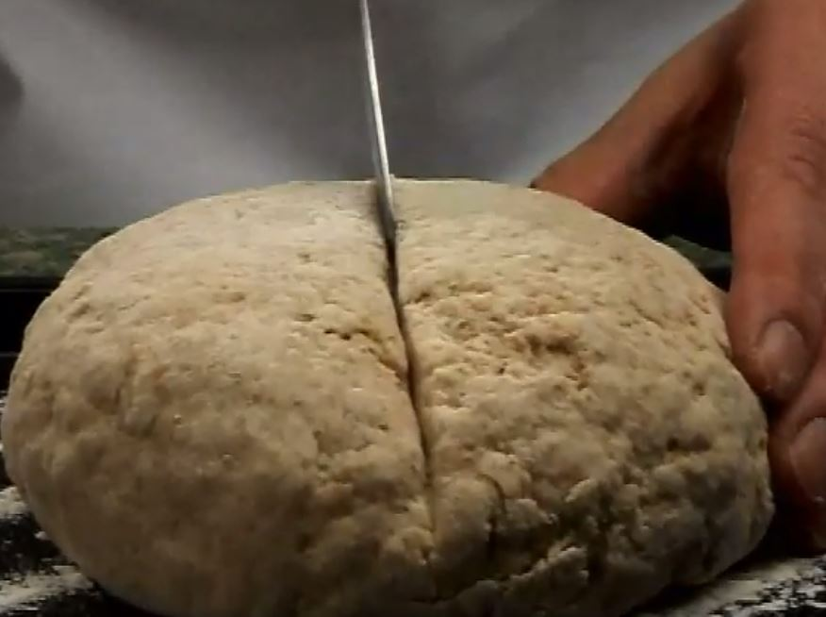
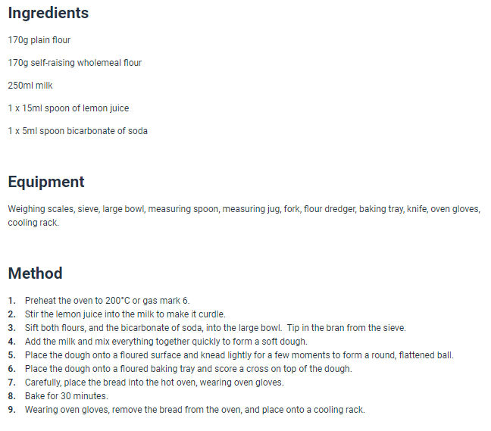
Soda bread
Soda bread is a type of bread made without yeast, instead using bicarbonate of soda.
Soda bread originates in Ireland but is commonly eaten in other countries.
You can make your own soda bread using the recipe on this slide.

Slide 10
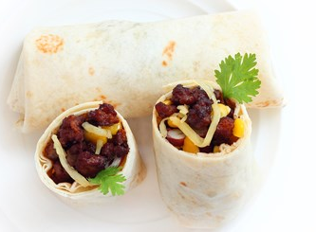
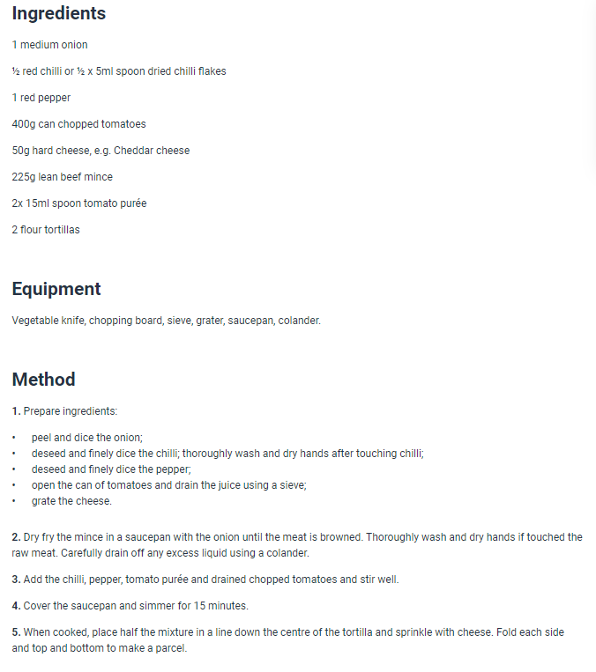
Tortilla
Tortilla is a thin flatbread that can be used for wraps. You can get different types of tortilla in the UK, made with wholemeal or white flour.
Tortillas are commonly used in Mexican dishes, such as tacos and burritos.
You can try making a Mexican burrito using the recipe on this slide.

Slide 11
Match each bread with the country
Ireland
India
Mexico

Slide 12
Match each bread with the country
Ireland
India
Mexico

Slide 13
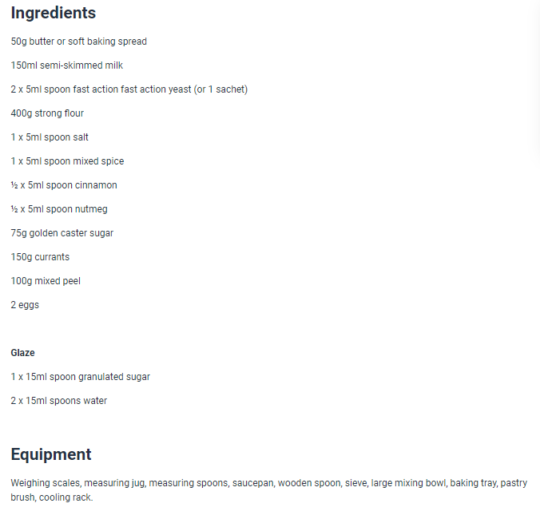
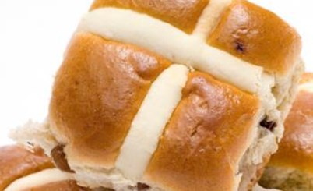
Bread on special occasions
Bread can also be part of special occasions, such as religious holidays.
Matzo is a form of flatbread eaten at the Jewish holiday of Passover.
Hot cross buns are eaten over the Christian holiday of Easter. You can make your own hot cross buns using the recipe on this slide.

Slide 14
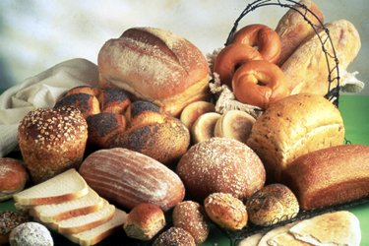
Bread types
There are a huge range of speciality breads available, originating from different cultures, e.g. pitta, naan, chapatti, ciabatta, bagels, baguettes, soda bread.
How many of the bread types in the next slides can you name? There are some new types that we have not seen yet.

Slide 15
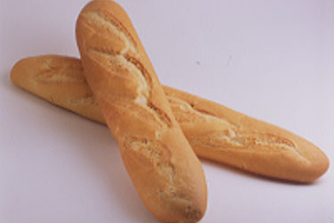
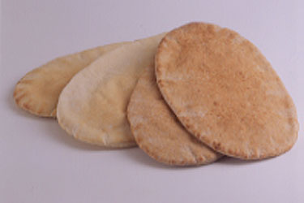
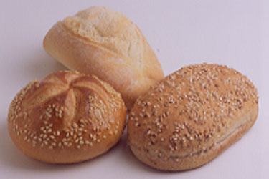
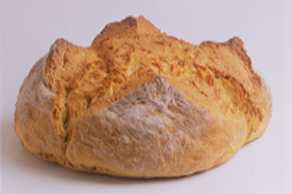
Name the bread type
Baguettes
Pitta bread
Bread rolls
Soda bread

Slide 16
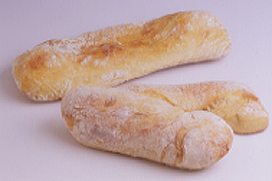
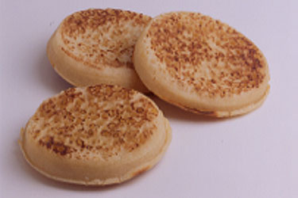
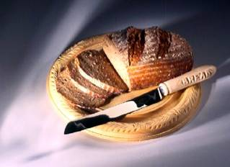
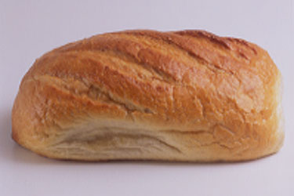
Name the bread type
Ciabatta
Crumpets
Rye
White bloomer

Slide 17
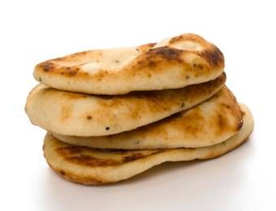
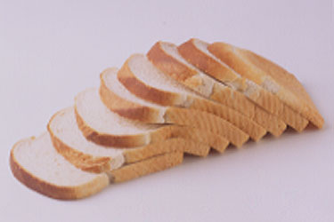
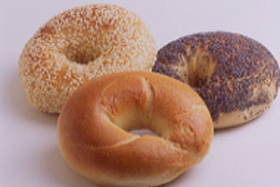
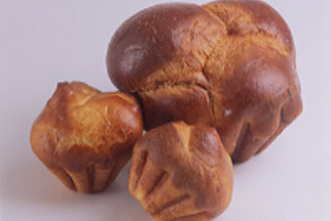
Name the bread type
Sliced bread
Bagels
Brioche
Naan bread

Slide 18
Bread traditions around the world
For further information, go to:
www.foodafactoflife.org.uk

