Slide 1
Types of flours for breadmaking

Slide 2
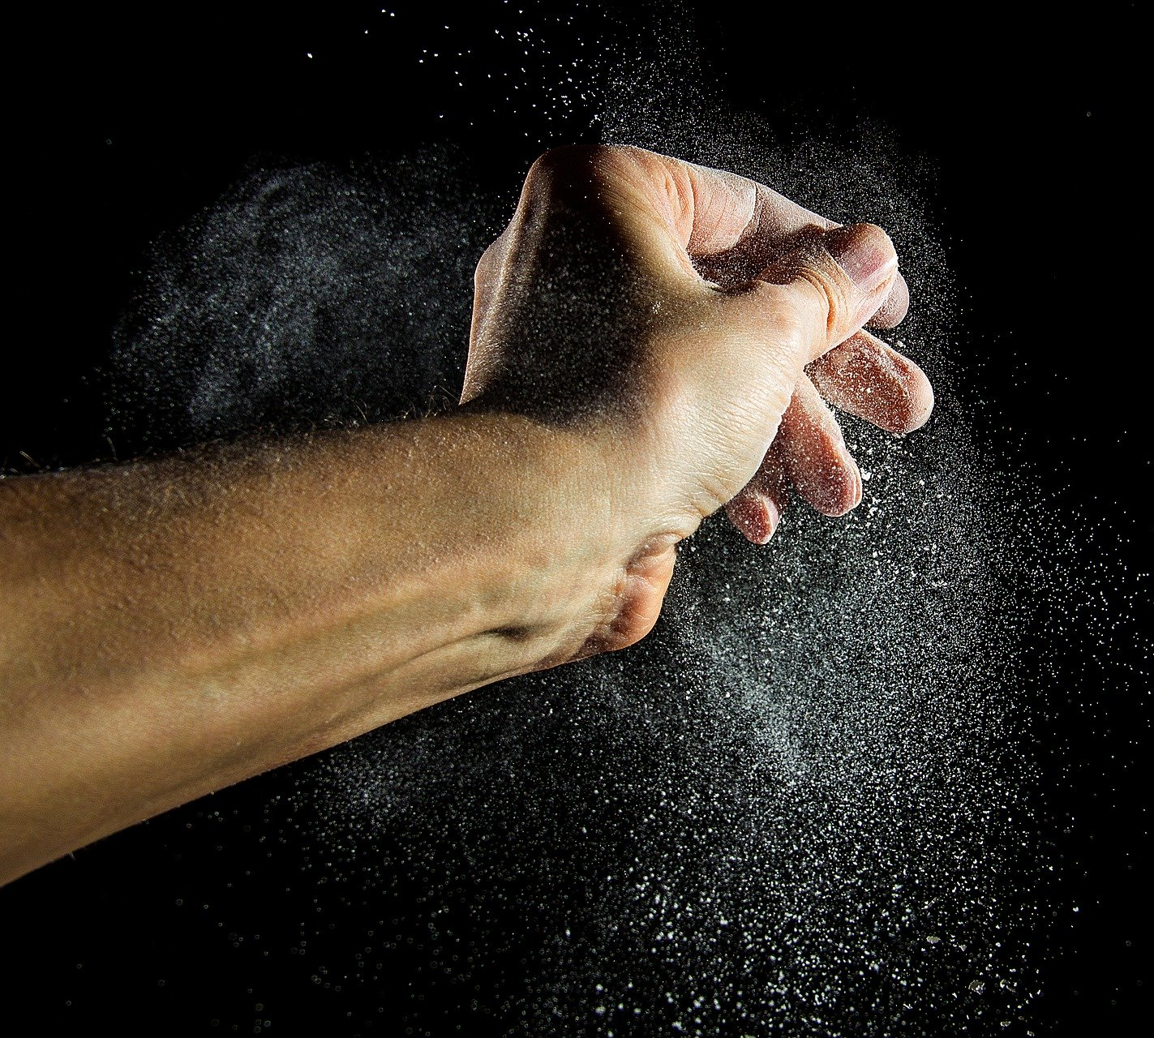
Different types of flour
The type of bread that is produced can differ depending on the type of flour used.
How many different types of flour can you list?
This could include:
white;
brown;
wholemeal;
malted wheatgrain;
wheatgerm;
organic;
stoneground.

Slide 3
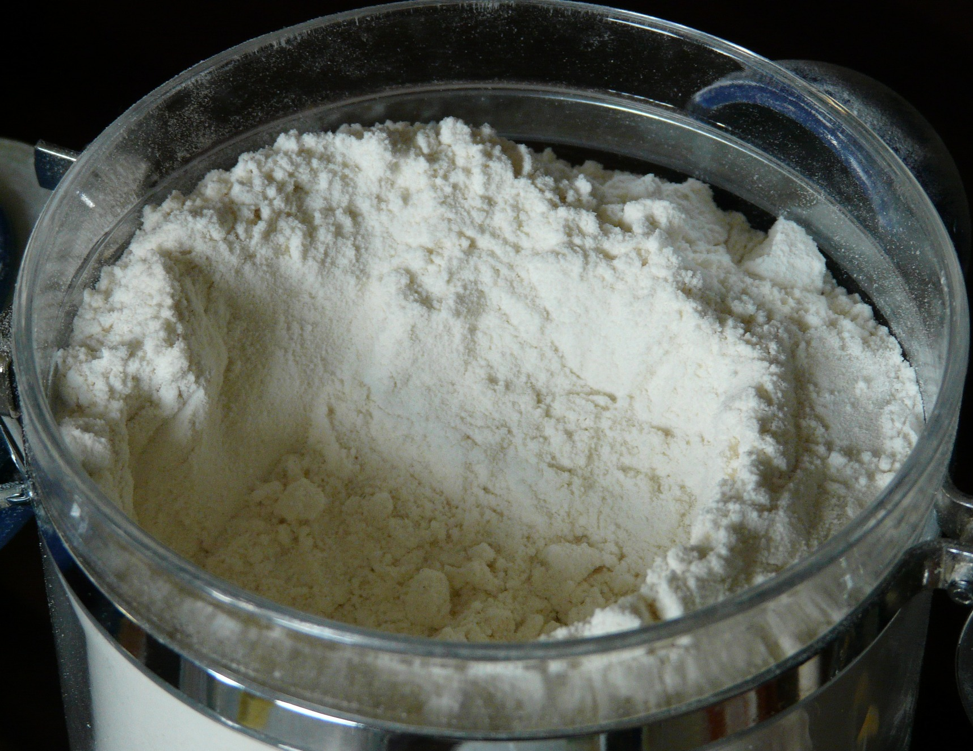
Types of flour: white
This usually contains around 75% of the wheat grain.
During milling, most of the bran and wheatgerm are removed.

Slide 4
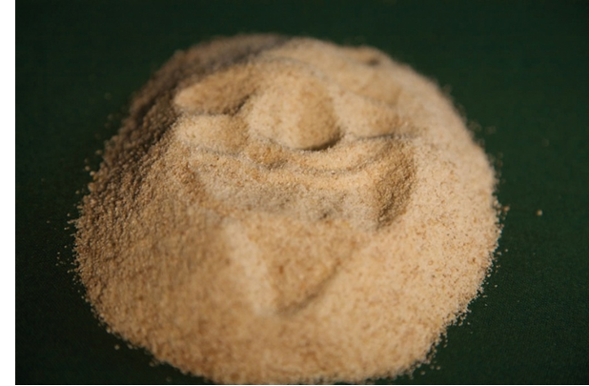
Types of flour: brown
This usually contains about 85% of the original grain.
During milling, some of the bran and wheatgerm are removed.

Slide 5
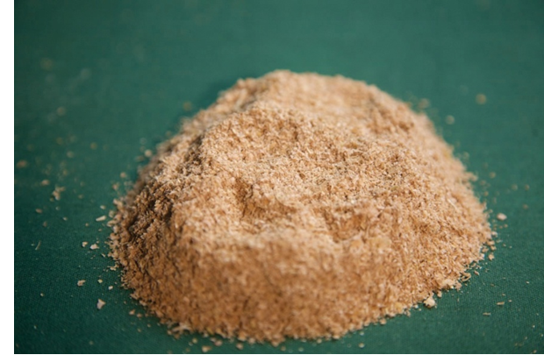
Types of flour: wholemeal
This is made from the whole wheat grain without any additional ingredients, or any parts being removed in the milling process.

Slide 6
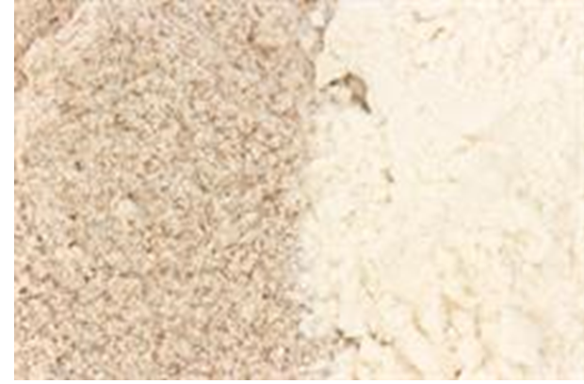
Types of flour: malted wheatgrain
This is brown or wholemeal flour with malted grains added after the milling process.

Slide 7
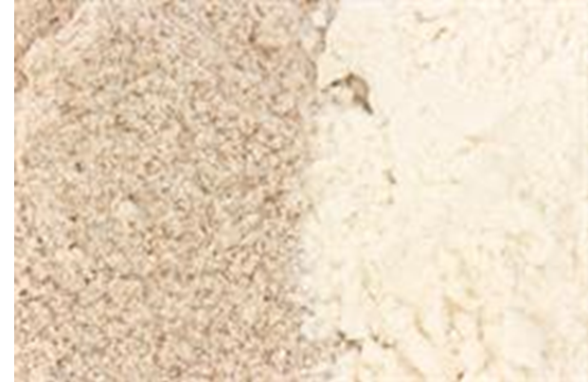
Types of flour: wheatgerm
This can be white or brown flour with at least 10% made up of wheatgerm added during the milling process.

Slide 8
Types of flour: organic
This is made from grain that has been grown to organic standards.
Growers and millers must be registered and are subject to regular inspections.

Slide 9
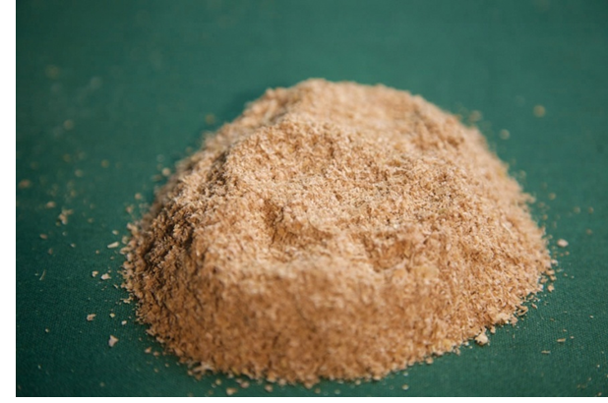
Types of flour: stoneground
This is whole flour grown between two stones using the whole wheat grain with no additional ingredients or any parts being removed.

Slide 10
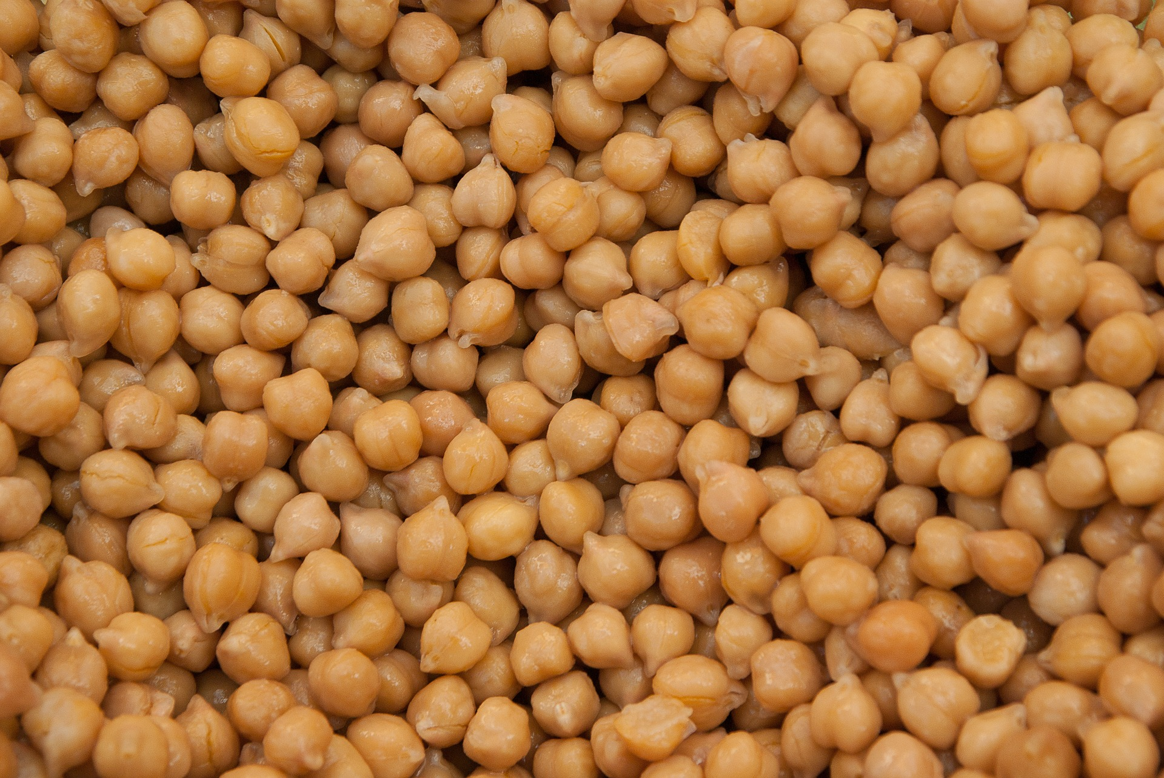
What about other types of flour?
Around the world there are flours which are not made from wheat.
Some of the more unusual types include flour made from coconut, potato, peas and chickpeas. Other grains such as rye, oats and spelt are also used.

Slide 11
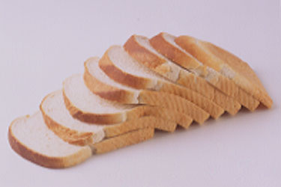
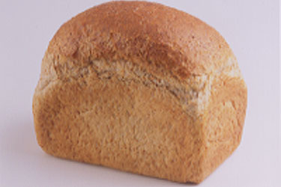
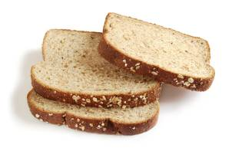
Bread types
Different flours can be used to make different types of bread.
White bread is made from flour that contains only the endosperm of the wheat grain (about 75% of the whole grain).
Wholemeal bread is made from the whole of the wheat grain with nothing taken away. Wholewheat is another name for wholemeal.
Brown bread is made from flour from which some bran and wheatgerm is removed (it uses about 85% of the whole grain).

Slide 12
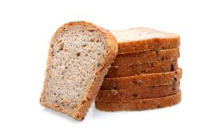
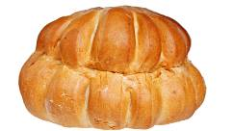
Bread types
Soft grain bread is made from white flour with extra grains of softened rye and wheat to increase the fibre content by 30% compared with standard white bread.
Sandwich loaves can be white or brown bread. They are baked in tins and have a flat top, giving even and rectangular slices.
A cottage loaf has two round sections, one on top of the other. It is believed to date back to Roman times when it was invented to make the most of the height of the oven.

Slide 13
Different types of flour
For further information, go to:
www.foodafactoflife.org.uk

