Slide 1
Be a baker challenge

Slide 2
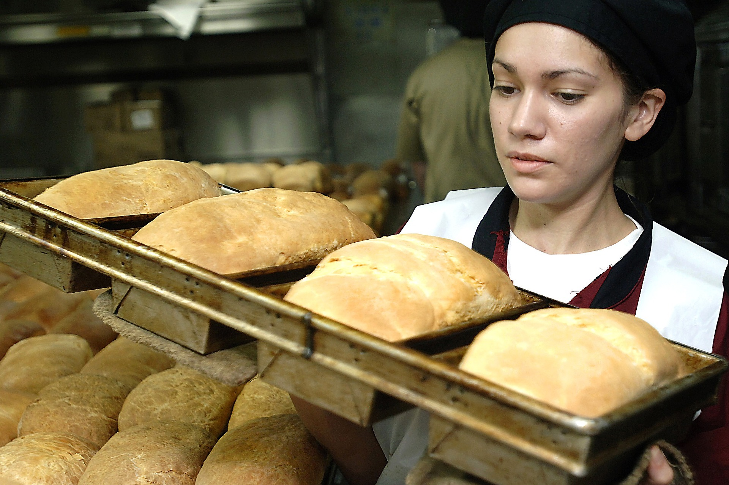
Be a baker challenge
The baker is someone who works in a bakery and bakes bread, as well as other dishes.
One of their main jobs is to bake the bread, but they also have lots of other jobs which are really important.

Slide 3
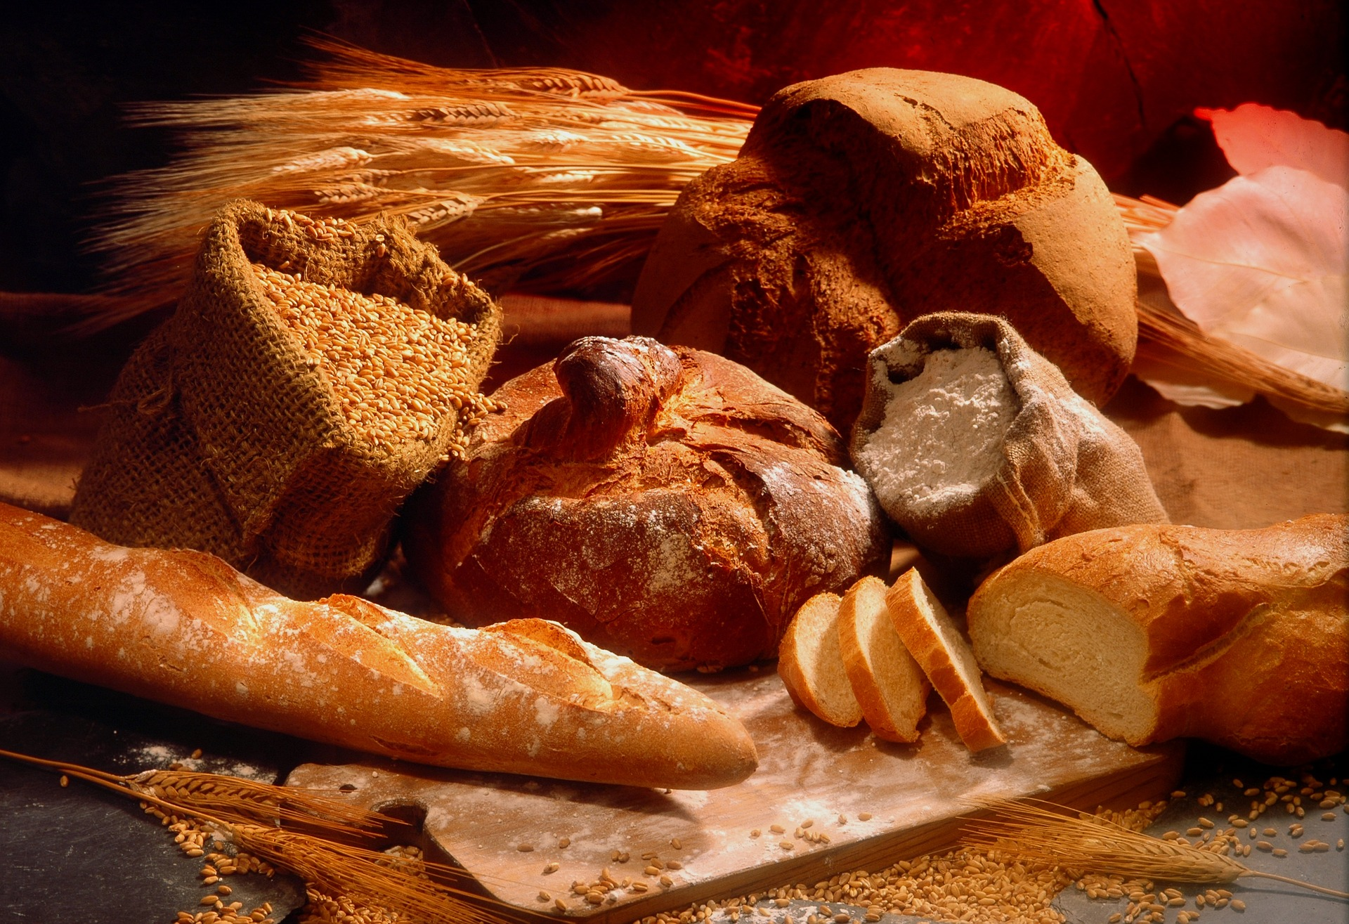
The baker
List all the jobs a baker has. This could start with baking the bread.
The baker’s jobs include:
baking bread;
designing and improving recipes;
making other baked goods such as cookies, bread and cakes;
displaying the baked goods in the bakery.

Slide 4
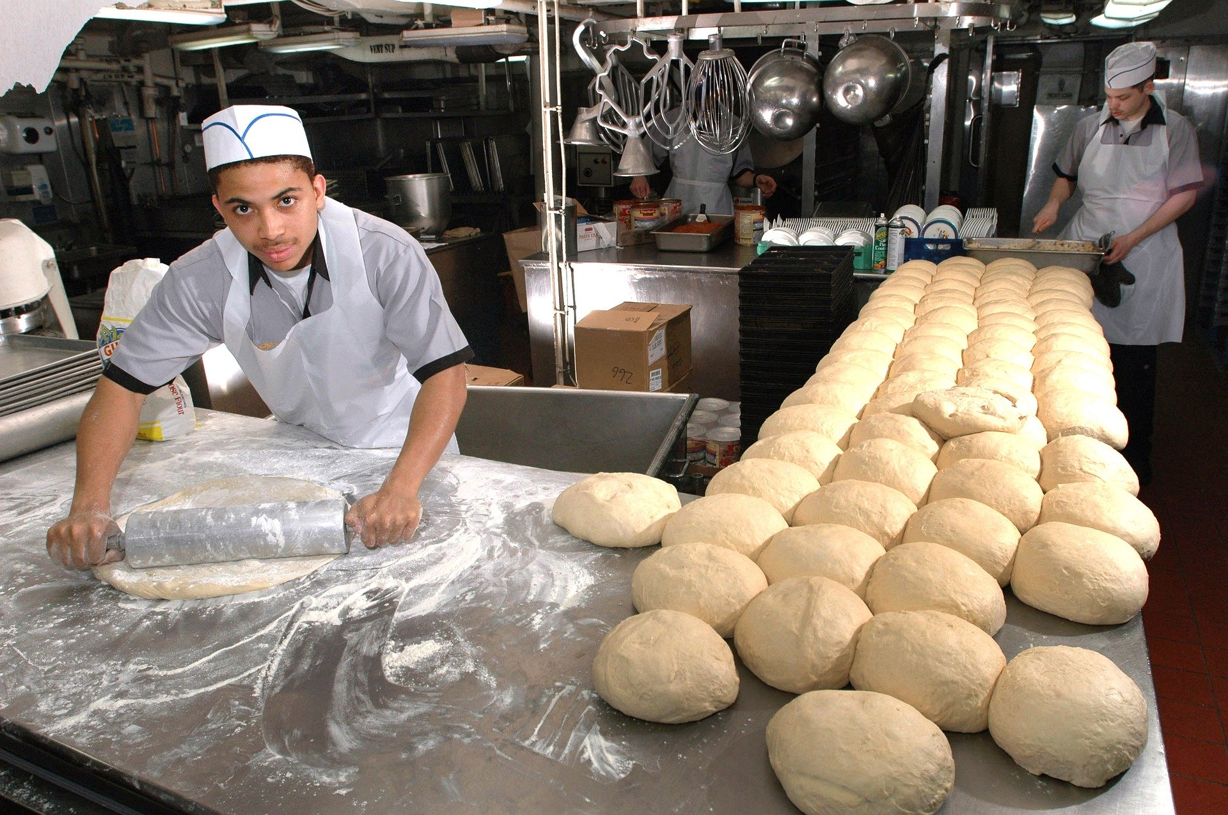
The baker
Depending on where the baker works, there may be some extra aspects of the job.
This may include:
answering customer questions;
selling the bread;
taking orders for deliveries and ensuring that deliveries are sent and processed on time;
cleaning the bakery and ensuring suitable hygiene and safety measures are taken.

Slide 5
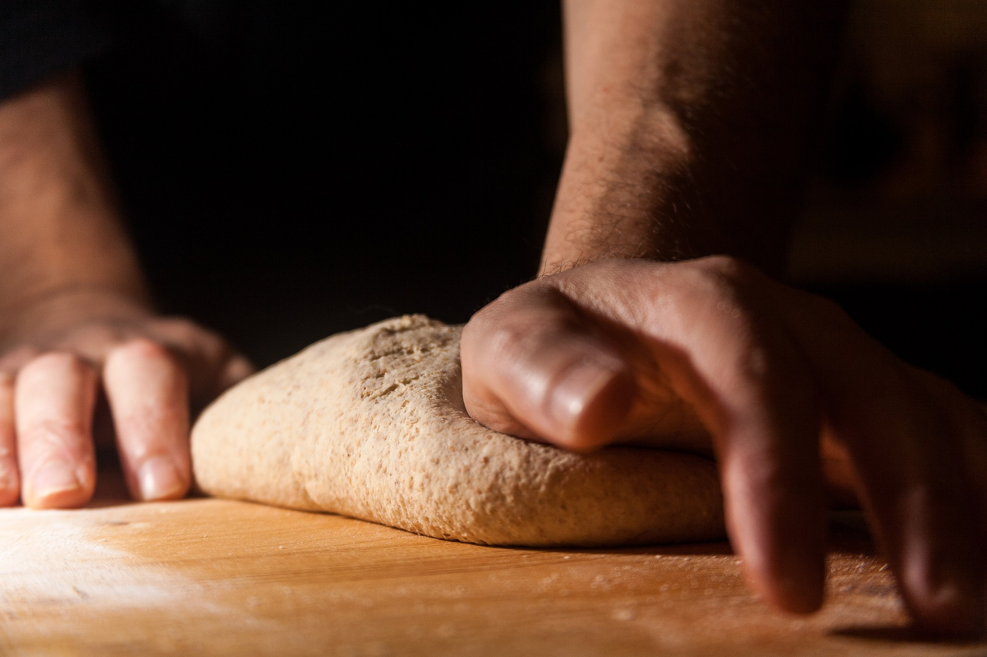
Being a baker
A baker will need to remember the basic recipe for making bread, including the ingredients and the steps.
A baker will also usually have their own style to make their bread unique or special.
Describe some ways you think a baker could make their bread unique.

Slide 6
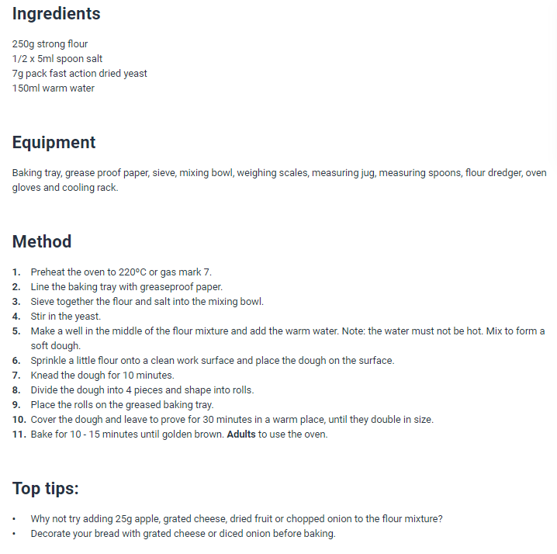
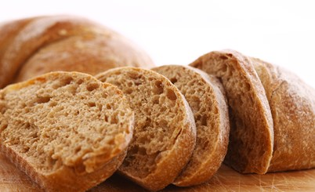
Bread recipe
On this slide there is a basic recipe for making bread.
Read through and write two places that you could make changes to make this bread special.

Slide 7
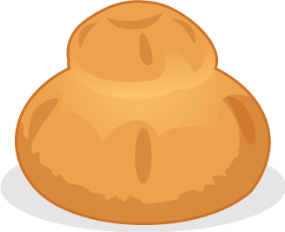


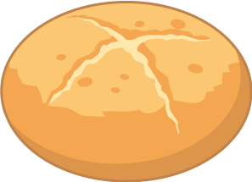


Create a new bread roll
Your challenge is to create a new bread roll!
Consider:
flour type;
fillings;
shape and size;
toppings;
decoration.

Slide 8
Be a baker challenge
For further information, go to:
www.foodafactoflife.org.uk

