Slide 1
Sugar

Slide 2
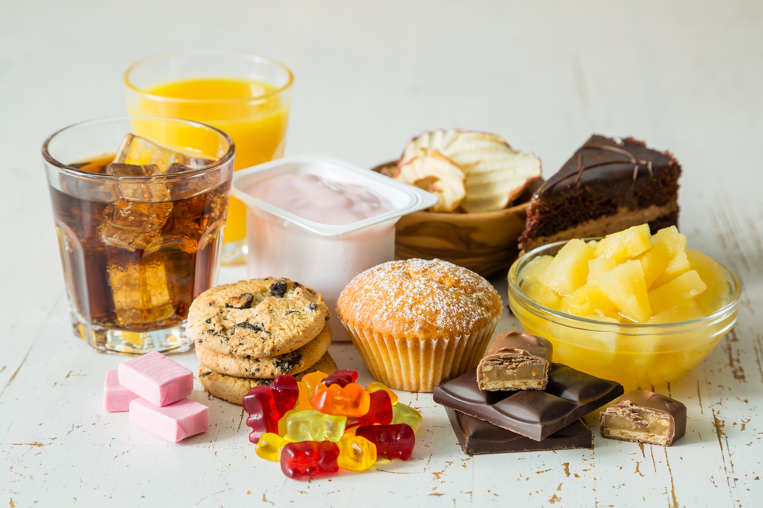
Carbohydrate
Sugars are a type of carbohydrate. Sugars provide energy – 3.75kcal/16kJ per gram.
All carbohydrates are compounds of the elements carbon, hydrogen and oxygen and have the general formula (CH₂O)_{n}.
For example - glucose (CH₂O)₆ = C₆H₁₂O₆.
Another name for carbohydrates is ‘saccharides’.
A variety of foods that contain sugars.

Slide 3
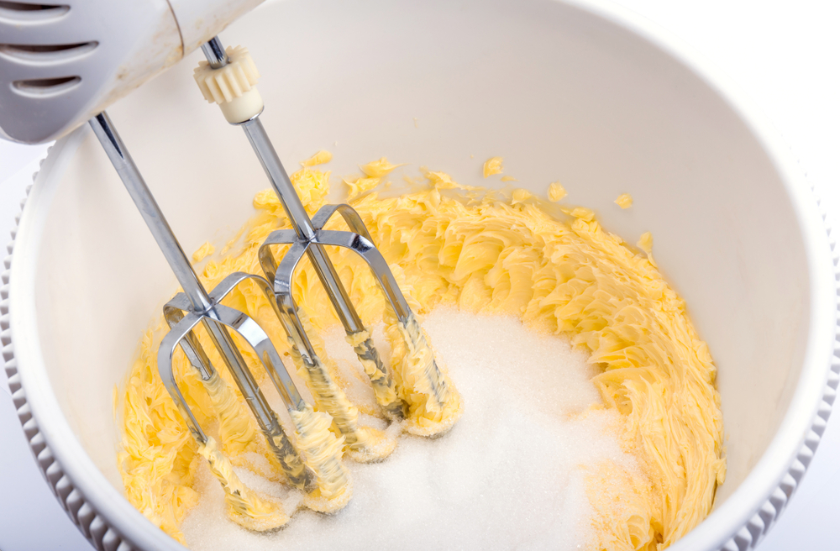
Mono-, di- and poly- saccharides
Carbohydrates fall into three main categories depending on their structure.
These are known as monosaccharides (when they are made up of a single unit), disaccharides (two units) and polysaccharides (multiple units).
Sugars are either monosaccharides (such as glucose, fructose and galactose) or disaccharides (sucrose, maltose, lactose).

Slide 4
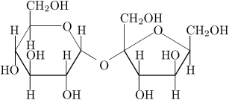
What is sugar?
When we think of sugar we tend to be thinking of sucrose as this is table sugar, the type extracted from sugar beet and sugar cane.
Sucrose is known as a disaccharide as it is made up of two monosaccharides (glucose and fructose).
Disaccharides have the general formula C₁₂H₂₂O_{11.}
Sucrose

Slide 5
Sucrose = glucose + fructose
Glucose
Fructose

Slide 6
Sucrose
Sucrose

Slide 7
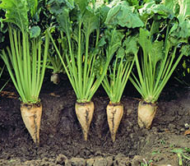
Growing sugar
Sugar is grown as either sugar beet or sugar cane.
In the UK, sugar beet is grown and processed. Sugar cane is still used in the UK, but it is grown outside of the UK and shipped in.
There is a slight difference between the two.
Sugar beet is a root crop whereas sugar cane is a tropical grass.

Slide 8
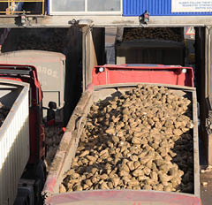
Growing sugar
In the UK, it is sugar beet that is grown, mainly on farms in East Anglia and the East Midlands.
Sugar beet is sown in the spring and harvested in the autumn and winter.
This sugar beet can then be used to make sugar.

Slide 9
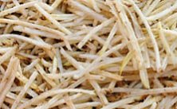
Processing sugar
Once the sugar beet arrives at the factory, it is sliced into thin strips. These strips are known as cossettes.
The cossettes are mixed with hot water. This extracts the sugar from the sugar beet crop to form a syrup.
A lime mixture is added to ensure that any impurities are removed.

Slide 10
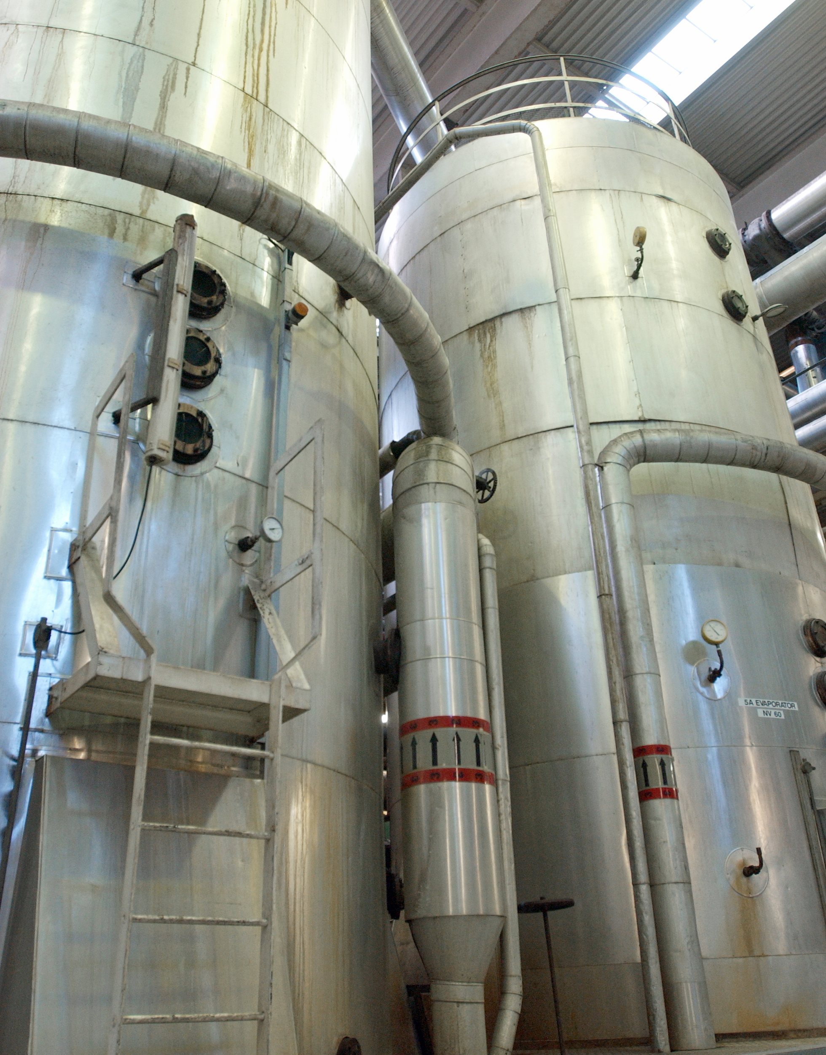
Processing sugar
The syrup is filtered, heated and seeded with tiny sugar crystals.
These crystals are grown, until they are the required size, and then are washed, dried and cooled.
Once cooled, these can be packaged and sent to customers.

Slide 11
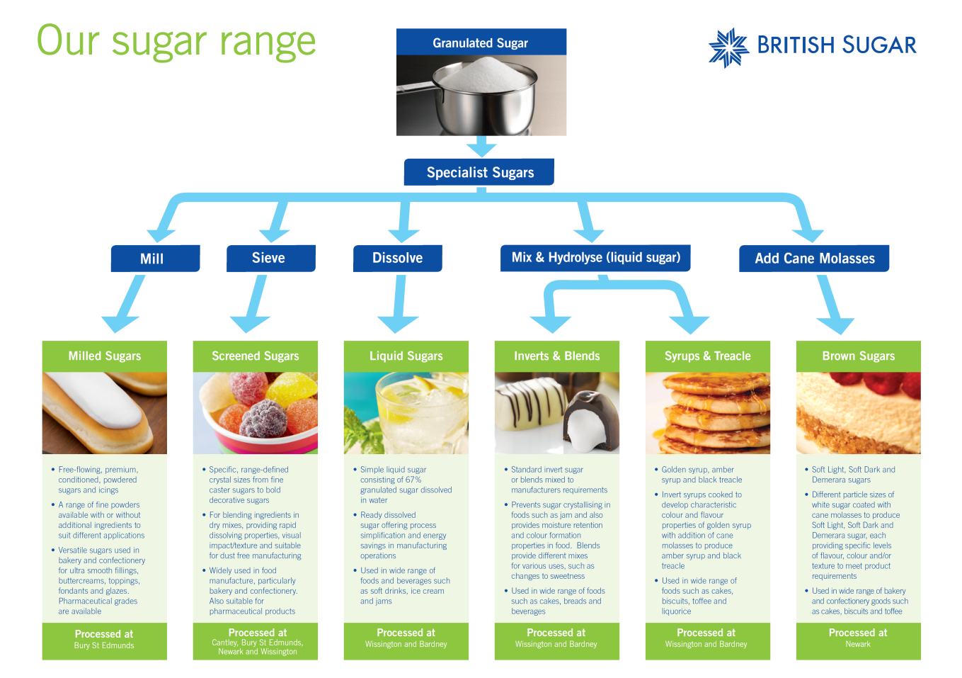
Sugar
There is a range of sugar products that can be made from sugar beet.
This includes:
granulated sugar;
caster sugar;
icing sugar;
brown sugar.
Here are a few more examples.

Slide 12
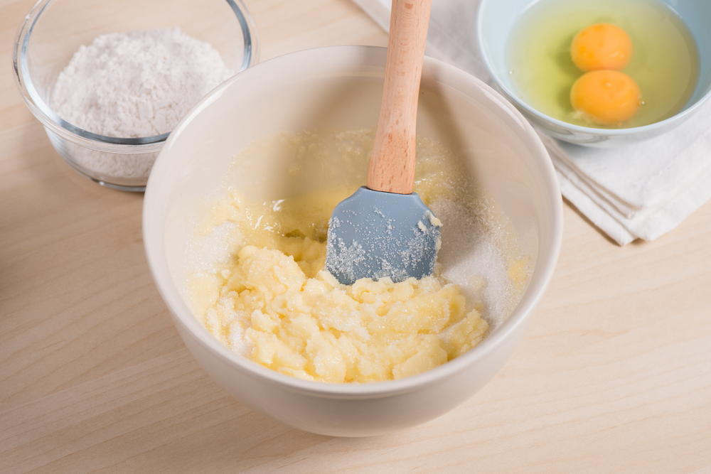
Functionality of sugar
Sugar has a range of different functions in products, including:
Energy
Sweetener
Bulking agent
Texture modifier
Stabiliser
Preservative
Flavour precursor
Colour precursor
Glazing agent
Solubilizing agent
Diluent
Fermentation substrate
List as many different functions of sugar in a biscuit.

Slide 13
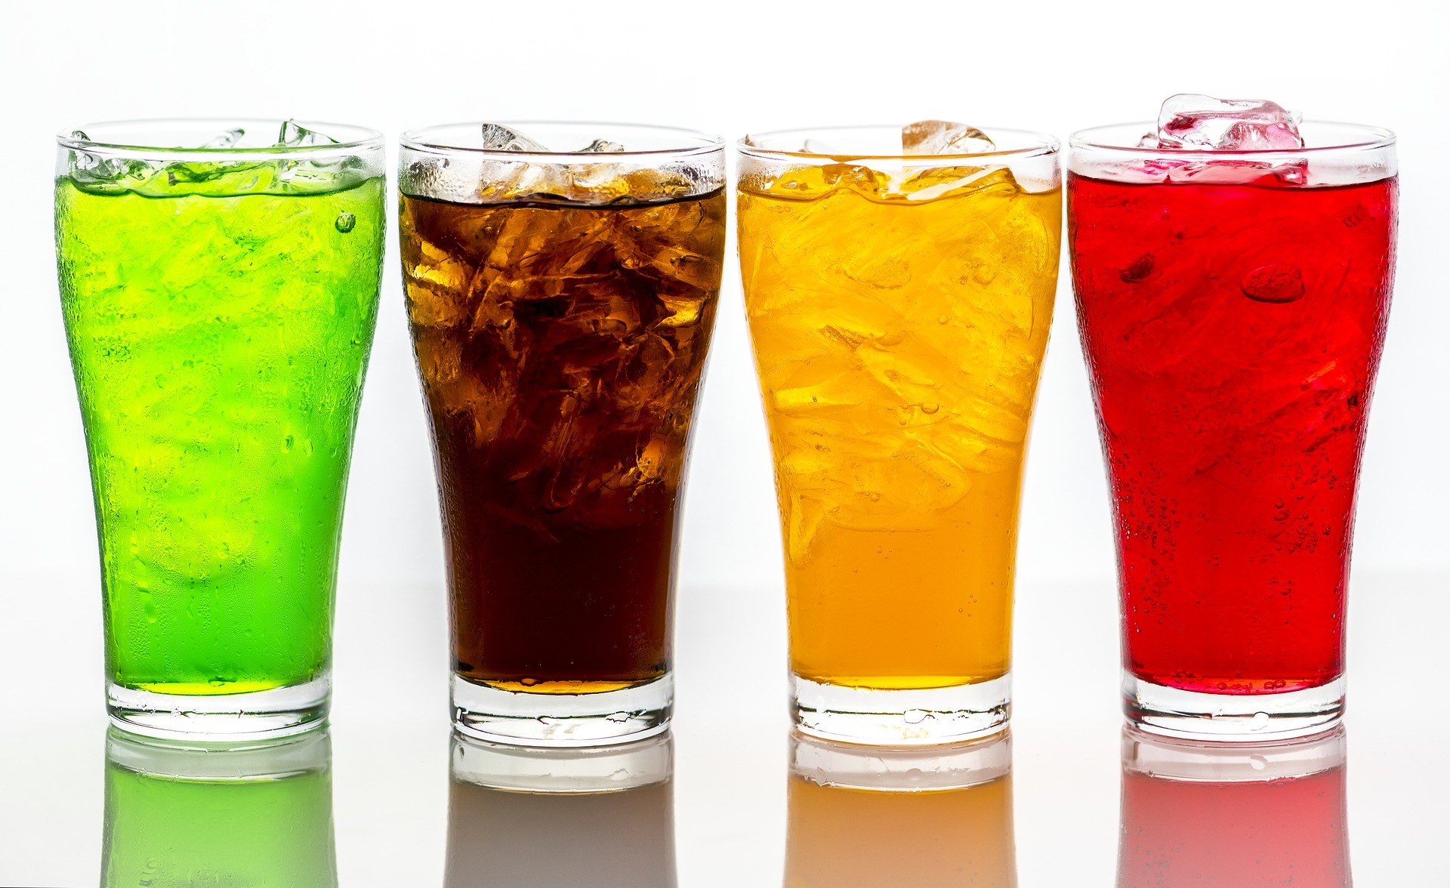
What does sugar deliver?
Beverages
Sweetness
Mouthfeel

Slide 14
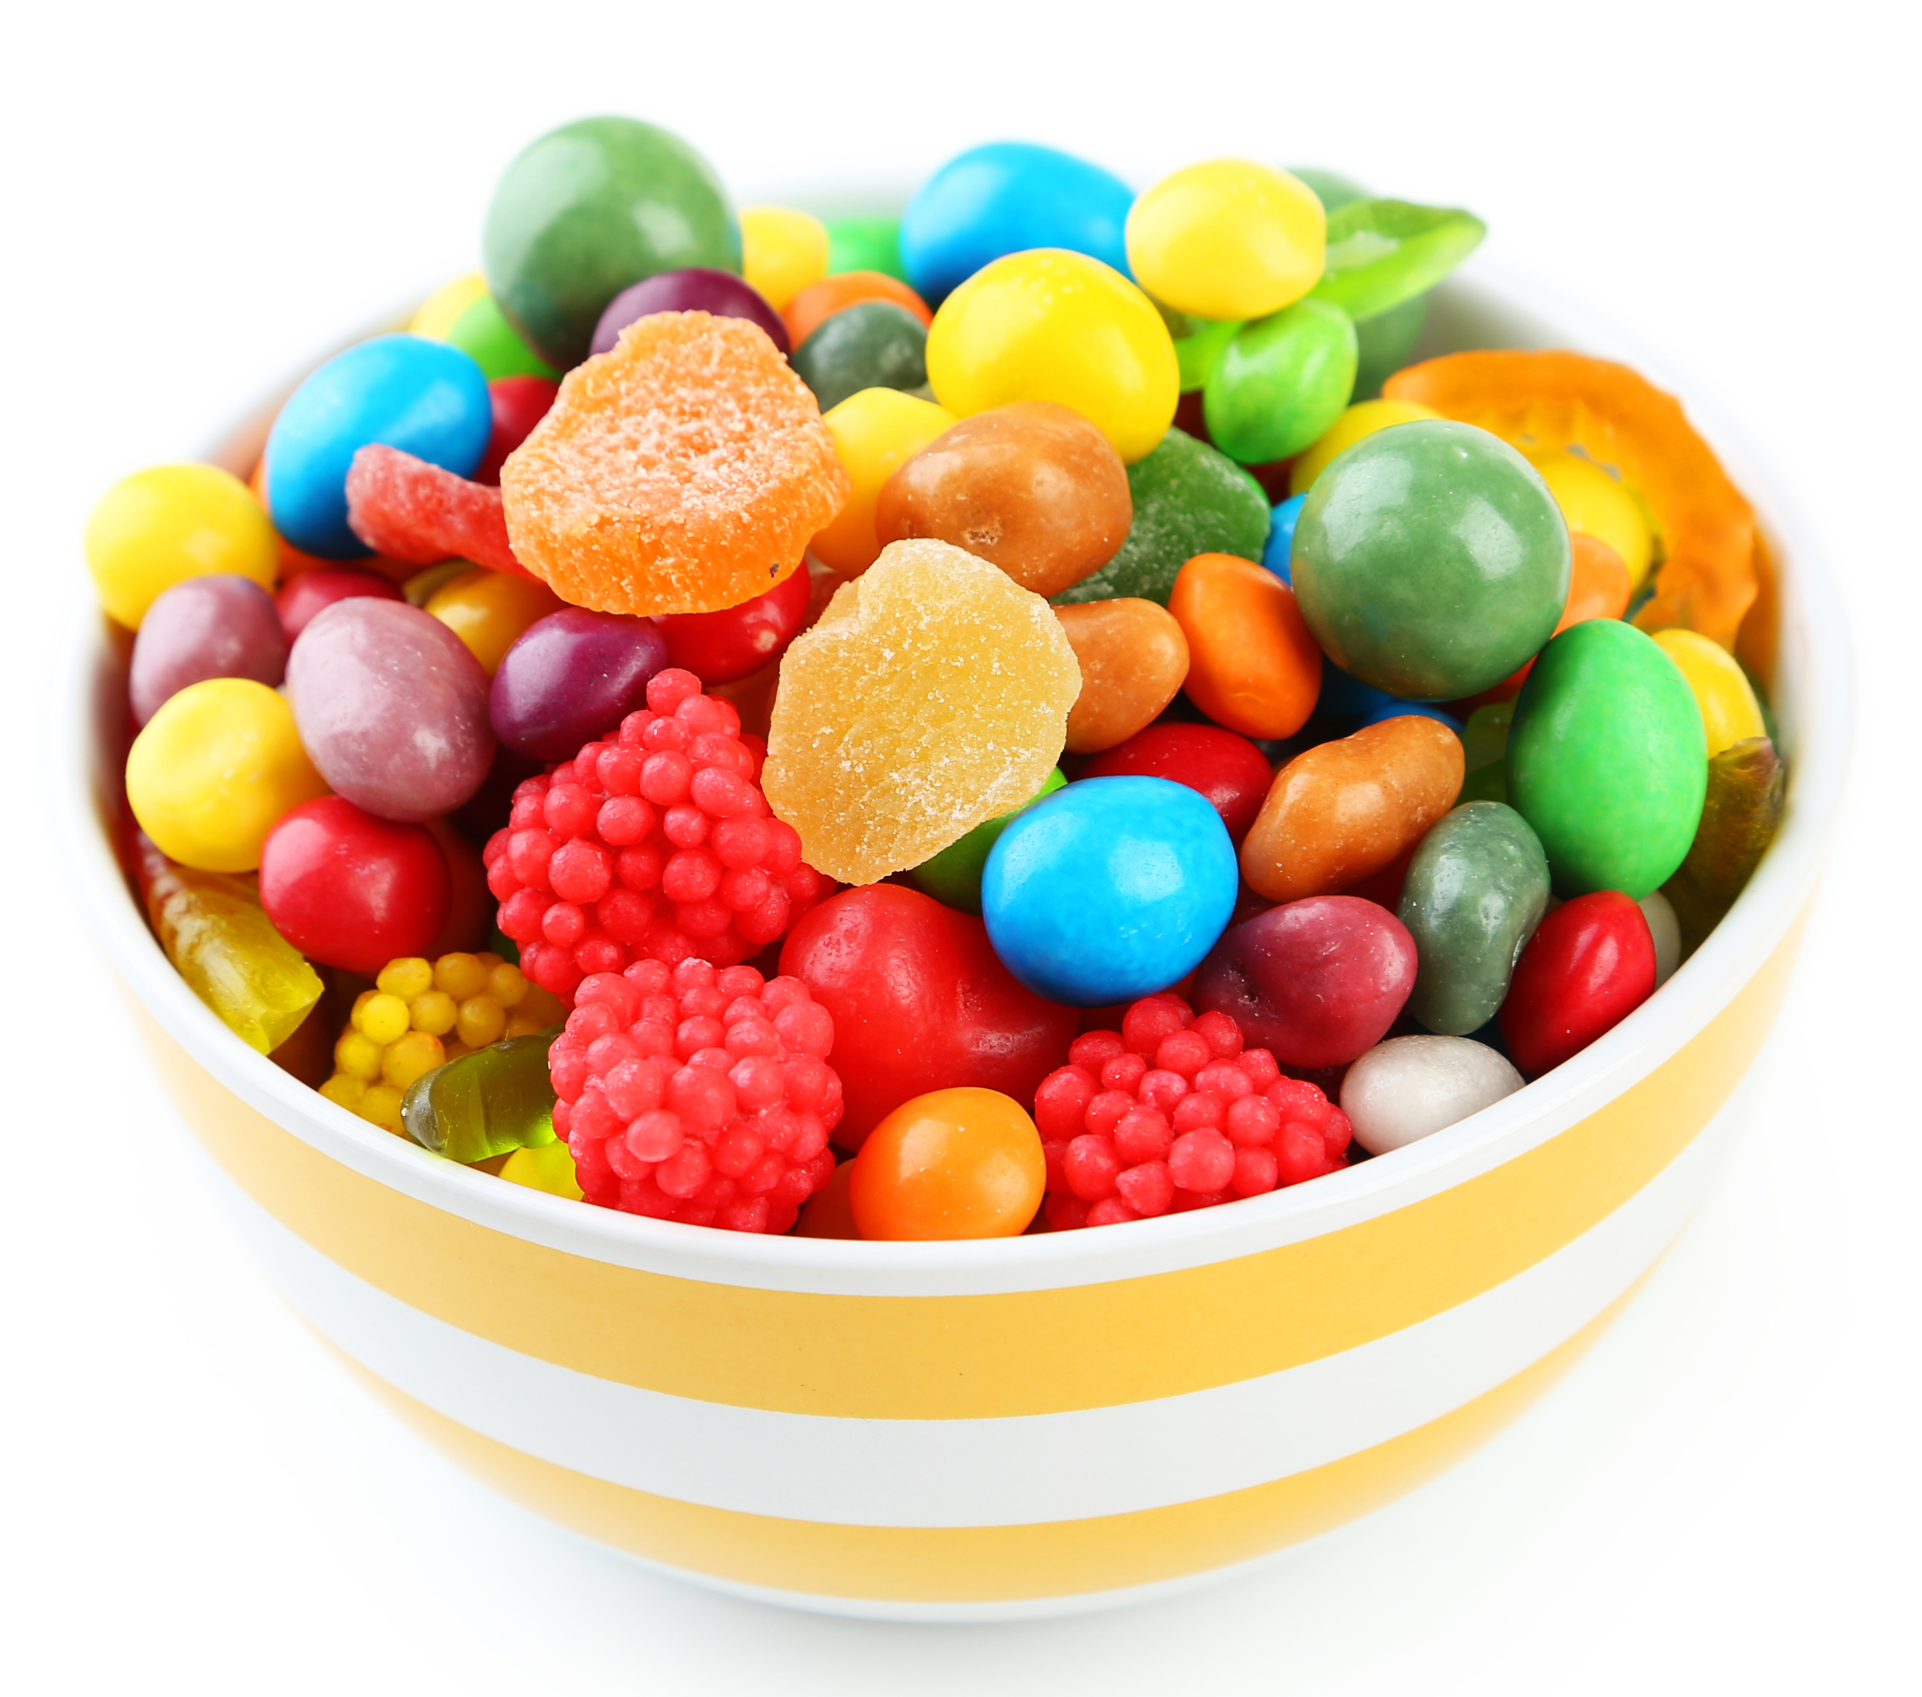
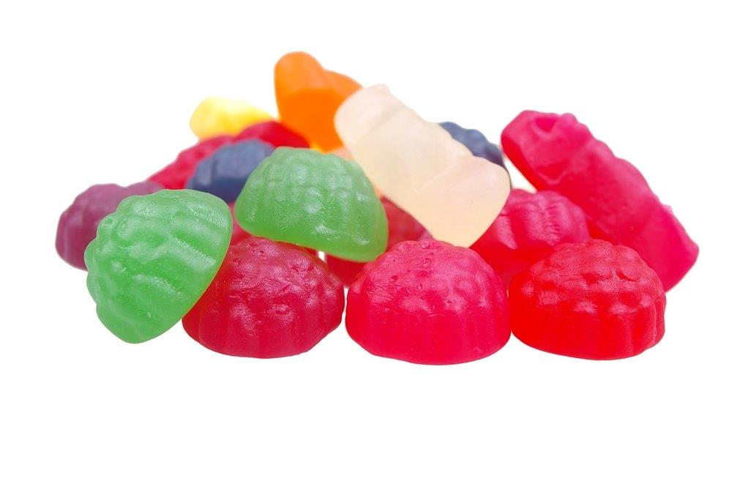
Sugar
Confectionery
Sweetness
Bulk/Texture/mouthfeel
Crystallinity/size
Colour/flavour
Solubility/Flavour release
Glass/amorphous
Stability/preservative
Humectancy

Slide 15
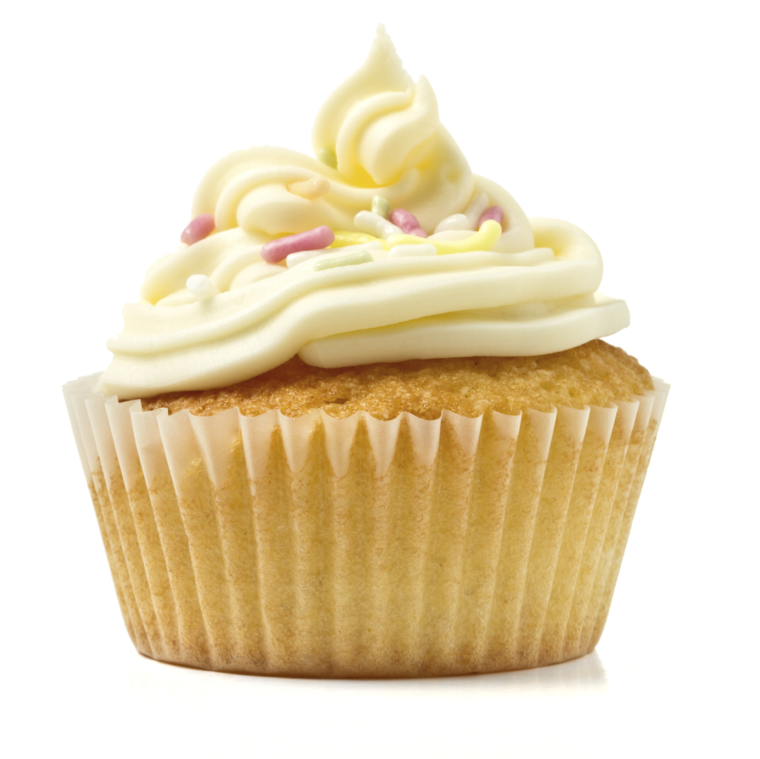
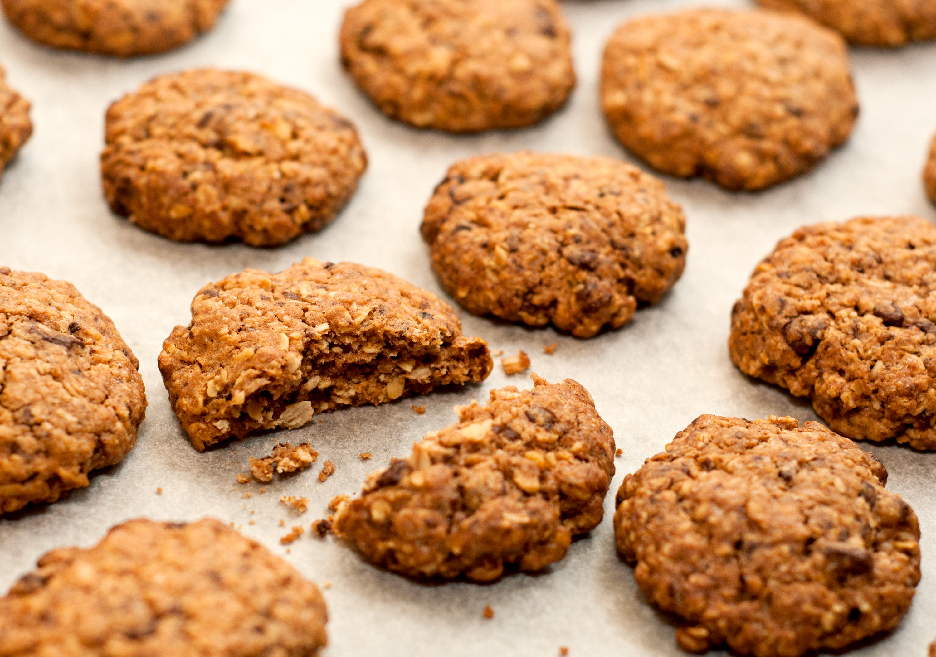
Sugar
Bakery
Sweetness
Bulk/Texture/mouthfeel
Crystallinity/size
Colour/flavour
Crumb texture
Glass/amorphous
Stability/preservative
Humectancy

Slide 16
Relative sweetness of sugar
Sugar is characterised by its sweetness.
Sucrose is the standard to which the sweetness of other sugars is measured and therefore has a relative sweetness of 1.0.
Name a product you know that uses fructose.
Sugar | Relative Sweetness
Fructose | 1.2
Sucrose | 1.0
Glucose | 0.7
Maltose | 0.5
Lactose | 0.4

Slide 17
Sugar
For further information, go to:
www.foodafactoflife.org.uk

