Slide 1
Fish dishes

Slide 2
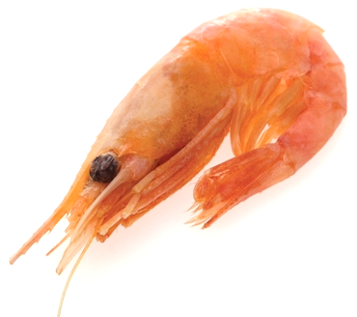
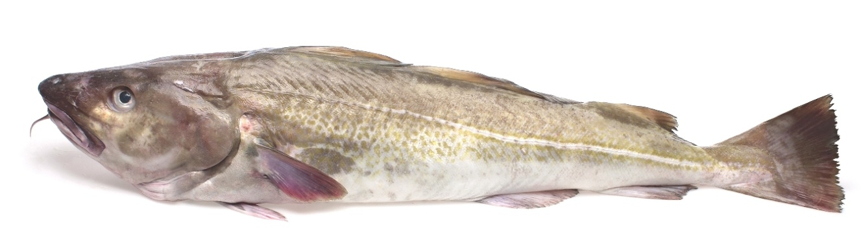
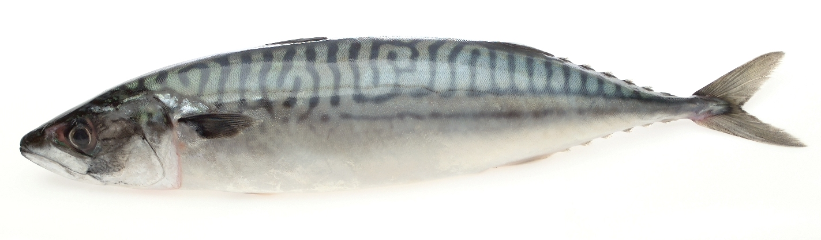
Fish dishes
Lots of dishes and meals can be made with fish.
Name one fish dish that you have tried.

Slide 3
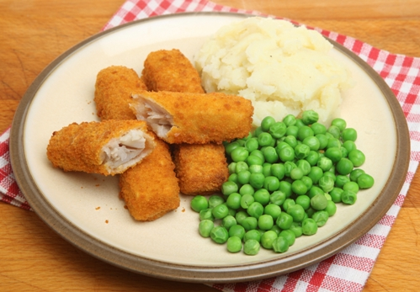
Fish dishes
Name this fish dish.
Fish fingers, chips and peas
Have you tried this before?

Slide 4
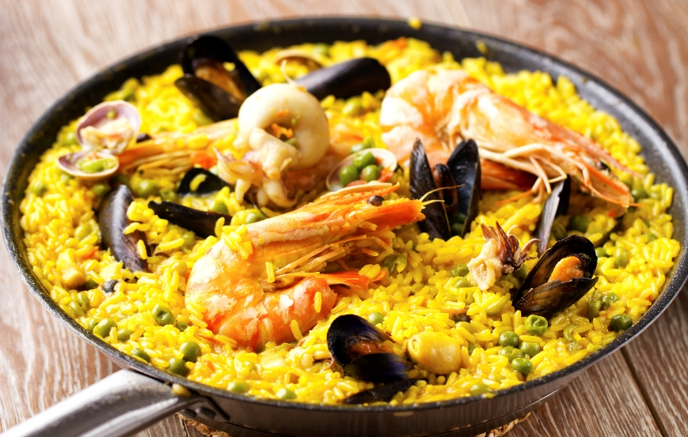
Fish dishes
Name this fish dish.
Paella
Which country does this dish come from?

Slide 5
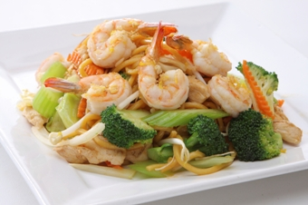
Fish dishes
Name this fish dish.
Prawn stir fry
How many prawns can you see?

Slide 6
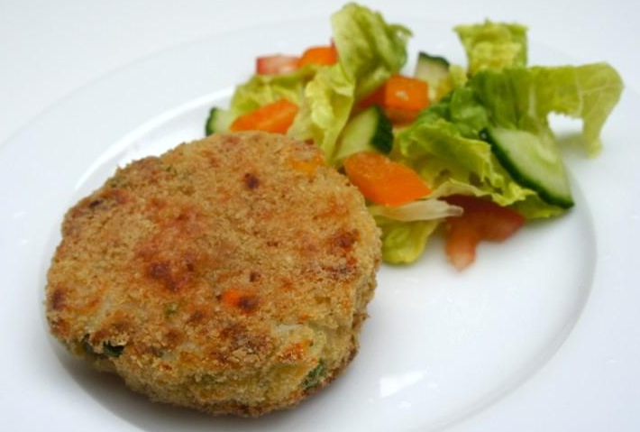
Fish dishes
Name this fish dish.
Fish cake
What is this fish cake served with?

Slide 7
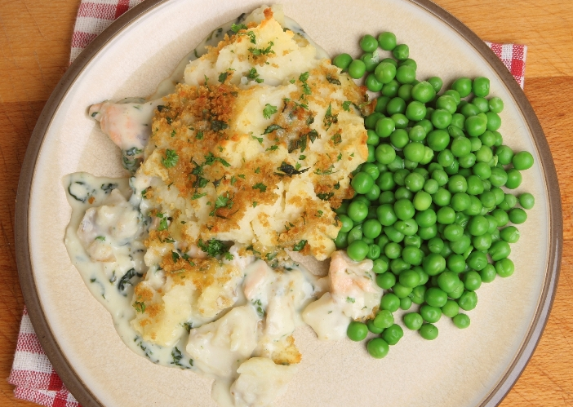
Fish dishes
Name this fish dish.
Fish pie and peas
Name three other vegetables that you could have with fish pie.

Slide 8
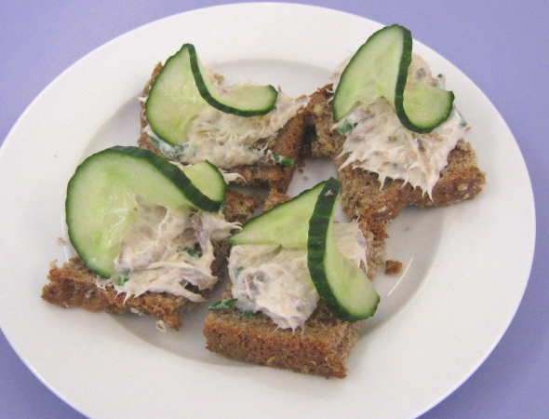
Fish dishes
Name this fish dish.
Mackerel pâté on toast
Name two other fish dishes.

Slide 9
Fish dishes
Name your favourite fish or fish dish.
Name one fish that you would like to try.

Slide 10
Fish dish finding out
Conduct a survey to find out which of the fish dishes you have just seen are the most popular in your school.
You will need to draw a table to record the information or use the Survey template.
Ask 15 different people.

Slide 11
Fish dishes
For further information, go to:
www.foodafactoflife.org.uk

