Slide 1
A fishy tale

Slide 2
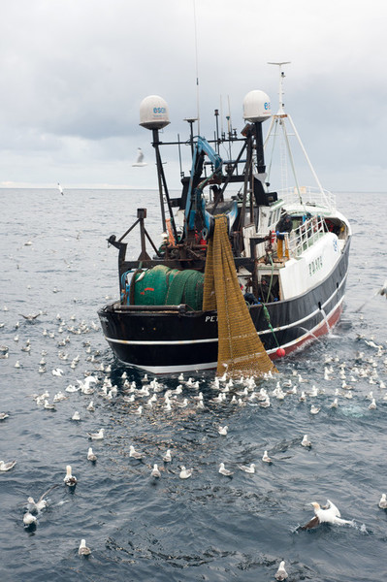
Fishing boat
The fisher sails the boat out to sea and drops the fishing nets into the water.
Where is the net?
Why do you think there are so many gulls near the boat?

Slide 3
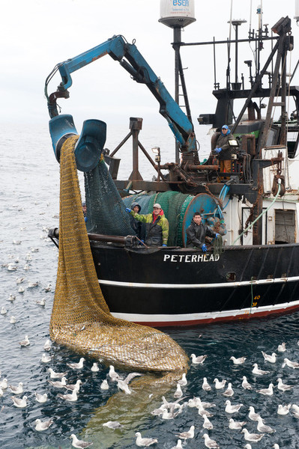
Nets
When it is time, the fisher pulls the net out of the water using a winch.
What can you see here?

Slide 4
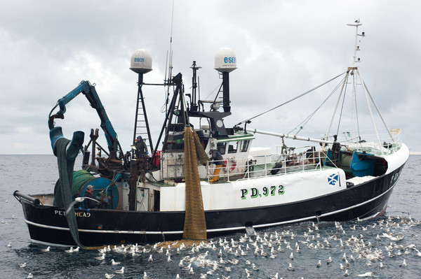
Catching fish
The net is dropped on the deck of the boat and the fisher checks the fish.
Fish that are too small are thrown back into the sea.

Slide 5
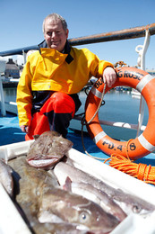
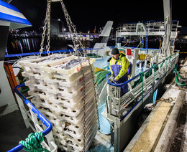
Moving the fish
The fisher puts the fish in crates ready to be taken ashore.
Large boats may have many crates of fish.

Slide 6
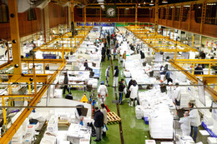
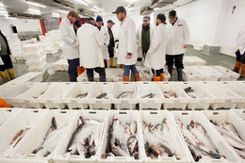
The market
The fish goes to a big market to be sold to different places.
The market sells fish to fishmongers and restaurants.

Slide 7
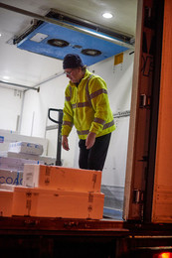
Fishmonger
These boxes of fish are being delivered to a fishmonger.

Slide 8
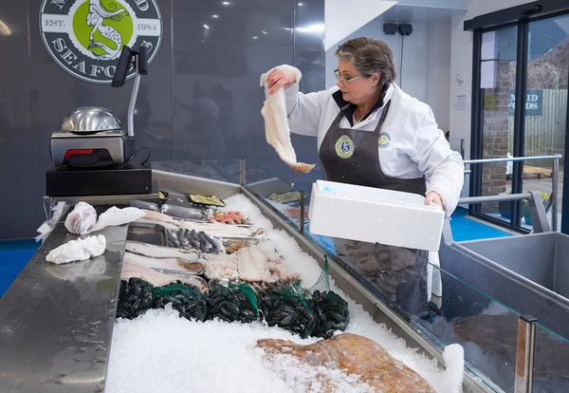
Preparing the fish to sell
This fishmonger is setting out the fish counter.

Slide 9
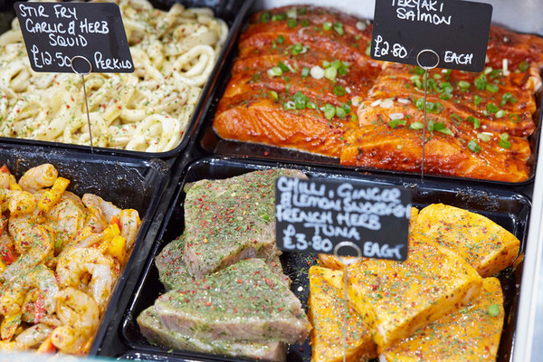
Fish dishes
Some fishmongers sell fish dishes too!
Name these dishes.

Slide 10
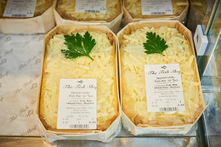
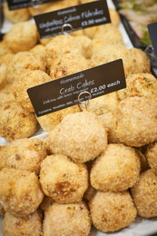
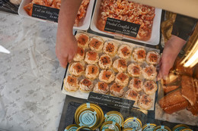
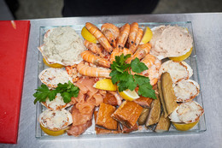
The fish bought
And used to make….

Slide 11
A fishy tale
For further information, go to:
www.foodafactoflife.org.uk
Fish images provided by Seafish www.fishisthedish.co.uk

