Slide 1
Catching fish

Slide 2
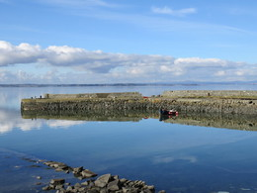
Fish
Fish can live in different types of water.

Slide 3
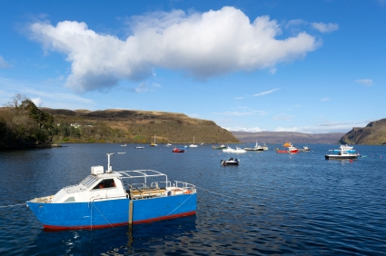
Sea
Fish can live in the sea.
This is the sea near the Isle of Sky in Scotland.

Slide 4
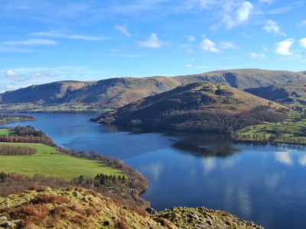
Lakes
Fish can live in lakes.
This is lake Ullswater in the Lake District.
(Wild brown trout, pike, perch.)

Slide 5
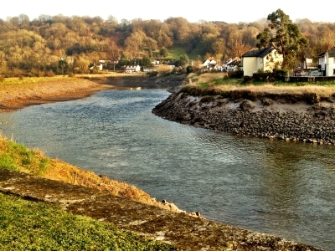
Rivers
Fish can live in rivers.
This is the river Usk in Wales.
(Welsh salmon, brown trout.)

Slide 6
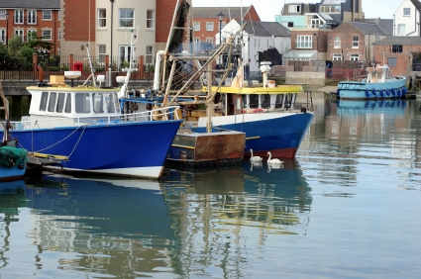
Catching fish
Fish are caught in different ways.
These are fishing boats in Portsmouth.
They sail out to sea and use nets to catch the fish.

Slide 7
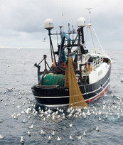
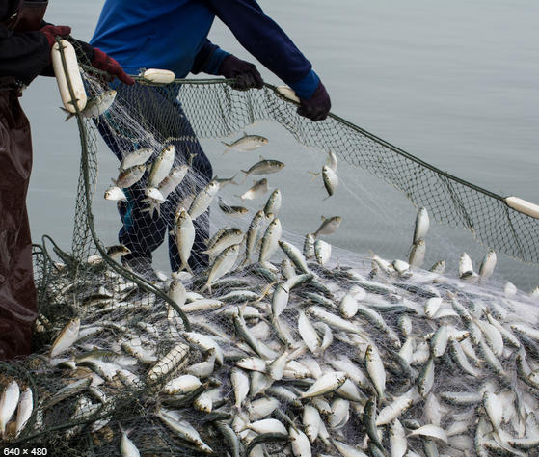
Catching fish
The nets can catch lots of fish at the same time.

Slide 8
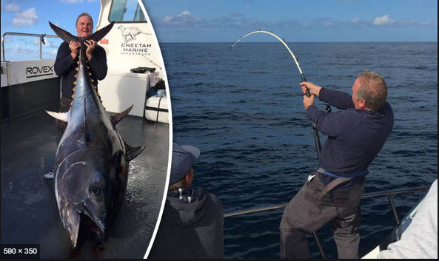
Catching fish
Some fish are caught using poles.
This fisher has caught a very large tuna fish.

Slide 9
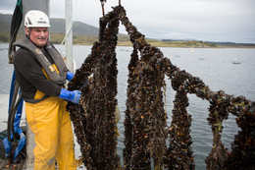
Catching fish
Mussels are grown on ropes.
Ropes are hung in the sea.
Mussels attached themselves to the ropes and grow.

Slide 10
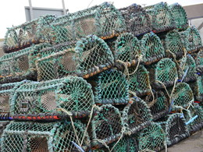
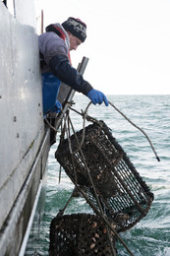
Catching fish
Lobsters and crabs are caught in ‘pots’.
Fishers drop these onto the seabed to catch the lobsters and crabs.

Slide 11
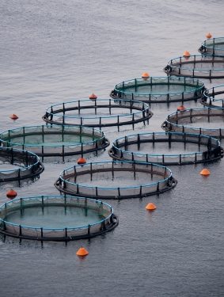
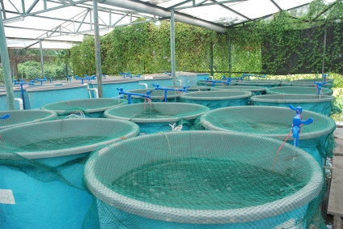
Catching fish
Some fish are reared on fish farms.
Farmed fish sometimes live in containers or nets in the sea or river.
Other farmed fish may live in containers on land.

Slide 12
Catching fish
Watch the Fishing video.

Slide 13
Catching fish
For further information, go to:
www.foodafactoflife.org.uk
Fish images provided by Seafish www.fishisthedish.co.uk

