Slide 1
Types of fish

Slide 2
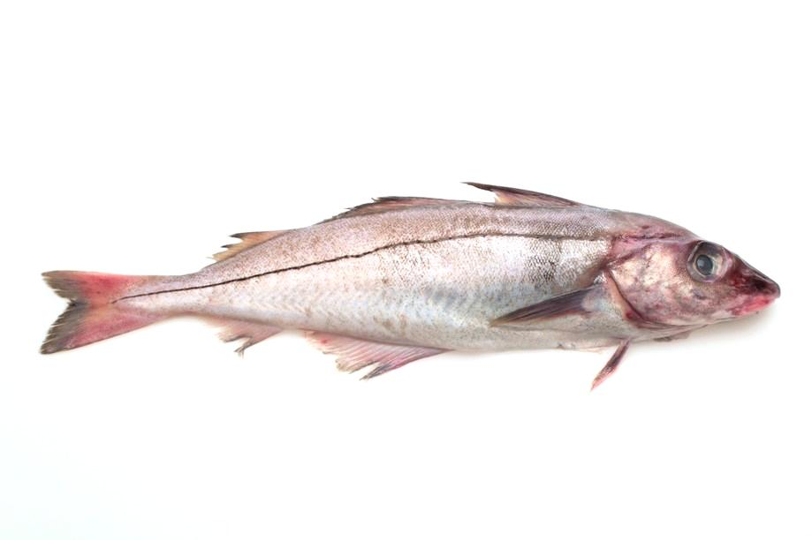
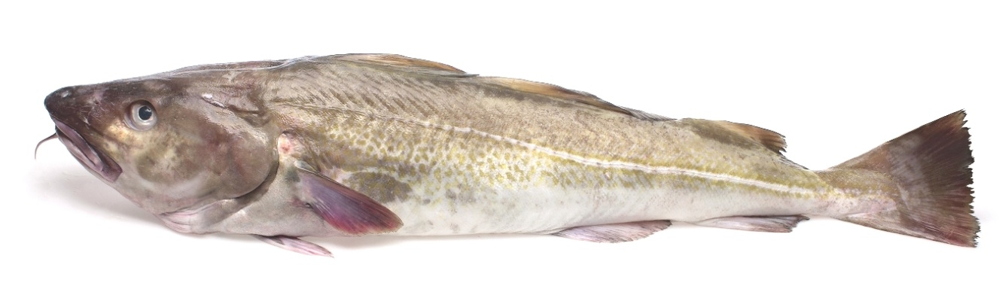
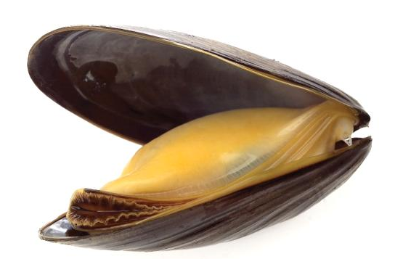
Fish
There are lots of different types of fish. Look at these!
How are these fish different?

Slide 3
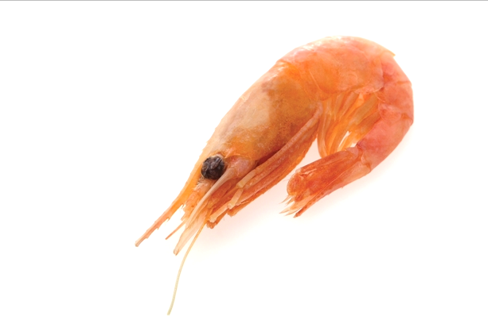
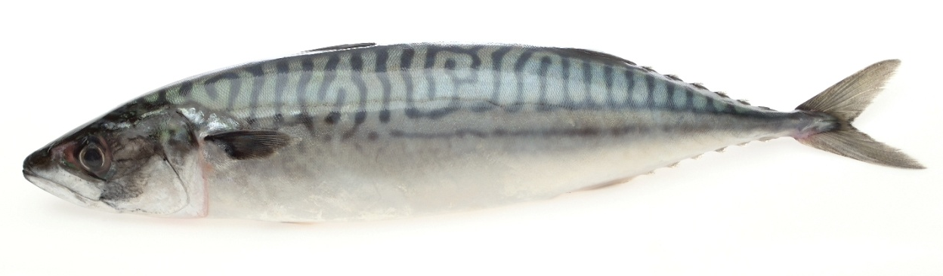
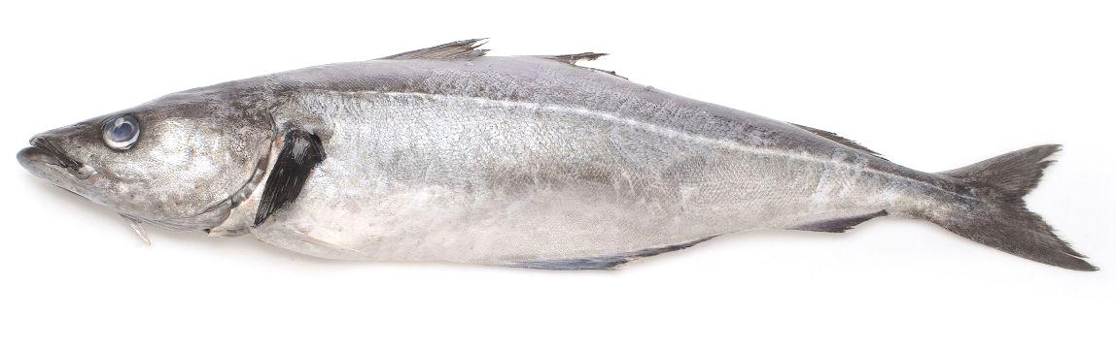
Fish
What do you notice about each of these fish?
How many types of fish can you name?

Slide 4
Name this fish
Prawn

Slide 5

Name this fish
Mackerel

Slide 6
Name this fish
Haddock

Slide 7
Name this fish
Coley

Slide 8

Name this fish
Mussel

Slide 9

Name this fish
Cod

Slide 10
Fish
There are lots of different types of fish.
Name these fish.

Slide 11
Fish investigation!
Find out about four different fish that people eat.
Draw and label each fish using the Fish investigation worksheet.

Slide 12
Types of fish
For further information, go to:
www.foodafactoflife.org.uk
Fish images provided by Seafish www.fishisthedish.co.uk

