Slide 1
The fish and chip shop

Slide 2
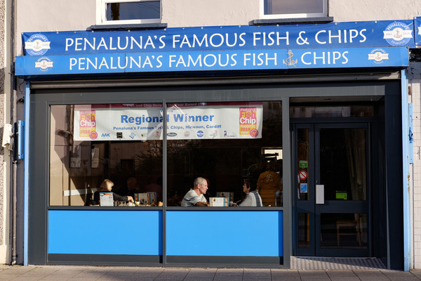
Fish and chip shop
Have you ever been to a fish and chip shop?
Name two types of food that they sold.
List what you had to eat.

Slide 3
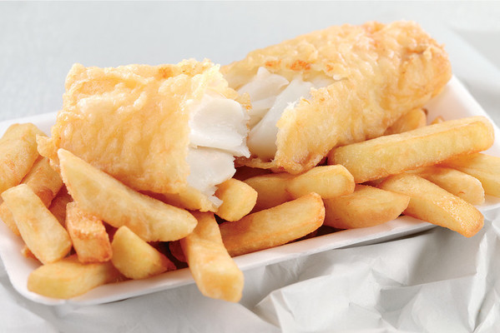
The first fish and chip shops
At the beginning of Queen Victoria's reign in1837, it is believed that fried fish was first sold at Billingsgate Market in London.
In around 1860, the first fish and chip shops started opening.
Sit-down fish and chips, bread and butter and a cup of tea would cost 4p!

Slide 4
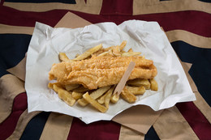
Fish and chip shop
It’s not clear where the very first fish and chip shop opened. Some say it was in East London and others say it was in Lancashire.
By 1910, there were 25,000 fish and chip shops in the UK.
Takeaway fish and chips used to be served wrapped in sheets of old newspaper but now is often served in boxes which helps protect the fish and chips.

Slide 5
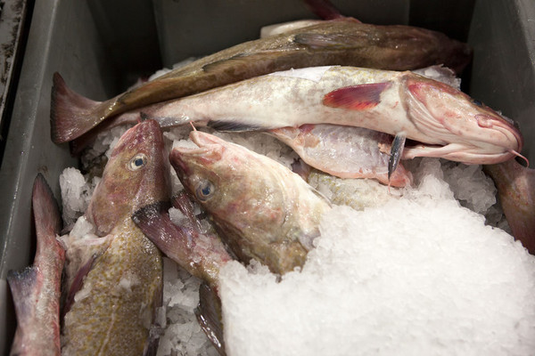
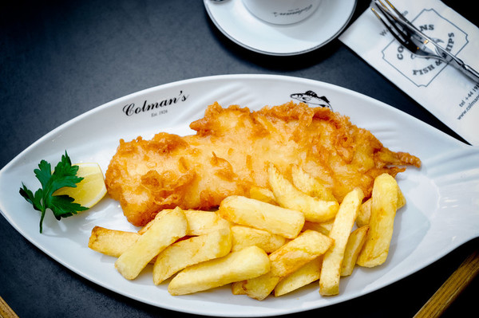
Fish today
Let’s find out how fish goes from this to this.

Slide 6
The journey of fish
Most of the cod (around 95%) used by fish and chip shops in the UK is caught in the icy Arctic waters of the Barents Sea and Iceland.

Slide 7
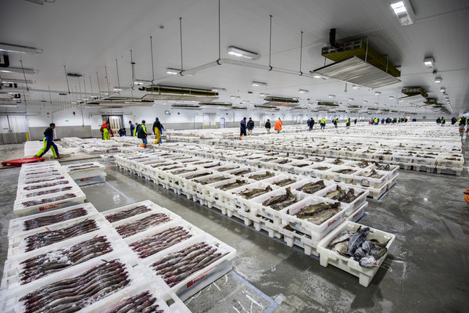
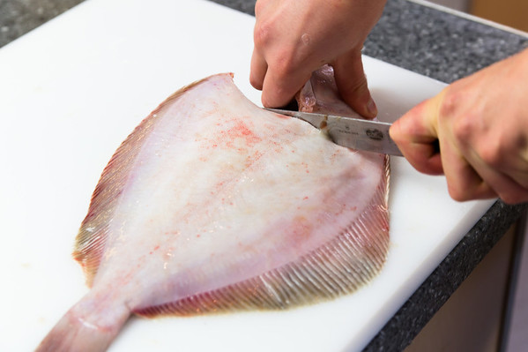
The journey of fish
Fishers catch the fish and it is sold at market.
It is bought by fish processing companies, fishmongers and restaurants.
Fish processing companies will cut the fish into portions/fillets, chill or freeze it and then sell it to fish and chip shops.

Slide 8
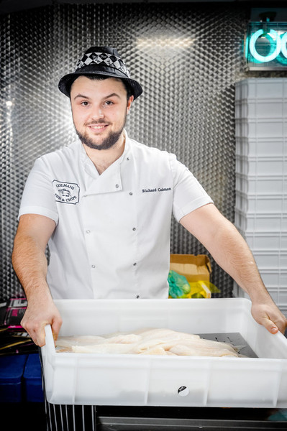
The fish and chip shop
When the fish is delivered to the fish and chip shop it is put into the chiller (fridge), or freezer, to keep it in the best possible condition.

Slide 9
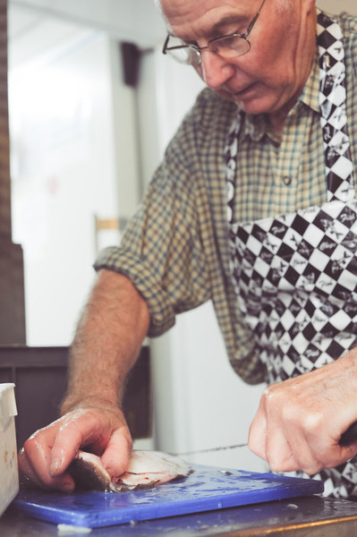
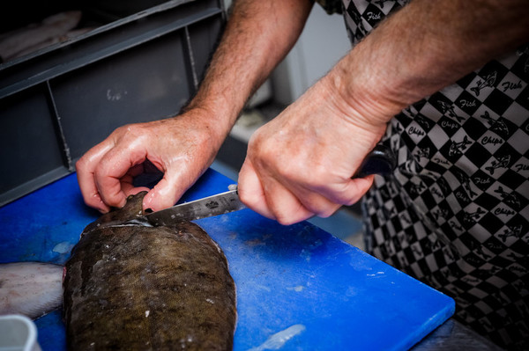
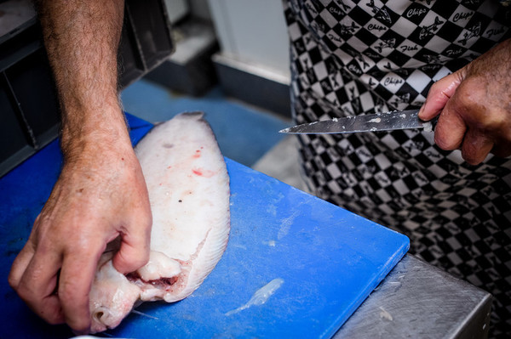
Portions
Sometimes the fish and chip shop has whole fish delivered and they prepare it themselves.
This man is preparing a sole. He is removing the skin and cutting it into the right size portions for cooking.

Slide 10
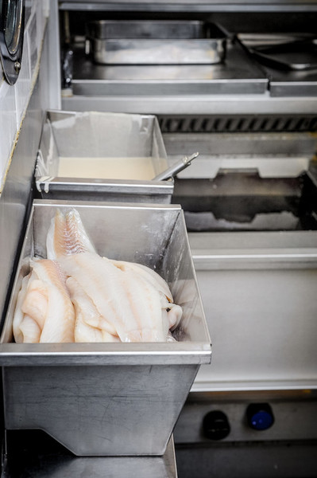
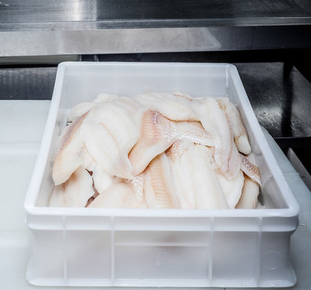
Fish fillets
Here are some fillets of fish waiting to be cooked.

Slide 11
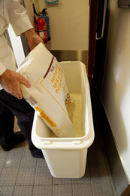
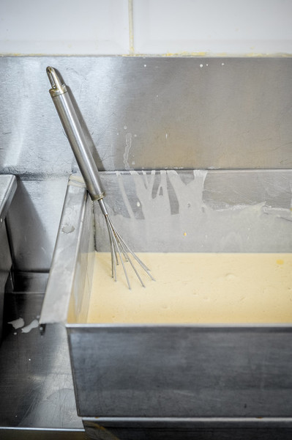
Batter
The fish needs to be battered before it is cooked.
The batter is made by mixing flour and chilled water.

Slide 12
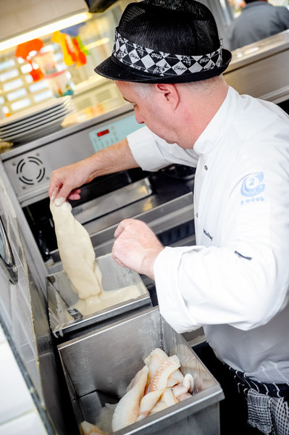
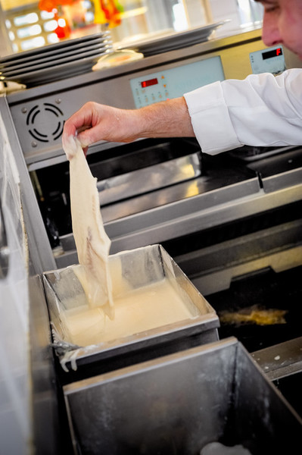
Battering the fish
The fish is dipped into the batter so it is completely covered.

Slide 13
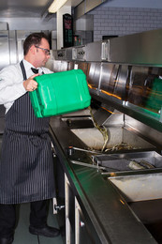
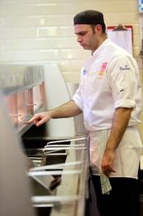
Fryers
There are large fryers (cookers) in fish and chip shops.
These are filled with either a liquid cooking oil or sometimes a solid fat.
The fat is heated until it is very hot.

Slide 14
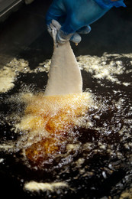
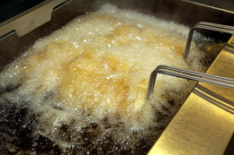
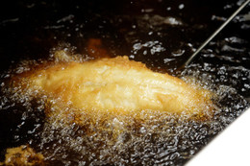
Frying
The fish is cooked for around 4-6 minutes.
Larger, thicker pieces of fish will usually take a little longer than smaller/thinner fillets.

Slide 15
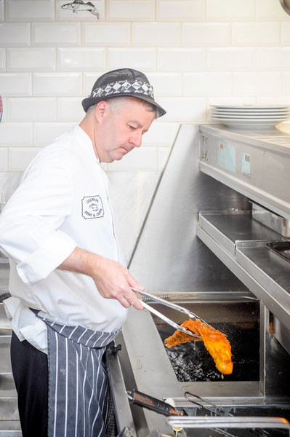
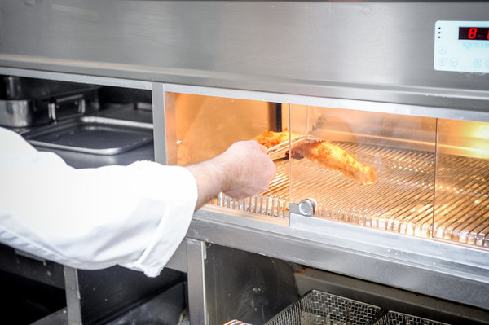
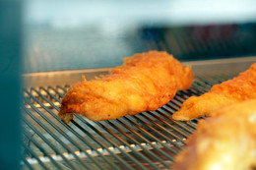
Cooked fish
When the fish is ready, the batter should be golden and crispy.
The cooked fish is either served straight to a waiting customer or put in a heated display counter ready for the next customer.

Slide 16
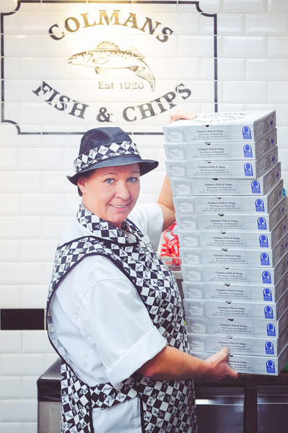
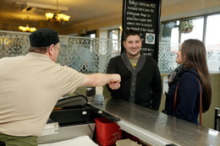
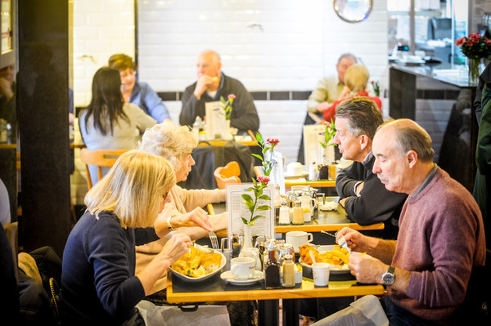
Eat in or take away
Some fish and chip shops sell fish and chips to take-away.
Others have eat-in restaurant facilities so customers can sit down and enjoy their fish and chips.

Slide 17
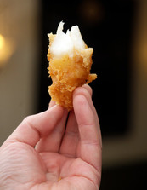
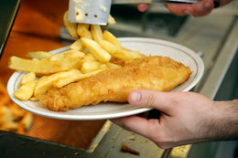
The fish and chip shop
Next time you visit a fish and chip shop, you’ll know just how your fish was prepared!

Slide 18
The fish and chip shop
For further information, go to: www.foodafactoflife.org.uk
Images kindly provided by Seafish www.seafish.org.uk

