Slide 1
Being a fisher

Slide 2
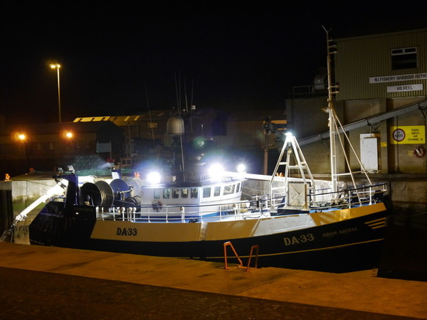
Fishers
Fishers can work all hours of the day, and all days of the week.
Some fishers may work on their own – while others may work as part of a larger crew.
Some fishers may fish for a day from their home port – while some may be at sea for many days or even many weeks.
A fishing boat in Kilkeel, Northern Ireland.

Slide 3
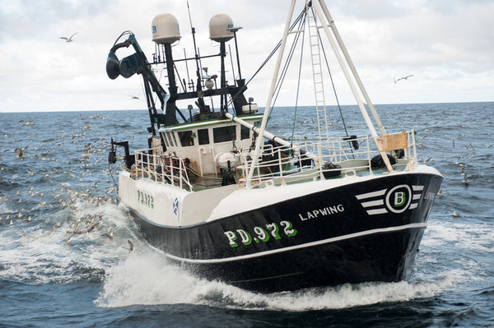
Fish habits
Fishers know a lot about the habits of the fish or shellfish they want to catch.
For example, John Dory fish hunt for their prey near the seabed just as it’s getting light and they also like water with a strong current.
This type of information helps the fishers have a more successful catch.

Slide 4
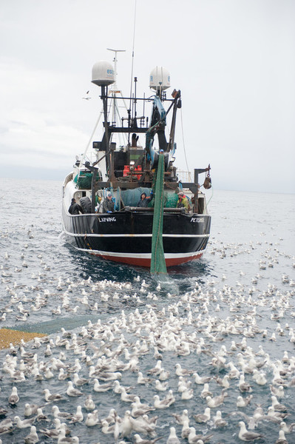
Shooting the nets
When it is the right time and place, the fishers will ‘shoot’ their nets or pots. This means drop them into the water.
Seagulls know that the fishers will be catching fish, so they often follow them all the way from the shore!
This is a fishing boat from Peterhead in North East Scotland.

Slide 5
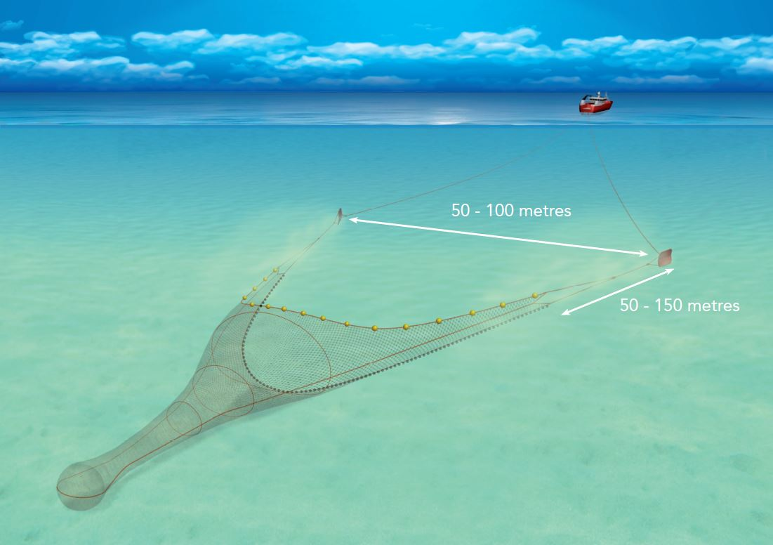
Trawling
The boat pulls the net through the water, which is called towing, for a set amount of time – this could be for a number of hours.
The fishers take turns to keep watch while the rest of the crew may sleep for a while.
This illustration shows what a trawl net looks like under the water.

Slide 6
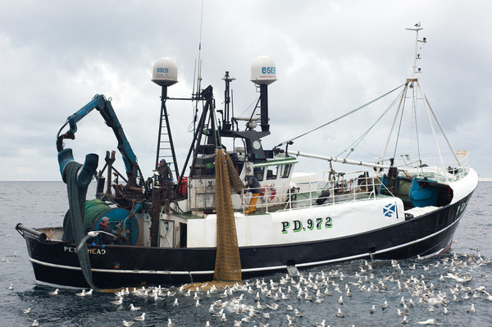
Hauling
When the net has been towed for long enough, it is time to pull it up and see what fish have been caught. This is called ‘hauling’.
This is an exciting time as the fishers eagerly wait to see what is in their net and if their instincts about where to fish were correct!

Slide 7
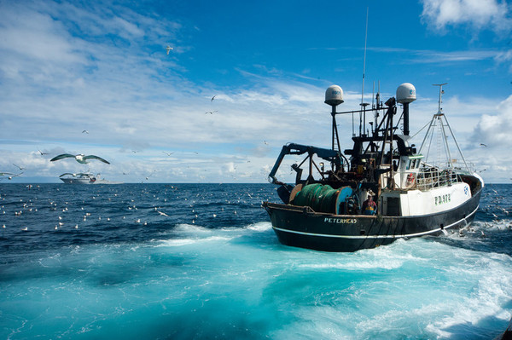
The Catch
The fishers pull up their nets and empty the fish onto the boat.
They quickly put the empty nets back in the water so they can carry on catching more fish before they deal with the fish they have already caught.

Slide 8
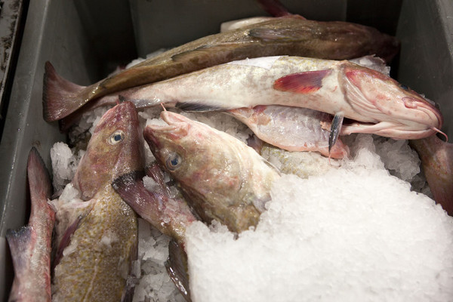
Dealing with the catch
On some boats, the fishers will remove the insides of the fish and wash them well. This process is known as gutting.
They are then placed in boxes and covered with ice to keep them fresh.
Here is some iced cod caught by a fishing boat in Cornwall, England.

Slide 9
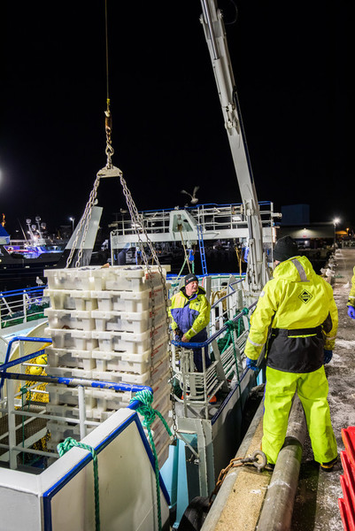
Dealing with the catch
The fishers may drop their nets, trawl and haul a number of times during their trip.
Here is a fishing boat arriving back at harbour very early in the morning and the catch being unloaded.

Slide 10
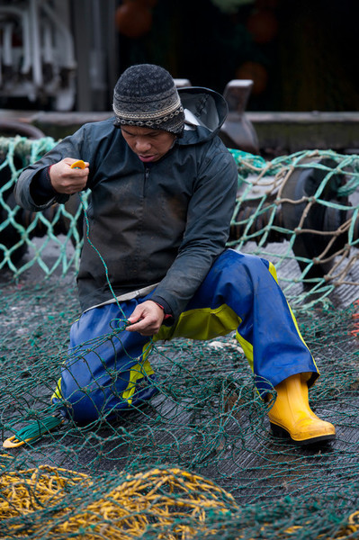
More than just fish
Fishers don’t always just catch fish!
Sometimes fishers haul their nets and find they have caught pieces of debris from a ship wreck or stones which can damage their nets.
This fisher is mending his net in the harbour.

Slide 11
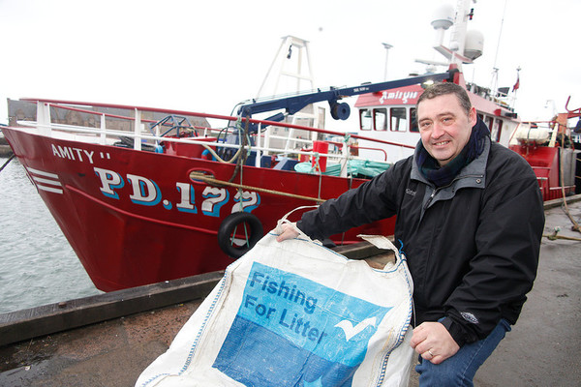
Fishing for litter
Fishers sometimes catch rubbish such as plastic bottles and bags.
They take this rubbish back to shore and make sure it is disposed of properly.

Slide 12
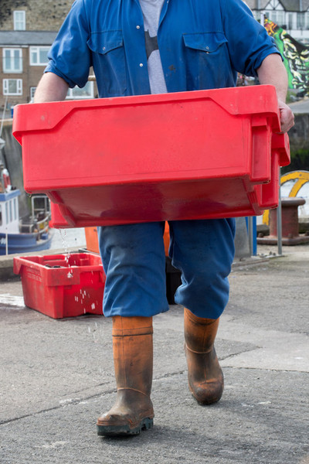
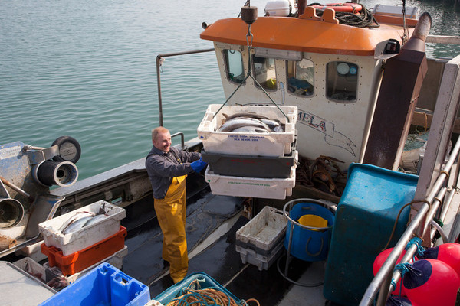
Back at shore
When the fishers get back to shore, they unload their catch.

Slide 13
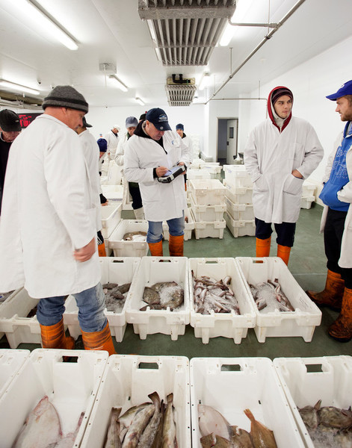
To market
The fish will be taken to market to be sold to fish processing companies, wholesalers, fishmongers and restaurants.
This is Brixham Fish Market in Devon, England.

Slide 14
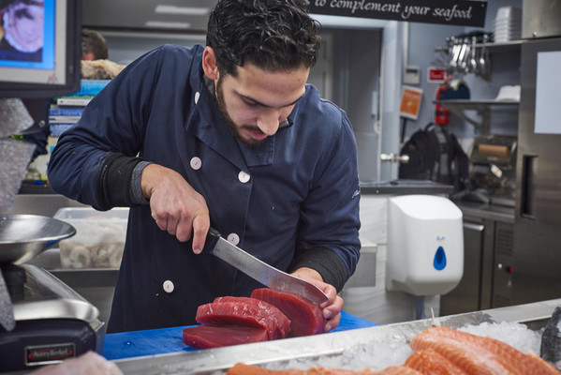
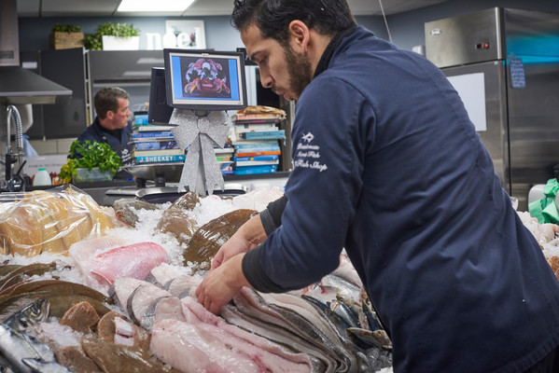
Fishmongers
This fishmonger is cutting fish into portions to display on his fish counter.
Some fish is cut into portions/fillets and some fish is sold whole.

Slide 15
Being a fisher
For further information, go to: www.foodafactoflife.org.uk
Images kindly provided by Seafish www.seafish.org.uk

