Slide 1
Growing mussels

Slide 2
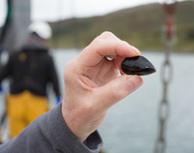
Where do mussels come from?
Mussels are produced in many places around the UK, including Cornwall, Devon, Scotland and Wales.
Mussels can be gathered from the bottom of the sea or grown on ropes.
Let’s find out more about how mussels are grown on ropes!

Slide 3
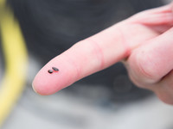
Young mussels
In the early summer, tiny mussels are born. These are called ‘seed’ mussels.
They float in the water ready to attach themselves to a suitable surface where they can grow.
Look at this tiny seed mussel on a finger tip!

Slide 4
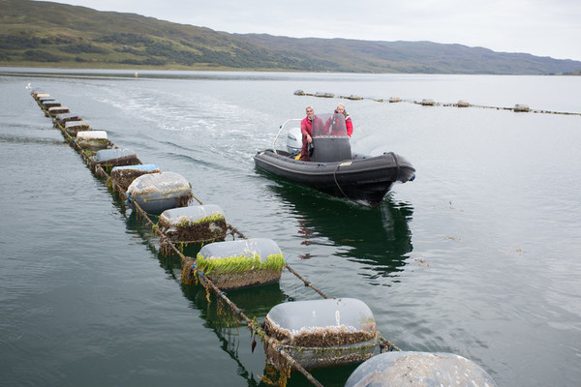
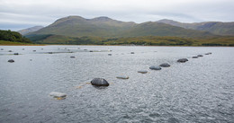
Growing mussels
Fish farmers place a line of rope around 200-400 metres long in the water.
The rope is anchored to the seashore or seabed at each end.
Floats are tied to the rope so it stays near the surface.

Slide 5
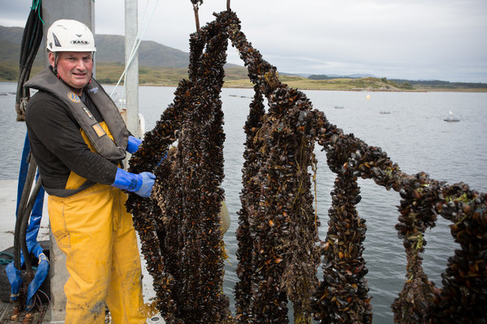
Droppers
Other ropes are tied to the long rope and hang down into the water.
These hanging ropes are called ‘droppers’.
The droppers are usually 6-10 metres long, depending on the depth of the water.

Slide 6
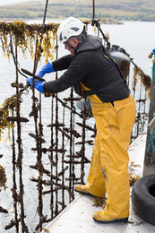
Seed mussels
The seed mussels that are floating in the water attach to the ropes.
They use threads called ‘beards’ to attach themselves.
There are tiny seed mussels on the droppers in this photograph!

Slide 7
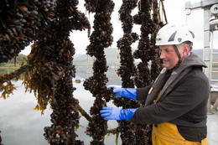
Growing
The mussels grow on the ropes for around a year and a half to two years.
The fish farmers lift the ropes out of the water from time to time to check on the mussels.

Slide 8
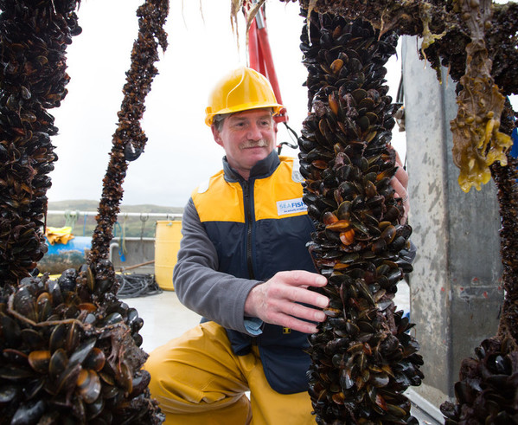
Harvesting
When the mussels are ready, they are harvested.
Look at all the mussels covering the rope.

Slide 9
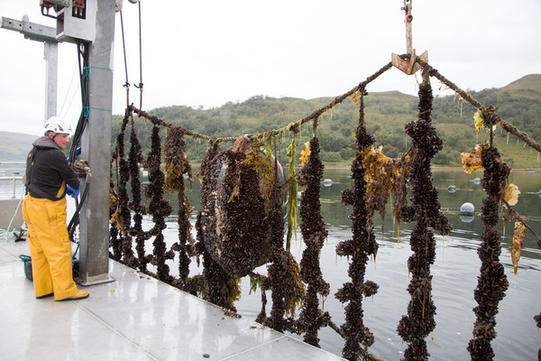
Harvesting
The mussels on the ropes are lifted out of the water by a machine on a boat.

Slide 10
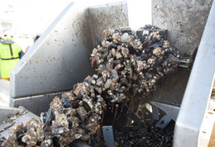
Stripping
The mussels on the rope are pulled through a machine with a narrow opening.
The mussels can’t fit through the opening so they are pushed off the rope.
This is called ‘stripping’ because the mussels are stripped from the rope.

Slide 11
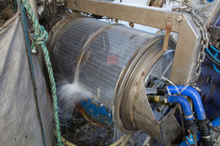
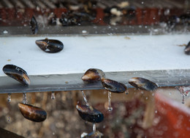
De-clumping
The mussels are in clumps because they are attached to each other by their beards.
The mussels go into a ‘de-clumper’ that rolls them around and sprays them with water to separate them.

Slide 12
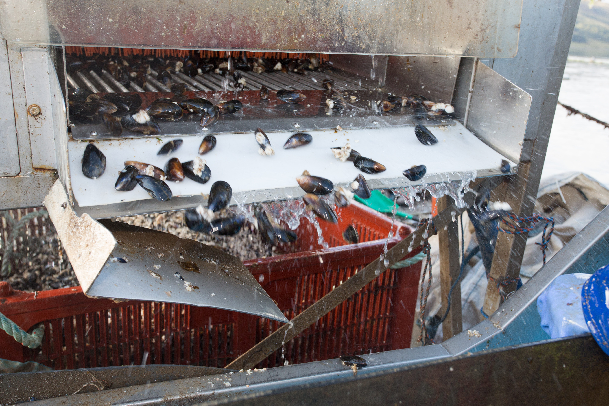
Grading
The mussels are put through a ‘grading’ machine to sort them into different sizes.

Slide 13
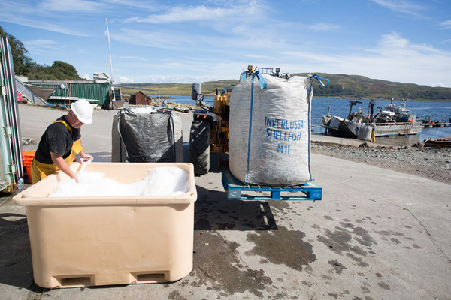
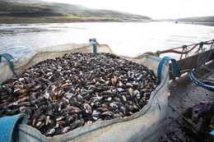
Packing
Finally, the mussels are bagged and ice is added to keep them fresh.

Slide 14
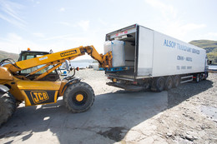
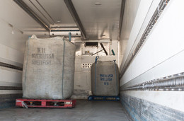
Loading
The mussels are loaded into a refrigerated vehicle to go to a fish market where they will be sold – while some may go direct to customers such as food businesses or restaurants.

Slide 15
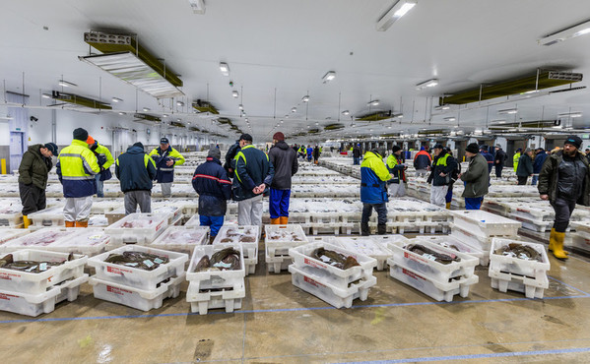
Market
At the fish market, the mussels will be sold to wholesalers, fishmongers and restaurants.

Slide 16
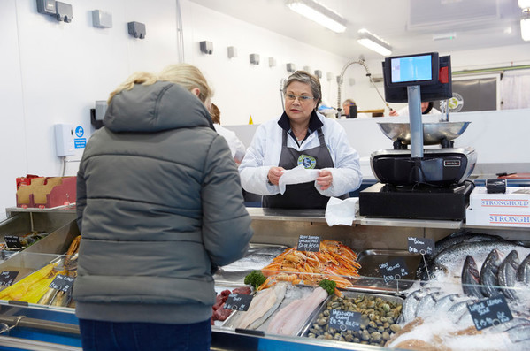
Fishmongers
Here is a fishmonger in Llandudno, North Wales selling fish to a customer.

Slide 17
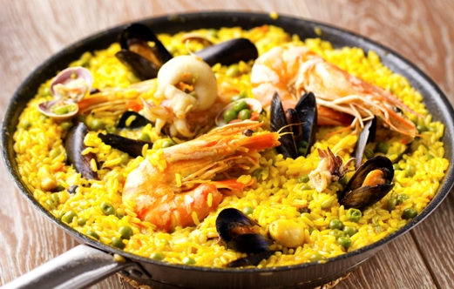
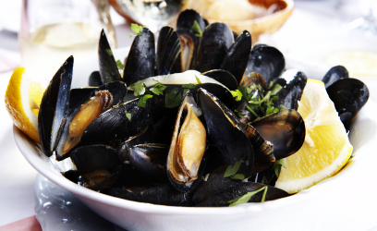
Mussels
Here are two dishes which use mussels.
Paella
Moules marinière
Name another dish that contains mussels.

Slide 18
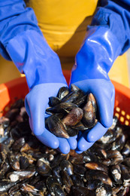
Three mussels facts!
1.There are more than 20 species of mussels around the world.
2.The UK produces around 10,000 tonnes of blue mussels a year. This is about the same weight as the Statue of Liberty in New York!
3.Mussels are in season (best to eat) if the month has an ‘R’ in it! (September to April)

Slide 19
Growing mussels
For further information, go to: www.foodafactoflife.org.uk
Images kindly provided by Seafish www.seafish.org.uk

