Slide 1
Harvest festival

Slide 2
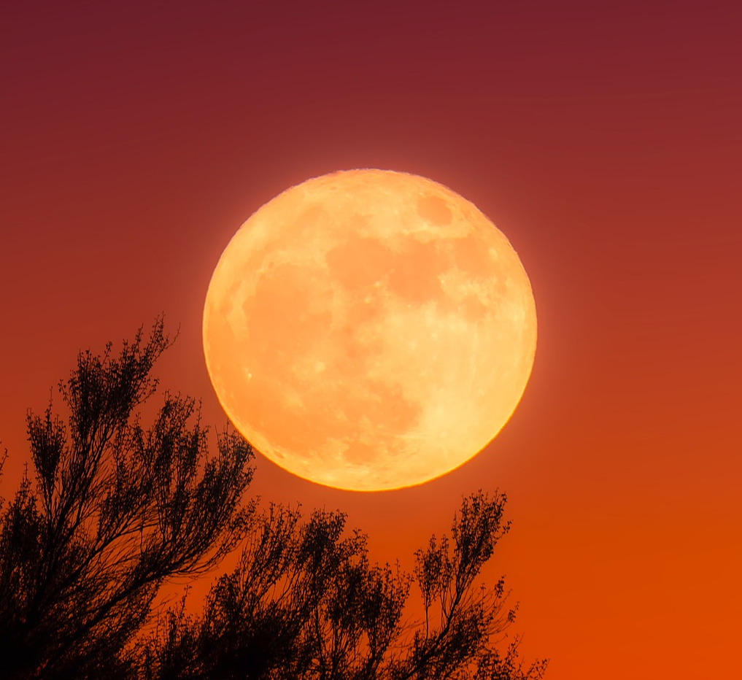
The history of Harvest Festival
Harvest Festival is traditionally celebrated in the UK on the Sunday nearest the full ‘Harvest Moon’.
In the past, celebrations used to begin on 1st August, with the very first loaves of bread from the new wheat crop. A celebratory dinner at the end of the harvest season was held on Michaelmas day (29th September).
The origins of the Festival date back to Pagan times, before being adopted by the Church; in fact the word ‘harvest’ comes from the Old English word ‘haerfest’, which means autumn.

Slide 3
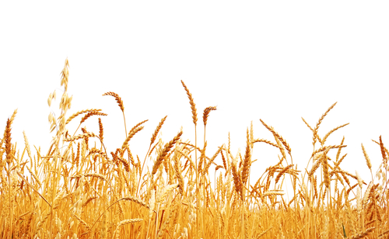
Traditions at Harvest Festival
Harvest Festival has a number of traditions associated with it, including:
The baking of ‘harvest loaves’;
The singing of songs about the harvest;
The making of ‘corn dollies’;
The creation of food baskets to be shared - either with each other or donated to those in need;
The arrangement of vibrant floral displays.

Slide 4
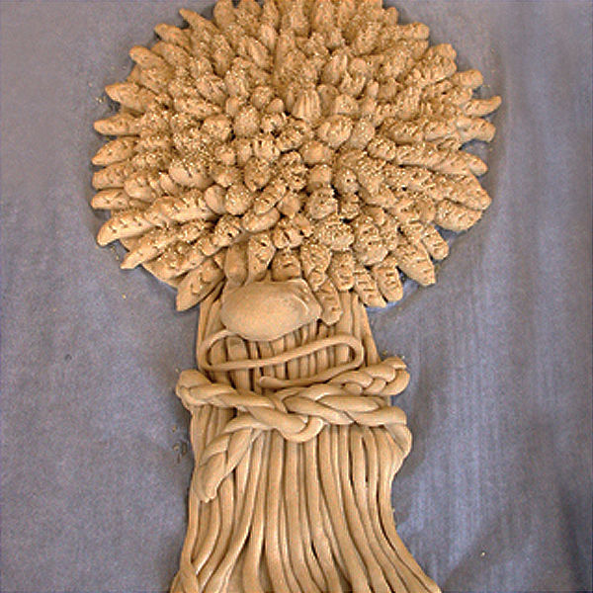
Harvest loaves
The baking of harvest loaves dates back to the tradition of ‘Lammas Day’, which is still observed in some areas of the UK.
Lammas Day is celebrated on 1st August and signifies the beginning of the harvest season by baking bread with the first crop of wheat.
Often these loaves have ornate designs. A common traditional design is to bake bread into the shape of a wheat sheaf.

Slide 5
Harvest songs
Harvest is a time for celebration and merriment, and so songs about bringing in the harvest have been an important part of traditional celebrations.
Many songs and hymns that are still sung today are associated with the harvest, due to the importance it had, and continues to have, on whether people were well fed.

Slide 6
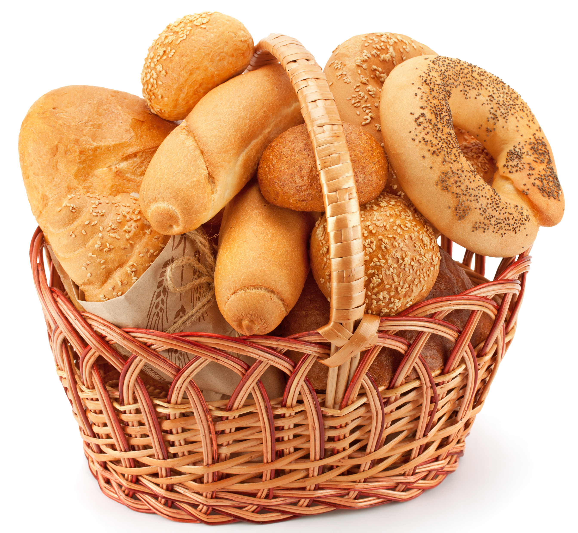
Food baskets
Harvest is a time for being thankful and sharing with those in need.
Food baskets were often prepared to be shared amongst the community, and often given to those in need.
Some schools, churches and local organisations still donate food to the elderly or otherwise needy around harvest time.

Slide 7
Corn dollies
In Pagan times, it was believed that the Corn Spirit lived in the fields, and would be without a place to live when the harvest was taken in.
This led to the creation of ‘corn dollies’, made from the last sheaf, where the Corn Spirit could live until the new crop was planted.
In the UK, different areas of the country have their own traditional design of corn dolly.

Slide 8

Harvest festivals around the world
Harvest-time is celebrated around the world because of the importance of having enough food to eat for the rest of the year.
Not all countries celebrate harvest in the same way, or on the same date, but many countries have their own variation on the festival.

Slide 9
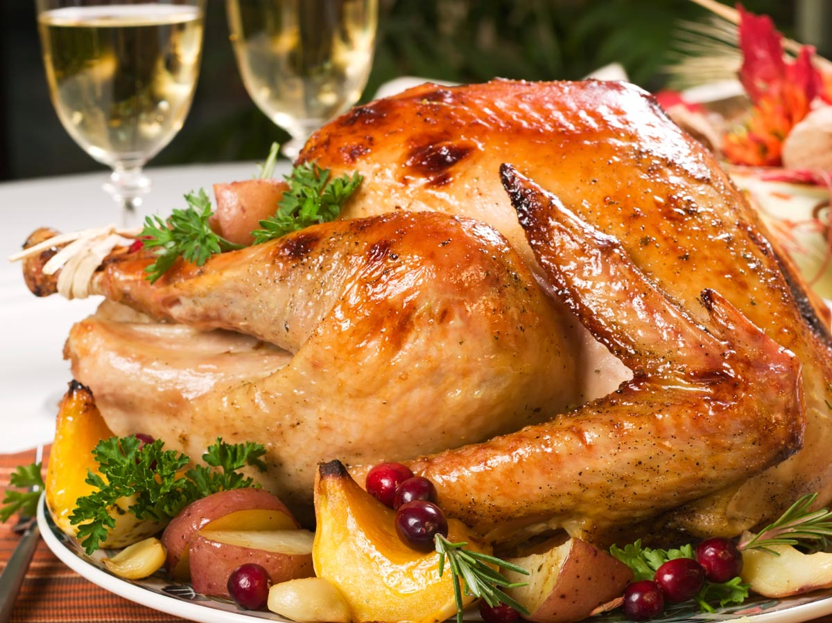
USA
The USA celebrates their harvest on the fourth Thursday of November, with a national holiday known as Thanksgiving.
During this time, family typically get together and celebrate with a meal, often with a turkey as the centrepiece.
Many American towns and cities also hold public parades on this day, with marching bands and floats.

Slide 10
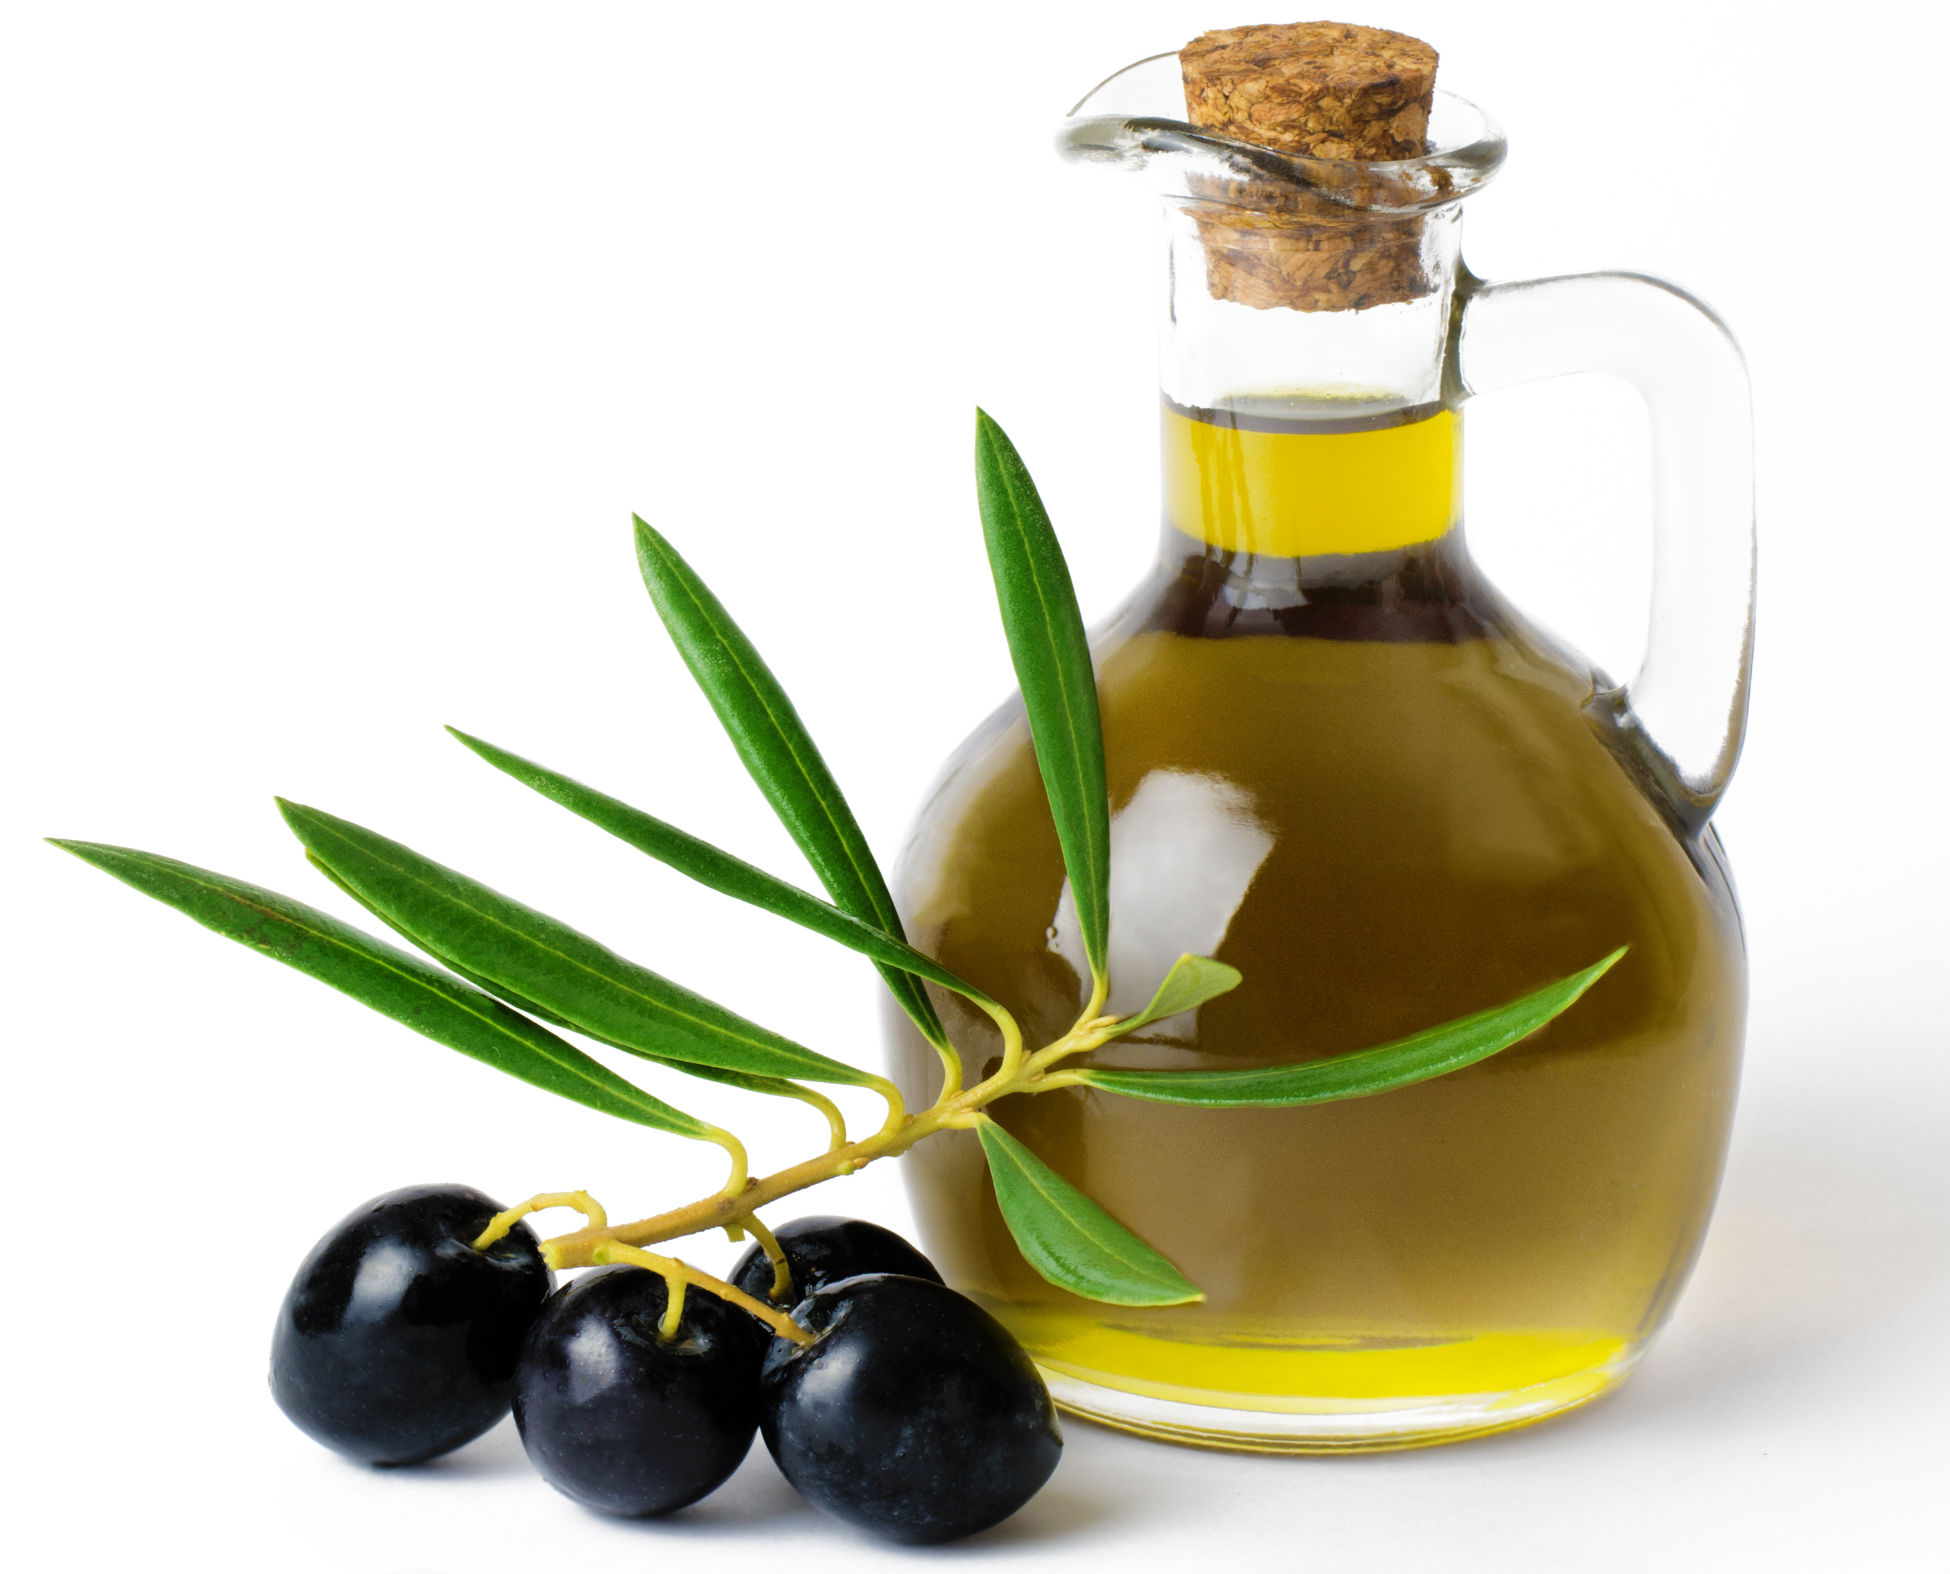
Magione, Italy
In Italy, olives are an important crop, particularly for making olive oil, which they export globally.
Italy is the second largest producer of olive oil in the world and the olive harvest is therefore a time for great celebration.
In the town of Magione, the olive harvest is celebrated each year with feasts of local food and wine, as well as theatrical performances.

Slide 11
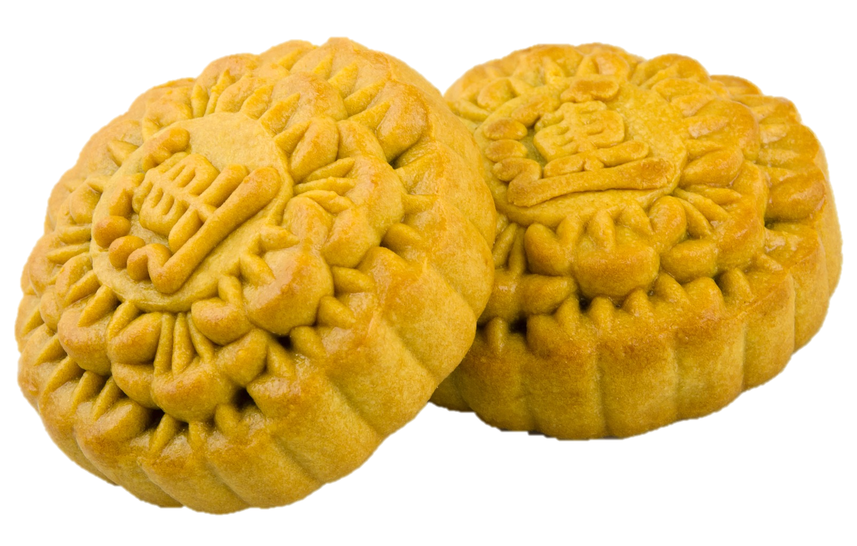
China
China celebrates the ‘Mid-Autumn Festival’ in September or October, under a full moon.
The festival is celebrated with brightly-coloured decorations and lanterns as well as food offerings and spending time with family.
Mooncakes are a popular food eaten during the festival. They are round pastries, usually containing sweet red bean or lotus seed paste, and sometimes the yolk of an egg, which represents The Moon.

Slide 12
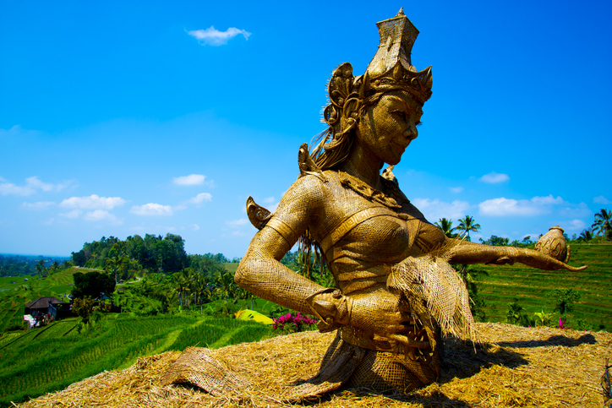
Bali, Indonesia
In Bali, rice is an important staple food. Therefore, the Rice Harvest Festival is a time for great jubilation.
This harvest festival is celebrated in May or June, immediately after the harvest is brought in.
Colourful flags are raised in towns and cities, and shrines to the ‘Rice god’ are erected in the fields in reverence.

Slide 13
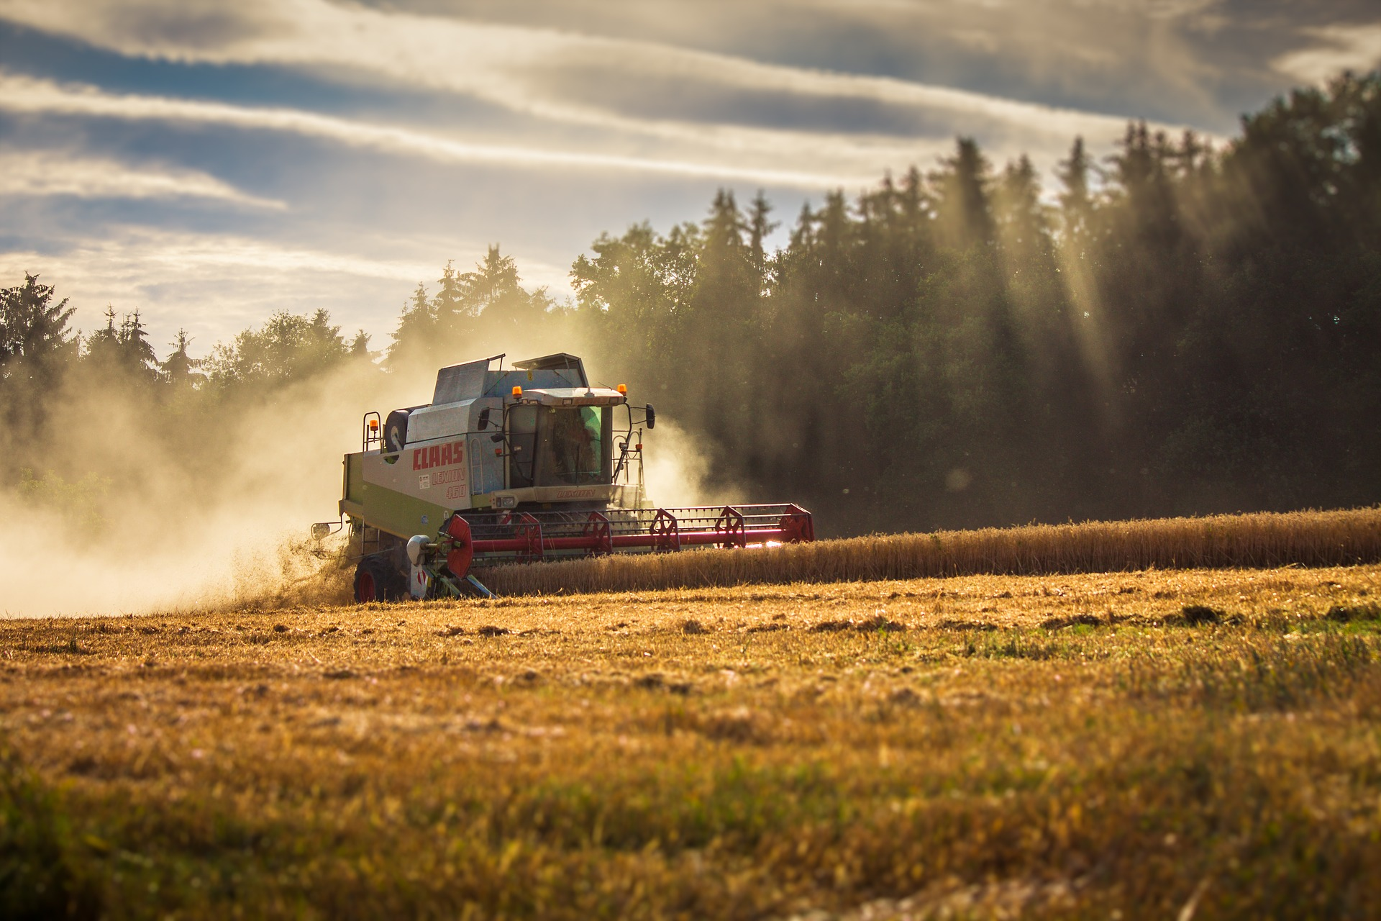
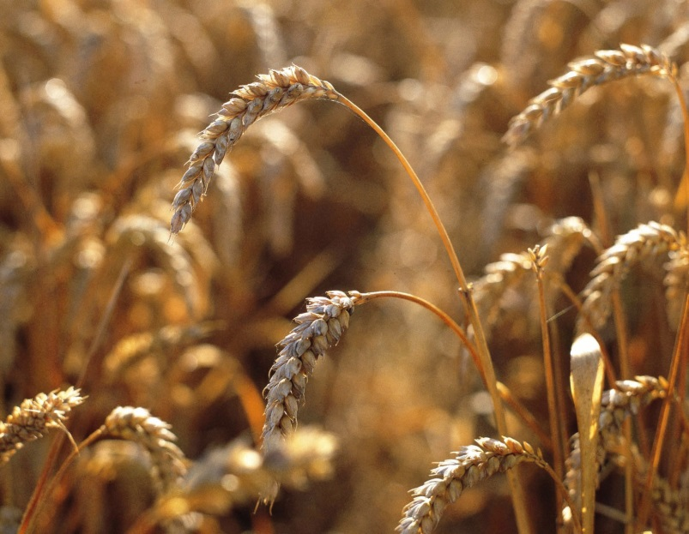
UK
The main cereal harvest takes place in late summer to early autumn.
A combine harvester can make short work of a field of wheat. Some can process over 500 tonnes in a day!
The combine harvester also ‘threshes’ the grain, to separate the seed from the stalks and inedible outer casing. This is called the ‘chaff’ and the process is known as separating the wheat from the chaff.

Slide 14
Harvest Festival
For further information, go to:
www.foodafactoflife.org.uk

