Slide 1
Harvest assembly

Slide 2
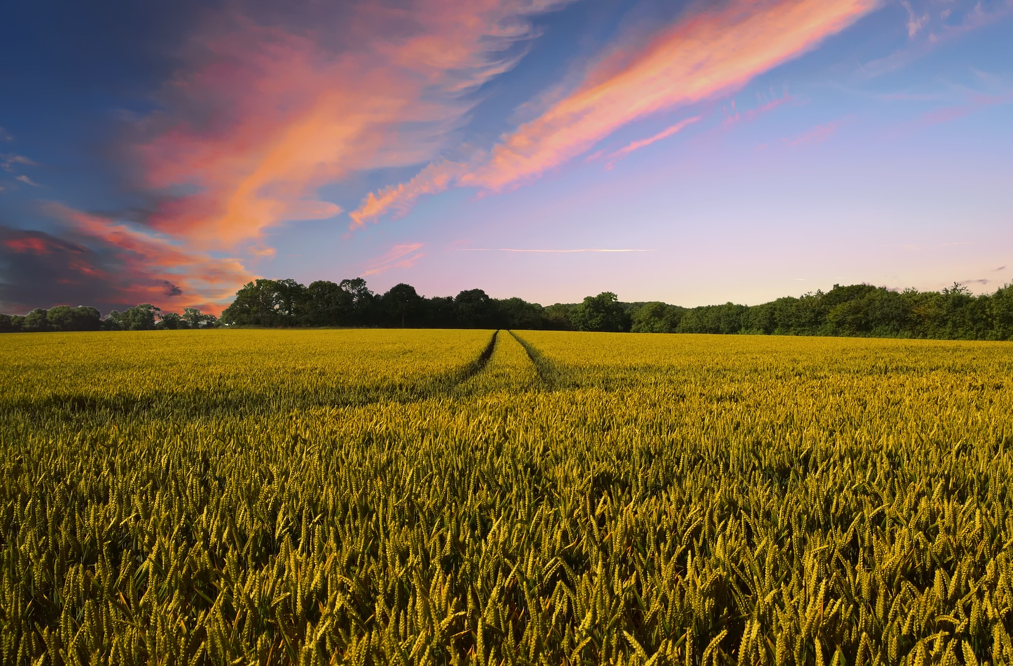
Harvest time
Harvest is a time for celebration.
But why do we celebrate the harvest?
The harvest season is important because it is when many valuable crops are collected. These can then be turned into the food you eat every day! Some of these crops are only harvested once a year.
In particular, this is a time to celebrate the harvest of cereals (i.e. grains, such as wheat), which can be used to make food such as bread, breakfast cereals and pasta.

Slide 3
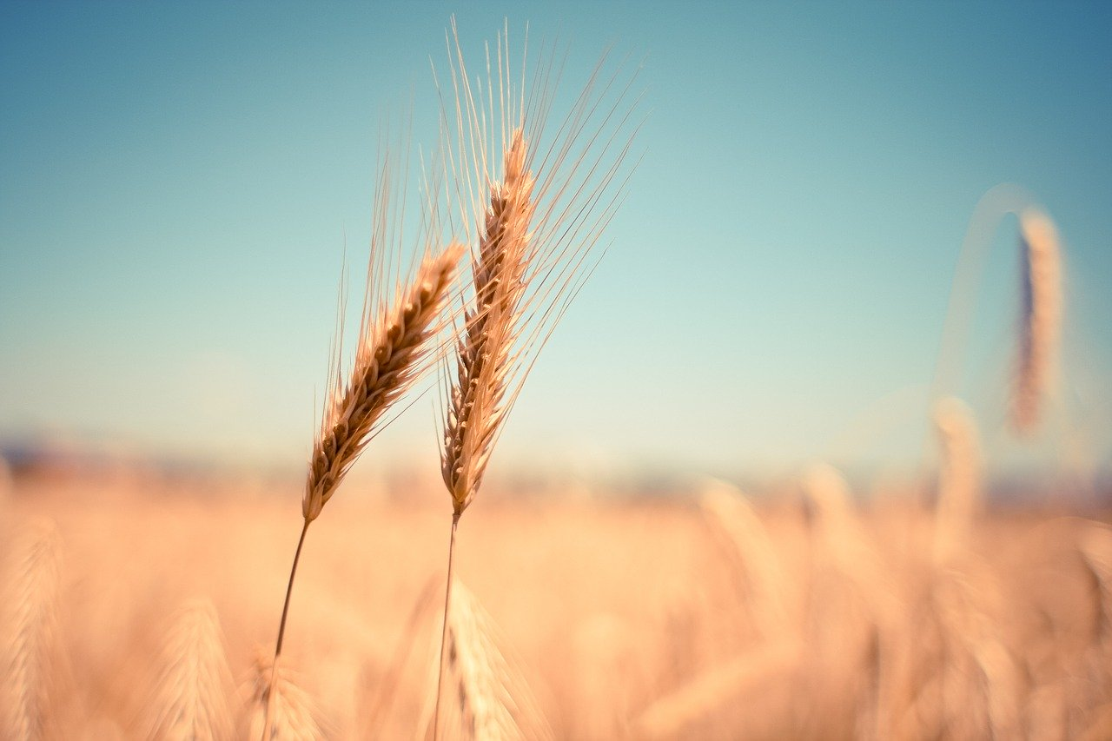
The cereal harvest
Between August and September, crops such as wheat are harvested.
This used to be done by hand, but farmers now use machines to speed the process up.
When the grains are harvested, they are separated from the ‘chaff’, which is inedible.
Most of the wheat harvested in the UK ends up at a flour mill to be made into flour.

Slide 4
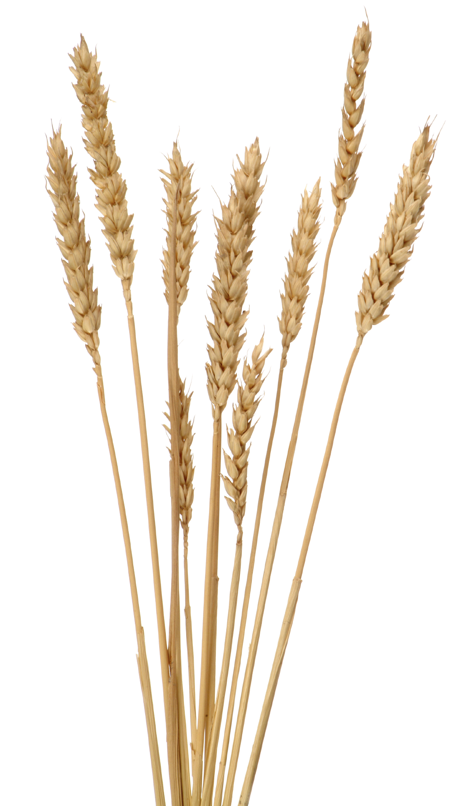
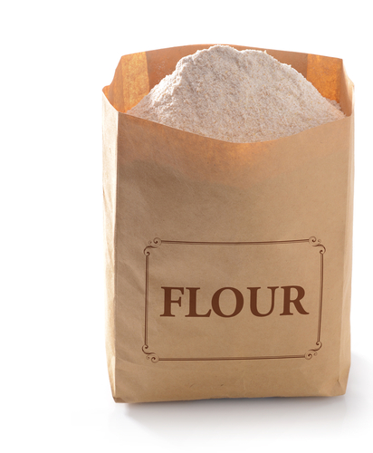
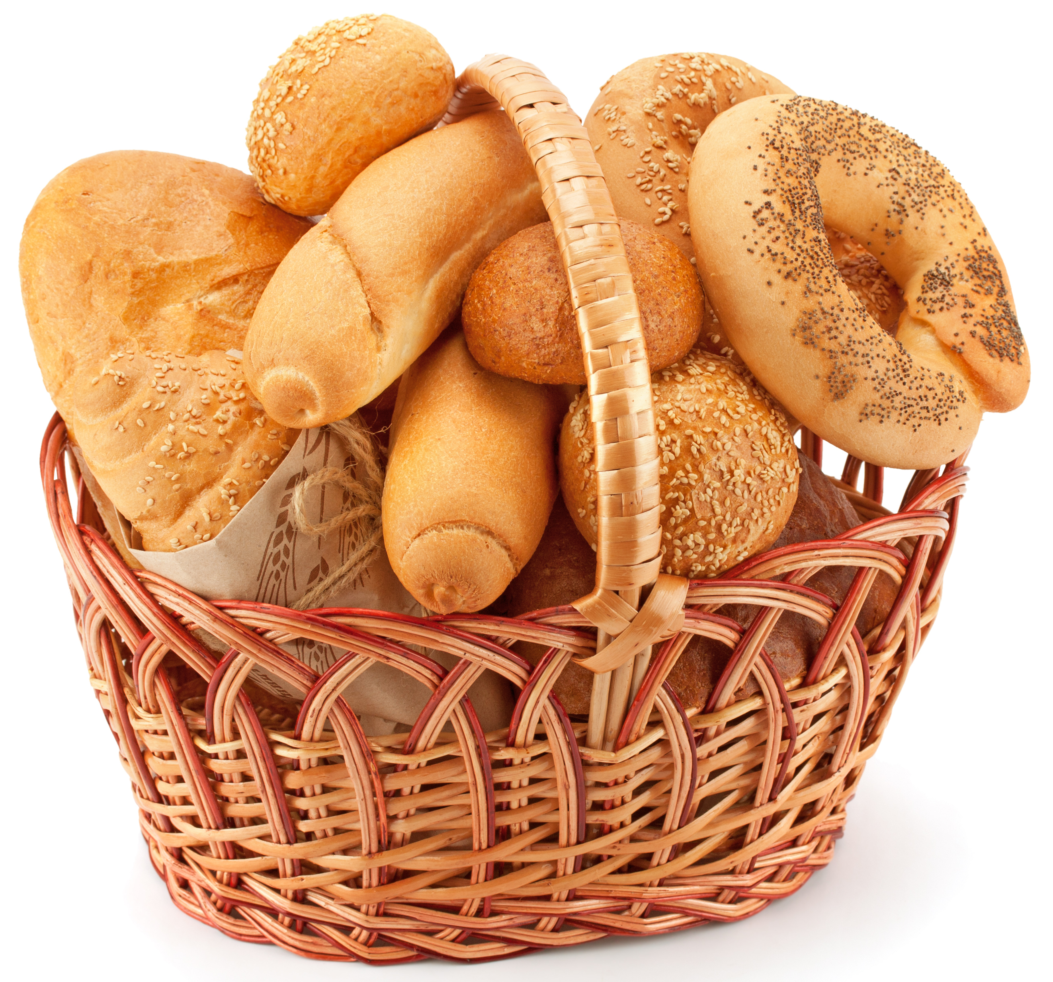
Making flour
When the grains get to the mill, they are carefully cleaned to remove dirt or other hazards.
Then, special rollers split the grains open. Sieves are used to separate the different parts of the grain.
Another set of rollers then crushes the remaining pieces of grain into a fine powder – flour!
White flour is separated out by the sieves. The other parts of the grain can be added back to the white flour if wholemeal or brown flour is needed instead.

Slide 5
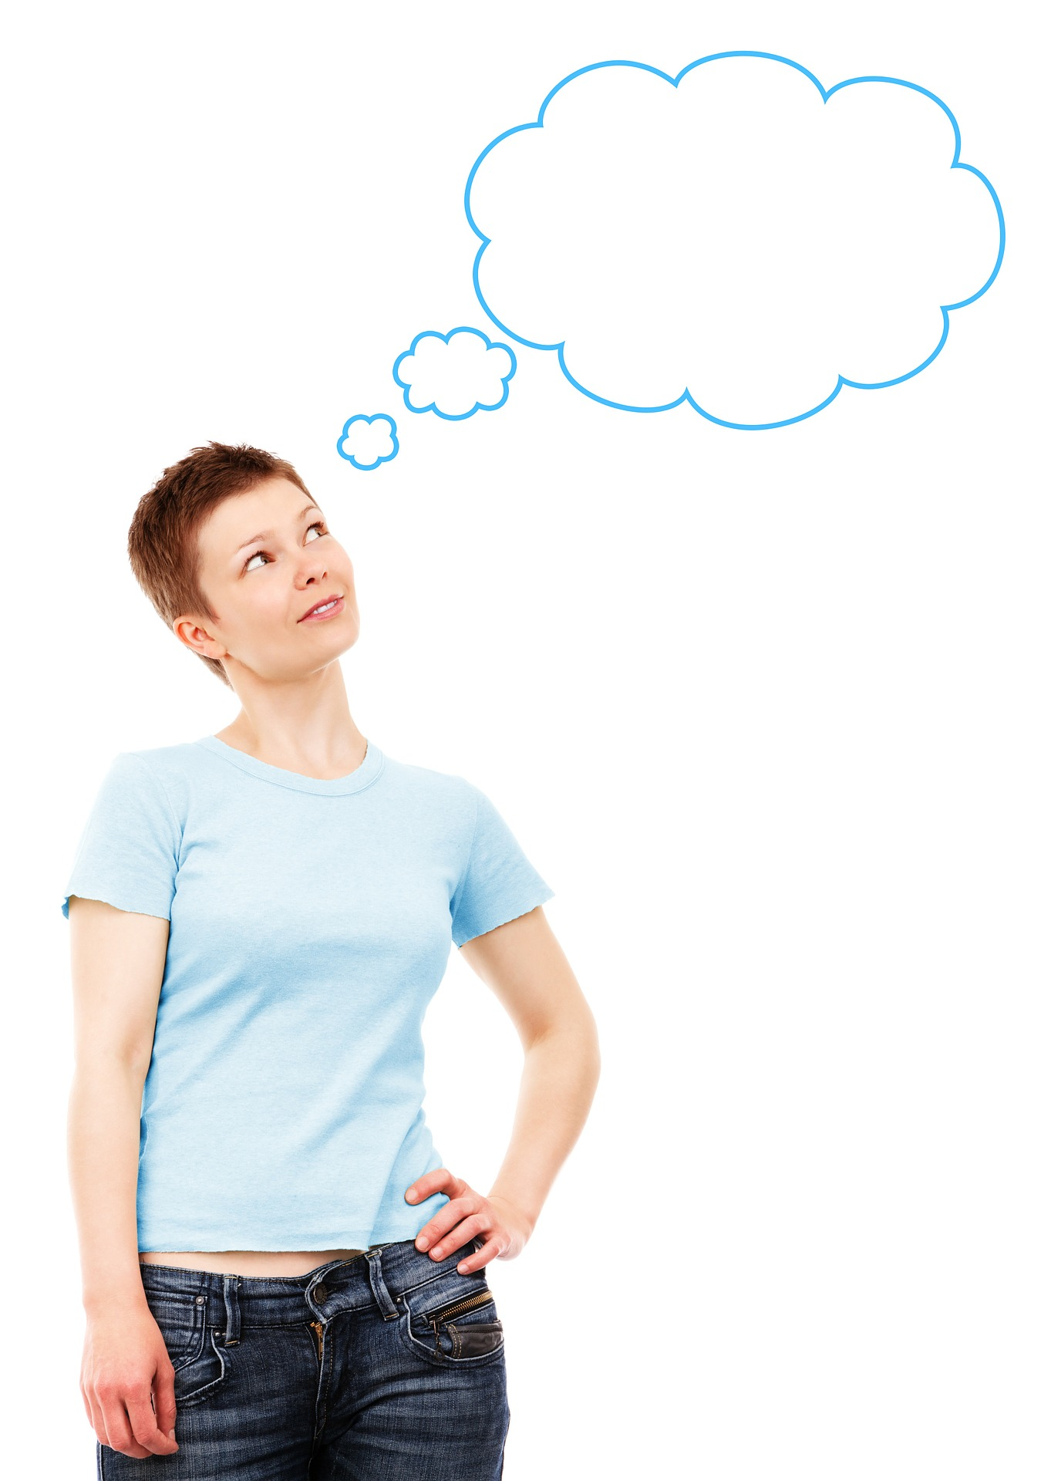
What do we use flour for?
How many foods can you think of that are made with flour?

Slide 6
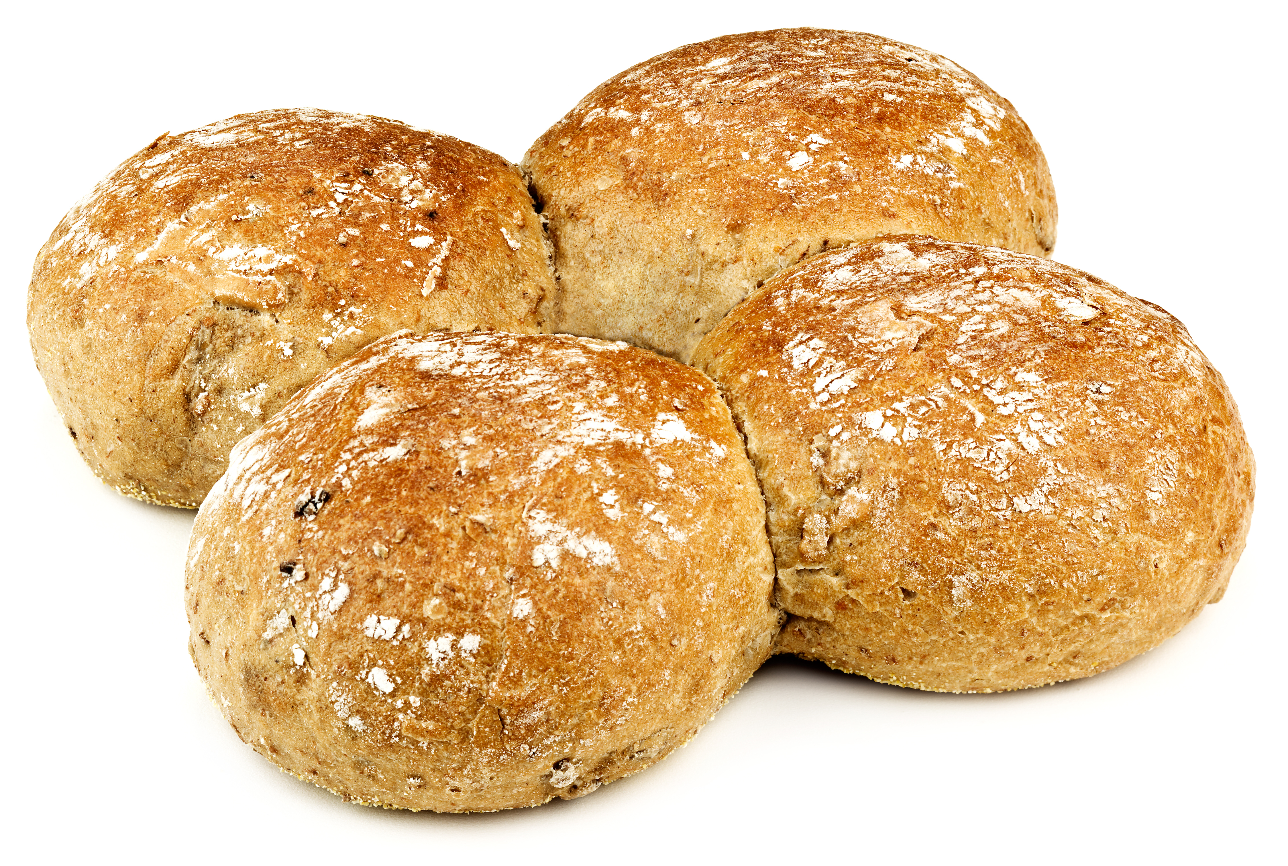
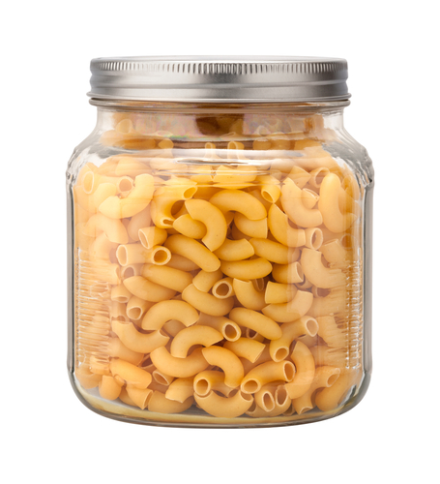
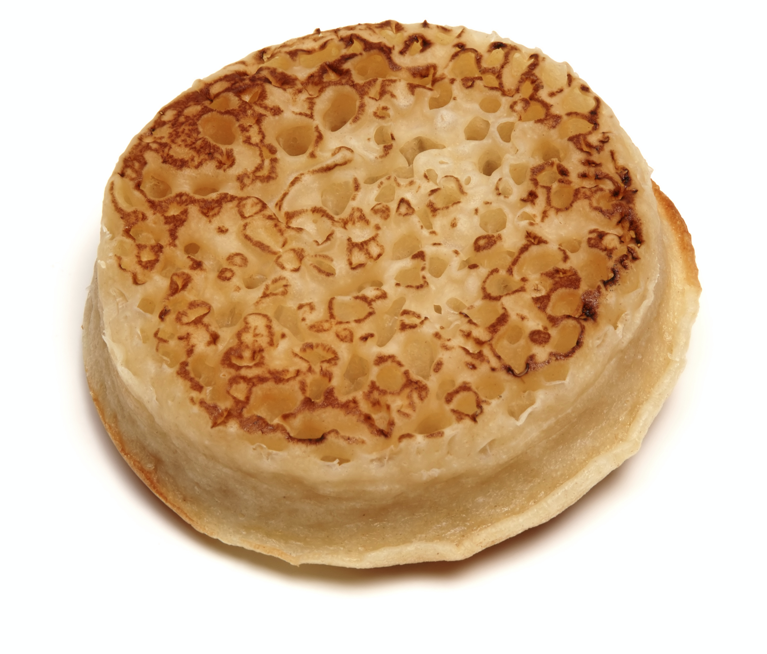
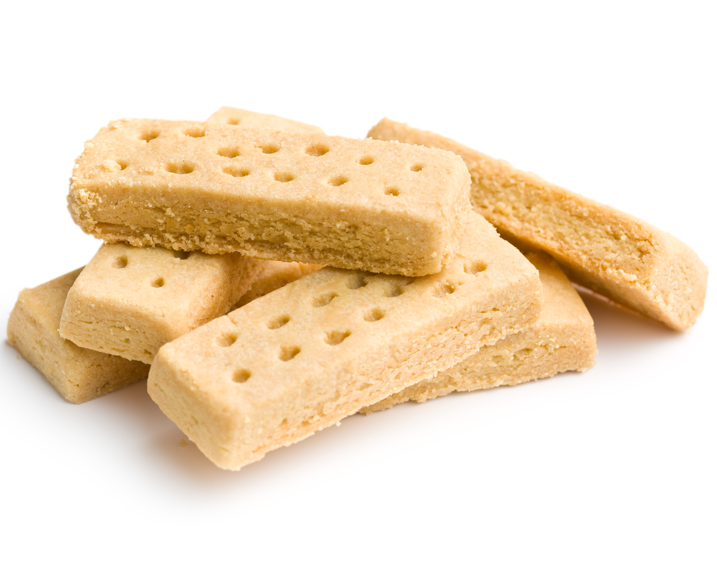
Uses of flour
Flour is used in many of the most popular food items in the UK, including:
breads;
pasta;
cakes;
biscuits;
pastries;
sauces.
It is also sold in bags so that it can be used in recipes at home.

Slide 7
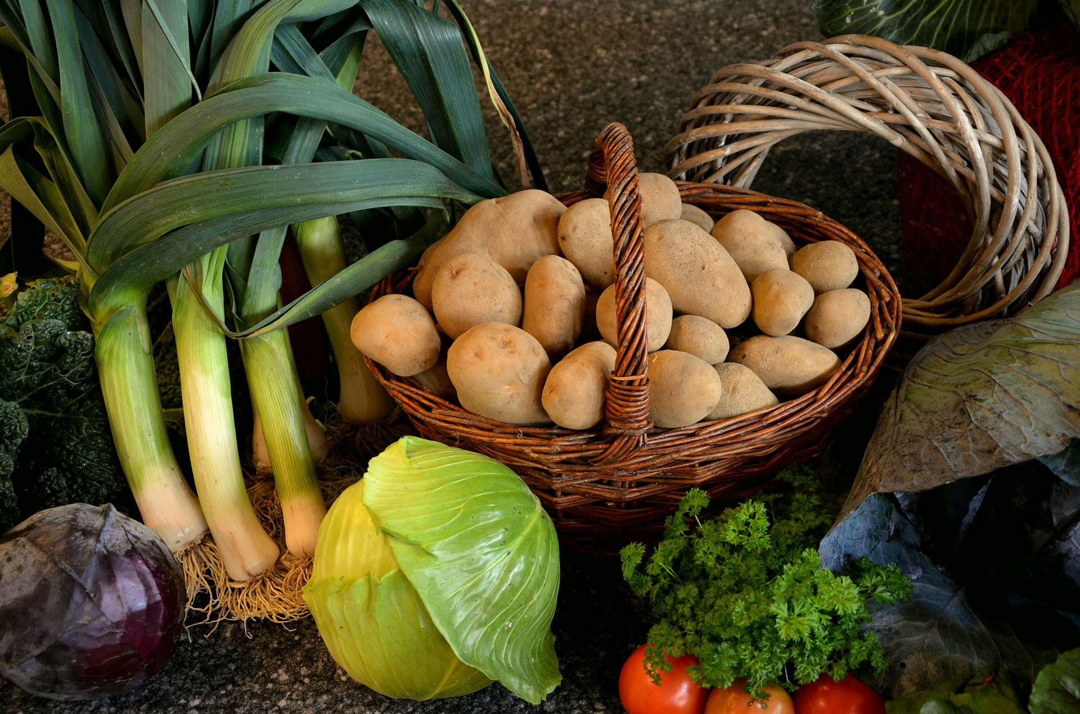
Harvest Festival
Harvest Festival is celebrated at the end of September or beginning of October.
It is a time of year to sing songs, read poems, make art, create delicious food and celebrate with family and friends.
But it can also be a useful time to reflect on what we have and think about others who might not be so fortunate.
It is also a good time to consider the people who work hard every day to make sure that we have food to eat.

Slide 8
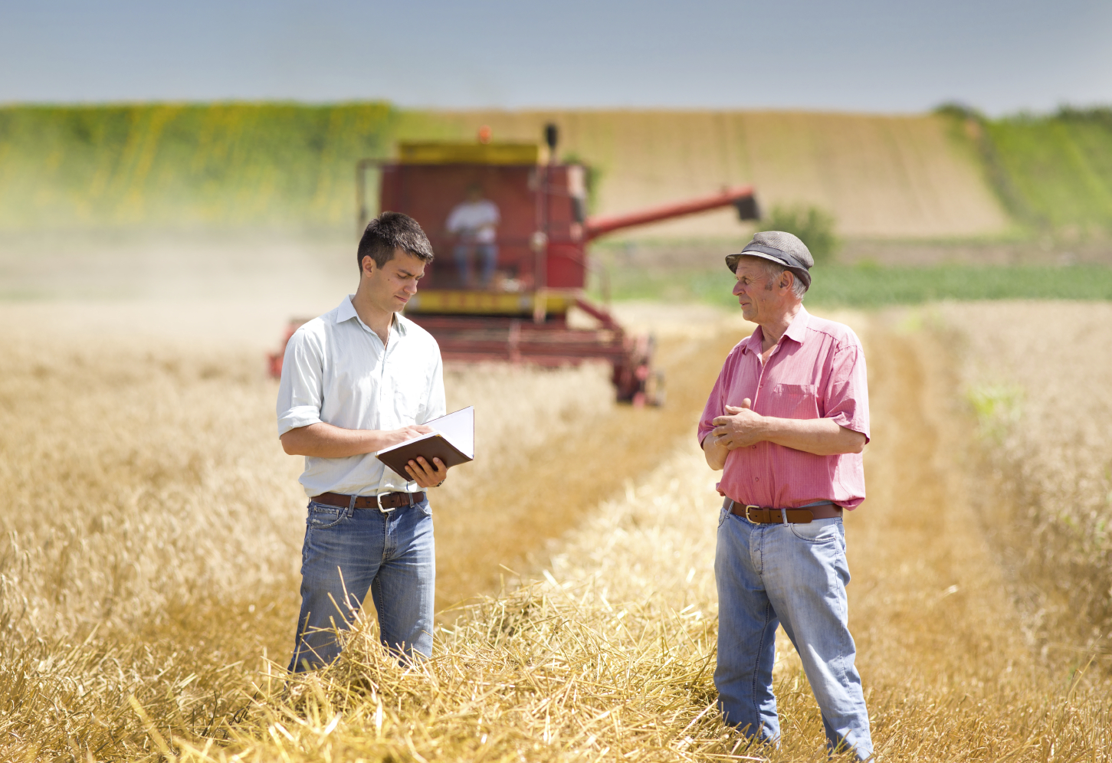
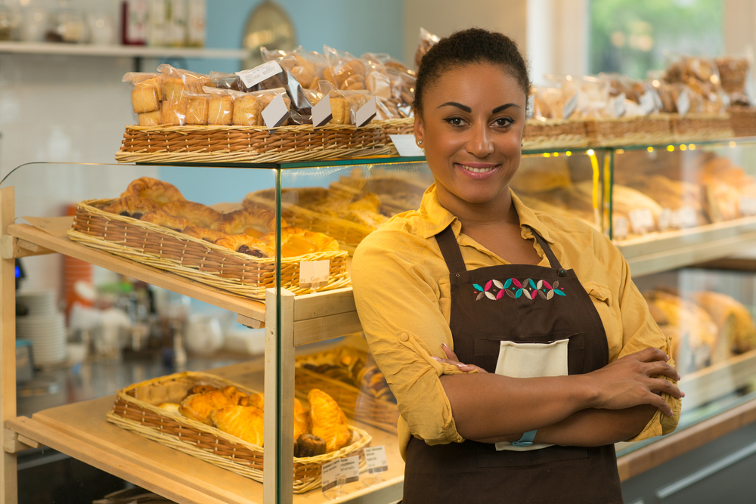
When you eat your food at harvest time, it’s important to remember that many people worked together to get the food from the fields onto your plate.
The journey of cereals from field to fork requires farmers, labourers, millers, lorry drivers, bakers and shopkeepers.
As you eat your next meal, think about all of the people you have to thank for the food in front of you.
H
A
R
V
E
S
T

Slide 9
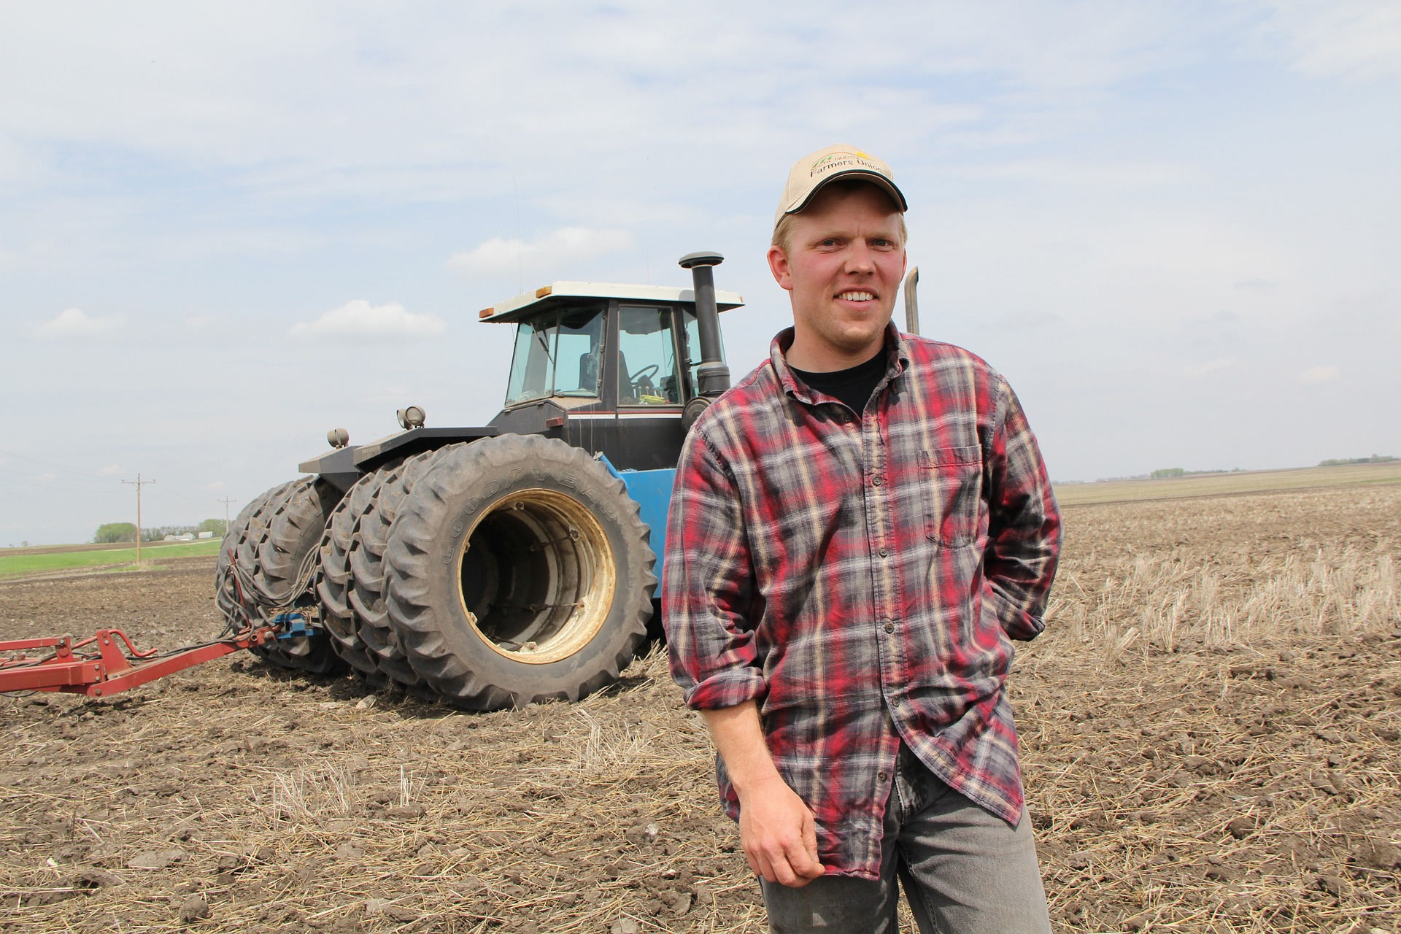
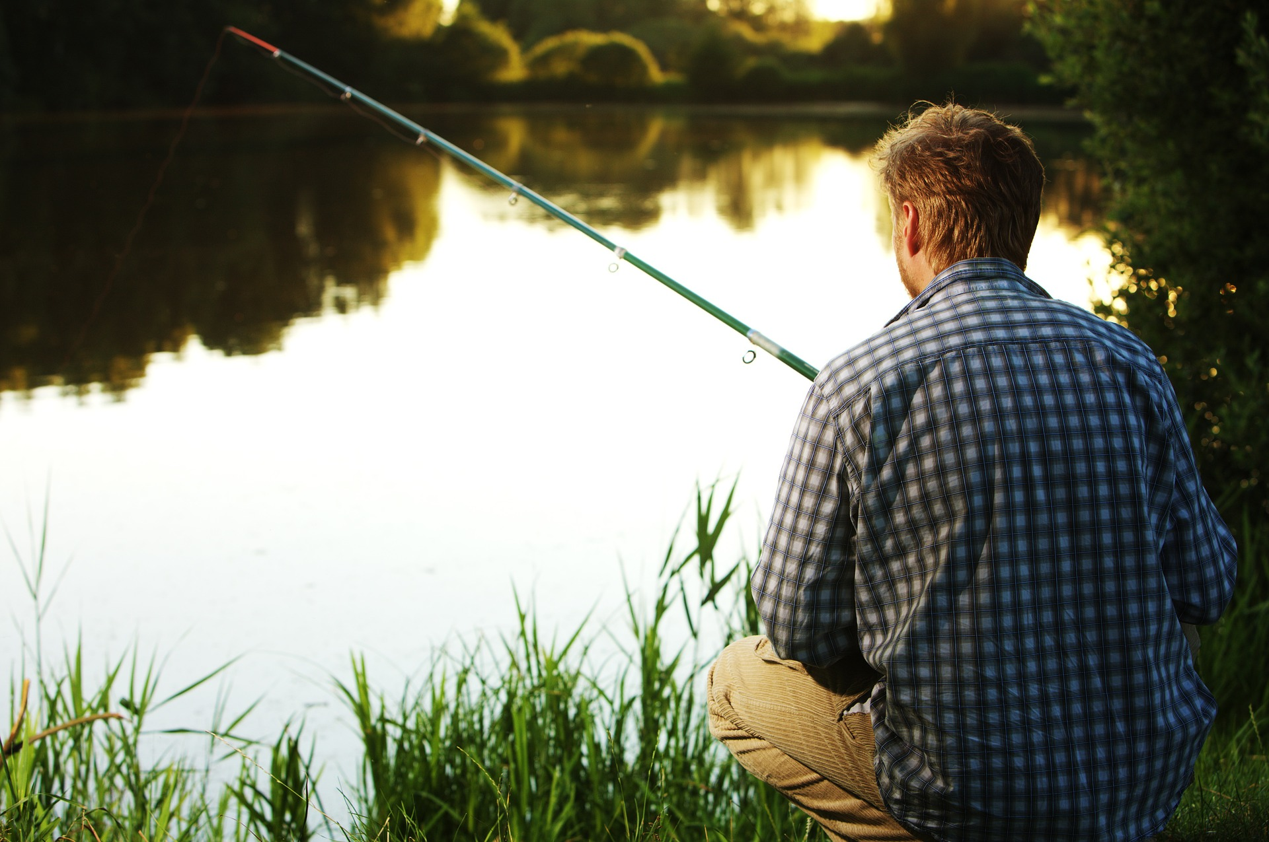
The end of the harvest is a time when the hard-working farmers can take some well-deserved rest.
Farmers work from dawn until dusk to make sure the harvest comes in on time.
Think about the important work the farmers do during the busy period of harvest, in order to make the food that you enjoy.
H
A
R
V
E
S
T

Slide 10
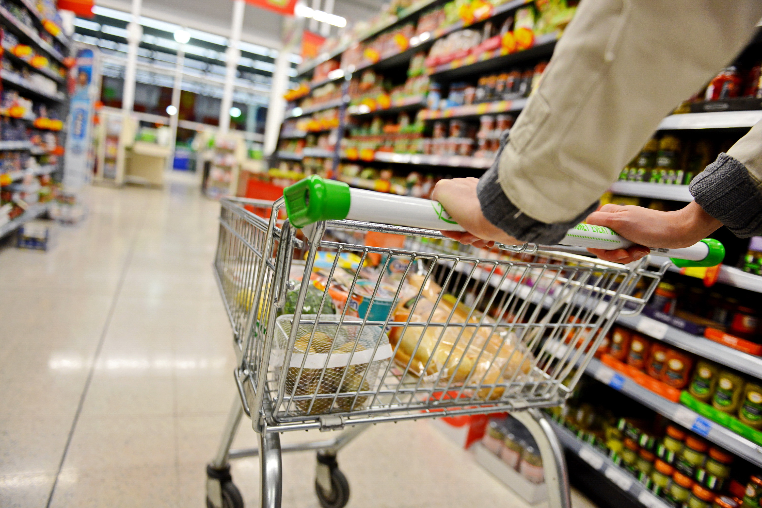
These days, we are lucky that we have a plentiful supply of food all year round.
In the past, food was often very scarce before the new harvest came in and this is one reason why harvest is a time to celebrate what we have.
H
A
R
V
E
S
T

Slide 11
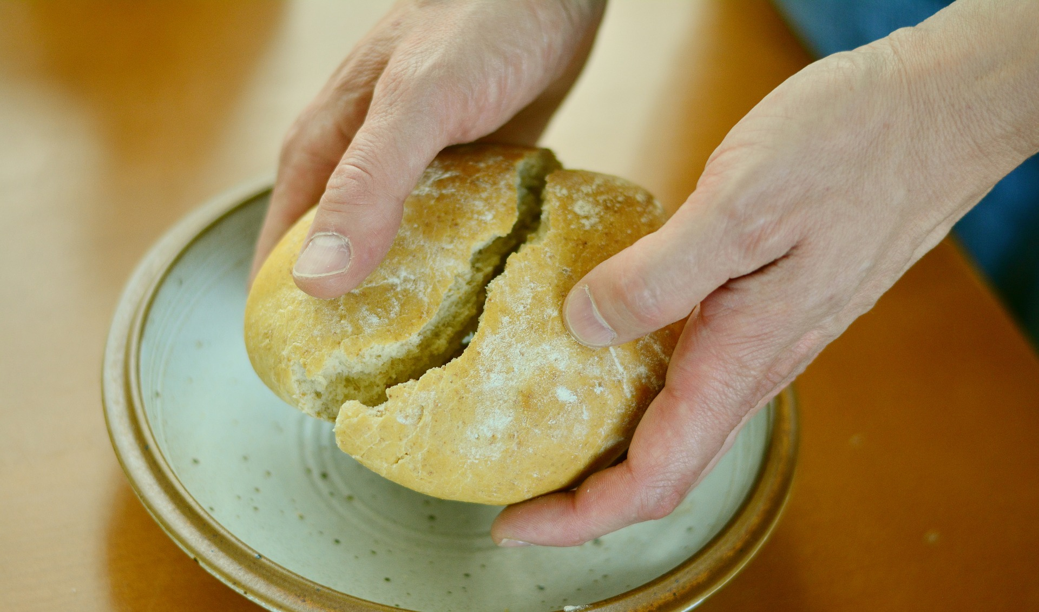
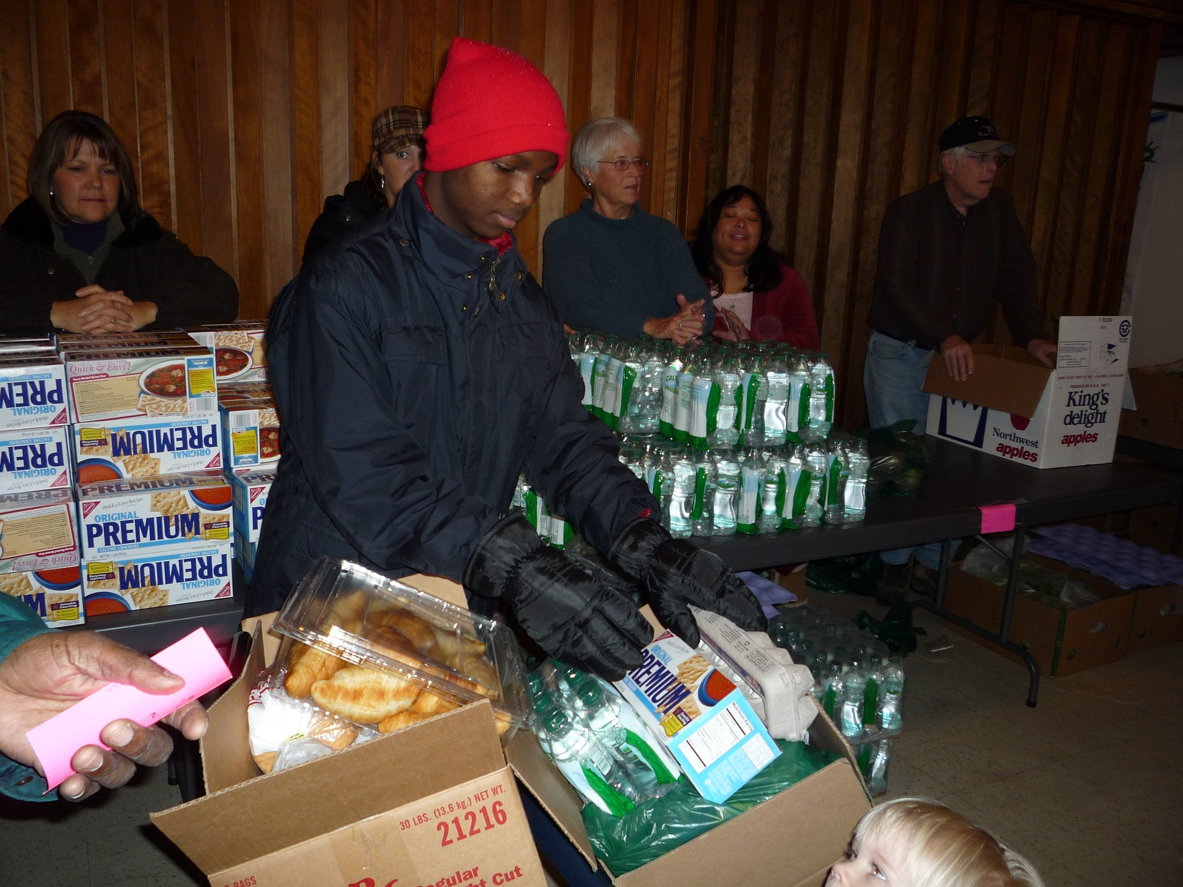
Whilst most of us are fortunate to have the food we need and enjoy, there are many others who do not have enough to eat.
Harvest time is a time to share with those that have less than us, in local communities and across the world.
H
A
R
V
E
S
T

Slide 12
Harvest assembly
For further information, go to:
www.foodafactoflife.org.uk

