Slide 1

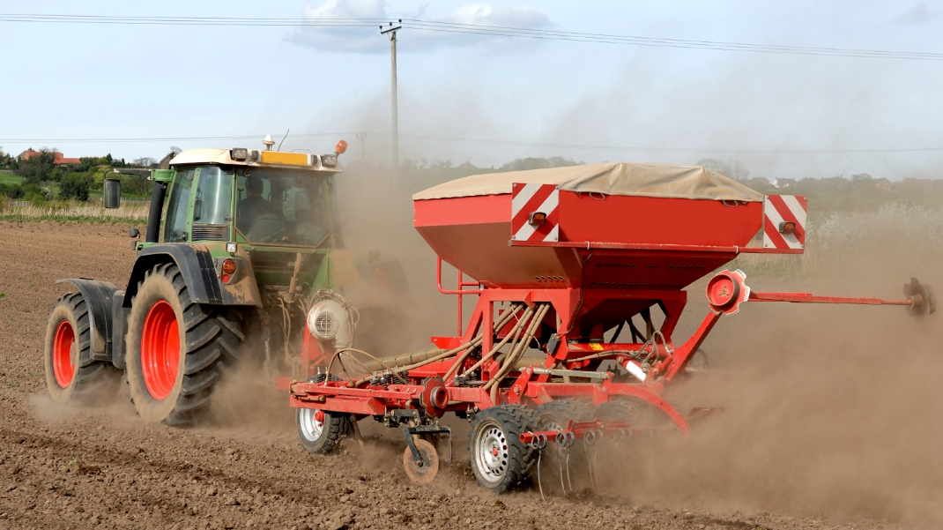
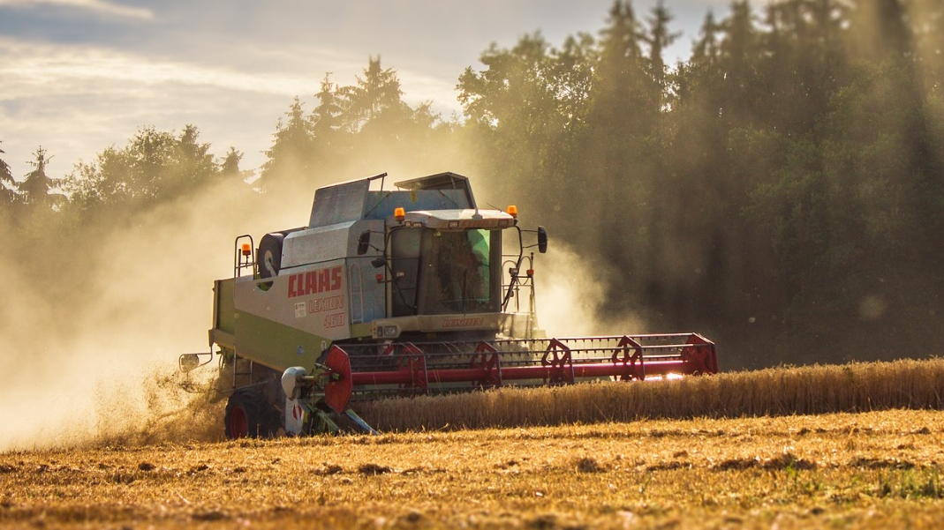
Sowing
© Food – a fact of life 2020
www.foodafactoflife.org.uk
Harvesting
© Food – a fact of life 2020
www.foodafactoflife.org.uk

Slide 2
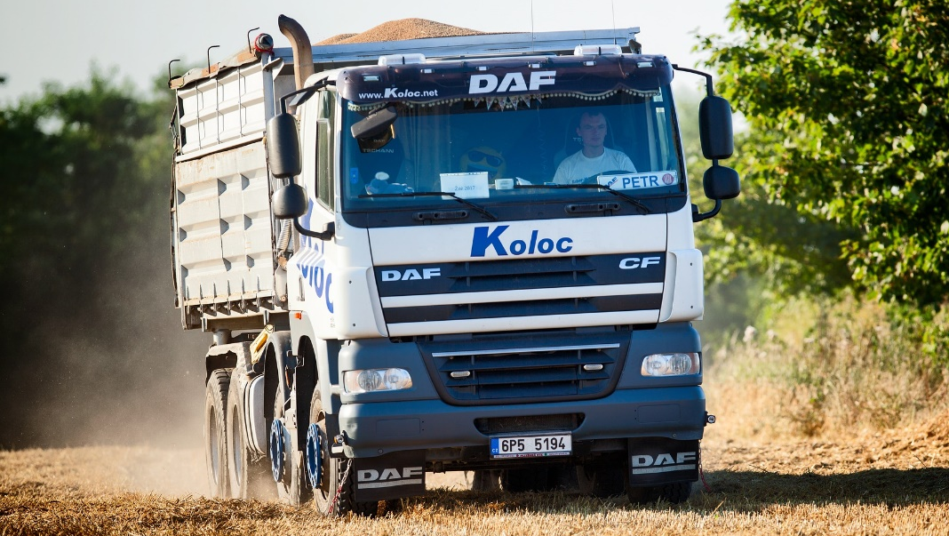
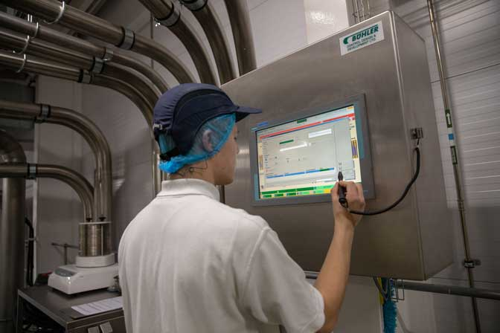
Transporting grain
© Food – a fact of life 2020
www.foodafactoflife.org.uk
Cleaning and conditioning
© Food – a fact of life 2020
www.foodafactoflife.org.uk

Slide 3
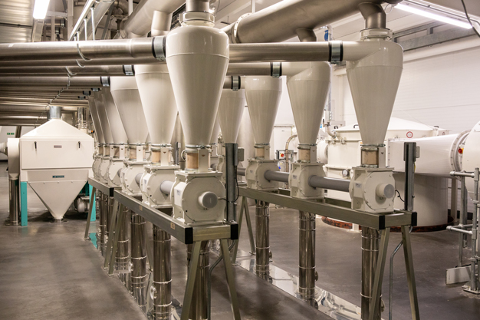
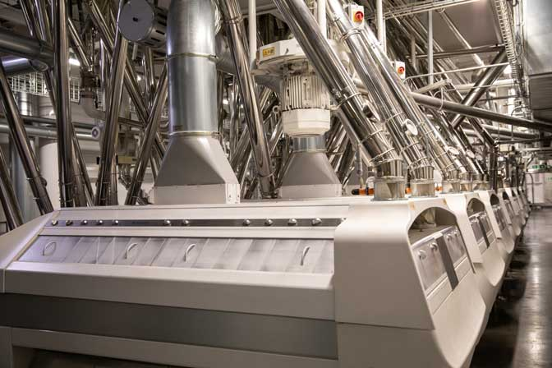
Gristing
© Food – a fact of life 2020
www.foodafactoflife.org.uk
Rolling and sieving
© Food – a fact of life 2020
www.foodafactoflife.org.uk

Slide 4
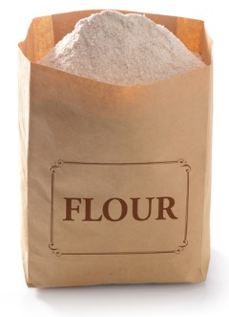
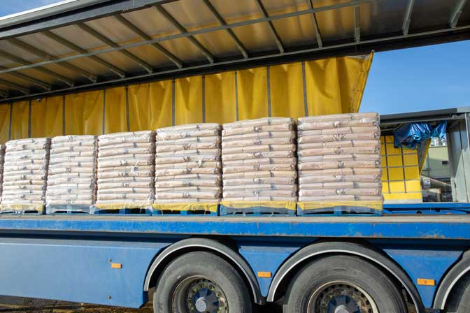
Separated white flour
© Food – a fact of life 2020
www.foodafactoflife.org.uk
Flour transportation
© Food – a fact of life 2020
www.foodafactoflife.org.uk

Slide 5
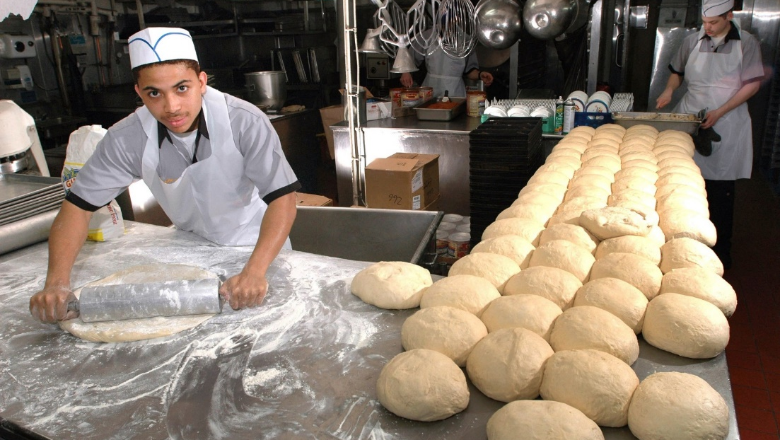
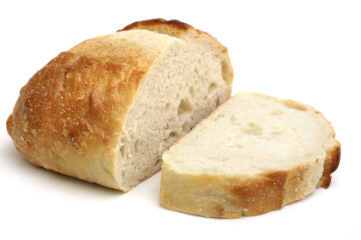
Baking
© Food – a fact of life 2020
www.foodafactoflife.org.uk
White bread
© Food – a fact of life 2020
www.foodafactoflife.org.uk

