Slide 1
The cereal harvest: from field to table

Slide 2
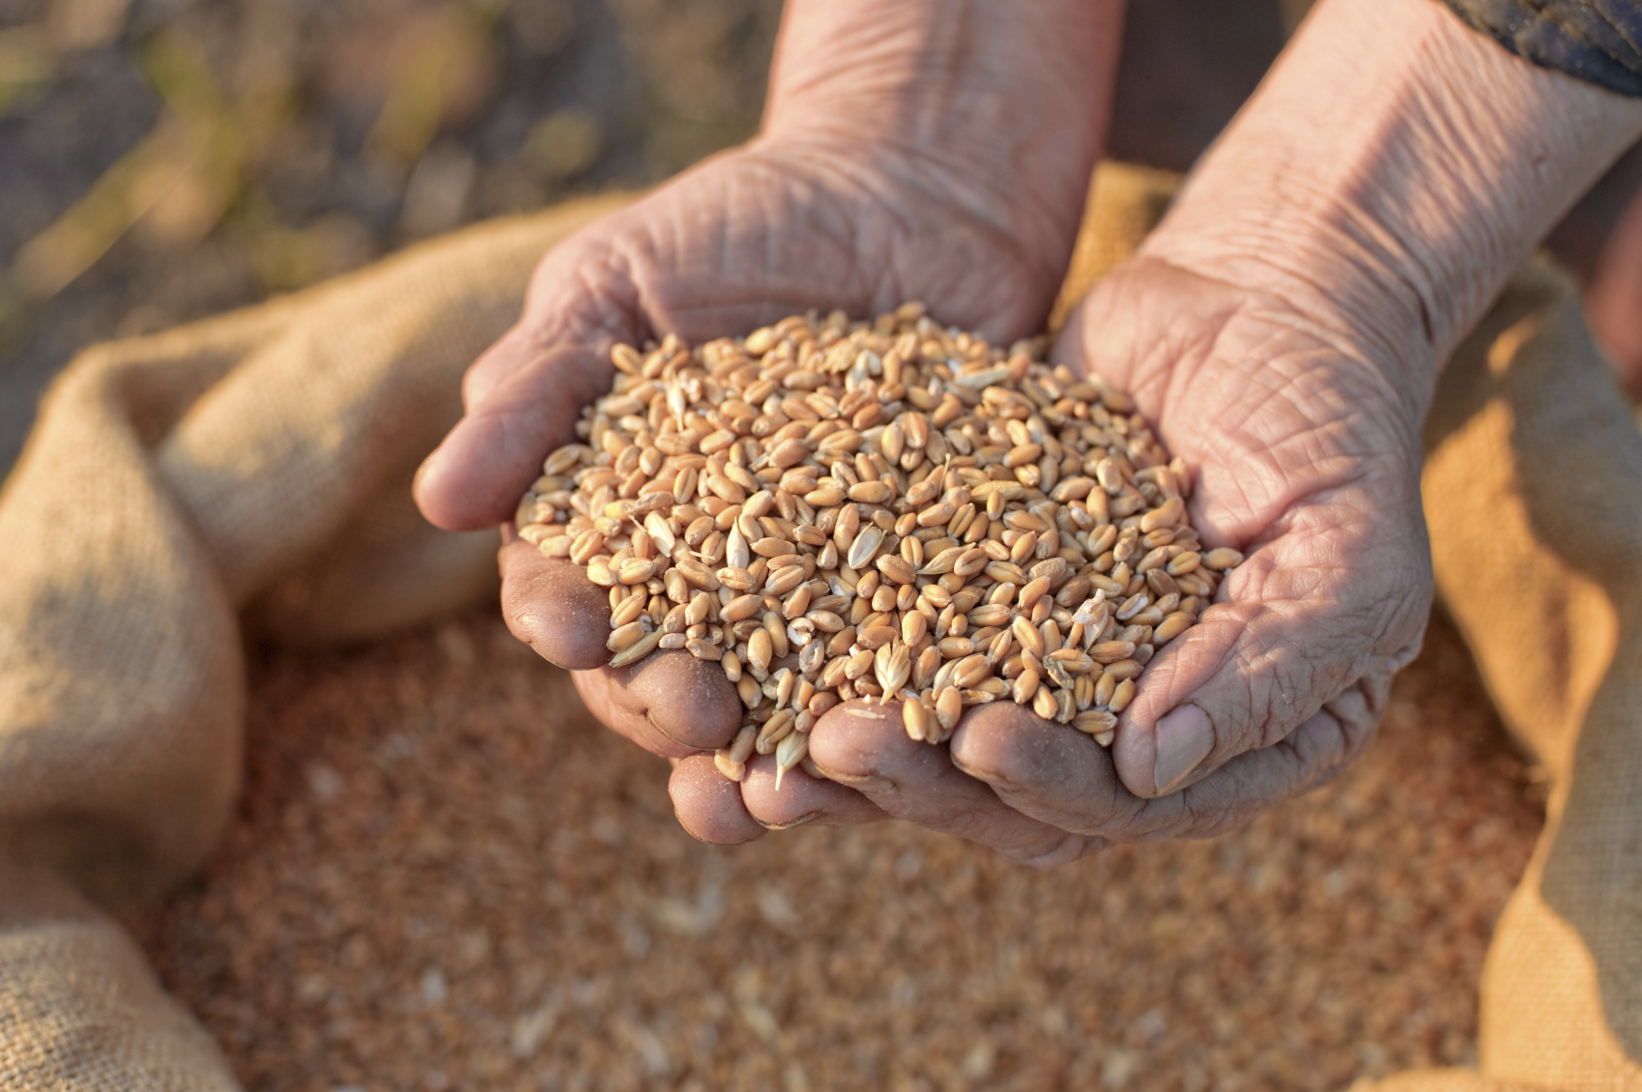
The importance of cereals
A ‘cereal’ means any grain that is used for food.
Cereals are some of the most important crops around the world, because they can be used to make staple foods such as bread, pasta and breakfast cereals.
Cereals include grains such as wheat, barley and rye.
Wheat is the most commonly grown cereal crop in the UK, with between 11 and 16 million tonnes grown each year.

Slide 3
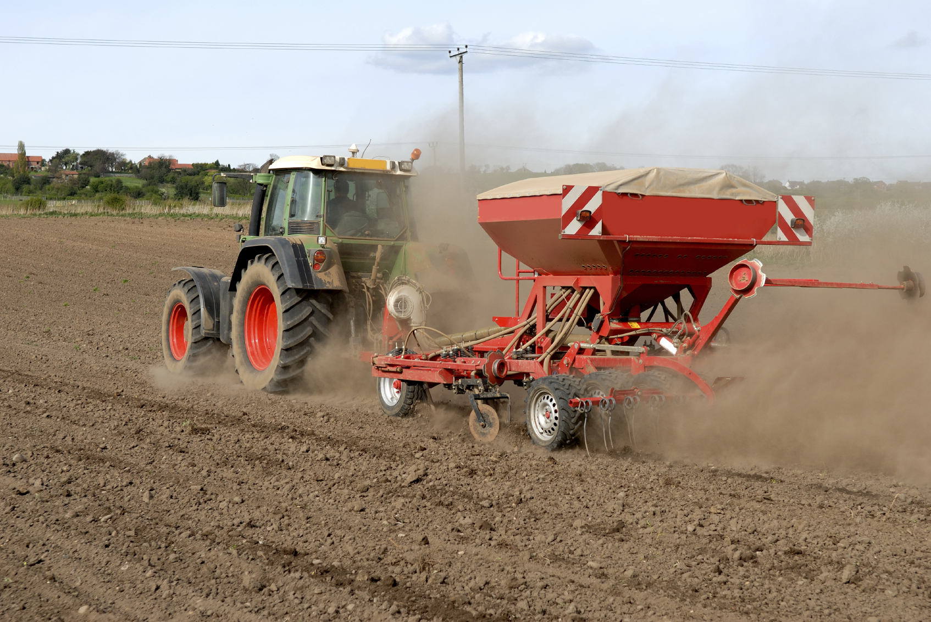
Planting the crop
Most wheat is ‘winter wheat’ and farmers usually plant it between September and November, before being harvested in late summer or early autumn of the following year.
Spring wheat grows quickly, and is planted in the spring and harvested in late summer or early autumn of the same year.
Barley and rye also have winter and spring varieties.

Slide 4
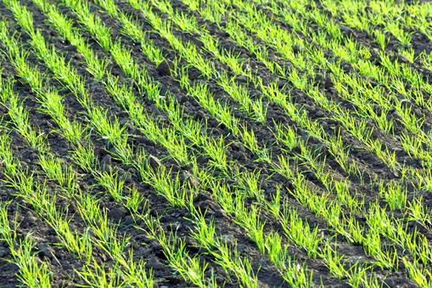
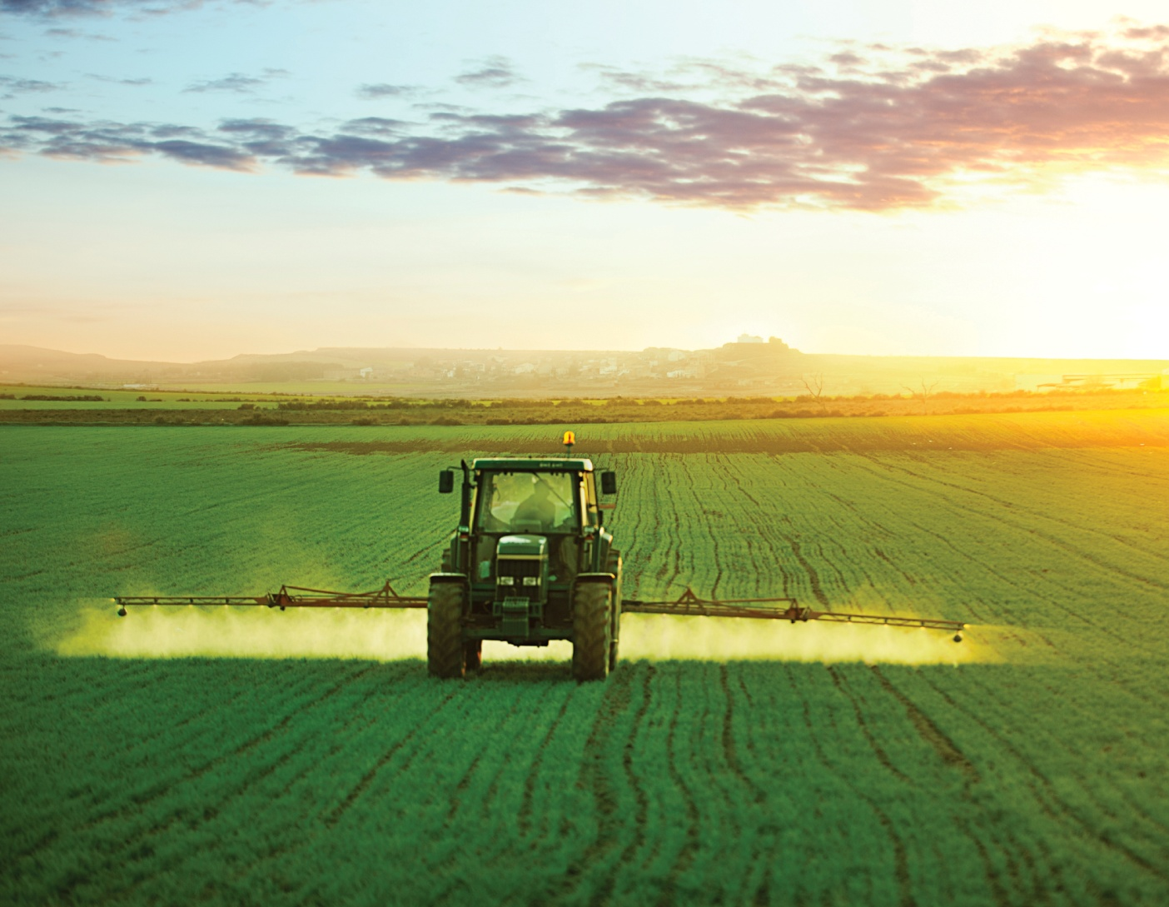
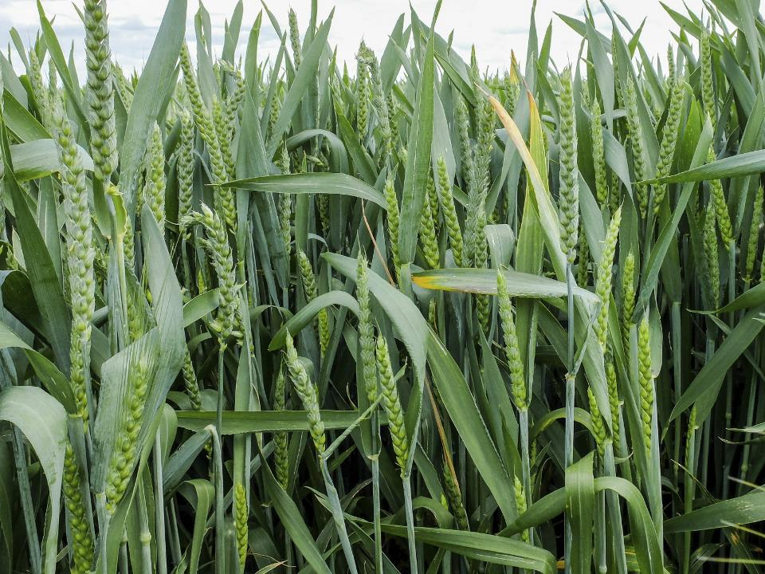
Growing
Spring wheat grows quickly, and is planted in the spring and harvested in late summer or early autumn of the same year.
Barley and rye also have winter and spring varieties.

Slide 5
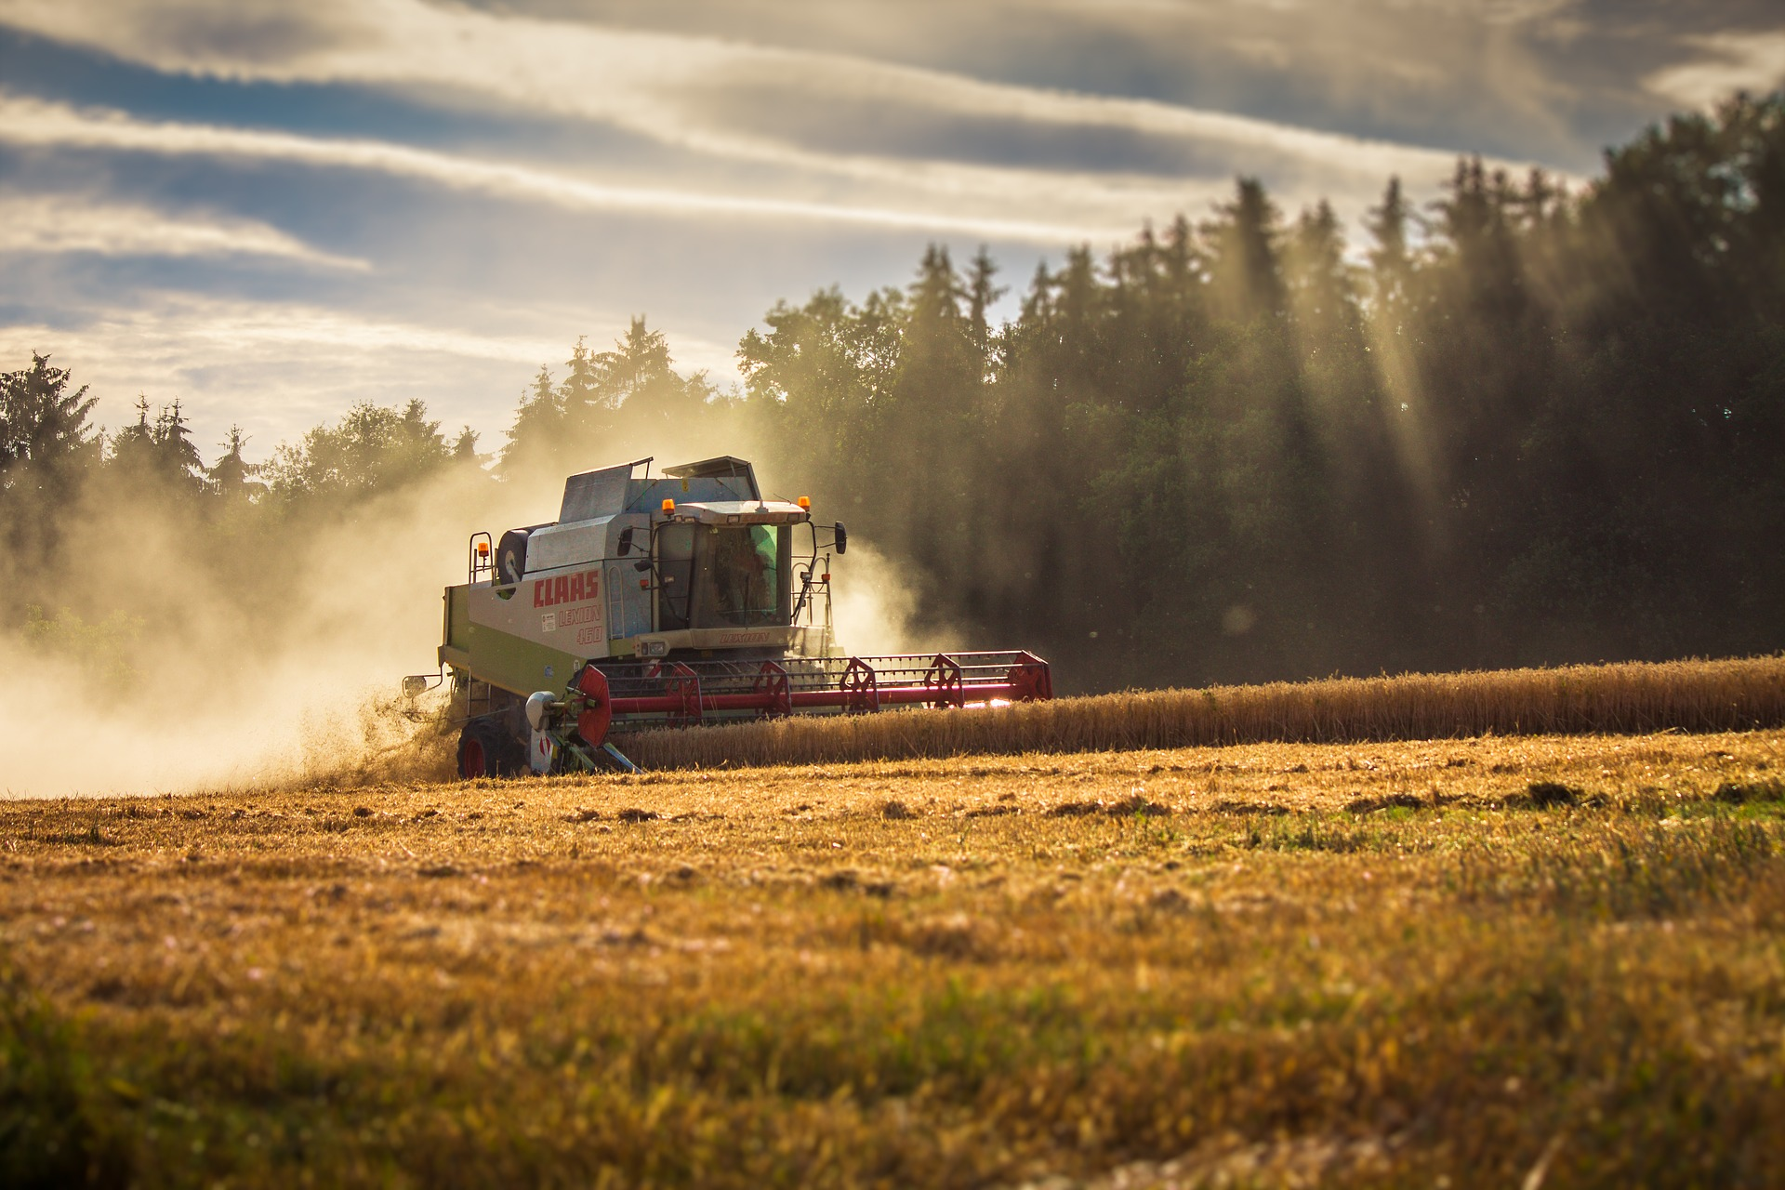
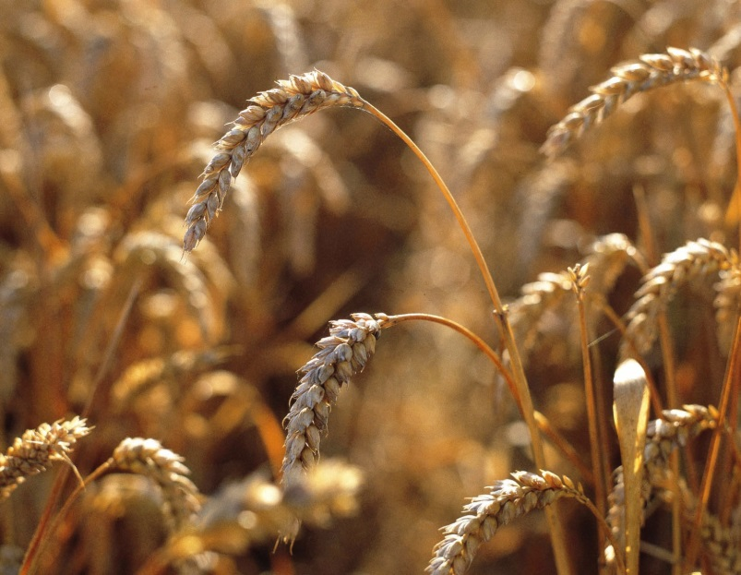
Harvesting the crop
The main cereal harvest takes place in late summer to early autumn. The harvest used to be performed by hand with sickles and scythes, but these days machinery has made the process far quicker and easier. A combine harvester can make short work of a field of wheat. Some can process over 500 tonnes in a day! The combine harvester also ‘threshes’ the grain, to separate the seed from the stalks and inedible outer casing.

Slide 6
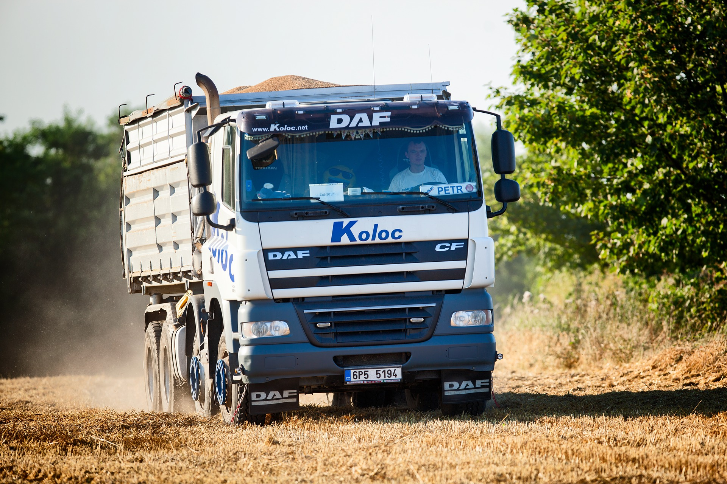
From field to mill
The grain needs to be transported, often to local mills, but sometimes to mills elsewhere in the country, or even abroad! Drivers transport the grains in large trucks directly to mills or to storage warehouses, where they can be kept until needed. Like all foods, proper storage of the grain is essential at all times. Grains also need to be kept safe from pests such as insects and rodents.

Slide 7
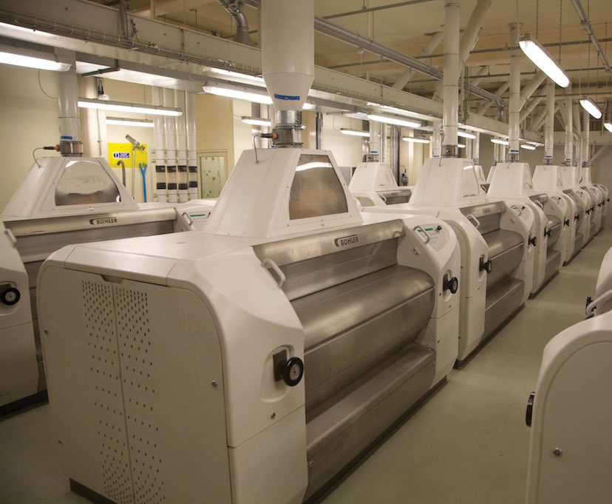
The milling process
Once a mill receives the grain, they can begin to turn it into flour. It is important that the millers produce a high quality product, otherwise the flour will fetch a low price, or even be rejected. This is why the modern milling process has several steps, all of which are important to produce a high quality, fit for purpose flour.

Slide 8
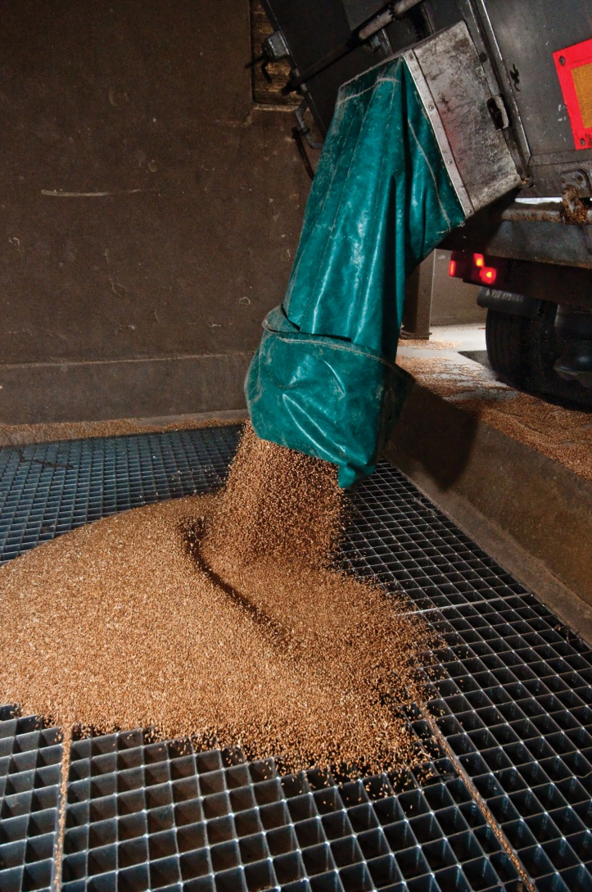
Cleaning and conditioning
Before grains can be milled into flour, they must be carefully cleaned. First, items like stones, pieces of metal and dirt are removed. The edible part of the grain is separated from the outer seed casing - the chaff, as this cannot be eaten by humans. Then, the grains are ‘conditioned’ with water, to soften them and make them easier to separate during milling.

Slide 9
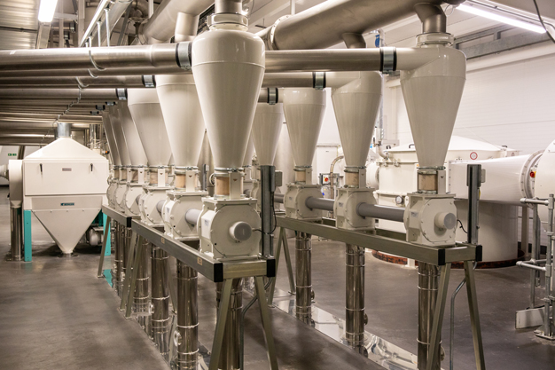
Gristing
During the gristing process, different kinds of grains are blended together.
Each unique blend produces flours that are suitable for different kinds of products. Wine producers also often blend different types of grape to get the best wine possible.
For example, flours which are higher in protein are more suitable for producing bread.

Slide 10
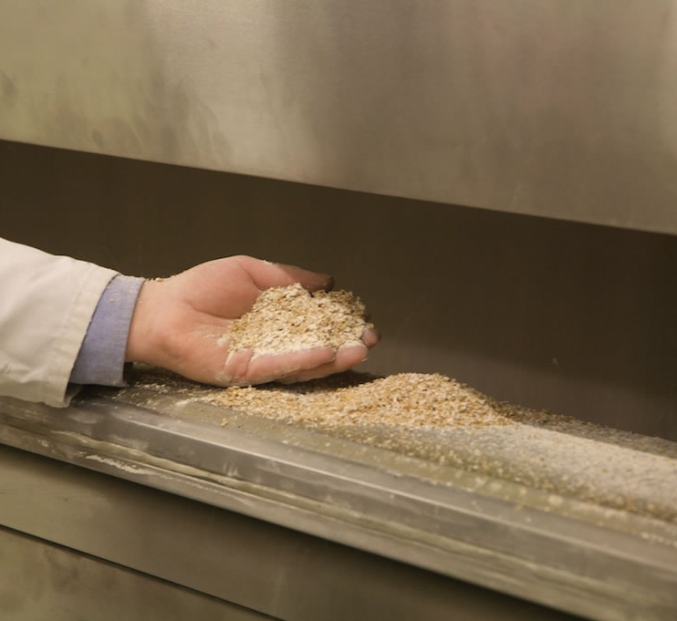
Breaking the grains
Next, the grains are broken apart by ‘break rollers’. These split the grain into three portions: the germ, the bran and the endosperm.
The endosperm is what is used to make white flour.
At this point the bran and some of the germ is separated out by sieving.

Slide 11
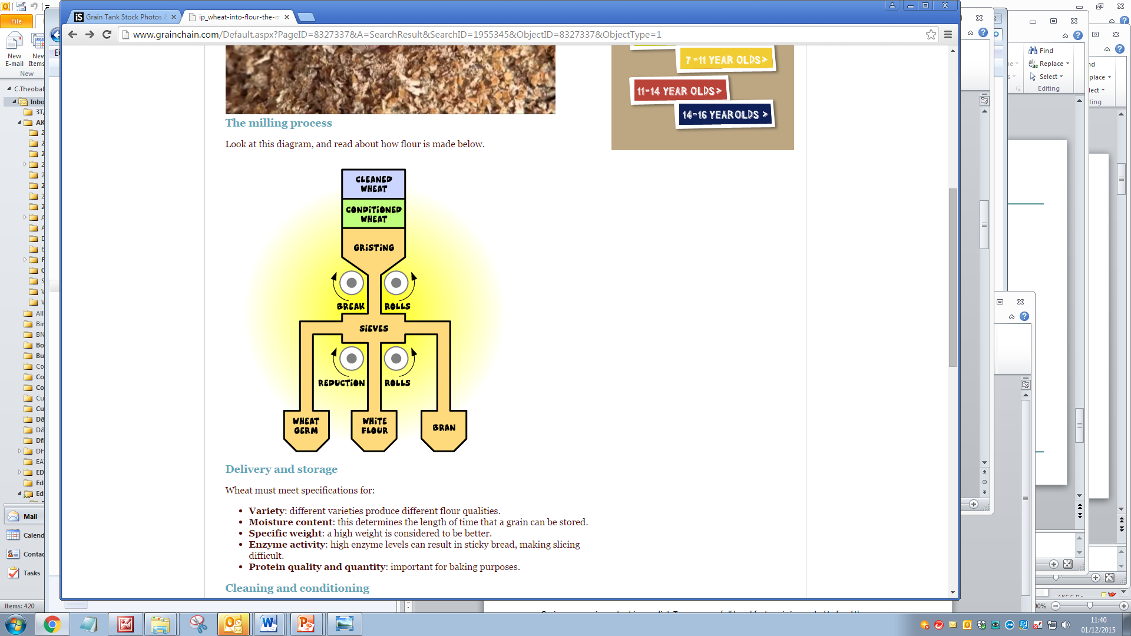
Reducing
The remaining separated parts of the grain now pass through ‘reduction rollers’, which grind the remaining pieces of grain into fine flour. Further sieving completes the separation of white flour from the other parts of the grain. At this point, white flour can either be used to make white bread or other ‘white’ products, or some bran and germ can be reintroduced. If all of the bran and germ are used, then the flour is wholegrain. if only some is used, then brown flour is made.

Slide 12
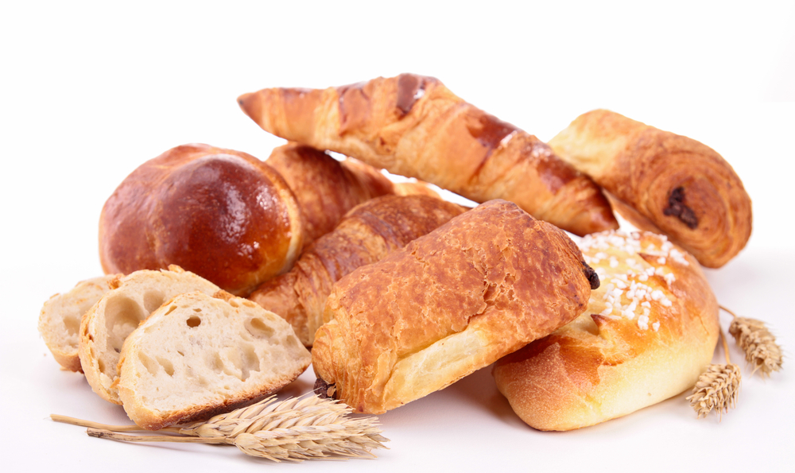
Uses of flour
After milling, flour can be made into a number of products, including breads, pastries, cakes, biscuits, pasta and more. Some mills use the flour they mill in their onsite bakeries, but most flour is transported for use elsewhere. Different kinds of flour are also sold directly in bags for use in home baking, or other cooking applications such as sauce making.

Slide 13
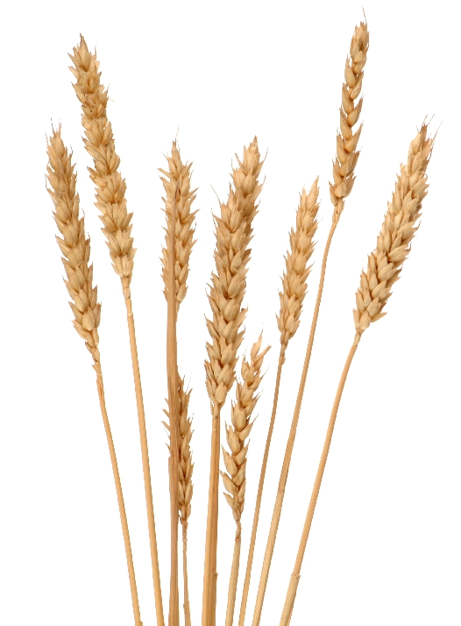
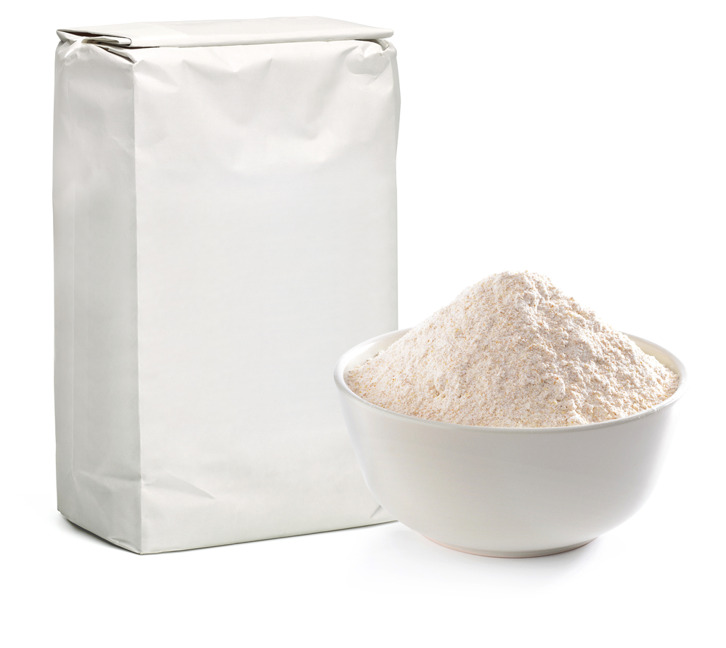
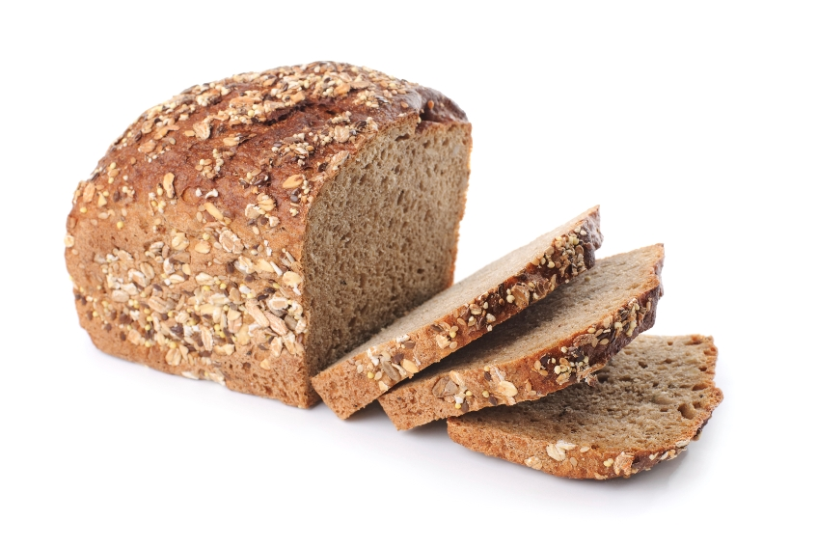
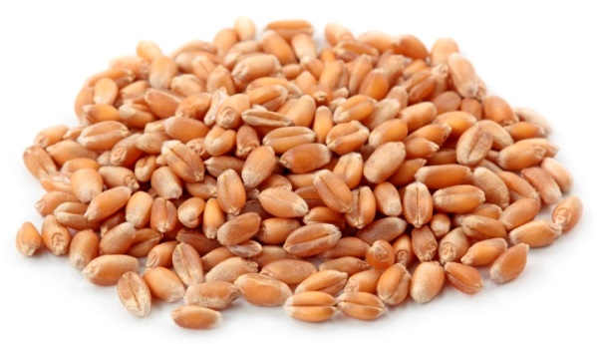
The grain’s journey
The journey from seed to flour involves many people to make sure everything goes smoothly:
Farmer – growing and harvesting
Driver – transporting the wheat to the mill
Miller – milling the wheat to flour
Baker – making and baking bread

Slide 14
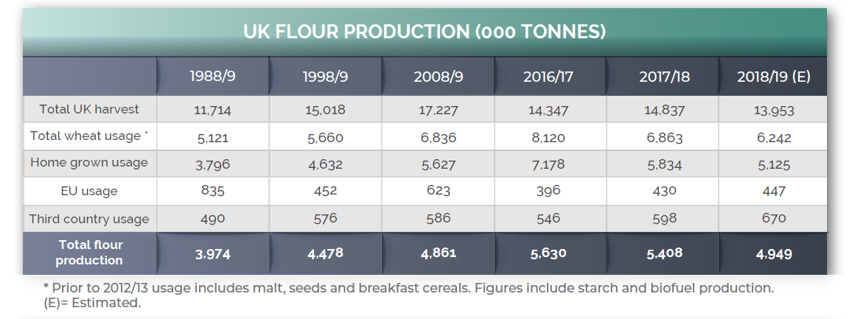
Milling – facts and figures!

Slide 15
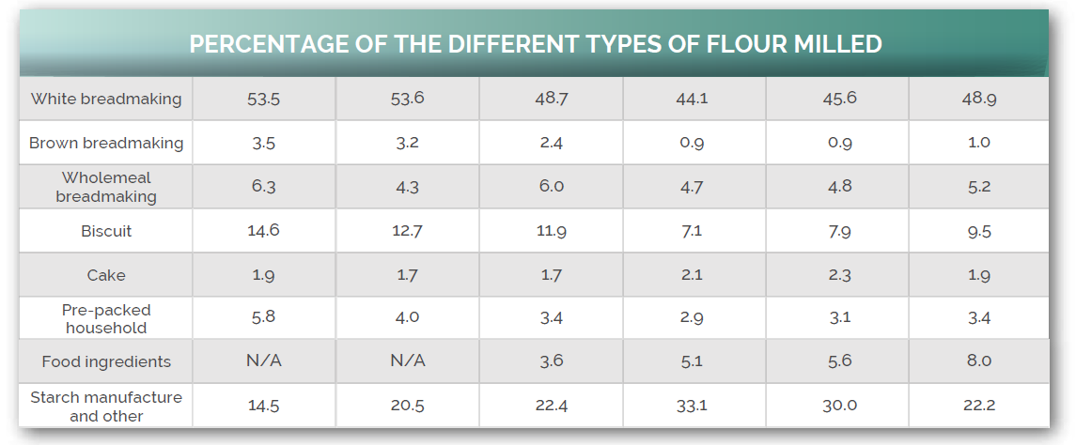
Milling – facts and figures!

Slide 16
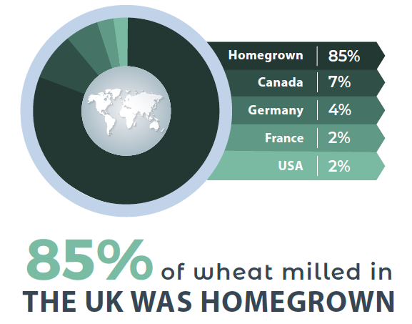
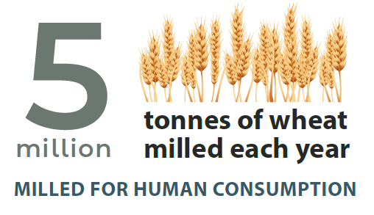
Milling – facts and figures!

Slide 17
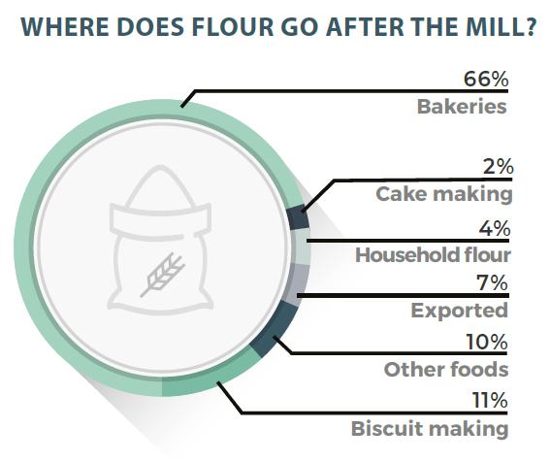
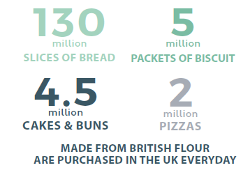
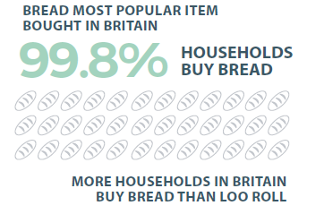
Milling – facts and figures!

Slide 18
The cereal harvest: from field to table
For further information, go to:
www.foodafactoflife.org.uk

