Slide 1
Milk processing

Slide 2
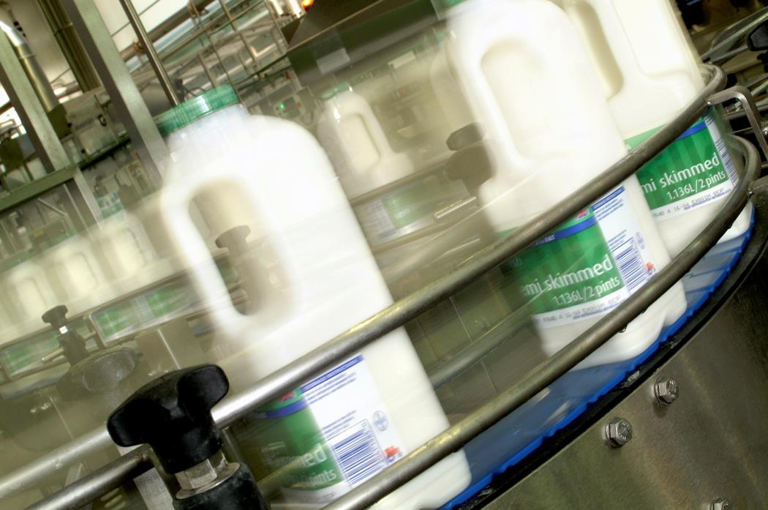
Objectives
To recall the key stages in milk processing.
To learn about primary milk processing.

Slide 3
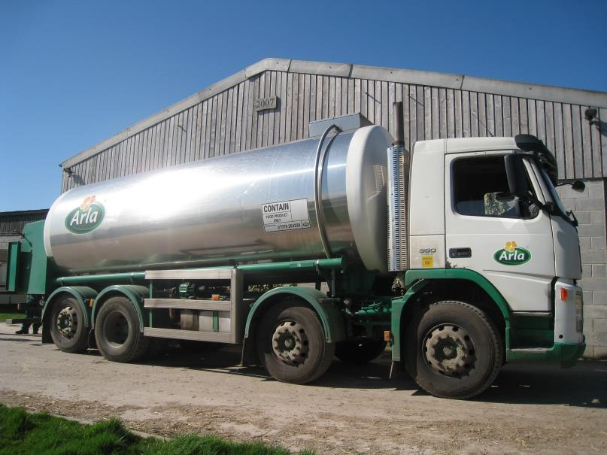
Primary milk processing
After the milk has been delivered from the dairy, it is pasteurised.
Pasteurisation is a process used to kill harmful microorganisms, such as certain pathogenic bacteria, yeasts and moulds, which may be present in the milk after initial collection.
This process extends the shelf life of milk.

Slide 4
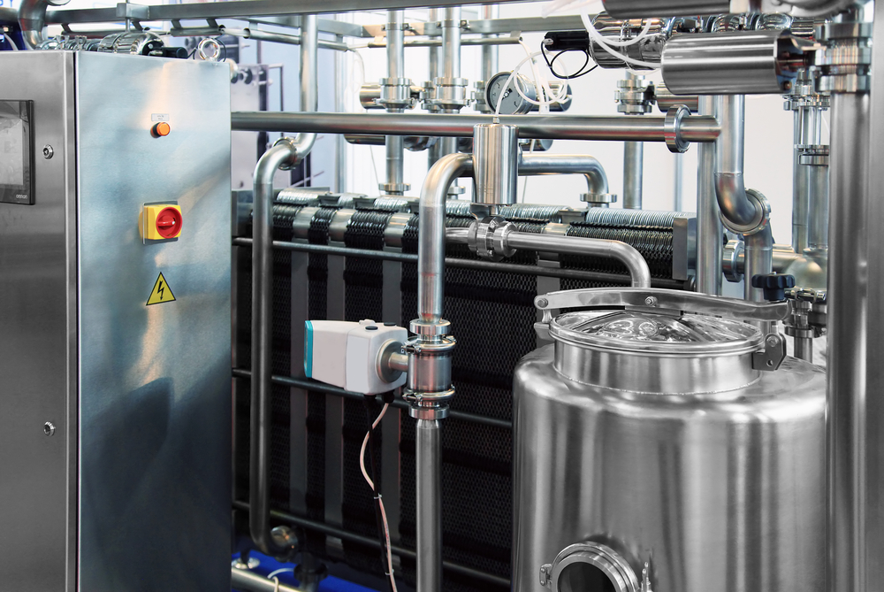
Pasteurisation
The basic process for whole milk involves heating the milk to a temperature of no less than 71.7ºC for 25 seconds.
This process is known as High Temperature Short Time (HTST).
The milk is then cooled for packing, storage and transportation.

Slide 5
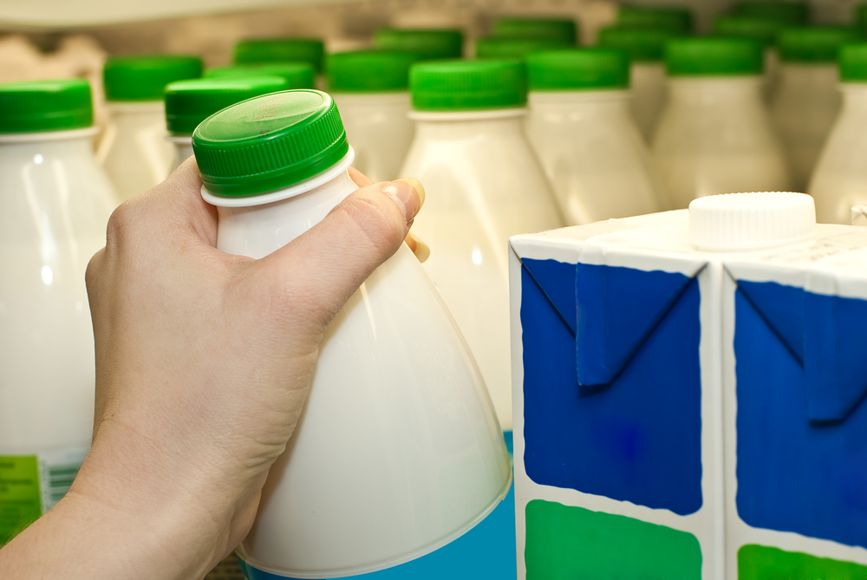
Packing
The milk is then packaged into bottles and labelled.
The packaging helps to increase the shelf-life of the milk.
The milk is then distributed to supermarkets and shops for sale.

Slide 6
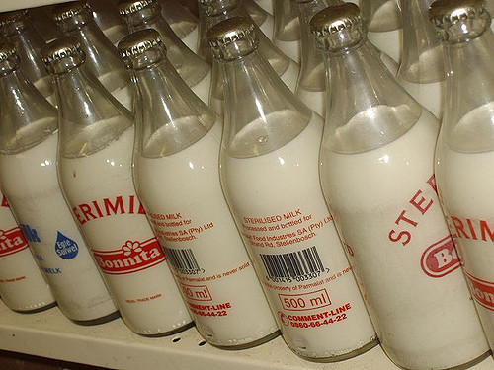
Sterilisation
This process uses a temperature in excess of 100ºC in order to destroy nearly all micro-organisms present in a food. This is important as some micro-organisms can form spores which have the ability to survive at high temperatures.
The product is packed in air-tight containers either before or after heat treatment.
Sterilising enables milk to be kept for 2-3 weeks unopened, but results in a burnt, caramelised flavour and browning.

Slide 7
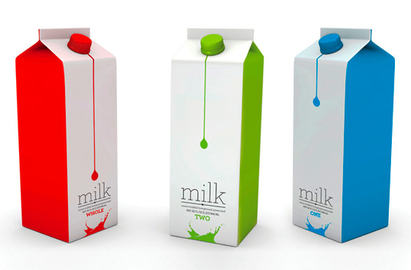
Ultra heat treated (UHT)
UHT is a continuous process and the product is packaged after treatment into sterile containers. Typical temperatures and times specified for UHT treatment of milk are 130º C – 150º C for 1-3 seconds.
As the product is moving continuously, rather than being stationary, high temperatures can be reached resulting in fewer chemical changes, but having the same sterilising effect.
UHT treatment was developed to destroy all micro-organisms without causing as much damage to the product as sterilisation. Milk may taste cooked and will be slightly brown in colour.

Slide 8
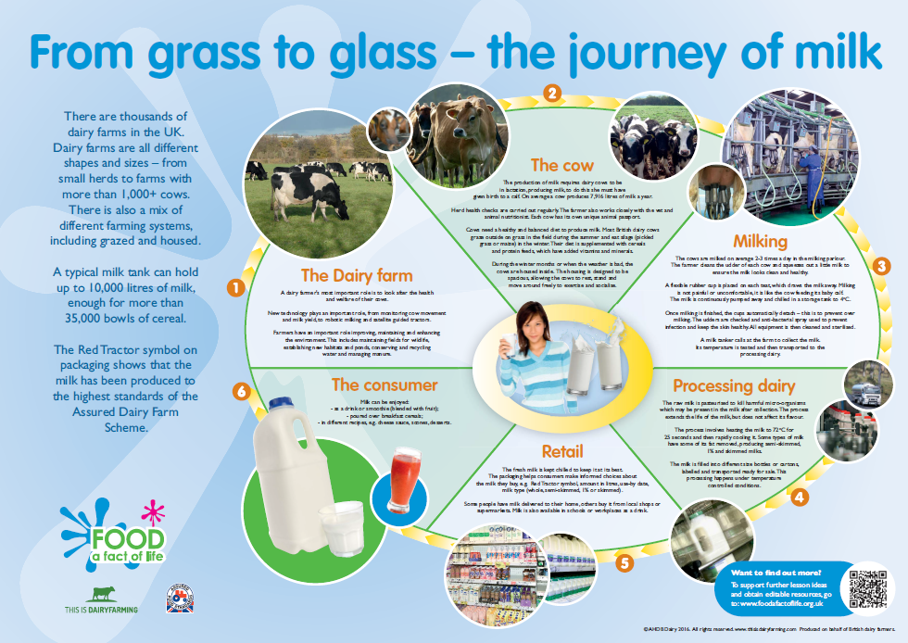
Find out more about milk
To find out more about milk, access the From grass to glass – the journey of milk poster.

Slide 9
For further information, go to:
www.foodafactoflife.org.uk

