Slide 1




‘Skill-a-long’ – an interactive food skills session (bread)
06/10/20

Slide 2
Resources

Slide 3
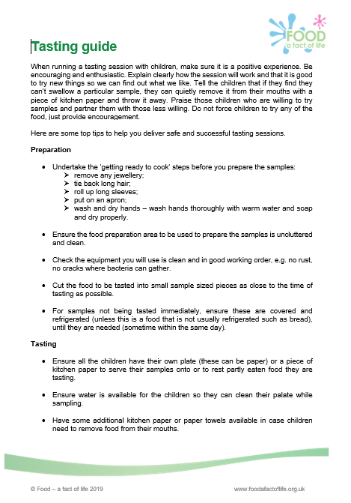
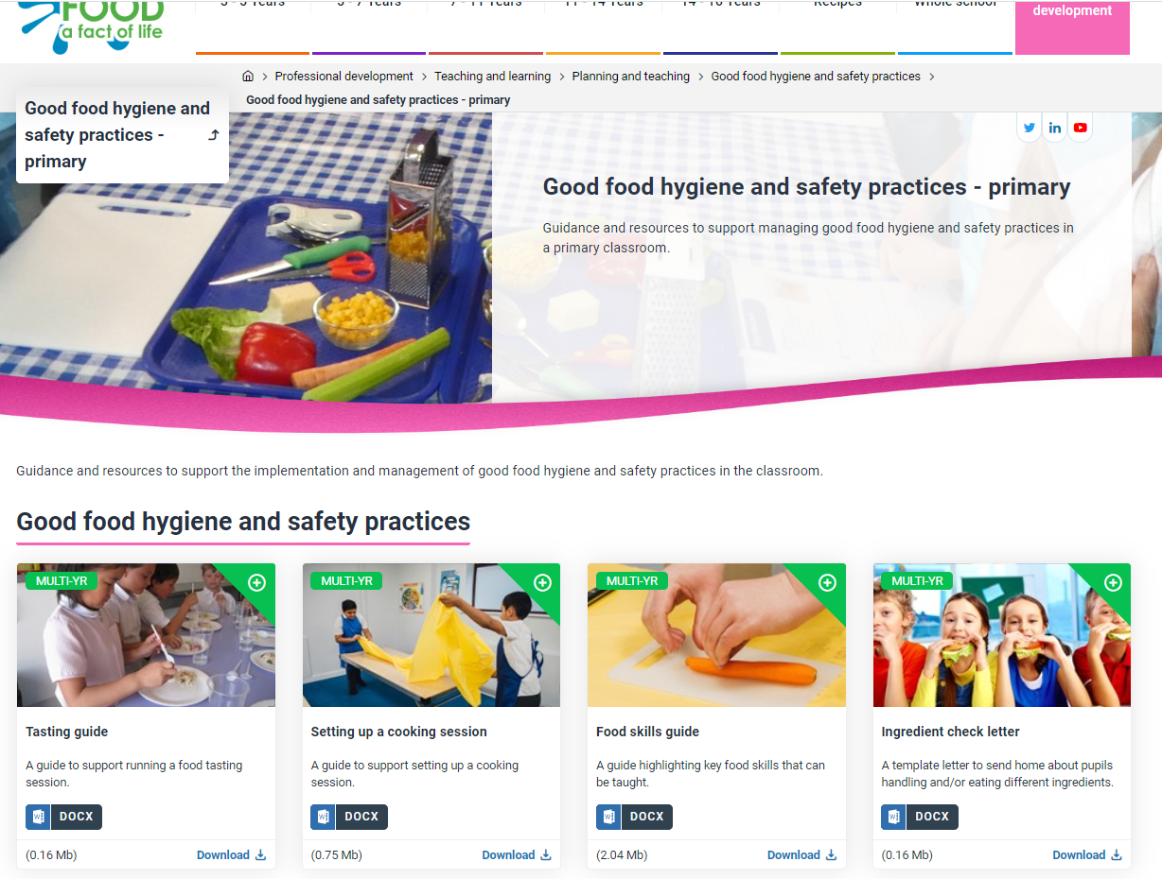
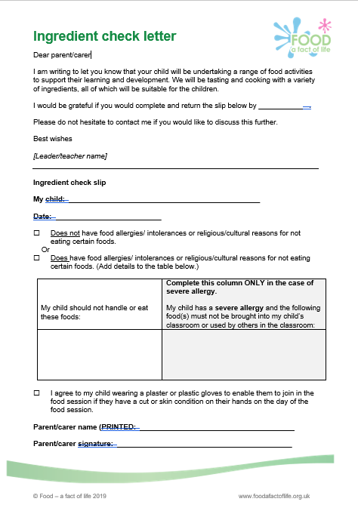
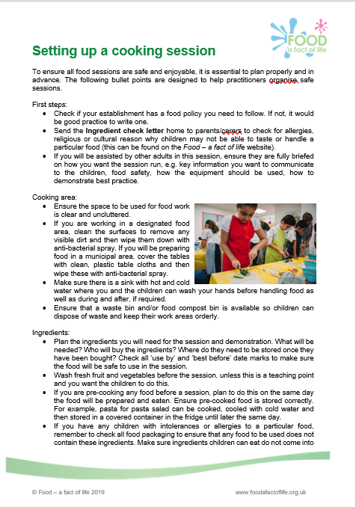
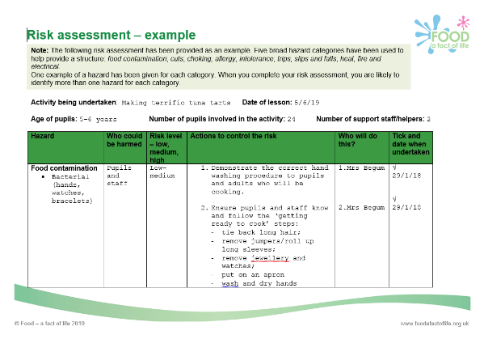
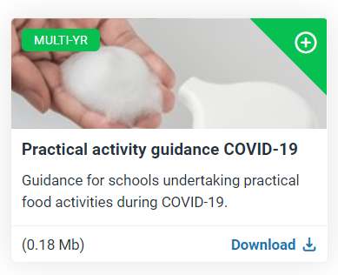
Cooking resources
To find these resources: Professional development > Teaching and learning > Planning and teaching > Good food hygiene and safety practices
For document providing guidance during COVID-19, click here.

Slide 4
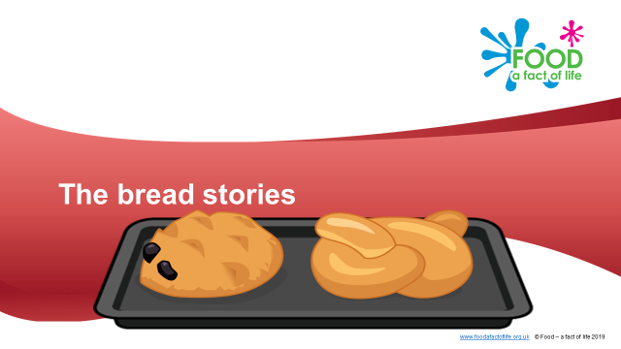
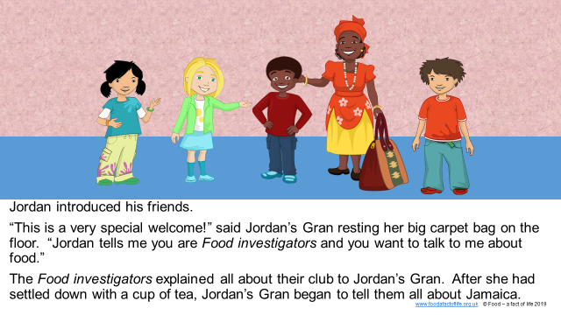
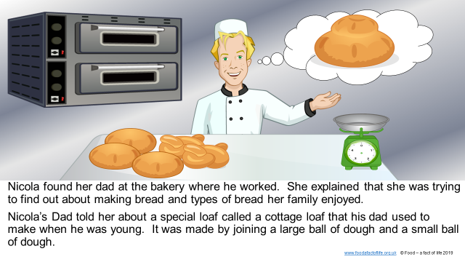
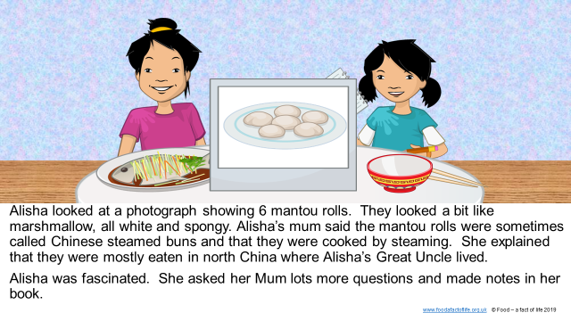
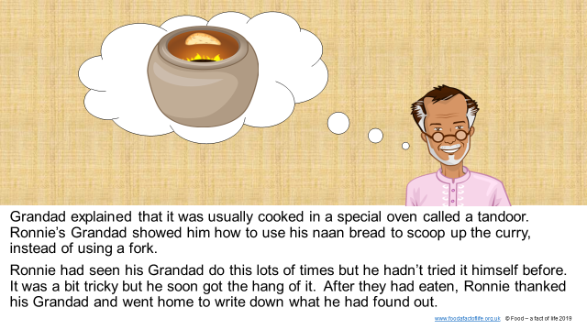
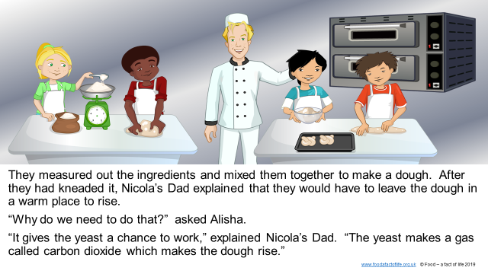
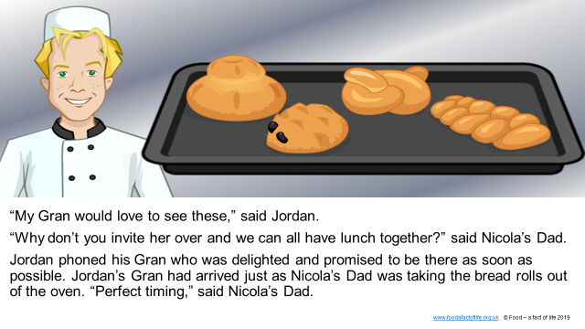
Learn with stories – The bread stories
Stories connecting where food comes from, cooking and healthy eating
Provide a ‘jumping off’ point for topics
Supplemented with activities to support cross-curricular learning, e.g. numeracy, literacy
To find these resources: 5-7 or 7-11 > Activity packs > Learn with stories (The bread stories )

Slide 5
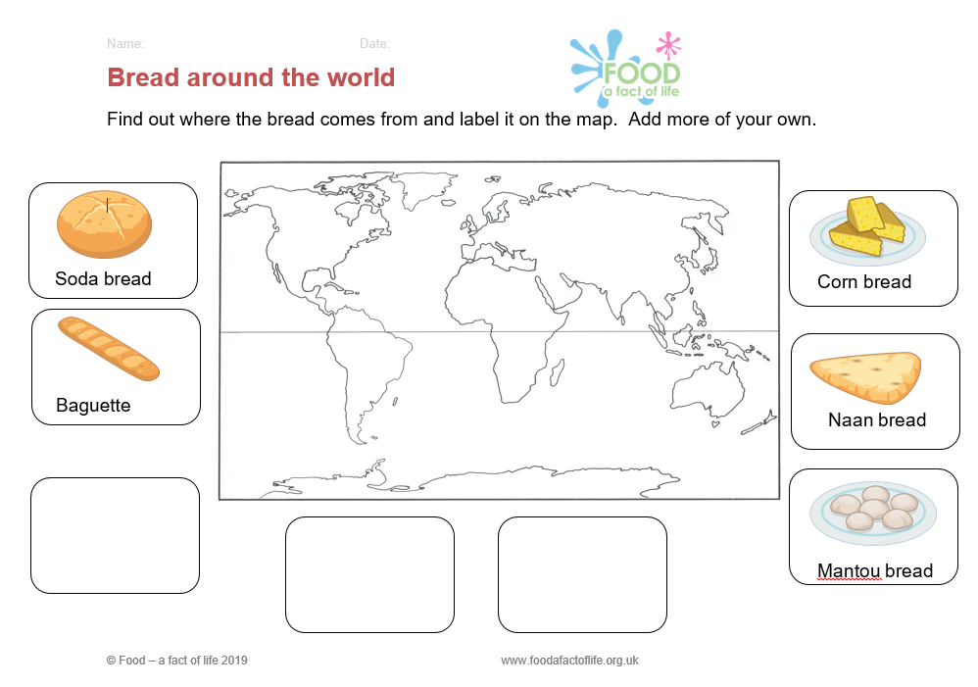
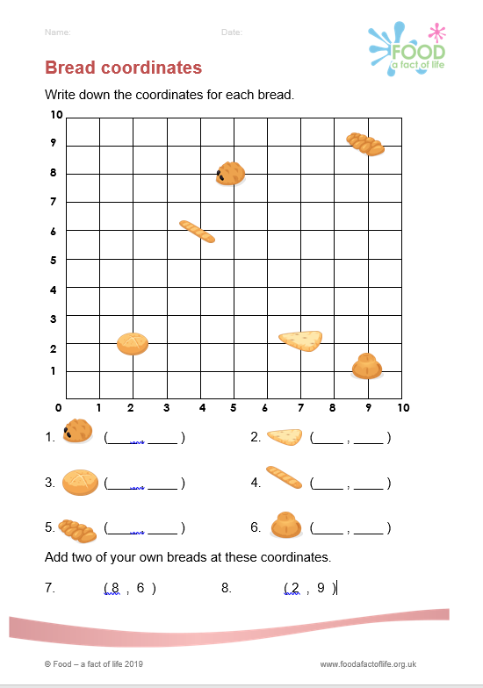
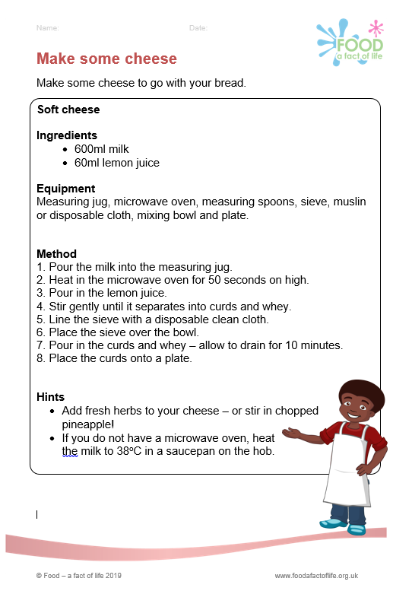
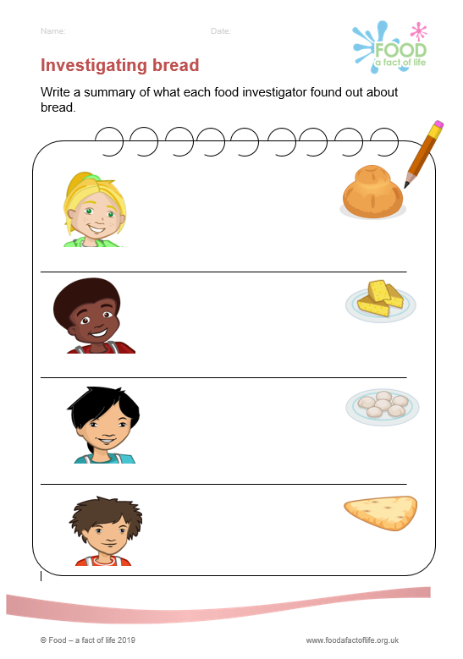
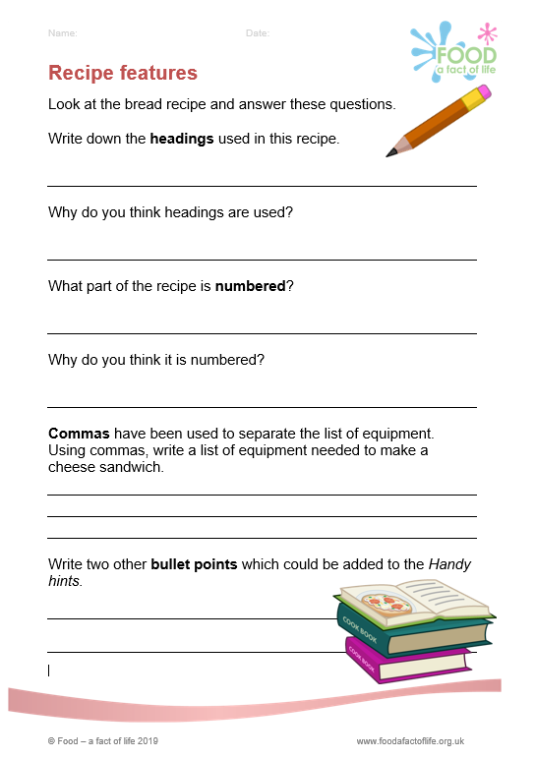
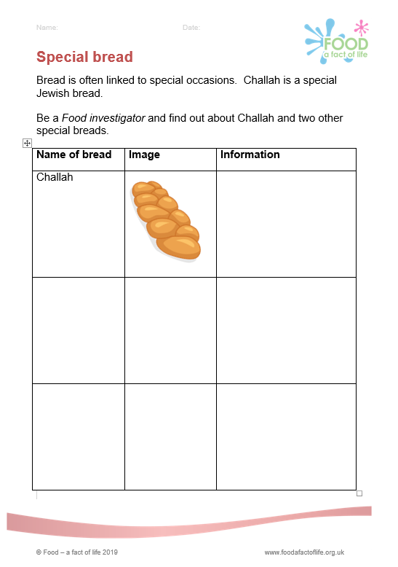

The bread stories- supplementary resources
To find these resources: 7-11 > Activity packs > Learn with stories (The bread stories )

Slide 6
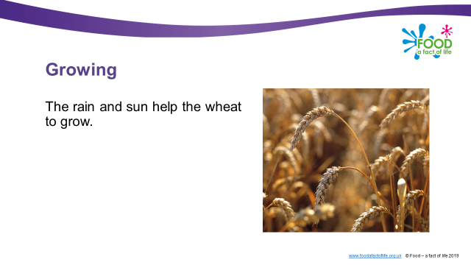
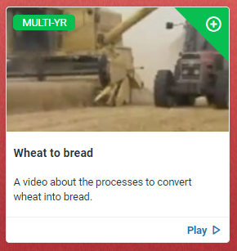
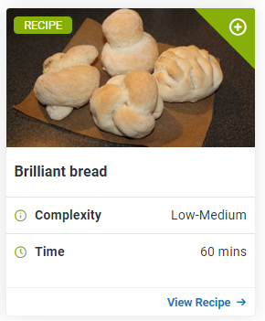
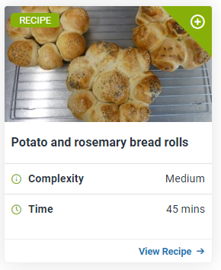
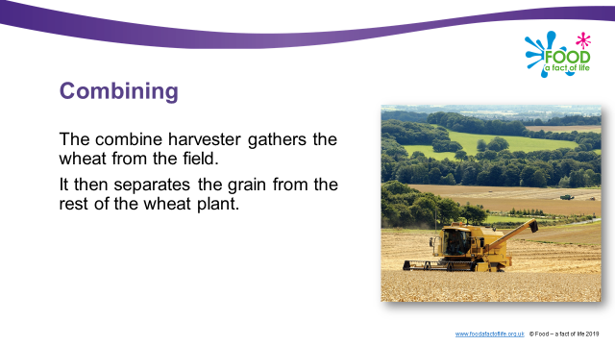
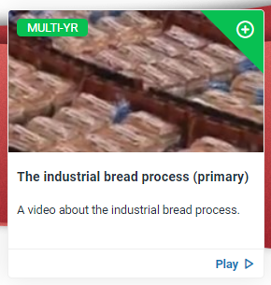
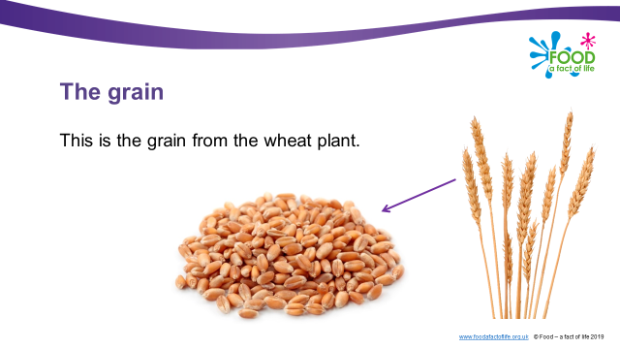
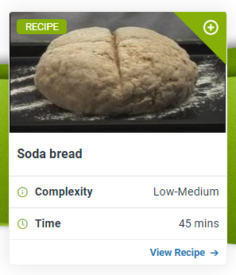
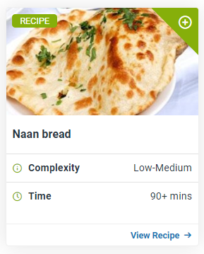
Videos, recipes and presentations
Presentations
Videos
Bread recipes
5-7 or 7-11 > Food commodities > Cereals (5-7 and 7-11)
7-11 > Where food comes from > Videos (Videos)
Recipes (Use the search function).

Slide 7
New – primary Knowledge organisers!
What is the purpose of FFL's Knowledge organisers?
Pupils:
To provide pupils with key facts and what they should know and can do at each age phase.
To provide an opportunity to learn, check and extend knowledge.
To develop key subject specific vocabulary/terminology.
Teaching staff:
To provide an outline of knowledge and skills that should be taught at each age phase.
To provide consistency between teaching colleagues in the same school or group of schools.
To support new, less-experienced and non-specialist teachers.
To save teachers time and reduce workload.
The Knowledge organisers demonstrate progression in key knowledge and skills throughout the age phases.

Slide 8
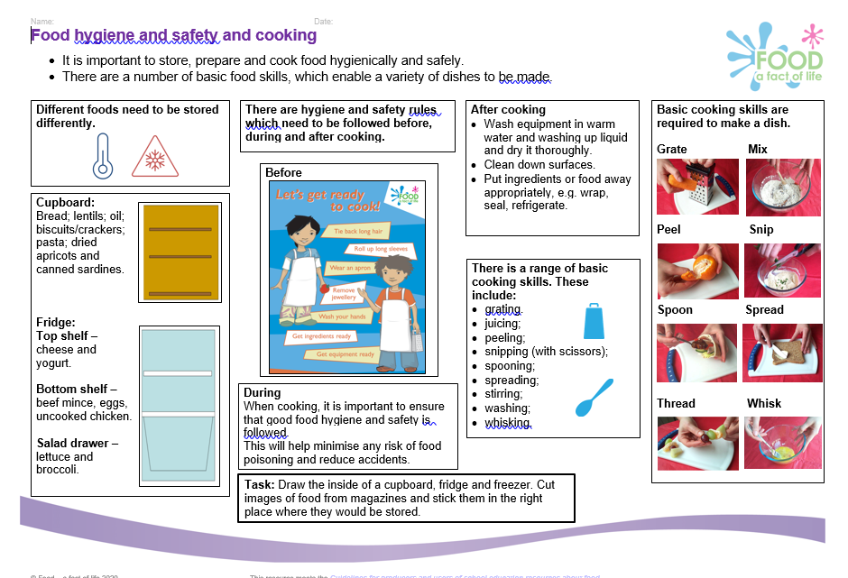
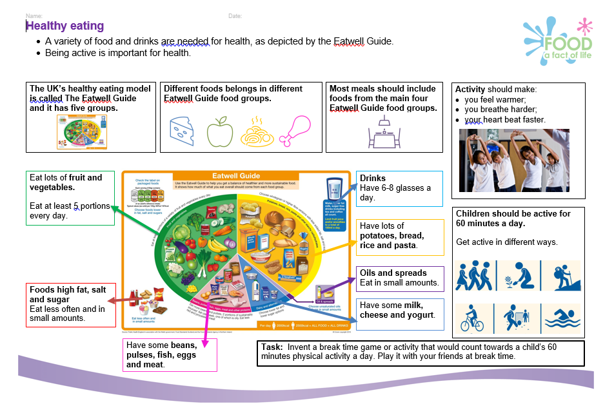
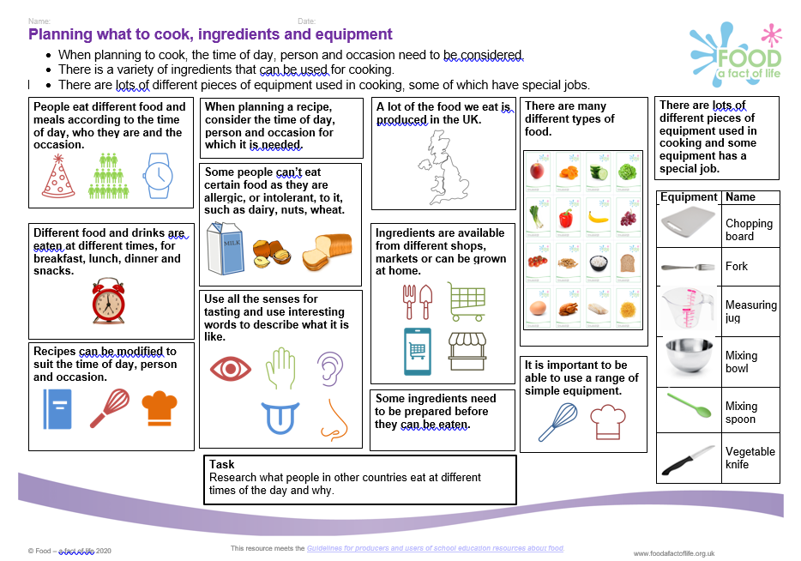
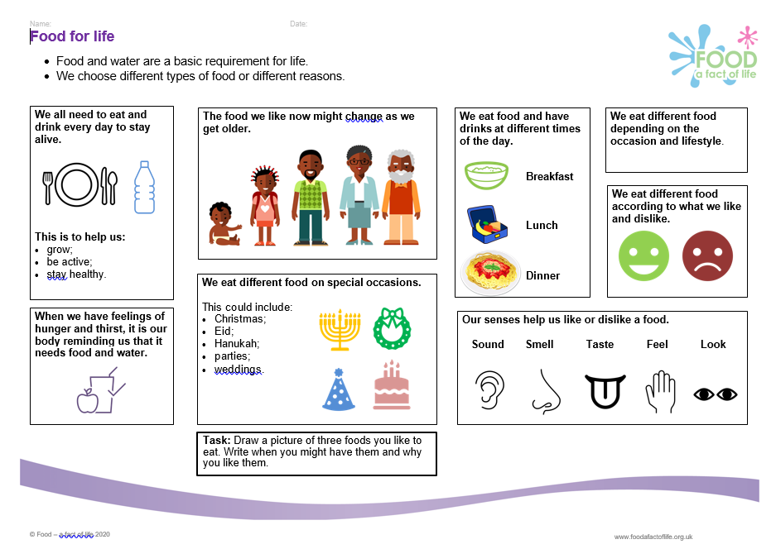
Knowledge organisers – 5-7 Years
Knowledge organisers – 5-7 Years

Slide 9
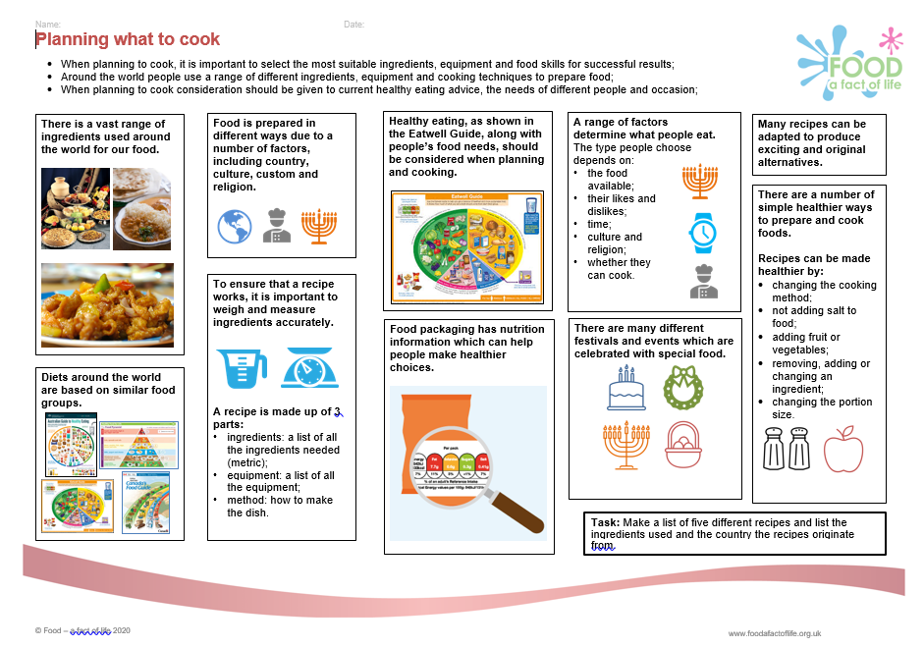
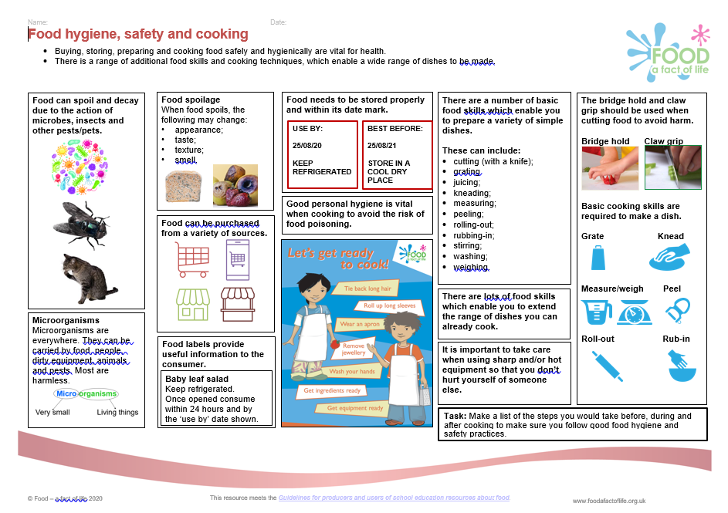
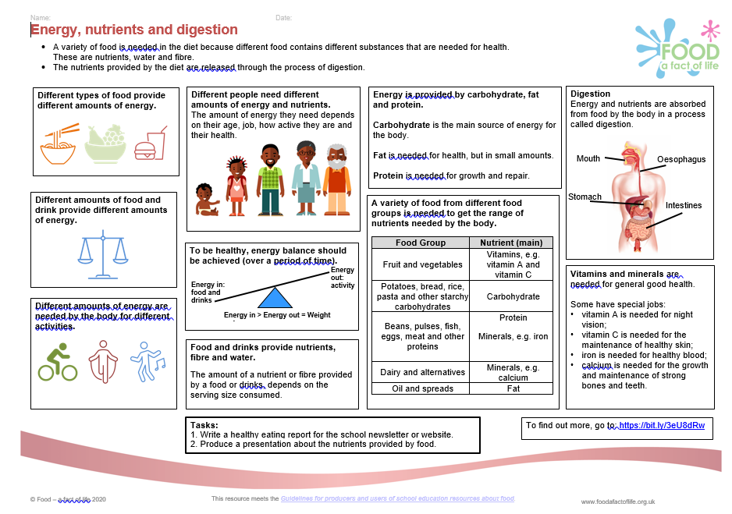
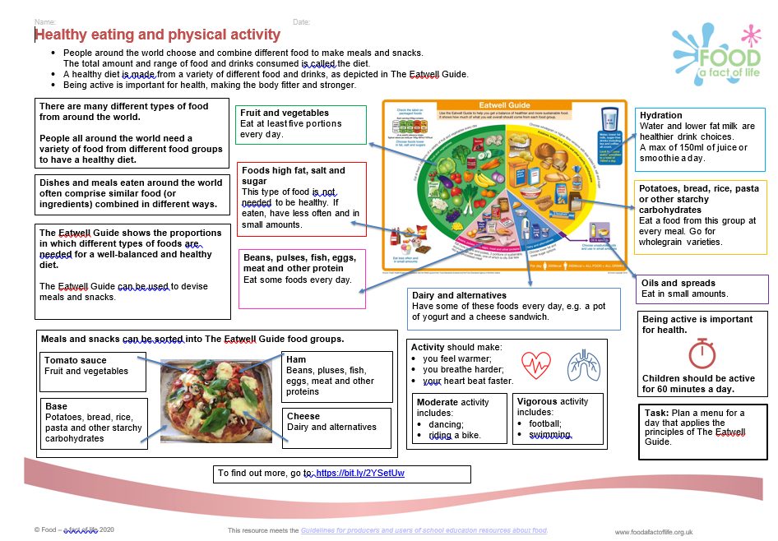
Knowledge organisers – 7-11 Years
Knowledge organisers – 7-11 Years

Slide 10
Skill-a-long – an interactive food skills session (bread)
For further information, go to:
www.foodafactoflife.org.uk

