Slide 1
Consumer food choice

Slide 2
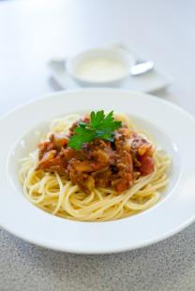
Quick starter activity
Think about what you had for your evening meal last night.
What aspects influenced your choice?
For example:
hunger;
time;
accessibility;
price.

Slide 3
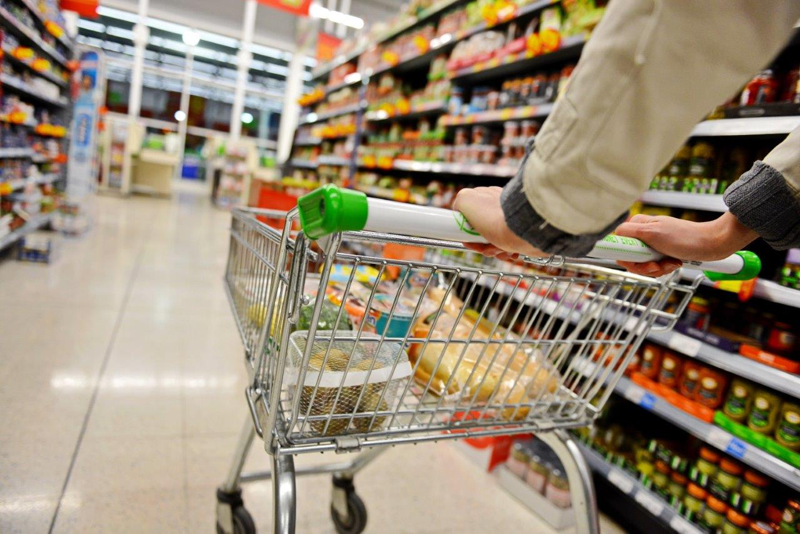
Factors affecting food choice
All around the world, people choose to eat different food for many different reasons, such as:
food preferences;
time of day and occasion;
diet and health;
religion and culture;
cost of food;
social and economic considerations;
environmental considerations;
advertising and other point of sale information.

Slide 4
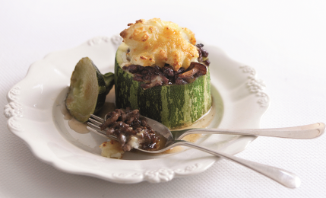


Likes and dislikes?
Not everyone likes the same food.
The taste, odour, appearance, shape and colour of food can affect people in different ways.

Slide 5
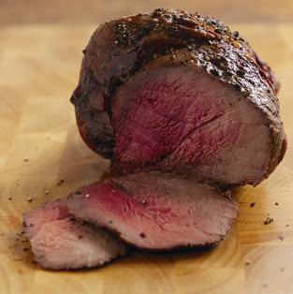
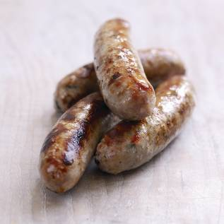
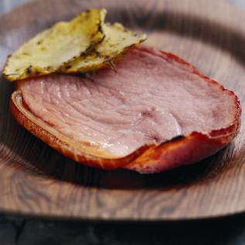
Quantity
How could the quantity of food affect choice?
Consider which consumers this might impact.

Slide 6
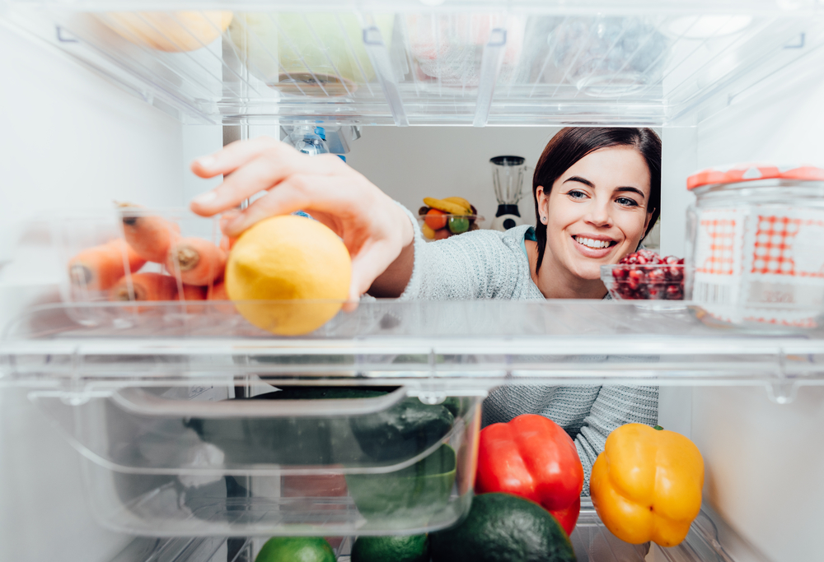
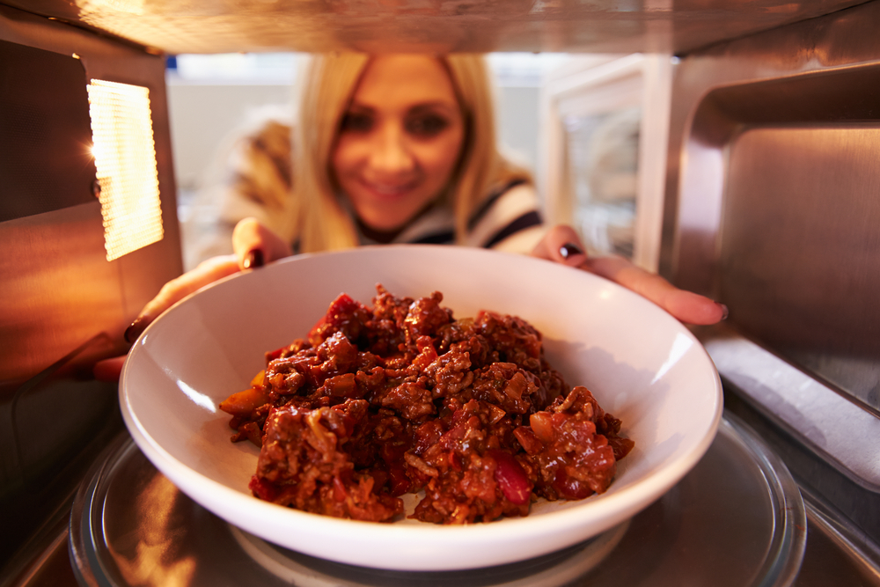
Social and economic considerations
Lack of competence and confidence in the kitchen – people may choose to buy ready made, frozen or dried foods that are easy to prepare and cook and that require only basic cooking skills.
Lack of time – many people work long hours and either haven’t got the time or do not wish to spend time cooking at home.
Development of ready meals – because people lack time and have labour saving equipment (such as microwaves) the amount and range of convenience foods has grown.
Smaller households – an increasing number of people now live alone and this may well affect their food choices.

Slide 7
Social and economic considerations
Body image and peer pressure can both influence the food that people choose to buy, cook and eat.
A balanced diet, together with regular physical activity, can help to maintain a healthy weight. Eating the right balance of a wide range of foods provides most people with the energy and nutrients that they need to stay healthy.

Slide 8
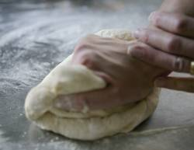
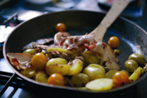

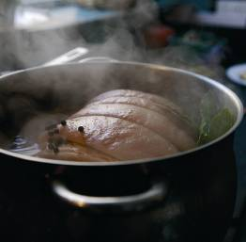
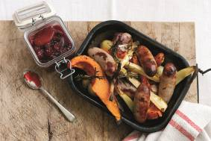

Cooking equipment and practical skills
How could cooking equipment and practical skills affect food choice?

Slide 9

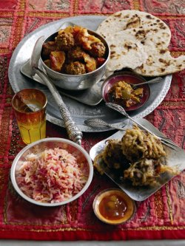


Culture and religion
Food is an important part of religious observance for many different religions.
Religions which have particular food restrictions or celebrations involving food include:
Christianity;
Islam;
Hinduism;
Judaism;
Sikhism;
Buddhism;
Seventh-day Adventist Church;
Rastafari Movement.

Slide 10
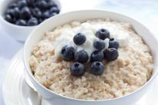


Time of day and occasion
The time of day will influence food choice – people may not eat the same for breakfast as they would for their main meal of the day.
The occasion will also impact on food choice – this could be a celebration such as a birthday or wedding or maybe a religious occasion such as Christmas or Passover.

Slide 11

Healthy eating
The amount of energy and nutrients needed differs between age groups and between males and females. Energy needs also depend on activity levels.
People may choose the food they eat based on their own or their family’s health and well being. This could include: Diabetes, allergies, e.g. nuts, intolerances, e.g. gluten or lactose, Vegetarian, Vegan and Weight loss or gain.

Slide 12
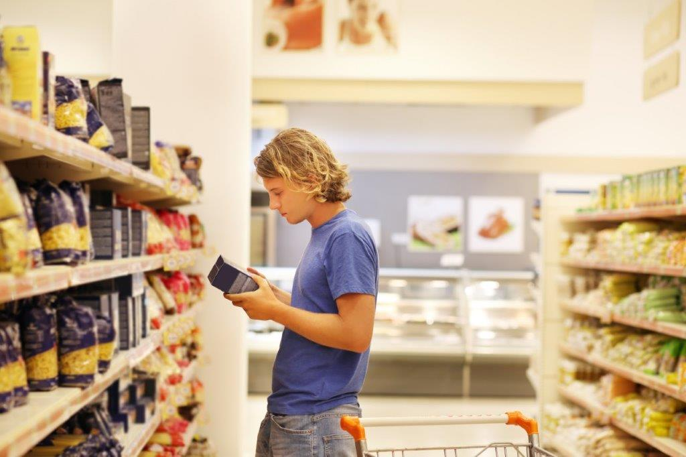
Cost
The cost of food and money available will influence people’s food choices.
If money is limited, people may choose to buy more basic items. Luxury items might then used for special occasions.
According to Family Food Statistics published by the Department for Environment, Food and Rural Affairs in February 2016, households spend 11% of their income on food.

Slide 13
Environmental and ethical considerations
Local foods – buying locally supports local business and farmers
Seasonal food – this can be fresher, tastier and more nutritious than out of season food.
Genetically modified (GM) food – scientific intervention is used to change a plant, animal or micro-organism’s genes or to insert one gene from another organism.
Organic food – food sold as ‘organic’ must come from growers, processors and importers who are registered and approved by organic certification bodies, which are shown on the food label.
Free range – animals are allowed to roam freely outside. This food may be more expensive.
Local food – some believe that food produced locally is more sustainable.

Slide 14


Food provenance
Red Tractor: Red Tractor assurance standards for a range of food encompass food safety, animal welfare, environmental protection and traceability. The basic welfare needs of animals must not be compromised at any stage of their lives and farmers must ensure that their farming practices do not damage the environment.
Protected Geographical Indication (PGI): Products which must be produced, processed or prepared within the geographical area and have a reputation, features or certain qualities attributable to that area.

Slide 15


Food provenance
Beef and Lamb Assurance Schemes
The Quality Standard Mark Scheme for beef and lamb provides one of the highest levels of independently-inspected quality assurance for meat in the United Kingdom.
Northern Ireland Beef and Lamb Farm Quality
The Northern Ireland Beef & Lamb Farm Quality Assurance Scheme was developed to give consumers assurances about the farm end of the production chain of their food.

Slide 16
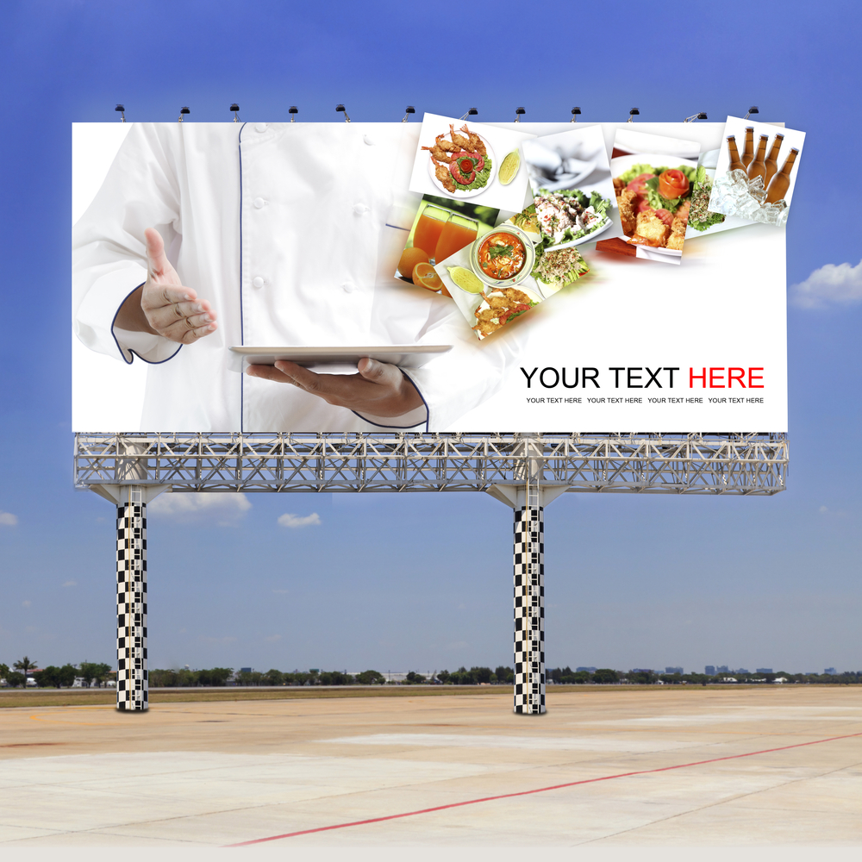
Advertising and other point of sale information
Advertisements encouraging people to choose certain foods often appear in the media.
Point of purchase information and product placement are strategies often used to provide information to consumers.

Slide 17
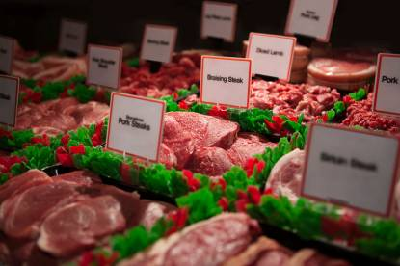
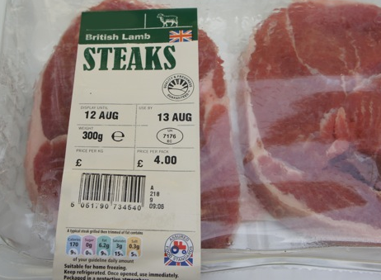
Food labels
Labels give consumers useful and essential information, as well as to help sell products. They can be attractive and eye-catching, and can advertise special features about the product, such as ‘extra lean’ or ‘low fat’.
Information is provided on packaging of food products to help consumers choose between different foods, brands and flavours. In addition, there is a legal requirement for much of the information that is often provided.

Slide 18
For further information, go to:
www.foodafactoflife.org.uk

