Slide 1
Meat and the consumer

Slide 2
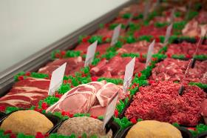
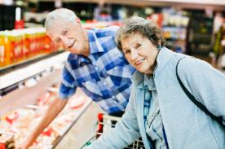
Introduction
A consumer is the user or buyer of a service or product. A retailer is the person or organisation who sells goods to the public from premises such as shops and supermarkets.
Meat is a food commodity sold by retailers to consumers.
Most consumers have particular likes and dislikes. Retailers offer consumers a range of products to choose from.

Slide 3
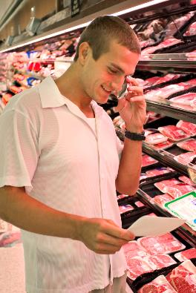
Consumer decisions and choices
Consumers therefore have to make decisions and choices such as:
what they want to buy and why;
which product will best meet their needs.

Slide 4
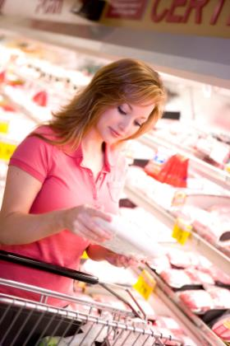
Buying meat
Some of the decision and choices about buying meat have already been made for the consumer by the supermarket buyers and butchers.
When a consumer buys meat they will have a range of types of meat and cuts to choose from.
There are many decisions for the consumer to make about which cut is the right one from them and their particular needs.

Slide 5
Choosing meat
Considerations when choosing red meat.
Cut of meat If the meat comes from muscle which has been used a lot, then it will need longer, moist cooking. | Cost Some cuts of meat are more expensive than others. Look out for seasonal offers or promotions.
Amount of lean, fat and bone Consumers need to look for meat which provides value for money and little waste. | Quality Consumers use their senses to judge the quality of meat. Industry standard labels also help to inform the consumer.
Portion size When buying ready prepared meat, consumers need to assess how much lean meat they are buying. | Fresh, wrapped, chilled and frozen Consumers need to decide how mat should be stored.
Presentation Consumers can select from lean, well-trimmed cuts, added-value lines and continental style cuts. | Convenience Some meat cuts do not need any preparation, saving time for the consumer. Ready-meals also offer a fast solution.

Slide 6
Consumer considerations
Some considerations for deciding the cut of meat include:
Likes and dislikes? Taste preference is different. What tastes do people prefer? What tastes do other people who may be sharing the meal prefer? | Culture and religion Some people do not eat certain types of meat. Has the animal been slaughtered in a certain way?
Quantity Are they buying for 1 person or many? What is the portion size? | Money How much can people afford?
Recipe How does the meat need to be prepared and cooked? | Practical skills Does the cook have the skills to prepare and cook the meat?
Time How much time is available? Some cuts can be purchased to save preparation time. | Cooking equipment Does the cook have the cooking equipment necessary? Oven? Hob? Grill? Microwave?
Storage Will the meat have to be prepared and cooked straight away? Can it be stored safely? | Healthy eating Some cuts are carefully trimmed to make them extra lean. Is the consumer looking for leaner cuts?

Slide 7

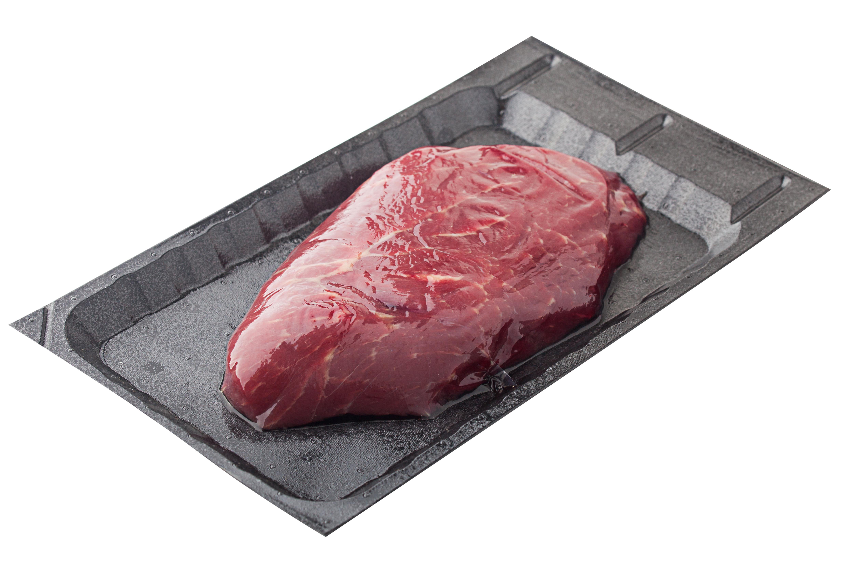
Factors influencing consumer product choice
£
1. Quality
2. Pack size
3. Price and promotions
Three of the top attributes consumers say are important in their purchase decision.
Source: IGD ShopperVista Category benchmark research, 2018, base 3,600 UK supermarket shoppers

Slide 8
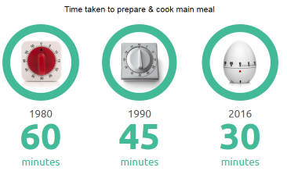
Continued drive for convenience
A continued drive by consumers for convenience and ways to save time has led to:
the time taken to cook and prepare main meals reducing;
increased consumer searches for quicker convenient meals;
meals plans and products that fit well with this proving popular;
an increase of convenience themed products.
Source: ONS/Kantar Worldpanel Usage

Slide 9
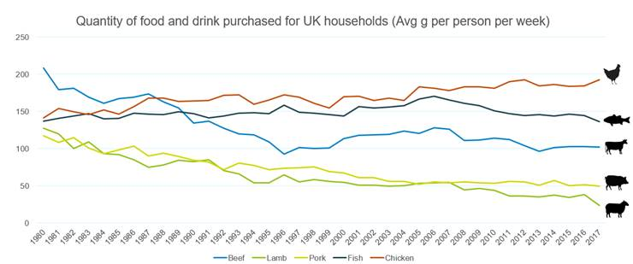
Long term consumer behaviour is impacting the amount of and type of food consumed
This chart shows that the UK consumption of a number of commodities has declined in recent years.
Results from the Family Food Survey show that ready meals and convenience meat products are popular with a highest ever estimate of 170g per person per week purchased in 2016/17.
Family Food Survey

Slide 10
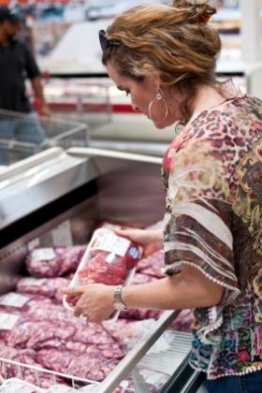
Where to buy meat
Consumers need to think about where to buy meat. A variety of retail shops sell meat, e.g. butcher, supermarket and farm shop.
Consumers need to be aware of the advantages and disadvantages of purchasing meat from different types of retail outlets.

Slide 11
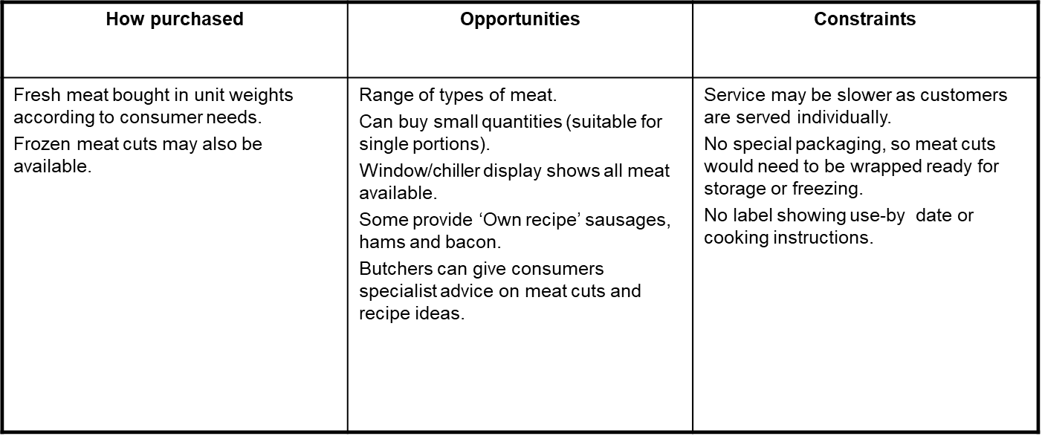
A butcher/farm shop

Slide 12
Supermarket
How purchased | Opportunities | Constraints
Wide variety of meat cuts sold ready packaged and priced. Some stores/chains have butchers available. | Good variety of fresh/pre-packed and frozen meat cuts. Self-selection – allows consumers to browse and choose in own time. Sold in portion amounts and family packs. Weight and price displayed. Labelling provided. Selection of ‘added-value’ packs available. One-stop shopping, consumer can buy other foods. | Extra packing and preparation may mean more expense. No individual service (expect for stores with a butcher service). Pack sizes may be larger than required, e.g. not single portions.

Slide 13
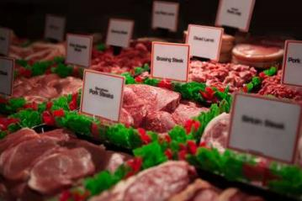
Labels on meat
Labels give consumers useful and essential information, as well as to help sell products. They can be attractive and eye-catching, and can advertise special features about the product, such as ‘extra lean’ or ‘low fat’.
Information is provided on packaging of food products to help consumers choose between different foods, brands and flavours. In addition, there is a legal requirement for much of the information that is often provided.

Slide 14
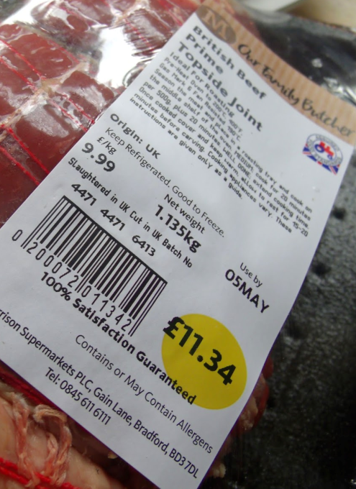

What does the meat label tell us?
Country of slaughter (site approval number)
Country of origin
Handling information
Accreditation
Product safety information
Born/Reared
UK 6413
EC
Traceability
The product can be traced back to its last place of processing and audits identify where its been farmed or produced.
Slaughtered
Cutting location

Slide 15
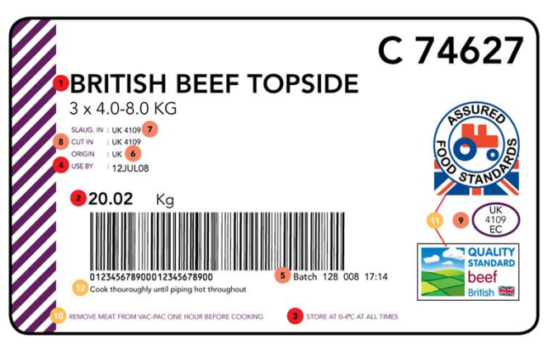


What is required on meat packaging by law?
1 Product description/cut
2 Product weight
3 Storage temperature
4 Use by date (best before if frozen)
• Supplier name (on outer packaging, not label)
• Supplier address (on outer packaging, not label)
11
5 Batch number or traceability code
6 Country of origin
7 Country of slaughter/slaughterhouse approval number
8 Country of cutting/cutting plant approval number
9 Country of packing/packing plant number
Additional information (not required by law)
10 Handling information
11 Accreditation scheme mark
12 Product safety information

Slide 16
General food labelling – legal requirements
Manufacturers include a range of information on food labels. Some of which is legally required and some of which is useful to the consumer or supermarket.
The following eight pieces of information must appear by law on food labels
name of food or drink;
list of ingredients (including additives and allergens);
weight or volume;
date mark;
storage and preparation conditions;
name and address of the manufacturer, packer or seller;
country of origin and place of provenance;
nutrition information*.

Slide 17
General food labelling – not legally required
Manufacturers might also include other information that would be useful to the consumer or supermarket. This might include:
front-of-pack nutrition information*;
price;
customer guarantee;
serving suggestion;
photograph or image of the food;
bar code.
*Front of pack nutrition information is voluntary but if a food business chooses to provide this additional declaration, only the following information may be provided:
energy only;
energy along with fat, saturates, sugar and salt.

Slide 18
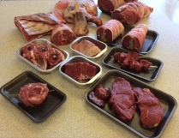
Food labelling – food sold loose
Food sold loose does not require a list of ingredients and date and storage conditions.
Loose food which has been genetically modified (GM), however must have information near the product to identify that it is GM.

Slide 19
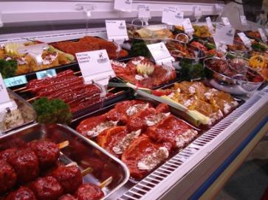
New allergen labelling Law
The government will introduce legislation mandating full ingredient labelling for food prepared for direct sale which will come into force by summer 2021.
The Law is known as Natasha’s Law, after Natasha Ednan-Laperouse who died after suffering an allergic reaction to a baguette.
The new legislation will tighten the rules by requiring food that is prepared for direct sale to carry a full list of ingredients.
Natasha’s Law, Gov.UK

Slide 20
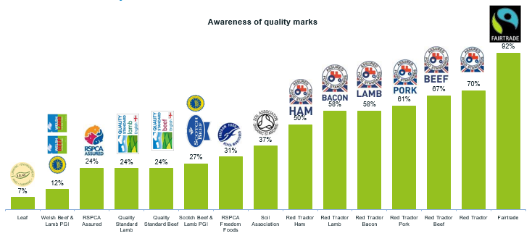
Quality assurance label awareness
Recent research showed that the majority of consumers, asked as part of a survey, were aware of the Fairtrade and Red Tractor logos but less aware of others.
When shopping, do you look for quality assurance labels on the food you buy?
If you do, what does the label mean to you?
AHDB/YouGov Apr/May 2019

Slide 21
Summary
A consumer is the user of buyer of a service or product. A retailer is a person or organisation who sells goods to the public from a premises.
A range of considerations affect consumers choice of meat and the cut of meat.
Market research companies provide information on factors influencing consumer product choice and trends in purchasing.
Meat is available to purchase from butchers, supermarkets and farm shops. Different opportunities and constraints apply to each retailer.
Food labelling provides consumers with essential product information. There are legal requirements for labelling on food products.

Slide 22
Meat and the consumer
For further information, go to:
www.foodafactoflife.org.uk

