Slide 1
Traceability of red meat – from farm to fork

Slide 2
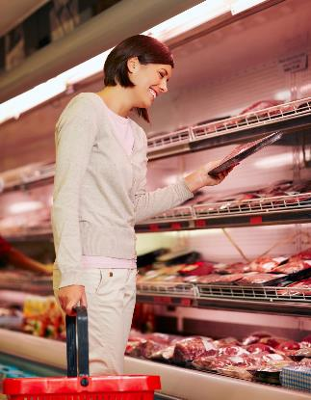
What do consumers want?
Consumers have many things to consider when buying food, such as:
price;
quantity;
quality;
diet and health issues;
marketing e.g. product brands, campaigns.
Consumers also want to know that the food they buy is safe to eat and, for some, that animal welfare and the environment have been taken into account.

Slide 3
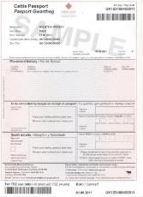
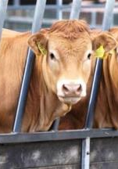
Traceability from farm to fork
Passport corresponds to the ear tag of the animal
The traceability from farm to fork is important when considering the safe production of our food. Any movement of cattle, pigs, sheep, goats or deer must be done under licence.
Bovine farm animals (cattle) wear ear tags to ensure traceability. The ear tag number of an animal is linked to its own personal passport.
The passport details information of parentage, birth and all movements an animal undertakes up to slaughter.
This information is recorded electronically making it easily accessible at any time when the information is needed.

Slide 4
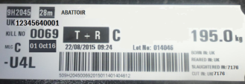
Traceability
Once the animal is slaughtered, the carcass is tagged. The tag includes details of the animal’s individual ear tag number from which we are able to pin-point which farm the animal is from.
Cattle passport number
Weight
Batch number
Grade

Slide 5
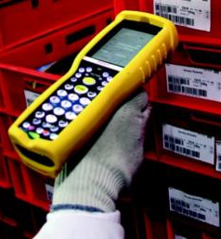
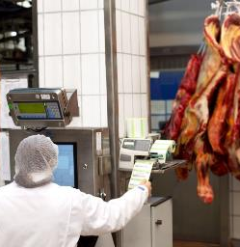
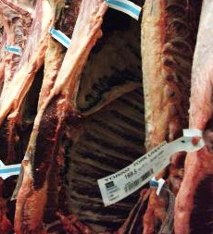
Traceability
The batch/unique reference number, which can be found on the carcass tag, is used throughout the production process to follow the movements of a product at each point of the supply chain.
Reference number
Reference number
Carcass tag

Slide 6
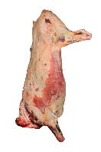
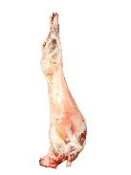
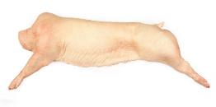
Abattoirs – safe and humane
Abattoirs are legally required to ensure that the animals are treated to high welfare standards throughout the process. Humane slaughter is ensured by protecting animals from avoidable excitement, pain or suffering.
Staff must be trained and the facilities provide adequate ventilation, light and shelter to protect from adverse weather conditions.
Abattoirs are also audited and inspected to check they meet the food hygiene and safety standards.

Slide 7
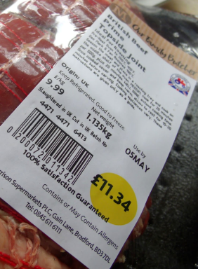

What does the meat label tell us?
Country of slaughter (site approval number)
Country of origin
Handling information
Accreditation
Product safety information
Born/Reared
UK 6413
EC
Traceability
The product can be traced back to its last place of processing and audits identify where its been farmed or produced.
Slaughtered
Cutting location

Slide 8
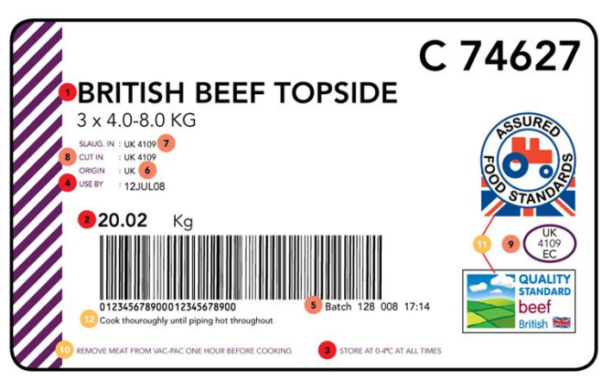


What is required on meat packaging by law?
1 Product description/cut
2 Product weight
3 Storage temperature
4 Use by date (best before if frozen)
• Supplier name (on outer packaging, not label)
• Supplier address (on outer packaging, not label)
11
5 Batch number or traceability code
6 Country of origin
7 Country of slaughter/slaughterhouse approval number
8 Country of cutting/cutting plant approval number
9 Country of packing/packing plant number
Additional information (not required by law)
10 Handling information
11 Accreditation scheme mark
12 Product safety information
11

Slide 9
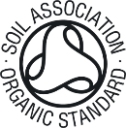
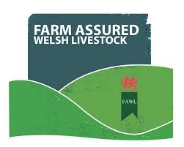

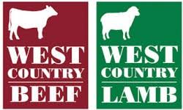






Food assurance schemes
There are a number of organisations in the UK that recognise high standards of animal welfare along with strict food safety standards and care of the environment.

Slide 10
Traceability of red meat – from farm to fork
For further information, go to:
www.foodafactoflife.org.uk

