Slide 1
Know your labels: nutrition and health claims
02/12/20

Slide 2
Overview
Food labels –their purpose and information provided.
Nutrition and health claims – what are they?
Understanding nutrition and health claims
How are nutrition and health claims regulated?
Have your say on how health claims are presented on food labels.
Food – a fact of life resources.
Further reading and sources of information.

Slide 3
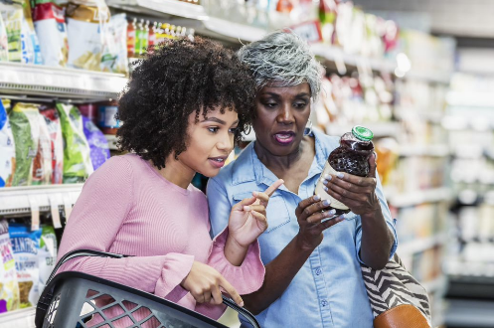
Why do we need food labels?
Food labels provide useful information about what foods and drinks contain, including the ingredients, nutritional content and any allergens.
Food labelling is required to be clear, easy to read and not misleading, so that you can be better informed about the foods and drinks you are going to buy.
Most pre-packed foods in the UK must provide nutritional information on the label by law.

Slide 4
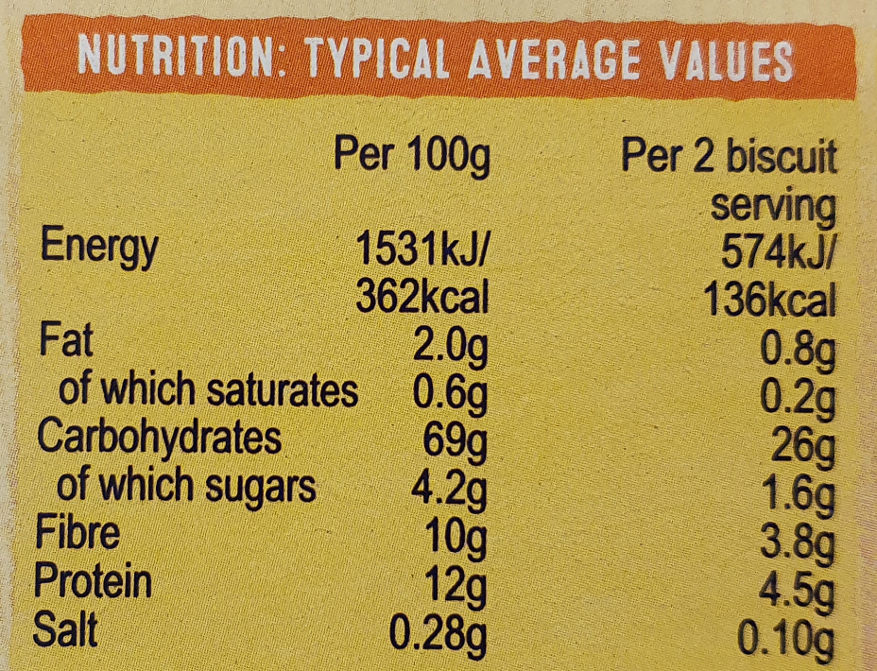
What information do food labels provide?
By law, the majority of pre-packed products must provide a nutrition label with information (per 100g or 100ml) on:
Extra voluntary information might also be provided on fibre, starch, mono-/polyunsaturated fats, vitamins and minerals
Energy
Fat
Saturated fat
Carbohydrate
Sugar
Salt

Slide 5
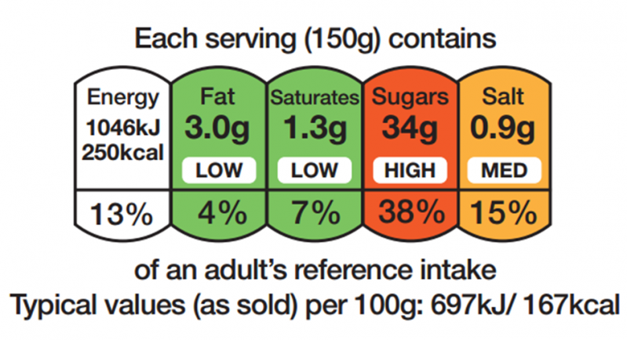
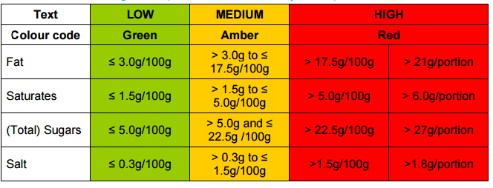
What information do food labels provide?
Front of pack labelling is voluntary in the UK, but most major supermarkets and food manufacturers provide this information
Using the government scheme, a combination of colour coding (traffic lights) and nutritional information is used to show, at a glance, whether a product is high (red), medium (amber) or low (green) in fat, saturated fat, salt and sugars, and how much energy (calories and kilojoules) it provides.
This can help consumers to compare products quickly at-a-glance to make healthier food choices by choosing foods with more green and amber symbols and fewer reds.

Slide 6
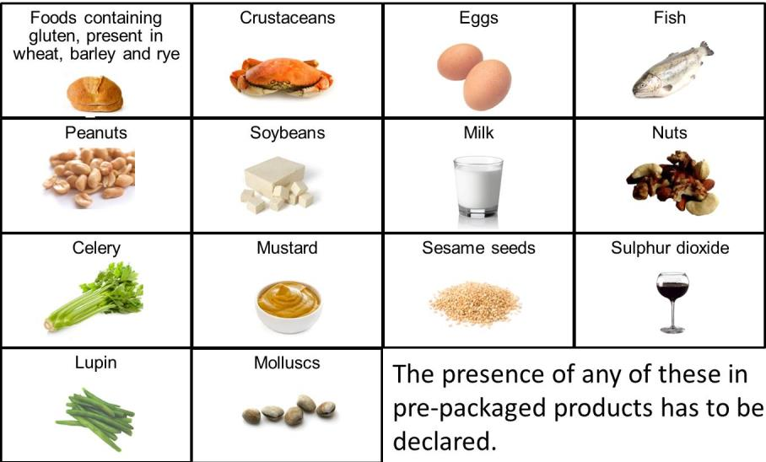
What about allergens on food labels?
There are 14 common allergens which, when present in a pre-packed product, must be emphasised clearly in the ingredients list, so it stands out from the other ingredients (e.g. bold, underlined, highlighted).
Natasha’s Law - from October 2021, foods pre-packed for direct sale (e.g. sandwiches, salads, pies) will need to have a label with a full ingredients list with allergenic ingredients emphasised within it.

Slide 7
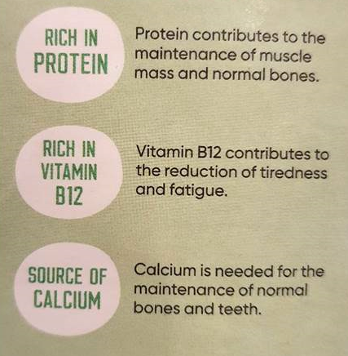
What are nutrition and health claims?
Nutrition claims relate to what a food or drink product does or does not contain, or what it contains in a higher or lower amount:
‘Sugar free’ (must contain less than 0.5g sugars per 100g)
‘Low fat’ (must contain less than 3g fat per 100g)
‘High in fibre’ (must contain at least 6g fibre per 100g)
Source of vitamin D’ (must contain at least 15% of the RI for vitamin D per 100g or 100ml)
Health claims are claims that state or suggest there is a relationship between a product and health:
“Plant sterols/stanols contribute to the maintenance of normal blood cholesterol levels”
"Iron contributes to normal oxygen transport in the body”

Slide 8

Regulation of nutrition and health claims
The use of nutrition claims and health claims is controlled by a European Regulation (EC 1924/2006), which came into effect on 1 July 2007.
If you see a nutrition or health claim on a food or drink, it should have been authorised and listed on the European register of claims
The aim of the regulation is to make sure that claims made on food are not misleading, and are based on scientific evidence, as well as encouraging food companies to develop healthier products.

Slide 9


How are health claims approved?
European Food Safety Authority (EFSA) Dietetic products, Nutrition and Allergies (NDA) panel provides scientific opinions on the proposed claim dossier, which must be submitted to EFSA for consideration.
EC considers EFSA opinion and also the likely consumer understanding of the proposed wording and gives final decision on approval/rejection.
A list of permitted claims, conditions of use and rejected health claims is published by the European Commission http://ec.europa.eu/nuhclaims/
Following the end of the Brexit transition period (1 January 2021), the UK Nutrition and Health Claims Committee will replace the EFSA NDA Panel https://www.gov.uk/government/groups/uk-nutrition-and-health-claims-committee

Slide 10
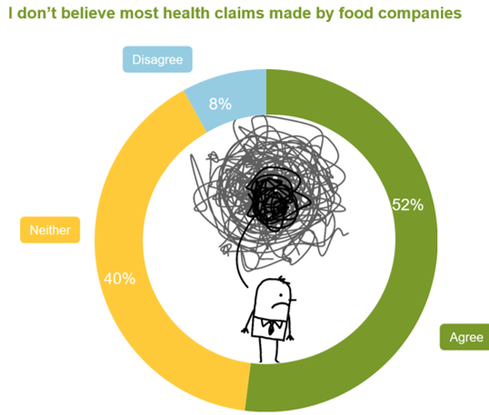
What do people think of health claims?
Instagram poll (September 2019) on behalf of the EIT Food-funded Health Claims Unpacked Project
Survey of 1,721 British grocery shoppers (April 2017)

Slide 11

Wording of health claims (1)
EFSA provides an official (approved) wording for health claims when they are authorised for use
The use of nutrition and health claims is only be permitted if the ‘average consumer’ can be expected to understand the beneficial effects as expressed in the claim.
By ‘consumer’, the EC Regulation ‘takes as a benchmark the average consumer, who is reasonably well‐informed and reasonably observant and circumspect, taking into account social, cultural and linguistic factors’.

Slide 12
Wording of health claims (2)
The official (approved) wording of claims can be viewed within the online EC register of nutrition and health claims.
Health claims range from simple to complex and more/less familiar:
“Zinc contributes to the maintenance of normal skin”
“Olive oil polyphenols contribute to the protection of blood lipids from oxidative stress”
“Copper contributes to the normal function of the immune system”
“Betaine contributes to normal homocysteine metabolism”

Slide 13
Wording of health claims (3)
The wording of health claims may present a barrier to consumer understanding and use of health claims on pack for a number of reasons
The use of scientific terms such as ‘oxidative stress’ may be hard to understand
Consumers may not like use of the word ‘normal’
Health claims may have a high ‘lexical density’ and may tend to use ‘nominalisation’, for example:
a) Selenium contributes to the protection of cells from oxidative stress (6)
b) Selenium contributes to antioxidant activity (4)

Slide 14

Flexibility on the wording of health claims
Companies are allowed some flexibility to change the wording of health claims to help consumer understanding, as long as the original meaning is retained and the modified version does not mislead (e.g. by exaggerating the claim).
The nutrition and health claims regulation is enforced differently in different EU member states, and the meaning of claims may not be the same when translated into different languages
The wording of health claims has been reported as the biggest challenge facing companies in communicating health claims while complying with the regulation

Slide 15
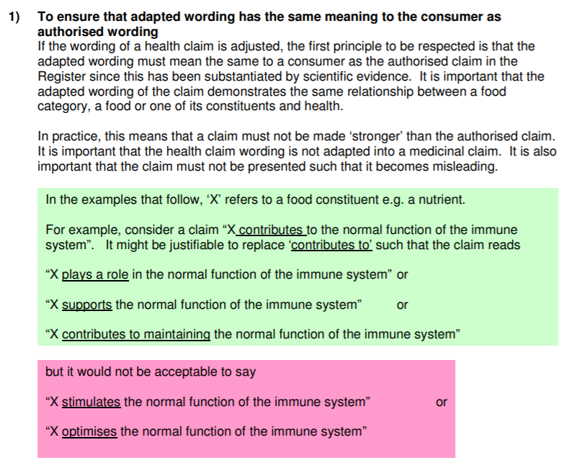
Guidance on the wording of health claims
The Department of Health and Social Care has published guidance for companies.
Based on general principles on flexibility of wording for health claims broadly agreed by 17 EU Member States in 2012.
A claim must not be made ‘stronger’ than the authorised claim.
The word ‘normal’ should not be replaced or removed
Can only be made for the nutrient, substance, food or food category for which they have been authorised and not for the product that contains them.

Slide 16
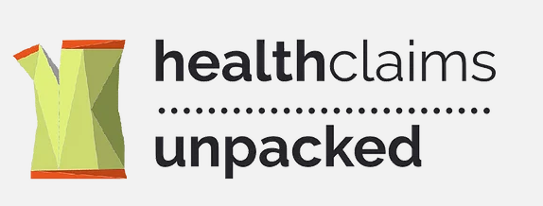






Health Claims Unpacked - have your say on health claims!
The Health Claims Unpacked project aims to improve the communication of health claims to consumers
An EIT Food-funded project led by experts in linguistics from the University of Reading, with partners from across Europe, including BNF.
Project is gathering data on consumer understanding of health claims made on food packaging and preferences on how claims are worded
Uses an interactive digital toolkit with educational activities (available in English, French, German and Polish)
This work has been funded by EIT Food, the innovation community on Food of the European Institute of Innovation and Technology (EIT), a body of the EU, under the Horizon 2020, the EU Framework Programme for Research and Innovation.

Slide 17
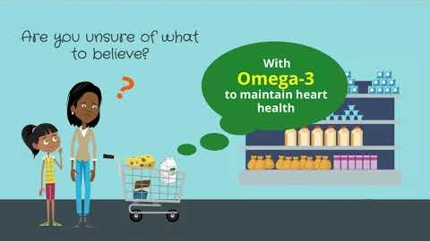
Health Claims Unpacked - have your say on health claims!
This work has been funded by EIT Food, the innovation community on Food of the European Institute of Innovation and Technology (EIT), a body of the EU, under the Horizon 2020, the EU Framework Programme for Research and Innovation.

Slide 18
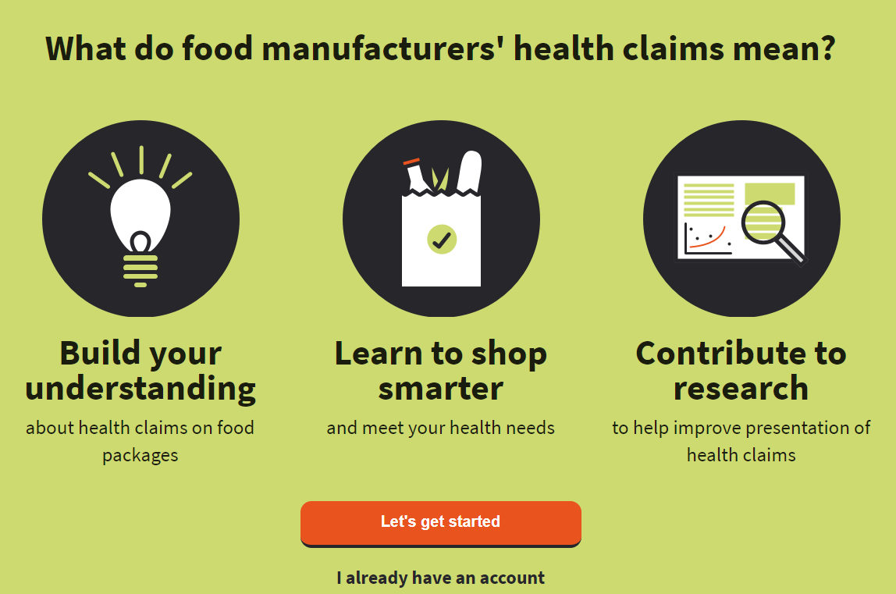
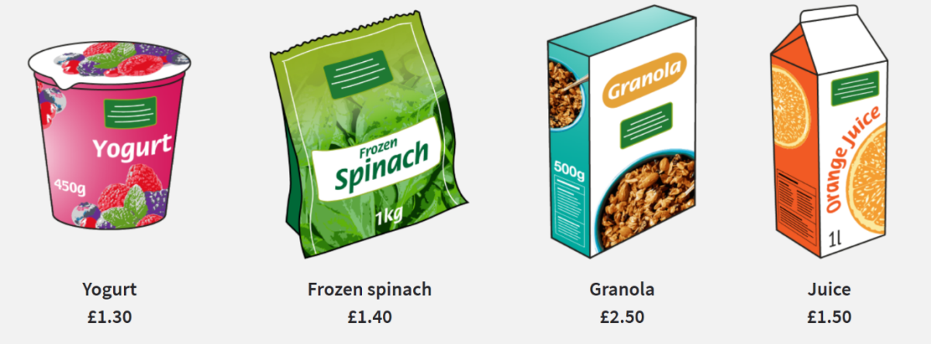
Health Claims Unpacked - have your say on health claims!
The digital toolkit takes about 15 min to do and includes 5 activities:
What’s good for what?
What is a health claim?
Similar or different?
What would you buy?
Design your own food pack
Results are being used to develop a business hub for manufacturers and regulators
Visit www.unpackinghealthclaims.eu
This work has been funded by EIT Food, the innovation community on Food of the European Institute of Innovation and Technology (EIT), a body of the EU, under the Horizon 2020, the EU Framework Programme for Research and Innovation.

Slide 19
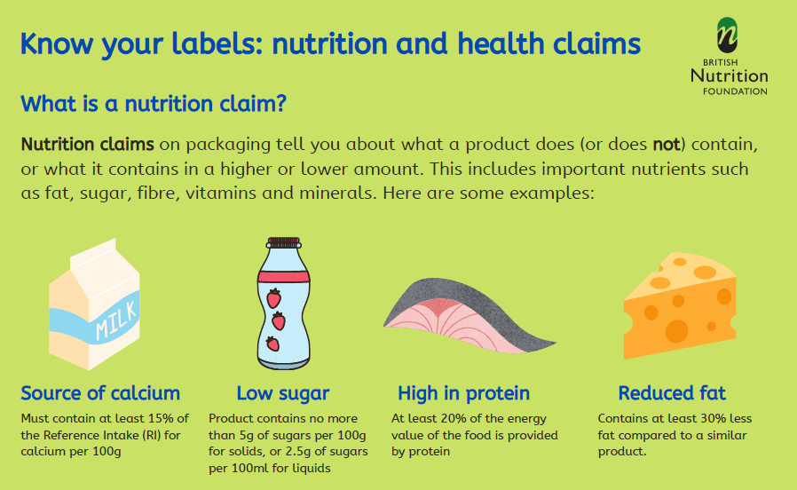
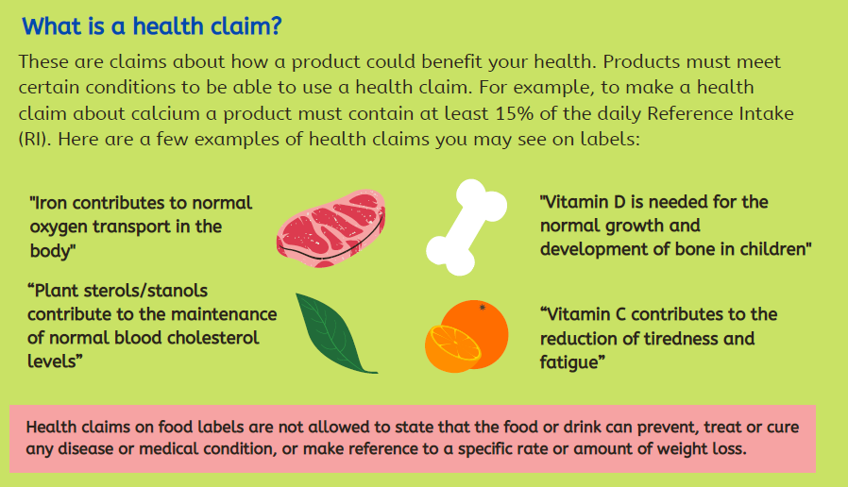
Free resource on nutrition and health claims
BNF has produced a free PDF resource on nutrition and health claims which can be downloaded from our website
https://www.nutrition.org.uk/healthyliving/resources/

Slide 20
Take home messages
Food labels provide consumers with information on nutrition, allergens and the health effects of a product, which can in making healthier food choices
Some nutrition information must be provided by law on pre-packed products, whereas some is voluntary (e.g. ‘traffic light’ labelling)
Nutrition and health claims on food/drink products are subject to regulation
Only authorised health claims can be used on products, which must meet certain conditions (e.g. be a ‘source of’ a nutrient such as calcium)
Consumers may not trust health claims or may find them confusing
Companies are allowed some flexibility to re-word claims, but it is not easy to know which changes consumers will prefer
The Health Claims Unpacked project aims to improve the communication of health claims (www.unpackinghealthclaims.eu)

Slide 21

Thanks for listening!

Slide 22
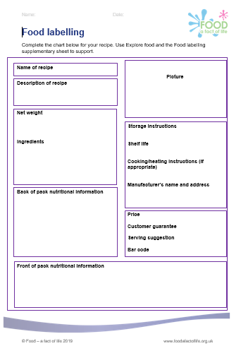
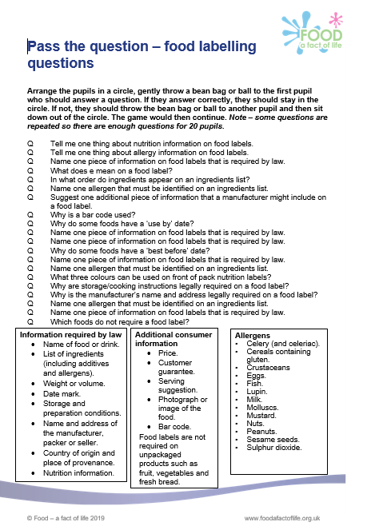
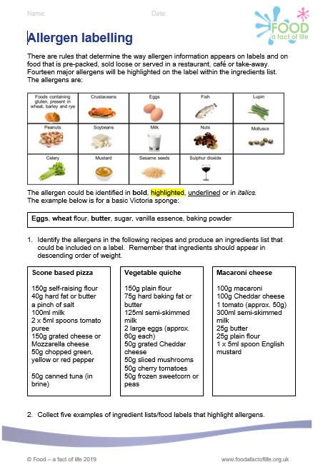
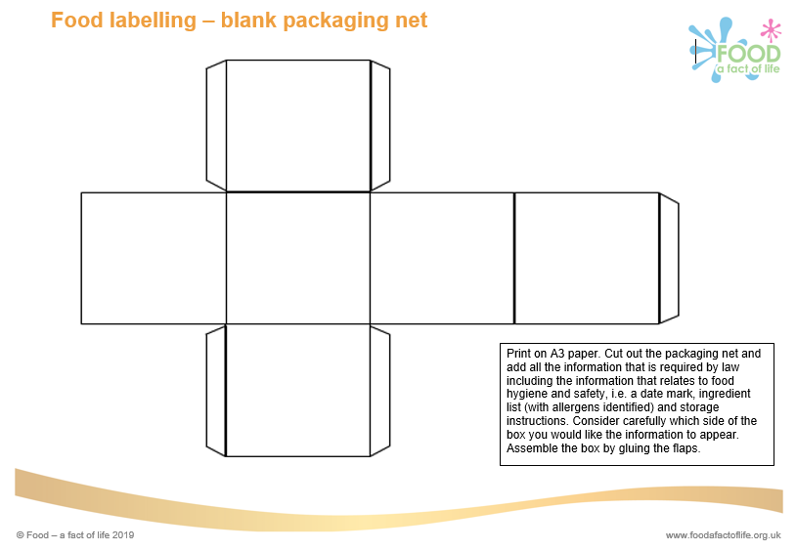
Food – a fact of life resources
Food labelling: 11-14 Years and 14-16 Years

Slide 23
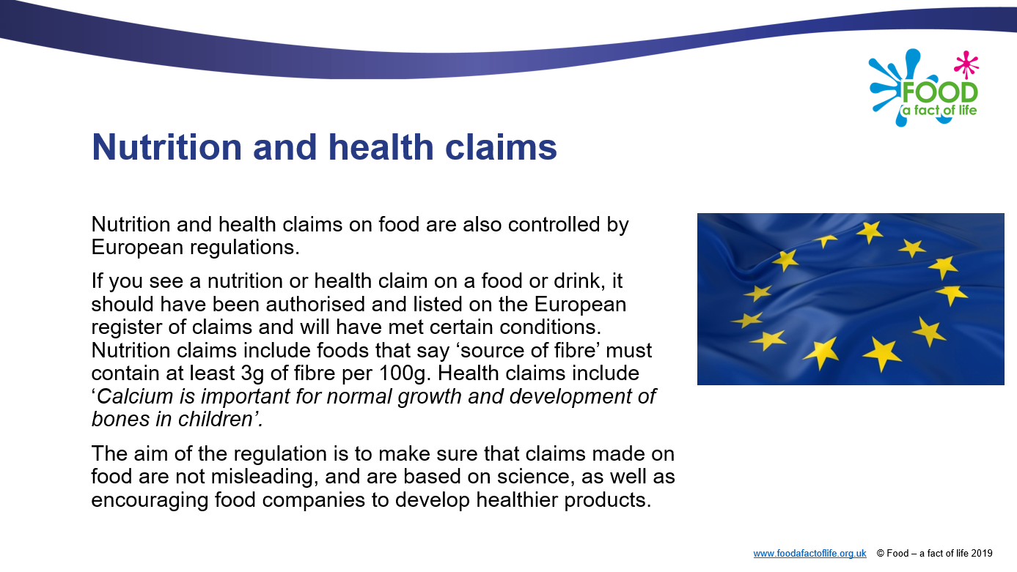
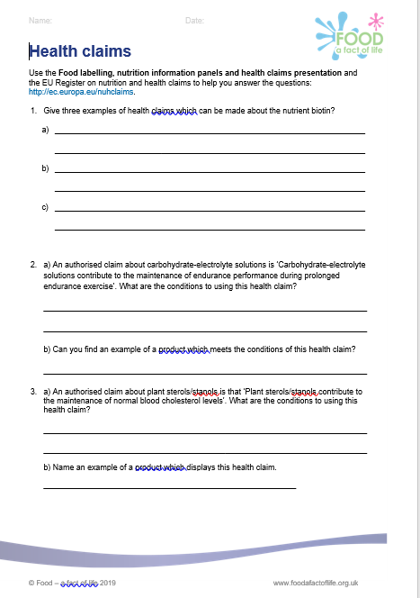
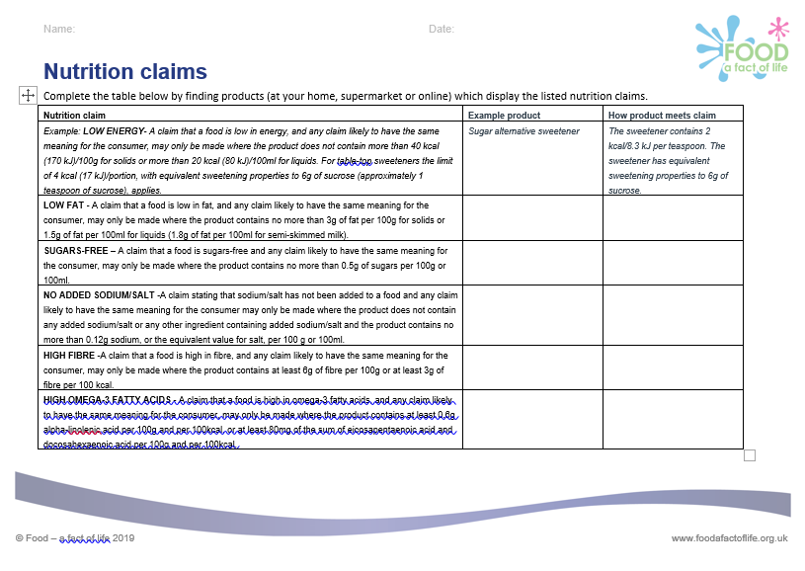
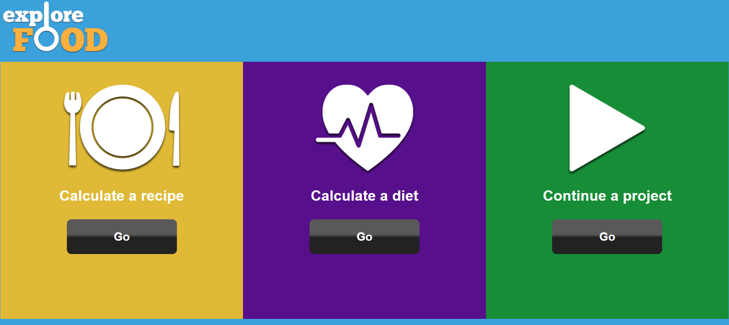
Food – a fact of life resources
Nutrition and health claims
Nutritional analysis: Explore food

Slide 24
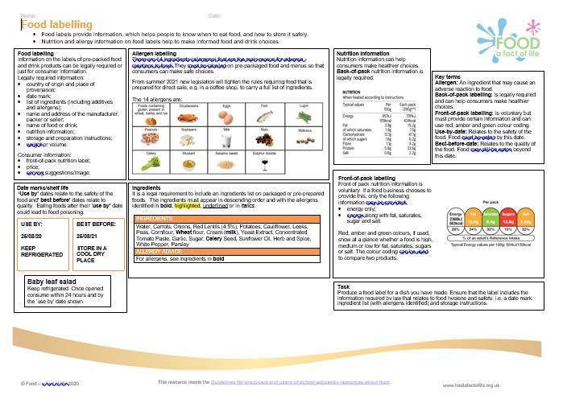
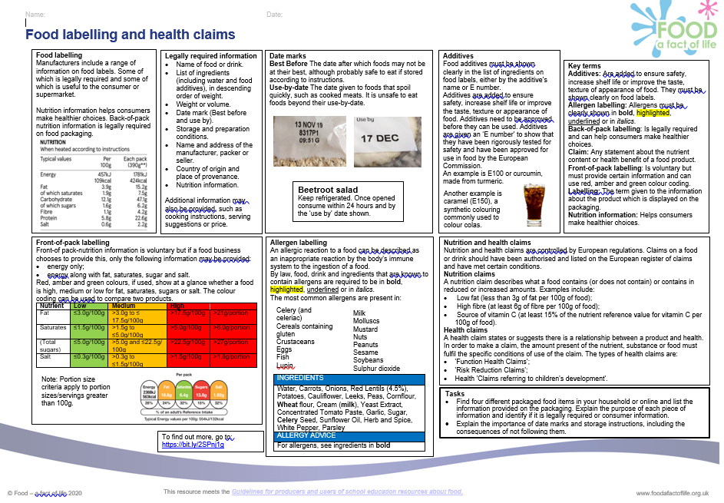
New – secondary Knowledge organisers!

Slide 25
Other sources of information and support
British Nutrition Foundation
Know your labels: nutrition and health claims
Putting health claims into words
European Commission – nutrition and health claims
Food – a fact of life
Food and Drink Federation – food labelling
Gov.uk – nutrition, health claims and supplement labelling
Gov.uk – food and drink labelling changes from 1 January 2021
NHS Live well – food labelling
NHS Live well – food labelling terms
Front of pack nutrition labelling – webinar recording and presentation

Slide 26
More training …
To find out more and to book, go to https://www.foodafactoflife.org.uk/training/
Virtual practical workshops
Regional virtual conferences
England – 30/01/21 at 9am
Northern Ireland – 27/02/21 at 9am
Wales – 20/03/21 at 9am
Webinars
New ways with red meat – 12 January 2021
How to write a worksheet – 3 February 2021
A thematic approach to teaching food and nutrition in primary schools – 24 March 2021
Anytime – online training
More PPD information, support and newsletter sign-up: https://www.foodafactoflife.org.uk/professional-development/

Slide 27
Know your labels: nutrition and health claims
For further information, go to:
www.foodafactoflife.org.uk

