Slide 1
Apples

Slide 2
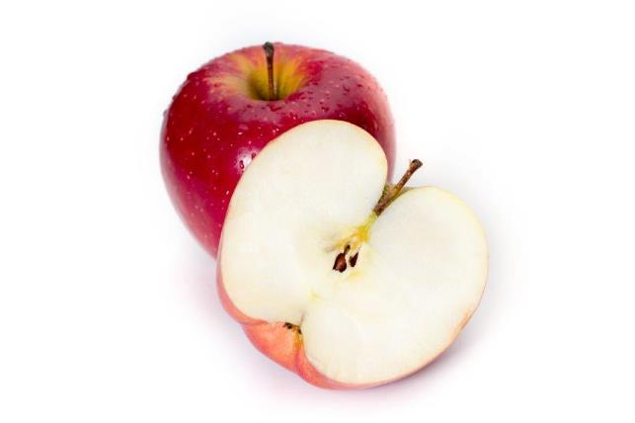
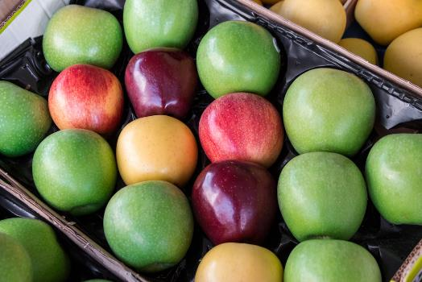
What are these?
These are apples.
Apples are a special type of fruit called a ‘pome’.
Pomes have a large portion of outer flesh and a tough ‘core’ which contains the seeds, more commonly known as ‘pips’ (usually 5).

Slide 3
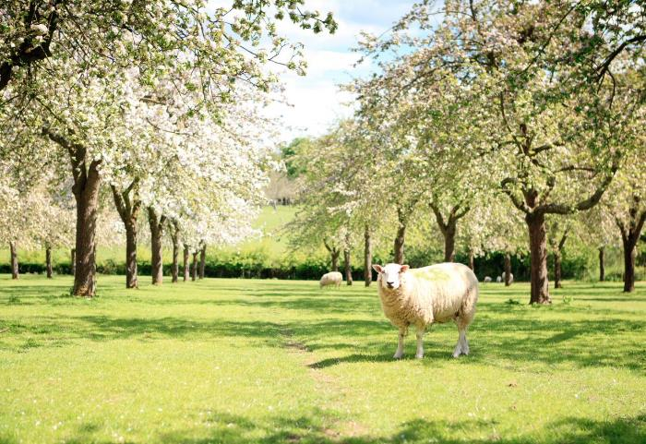
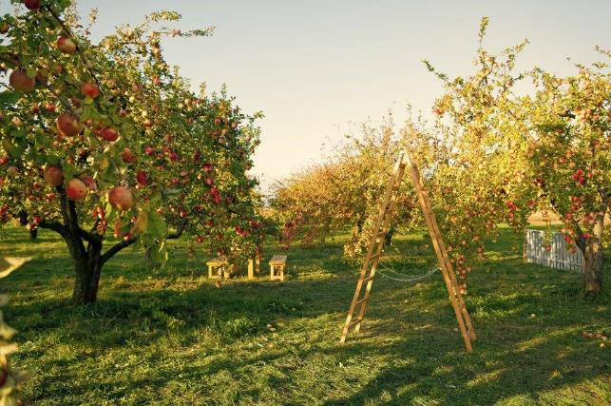
Where do apples come from?
Apples grow in the UK, as well as other countries.
Apples grow on a tree – they are from a plant.
They are a fruit.

Slide 4
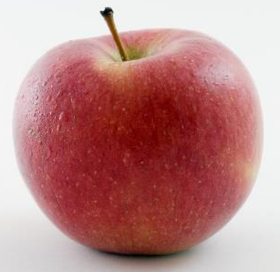
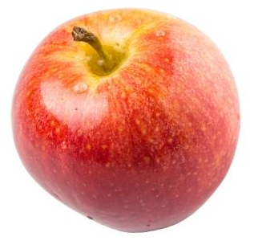
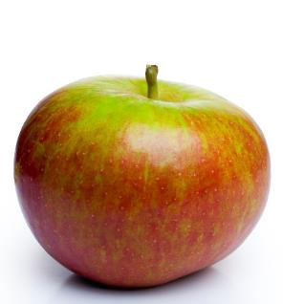
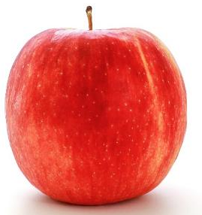
Apple varieties
There are lots of different types apple – 3,000 varieties in the UK!
They have different names, such as:
Braeburn;
Cox;
Jazz;
Royal gala.

Slide 5
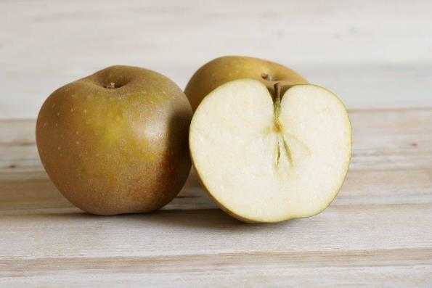
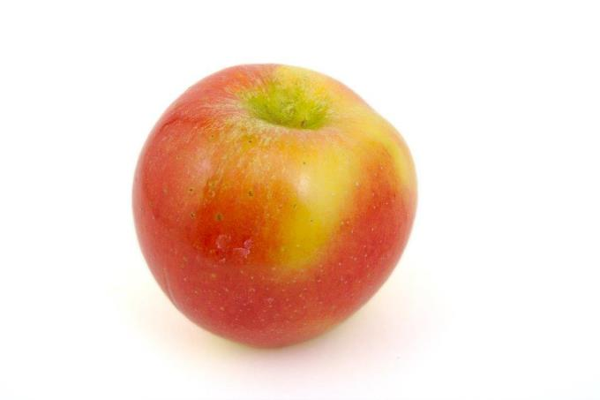
Apple varieties
Less well known apple varieties include:
Cameo;
Egremont Russet;
Kanzi;
Ruebens;
Worcester Pearmain.
Egremont Russet
Red Kanzi

Slide 6
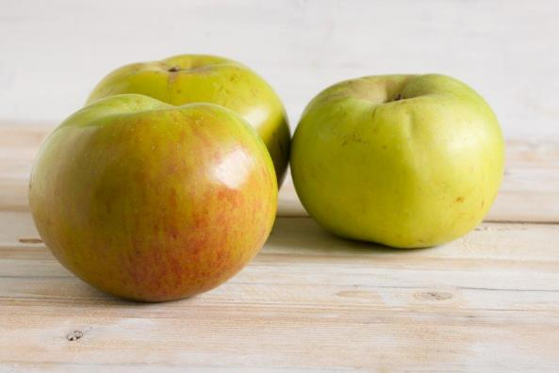
Cooking apples
Bramley apples are traditionally used for cooking.
The first Bramley tree grew from pips planted by a young girl, Mary Ann Brailsford, in her garden in England in 1809.

Slide 7
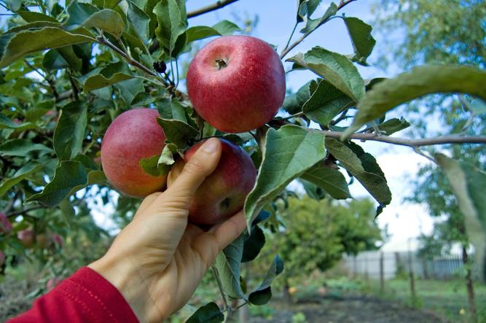
Harvesting apples
Apples are picked from the tree when they are ready.
Different apples are ready at different times during the year (seasons). For example:
Cox: September to early March
Jazz: November to May
Braeburn: Late December to May
Notes:
Apple seasons - https://britishapplesandpears.co.uk/production/the-british-season-apples/

Slide 8
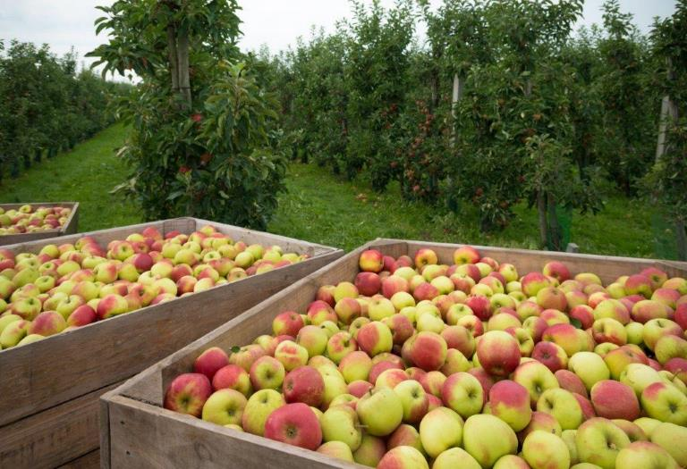
Harvesting apples
Apples are washed, graded and packed ready for sale.
Notes:
Apple seasons - https://britishapplesandpears.co.uk/production/the-british-season-apples/

Slide 9
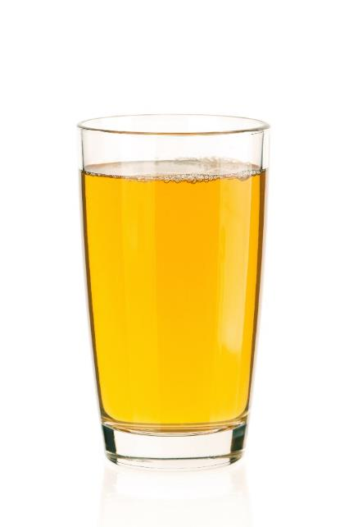

Apples
Apples can be purchased as:
fresh;
canned;
dried;
pureed;
juiced;
frozen (e.g. apple crumble).

Slide 10
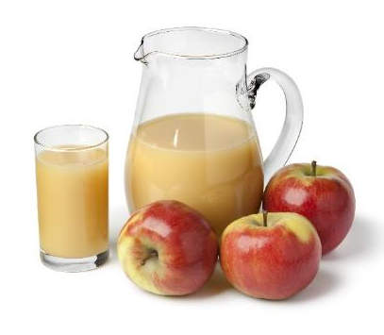
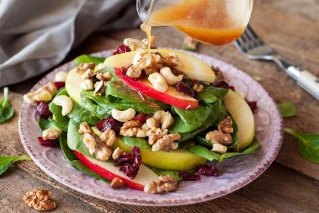
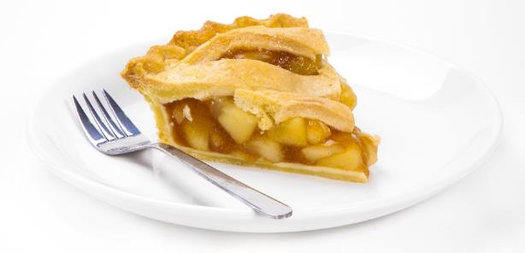
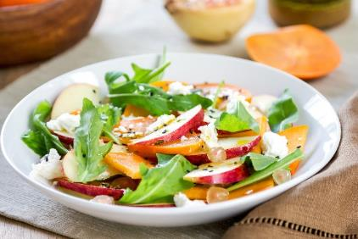
Dishes
Apples can be used in lots of dishes or eaten as a snack.

Slide 11
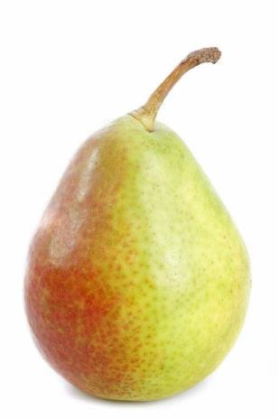
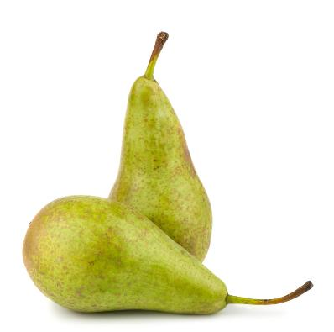
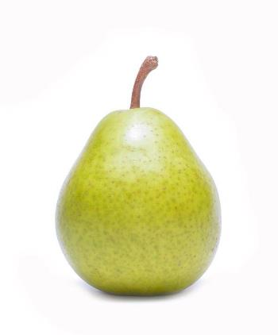
Similar
Pears are similar to apples.
They have a core which contain ‘pips’.
Pear varieties include:
Conference;
Comice;
Williams.
Conference
Comice
Williams

Slide 12
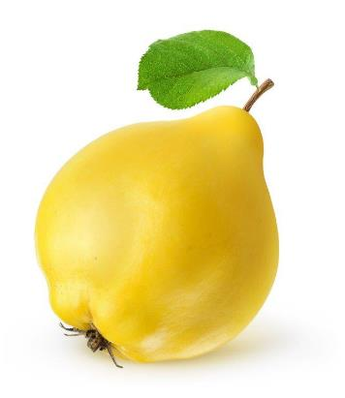
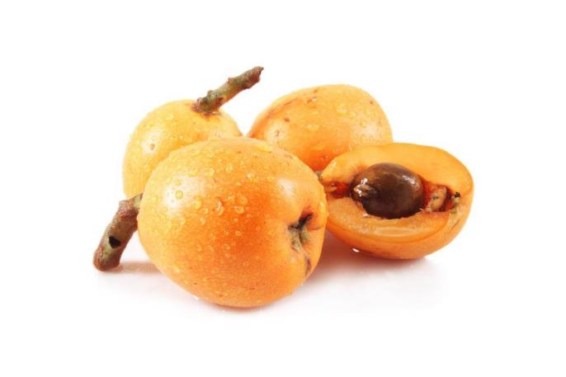
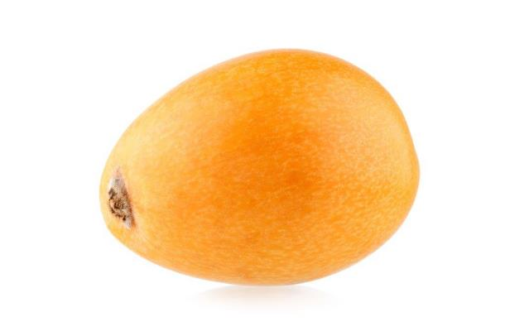
Similar
Less known fruits which are similar to apples are medlar, quince and loquat.
Quince
Medlar
Loquat

Slide 13
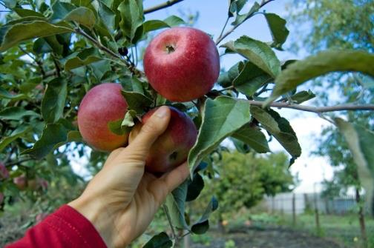

Summary
Apples are grown for our food.
Apples
Lots of dishes use apples.

Slide 14
Apples
For further information, go to:
www.foodafactoflife.org.uk

