Slide 1
Bananas

Slide 2
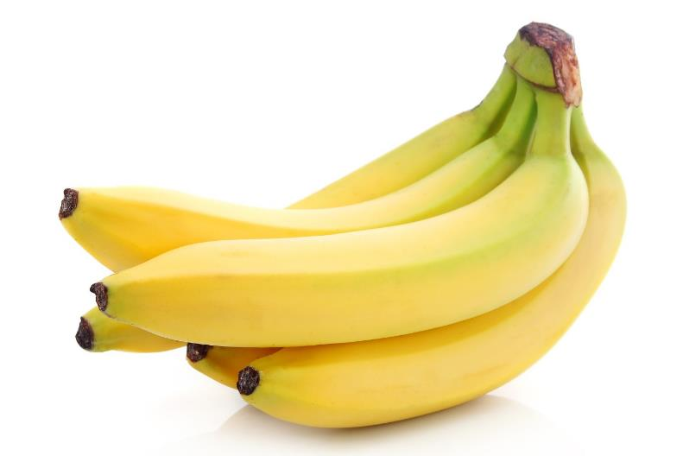
What are these?
These are bananas, known as a ‘fleshy’ fruit.
These fruits are usually fairly large and do not have a central stone.
Often, the seeds in the fruit are eaten along with the flesh as they are small and soft.

Slide 3
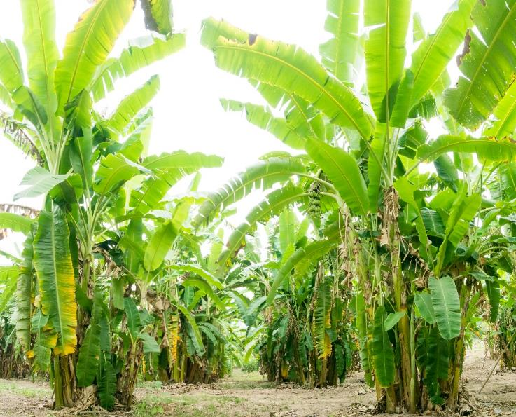
Where do bananas come from?
Bananas are from a plant.
They grow above the ground.
They are known as ‘fleshy’ fruit.
They are grown in hot climates.

Slide 4
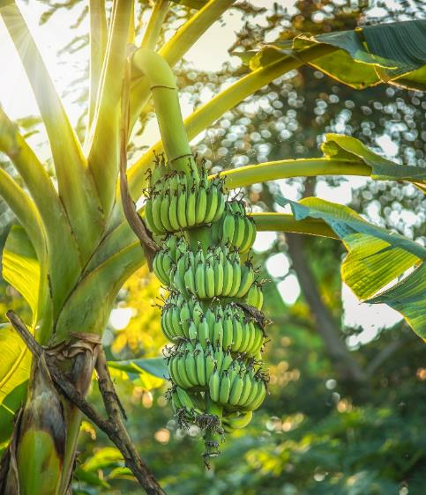
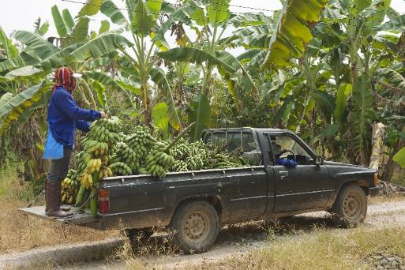
Where do bananas come from?
Bananas are picked when they are ready (ripe).

Slide 5
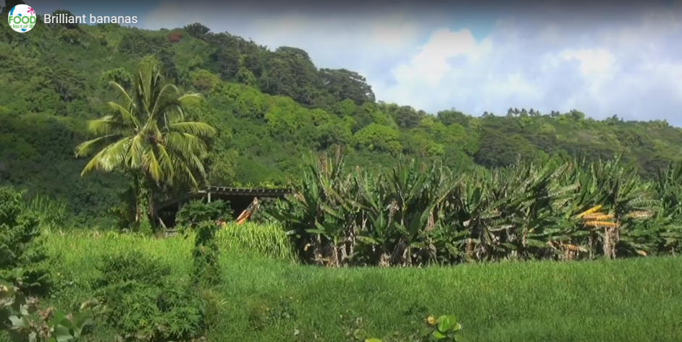
Where do bananas come from?
Here is a video about bananas.
Click the picture above to watch the video.

Slide 6
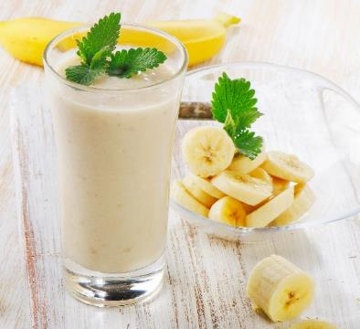
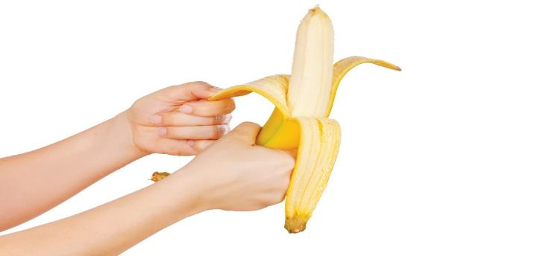
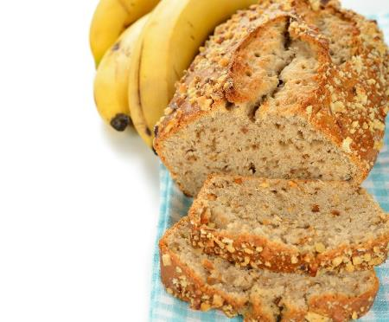
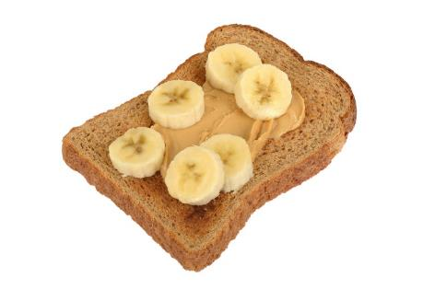
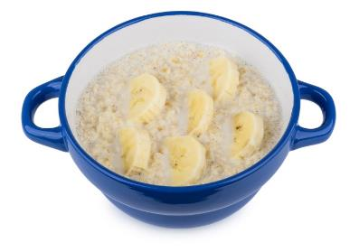
Dishes
Bananas can be eaten raw – just peel first.
Bananas can be used in lots of dishes.

Slide 7
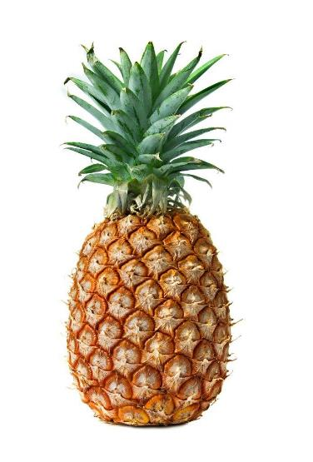
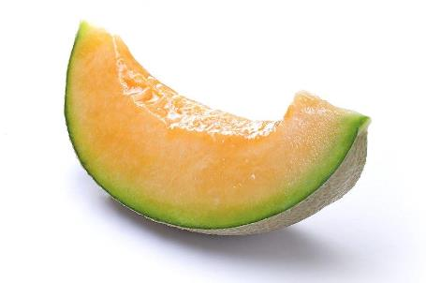
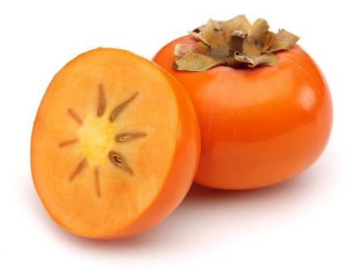
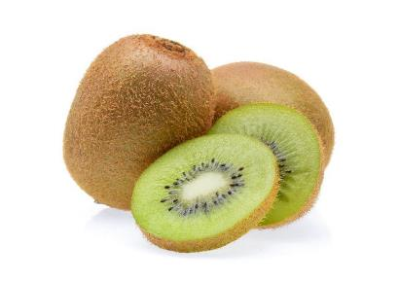
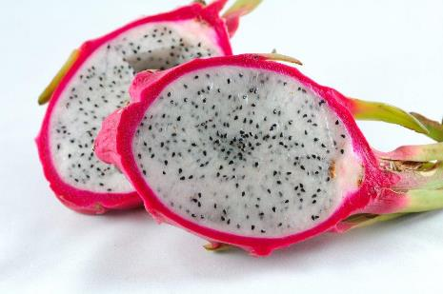
Similar
Kiwi, pineapple, guava, dragon fruit, persimmon and melons are similar to bananas.
They are all known as ‘fleshy’ fruits.
Melon
Persimmon
Pineapple
Kiwi
Dragon fruit

Slide 8



Summary
Banana are grown for our food.
Bananas
Lots of dishes use bananas.

Slide 9
Bananas
For further information, go to:
www.foodafactoflife.org.uk

