Slide 1
Carrots

Slide 2
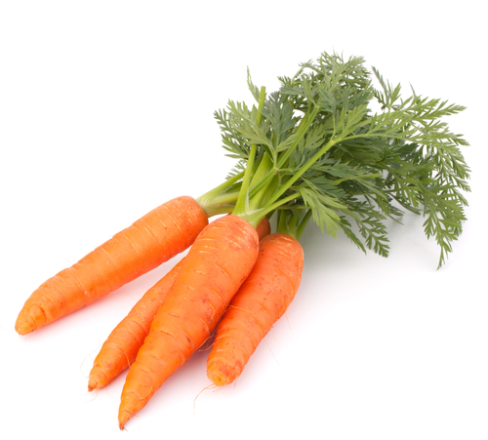
What are these?
These are carrots. They are a root of a plant.
The roots of the plant suck-up water and nutrients from the soil to help the plant stay healthy. They also anchor the plant to the ground.

Slide 3
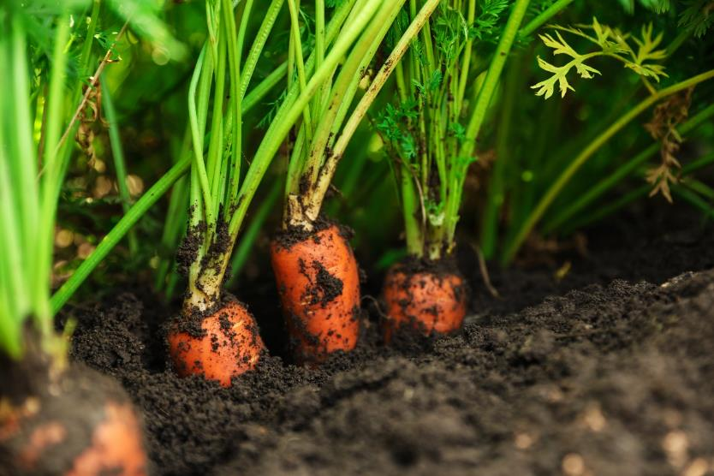
Where do carrots come from?
Carrots grow in the UK.
Carrots are a plant.
They grow under the ground.
Carrots are the roots of the plant.

Slide 4
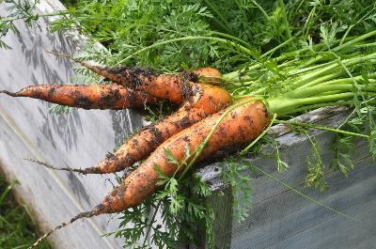
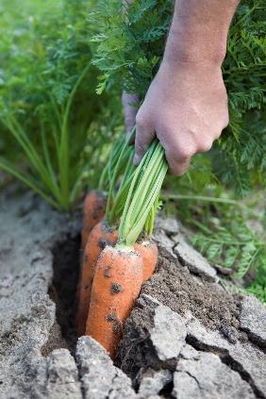
Harvesting
Carrots are pulled up from the earth when ready.
Carrots are harvested in Britain almost 12 months of the year.
Early season carrots are sown in the winter and very early spring and protected with plastic or fleece covers. They are harvested from June through to August.
Notes:
http://britishcarrots.co.uk/

Slide 5
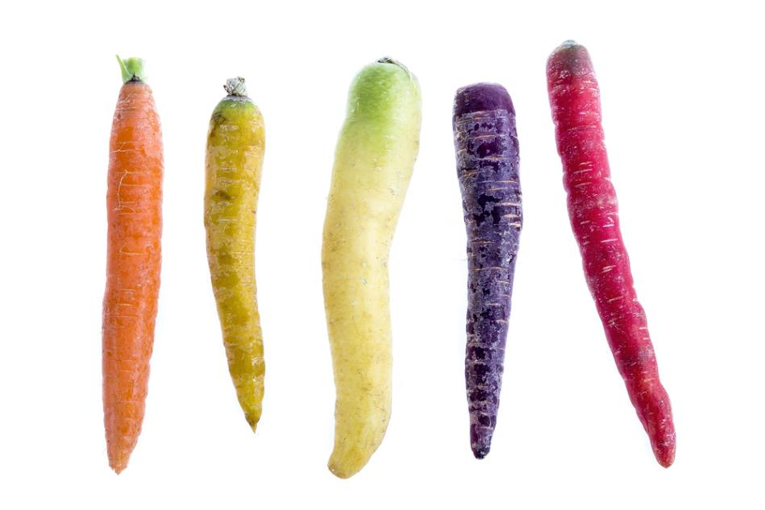
Carrot varieties
There are lots of different types carrots. There are 44 varieties around the world.
They have different names, such as:
Chanteray;
Danvers;
Nantes.

Slide 6
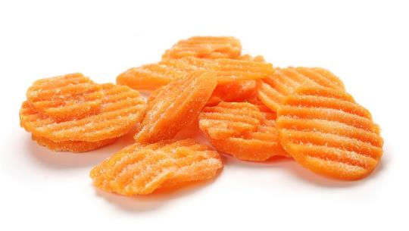
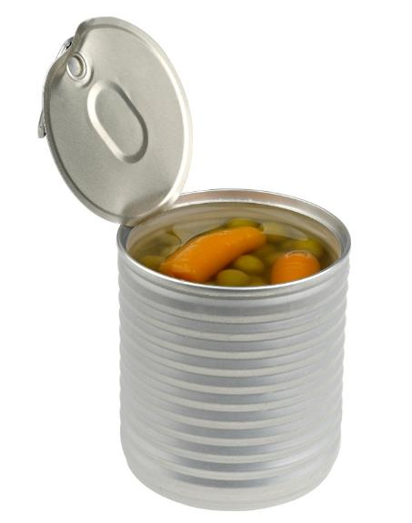
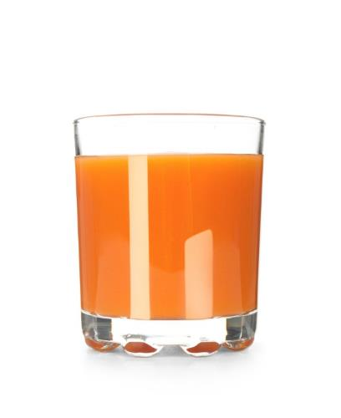
Carrots
Carrots can be purchased as:
fresh;
canned;
juiced;
frozen.

Slide 7
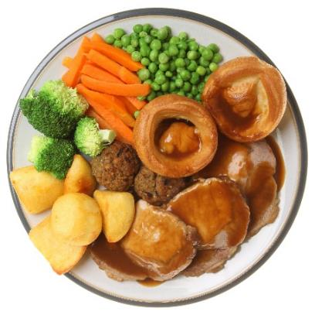
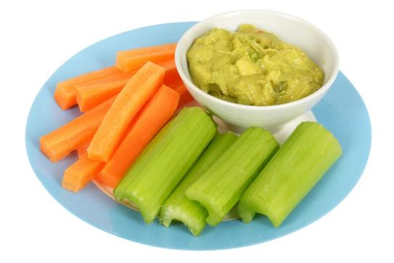
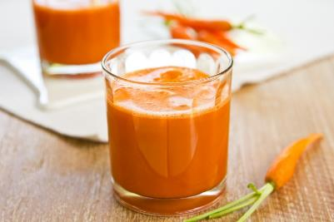
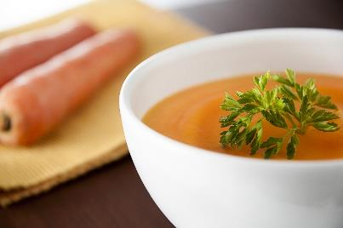
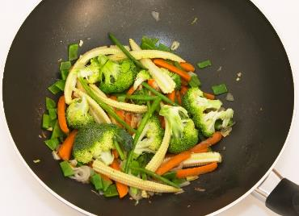
Dishes
Carrots can be eaten raw – just peel and wash first.
Carrots can be used in lots of dishes.

Slide 8
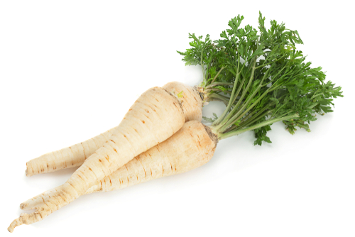
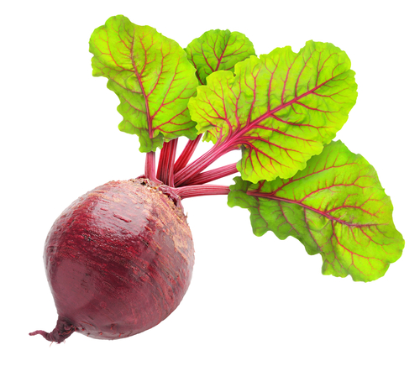
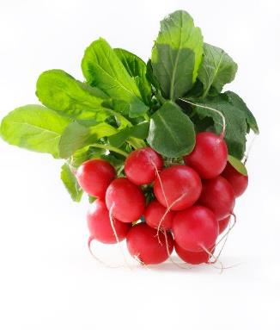
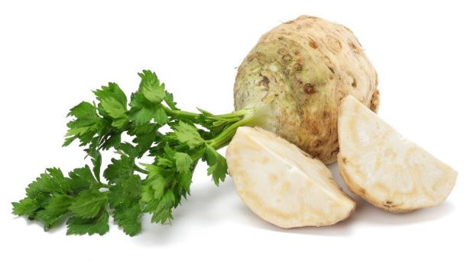
Similar vegetables
Parsnips, beetroot, radish, turnip and celeriac are similar to carrots.
Parsnips
Beetroot
Radishes
Celeriac

Slide 9

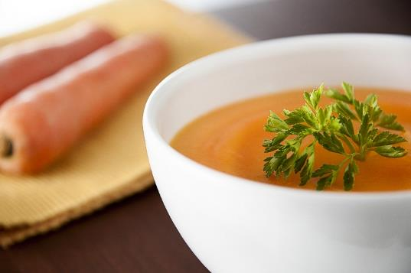

Summary
Carrots are grown for our food.
Carrots
Lots of dishes use carrots.

Slide 10
Carrots
For further information, go to:
www.foodafactoflife.org.uk

