Slide 1
Celery

Slide 2
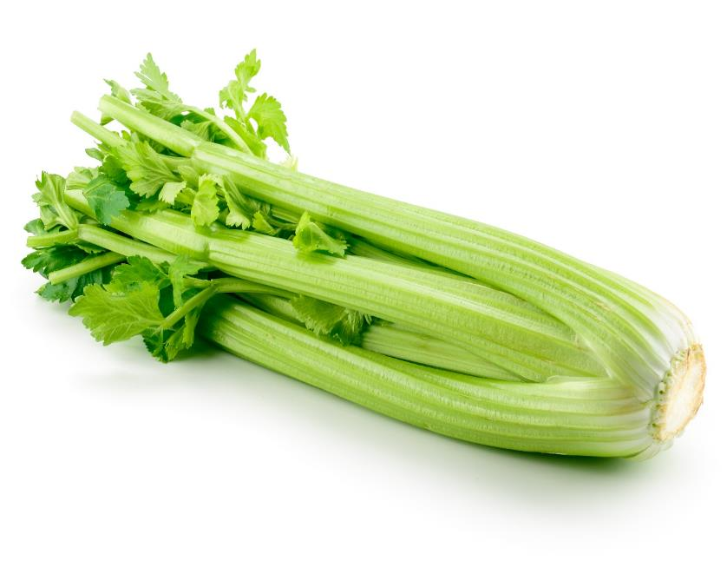
What is this?
This is celery, it is the stalk (stem) of a plant (vegetable).
The stalk of the plant helps to keep it standing up and also helps to move water and nutrients to other parts of the plant.

Slide 3
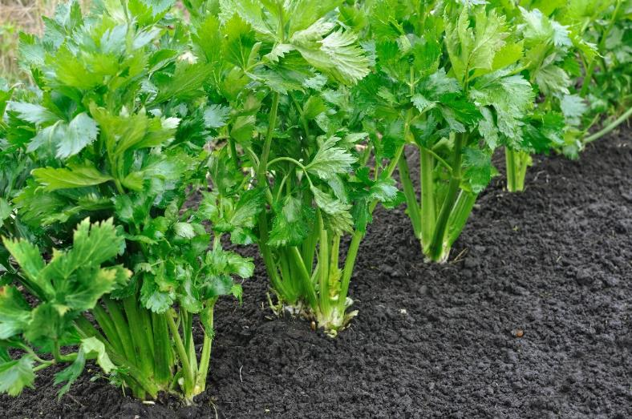
Where does celery come from?
Celery grows in the UK.
Celery is a plant.
It grows above the ground.
Celery is the stem (stalk) of the plant.

Slide 4
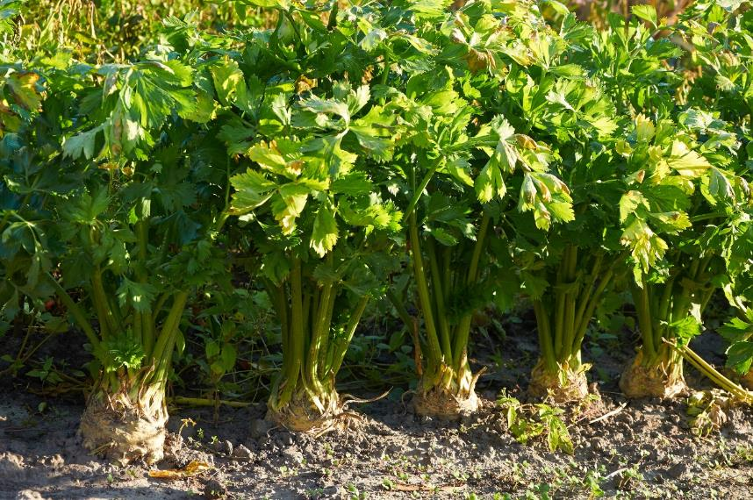
Harvesting
Celery is grown in a garden or in a field.
It grows above the ground.
Celery is harvested by hand between June and early November.

Slide 5
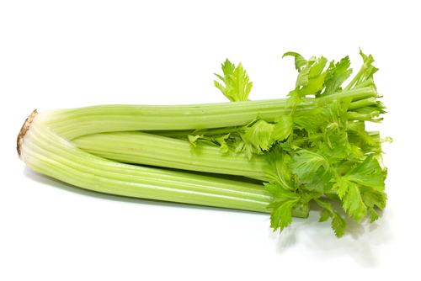
Celery
Celery is purchased fresh.

Slide 6
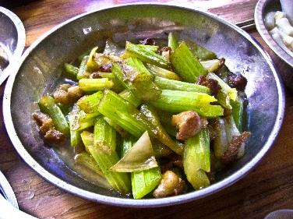
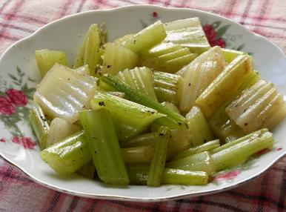
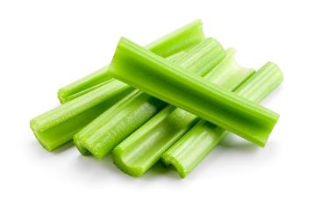
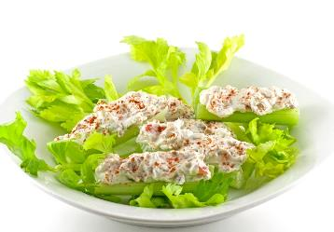
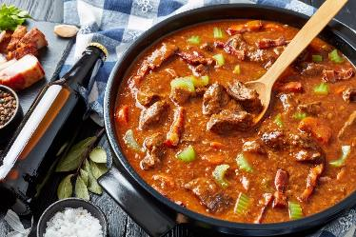
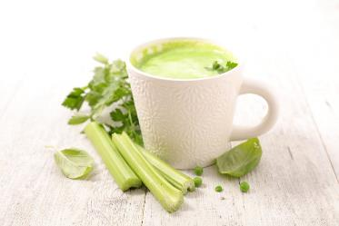
Dishes
Celery can be eaten raw – just wash first.
Celery can be used in many dishes.

Slide 7
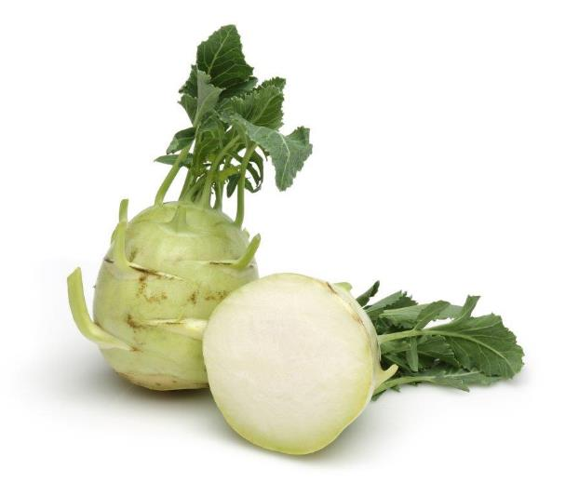
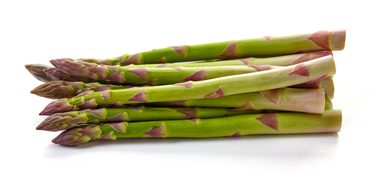
Similar
Asparagus and kohlrabi are similar to celery.
They are the stem (stalk) of a plant.
Kohlrabi
Asparagus

Slide 8
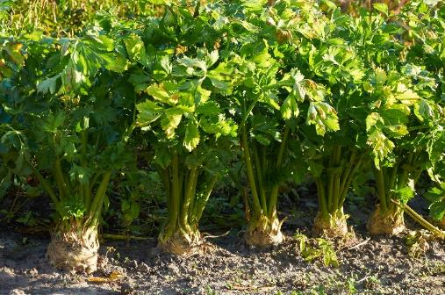

Summary
Celery is grown for our food.
Celery
Lots of dishes use celery.

Slide 9
Celery
For further information, go to:
www.foodafactoflife.org.uk

