Slide 1
Lettuce

Slide 2
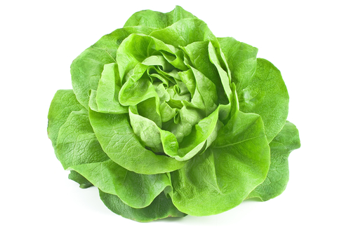
What is this?
This is a lettuce, the leaves of a plant (vegetable).
Plant leaves capture sunlight and use the energy from it to make food.
Leaves are usually flat and green, which helps them to capture lots of sunlight.

Slide 3
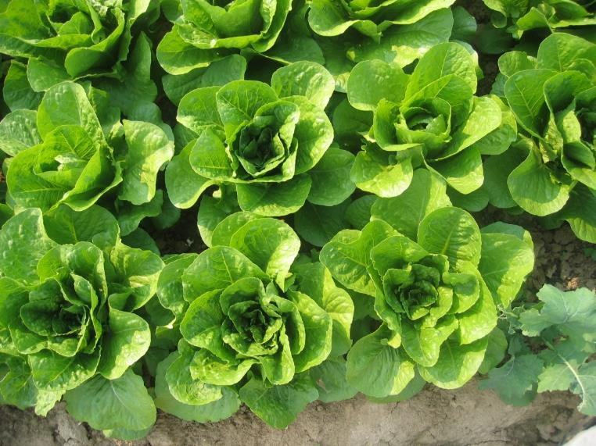
Where does lettuce come from?
Lettuce grows in the UK.
Lettuce is a plant.
They grow above the ground.
Lettuce is the leaves of the plant.

Slide 4
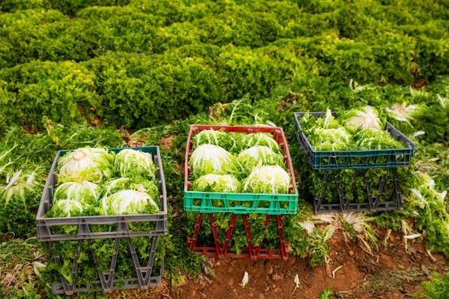
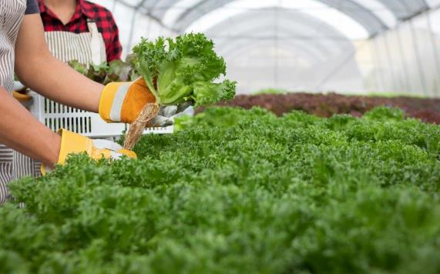
Harvesting
Lettuce is picked when ready from a garden or field.
Around 20% grows in greenhouses.
The UK season for wholehead lettuce begins around the middle of May and finishes at the end of October.
Notes:
https://www.britishleafysalads.co.uk/know/faq.shtm

Slide 5
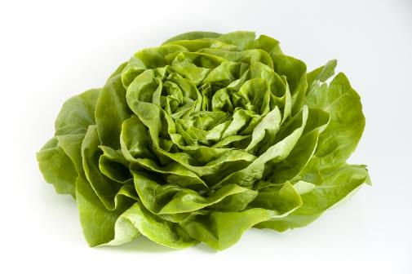
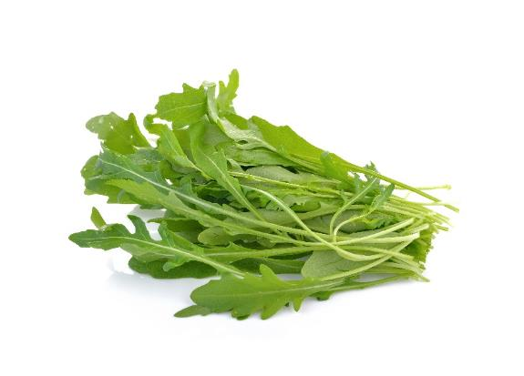
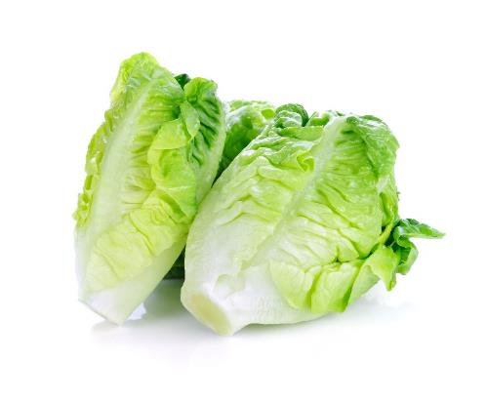
Lettuce varieties
There are lots of different types lettuce.
They have different names, such as:
Iceberg;
Cos;
Rocket.
Round
Rocket
Cos

Slide 6
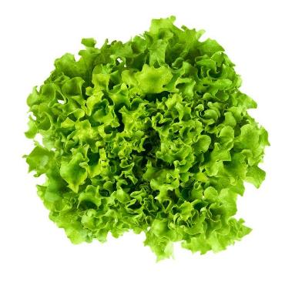
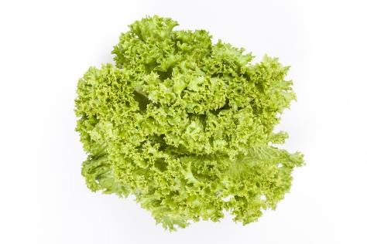
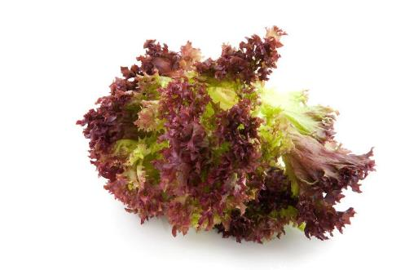
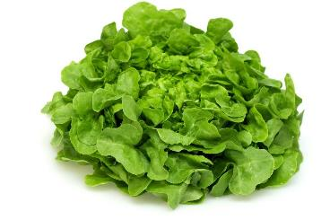
Lettuce varieties
More unusual varieties of lettuce include:
Lollo rosso;
Oak leaf;
Batavia;
Lollo verde.
Batavia
Lollo verde
Lollo rosso
Oak leaf

Slide 7
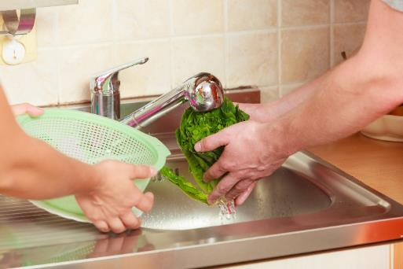
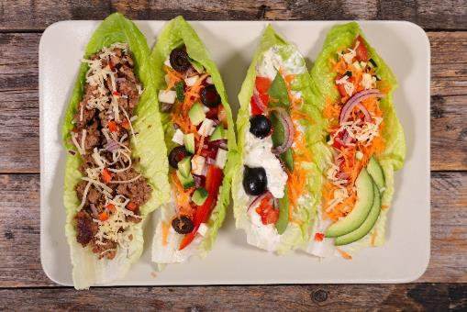

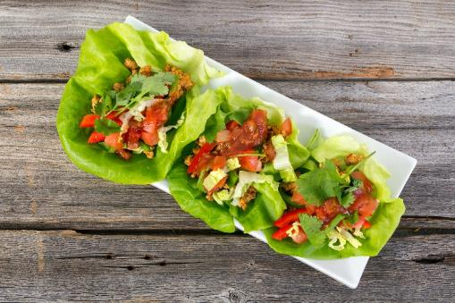
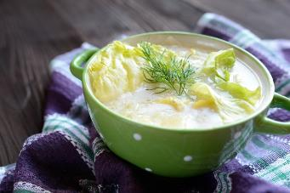
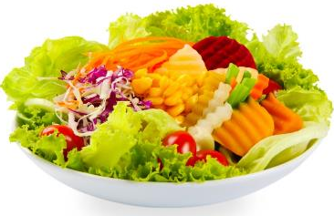
Dishes
Lettuce is eaten raw – just wash first.
Lettuce can be used in lots of dishes.

Slide 8
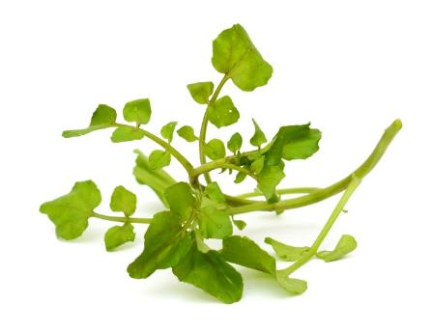
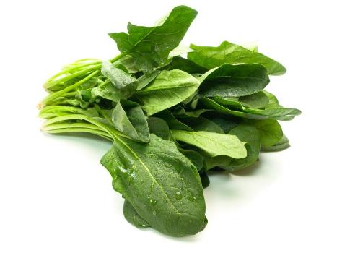
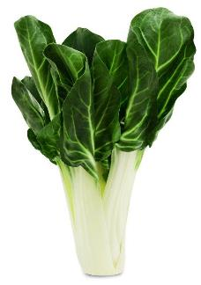
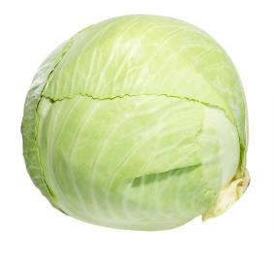
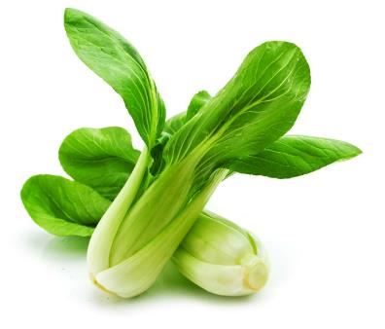
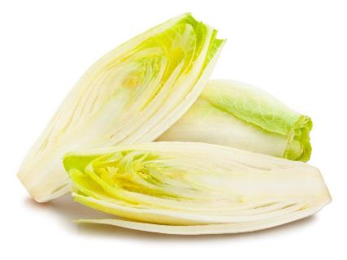
Similar
Spinach, cabbage, chard, chicory, watercress and pak choi are similar to lettuce.
They are all leaves of a plant.
Watercress
Spinach
Chard
Cabbage
Pak choi
Chicory

Slide 9



Summary
Lettuce is grown for our food.
Lettuce
Lots of dishes use lettuce.

Slide 10
Lettuce
For further information, go to:
www.foodafactoflife.org.uk

