Slide 1
Mushrooms

Slide 2
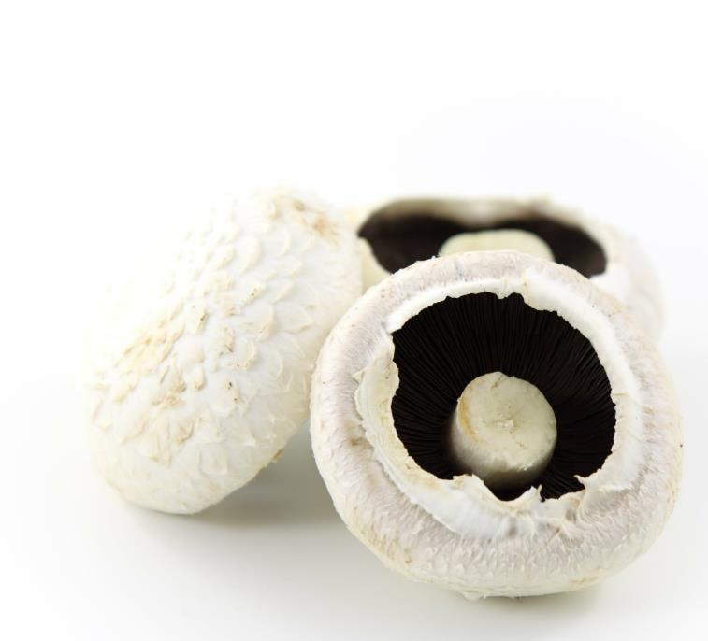
What are these?
These are mushrooms.
Mushrooms are actually different kinds of fungi, not plants.
Many types of mushroom are dangerous to eat, which is why the ones in the shops are carefully selected to be safe.
Notes:
At this age, mushrooms have been labelled as a vegetables – they are type of fungi, which are not plants.

Slide 3
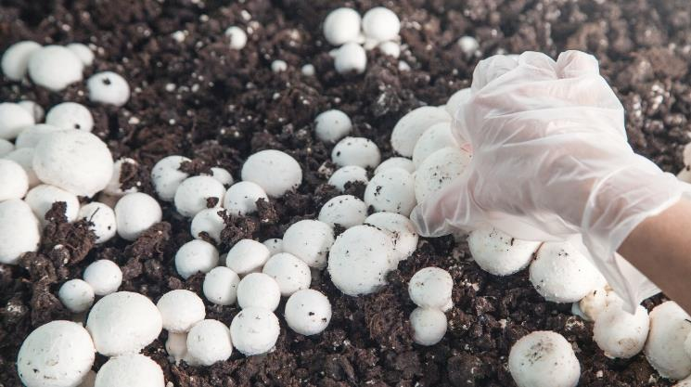
Where do mushrooms come from?
Mushrooms grow in the UK.
Mushrooms grow on soil/compost.
They grow above the ground.
In the wild, they may grown around trees.

Slide 4
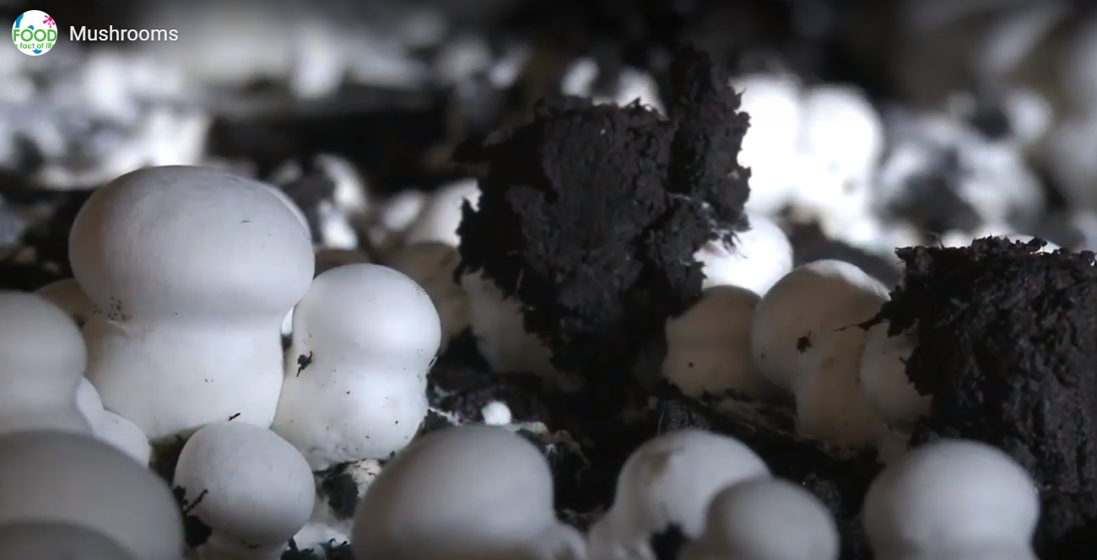
Where do mushrooms come from?
Mushrooms are picked when ready.
Watch this video about mushrooms.
Click on the picture above to watch the video.

Slide 5
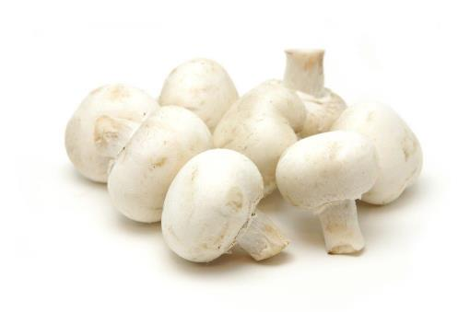
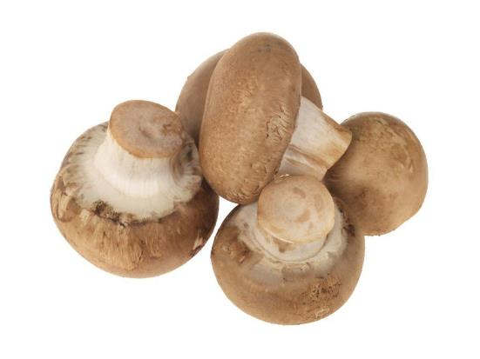
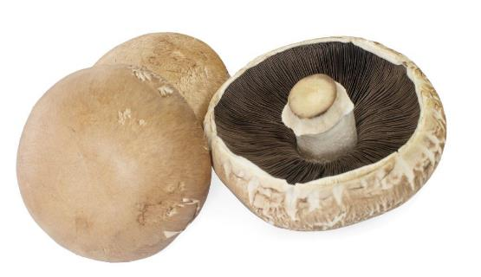
Mushroom varieties
There are lots of different types mushrooms.
They have different names, such as:
Button;
Chestnut;
Portobello.
Button
Chestnut
Portobello

Slide 6
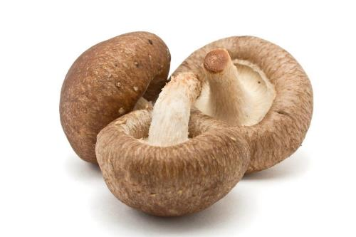
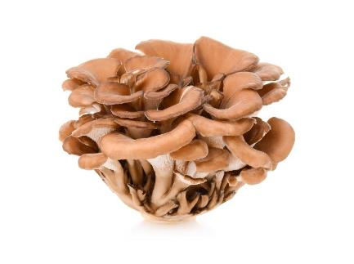
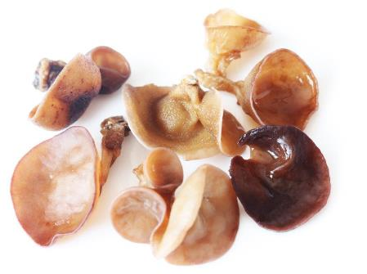
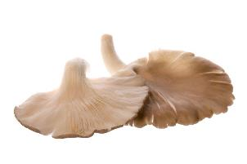
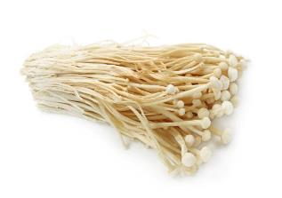
Mushroom varieties
More unusual mushroom varieties include:
Oyster;
Shiitake;
Maitake (hen of the woods);
Enoki;
Wood ear.
Shitake
Maitake
Oyster
Wood ear
Enoki

Slide 7
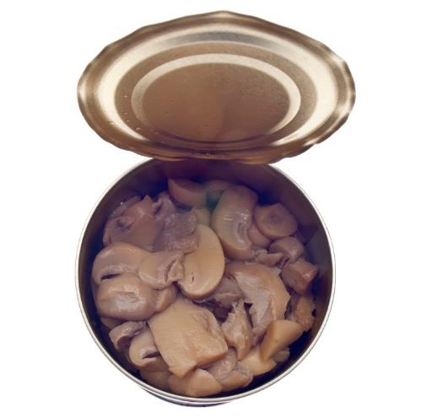
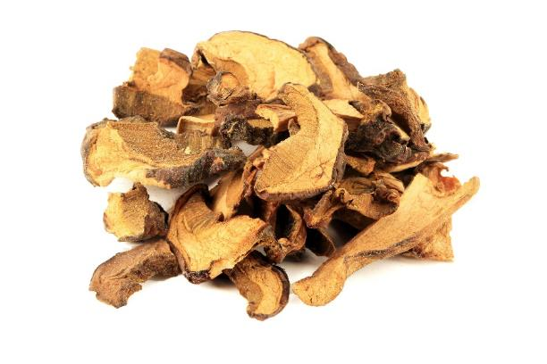
Mushrooms
Mushrooms can be purchased as:
fresh;
canned;
frozen;
dried.

Slide 8
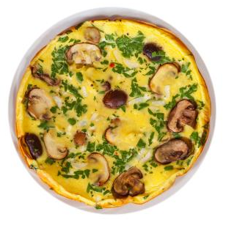
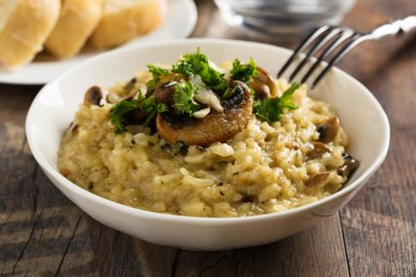
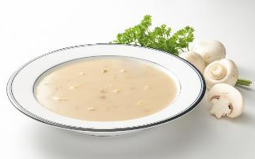
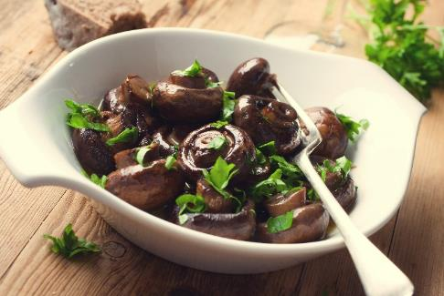
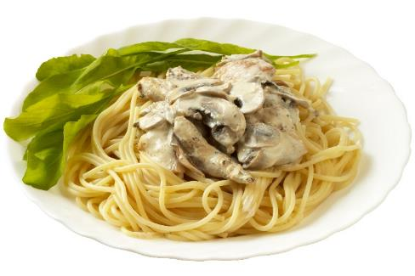
Dishes
Mushrooms can be eaten raw – just wipe first.
Mushrooms can be used in lots of dishes.

Slide 9
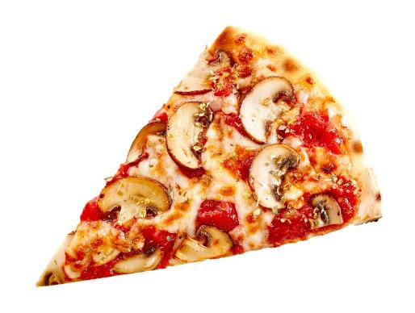
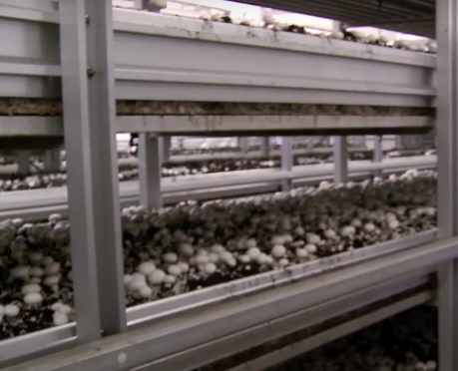
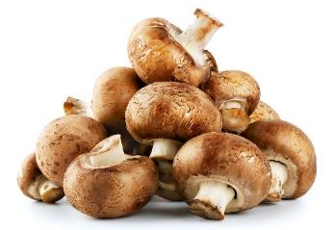
Summary
Mushrooms are grown for our food.
Mushrooms
Lots of dishes use mushrooms.

Slide 10
Mushrooms
For further information, go to:
www.foodafactoflife.org.uk

