Slide 1
Onions

Slide 2
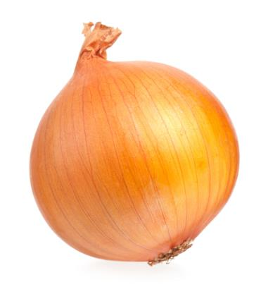
What is this?
This is an onion, the bulb of a plant (vegetable).
Some plants have bulbs which stay underground to store food for the plant when it is not growing.
When the time is right, the bulb produces shoots which grow up through the soil.

Slide 3
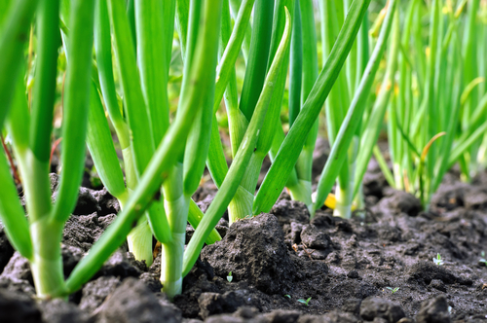
Where do onions come from?
Onions grow in the UK.
Onions are a plant.
Onions grow under the ground.
Onions are the bulb of the plant.

Slide 4
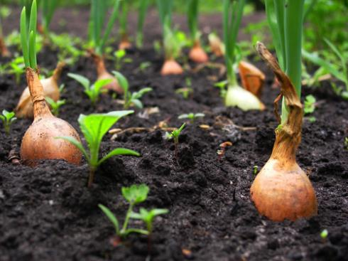
Where do onions come from?
Onions are pulled up from the ground when ready.
The main onion crop is harvested in late August and September. They can be carefully stored until the following July.

Slide 5
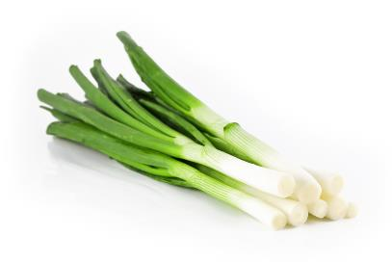

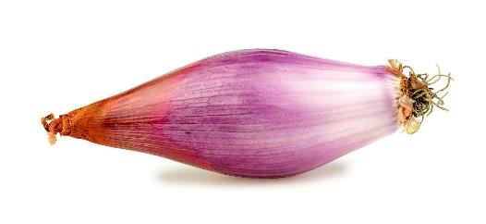
Onion varieties
There are 21different types of onion.
They have different names, such as:
Cipollini;
Spring onion;
Cocktail.

Slide 6
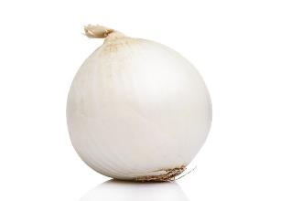
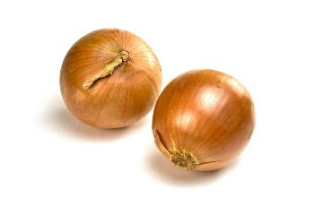
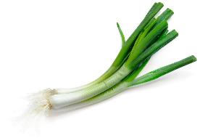
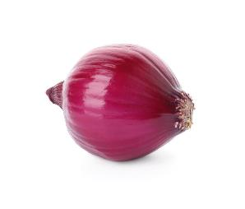
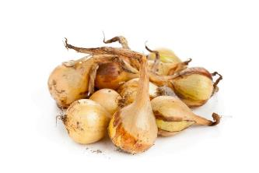
Onion types
Types of onions include:
Cooking;
White;
Pickling;
Green;
Salad;
Red.
Cooking
White
Green
Red
Pickling

Slide 7
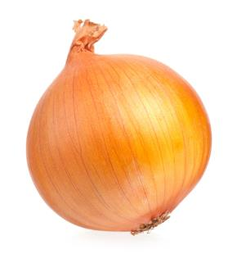
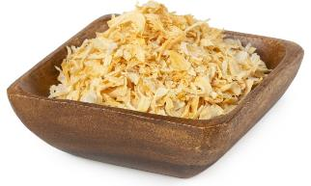
Onions
Onions can be purchased as:
fresh;
frozen;
dried.

Slide 8
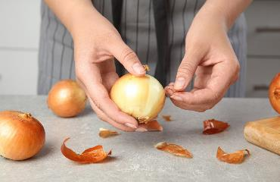
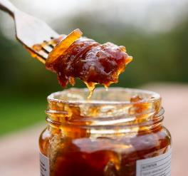
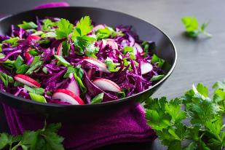
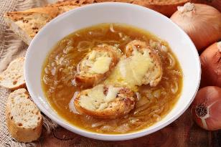
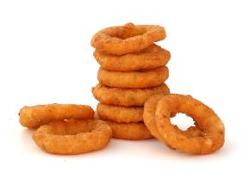
Dishes
Onions can be eaten raw – just peel first.
Onions can be used in many dishes.

Slide 9
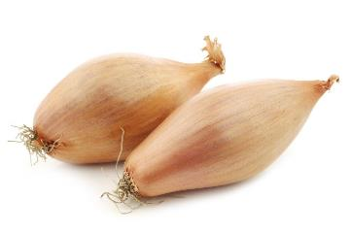
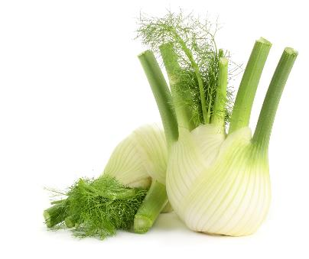
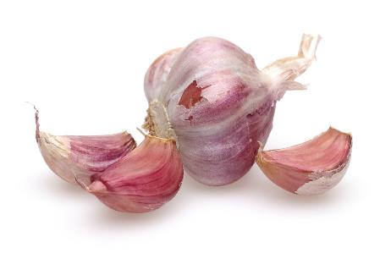
Similar
Garlic, shallot and fennel are similar to onions.
They are all bulbs.
Shallots
Fennel
Garlic

Slide 10


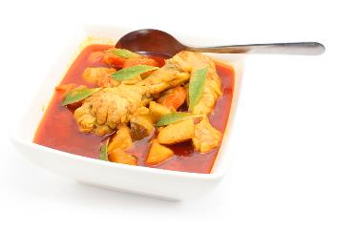
Summary
Onions are grown for our food.
Onion
Lots of dishes use onions.

Slide 11
Onions
For further information, go to:
www.foodafactoflife.org.uk

