Slide 1
Oranges

Slide 2
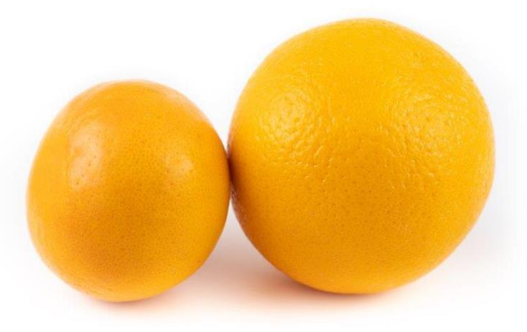
What are these?
These are oranges, known as citrus fruits.
Citrus fruits are usually quite large and round. They have a waxy outer layer that needs to be peeled off before they can be eaten. They also tend to have a sour taste.

Slide 3
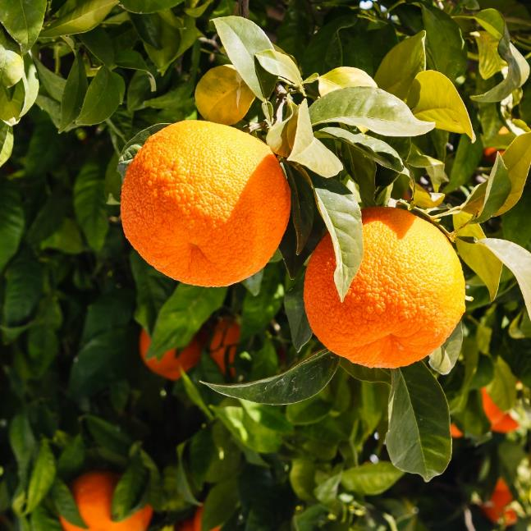
Where do oranges come from?
Oranges grow in warm climates.
Oranges are from a plant, they are the ‘fruit’ of the plant.
They grow above the ground.
They are known as ‘citrus’ fruit.

Slide 4
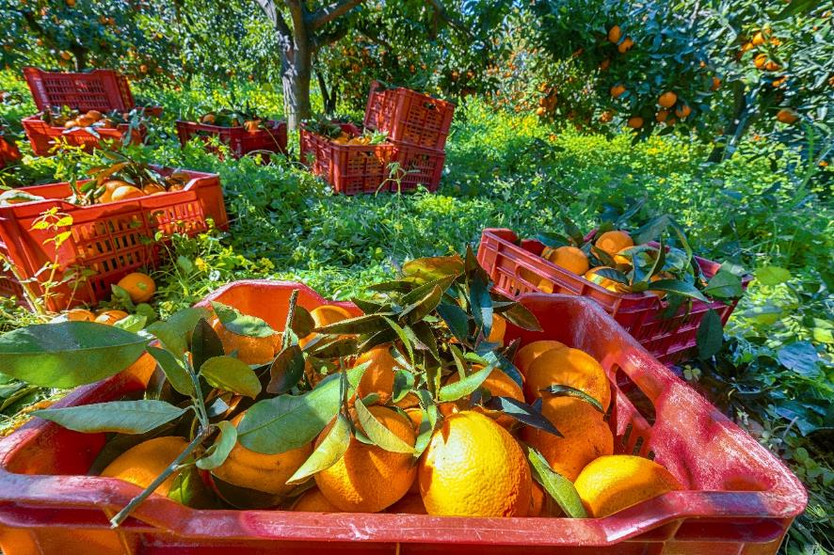
Where do oranges come from?
Oranges are picked when they are ready (ripe).
There are over 600 varieties of orange around the world.

Slide 5
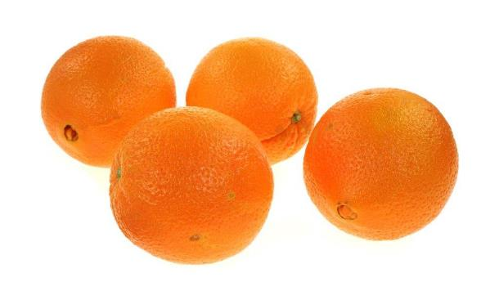
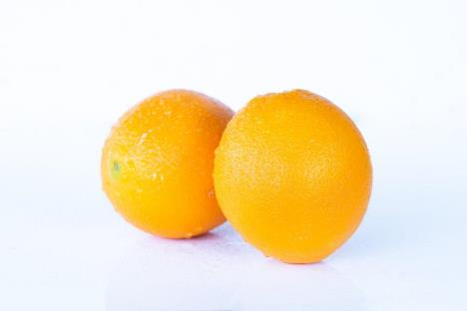
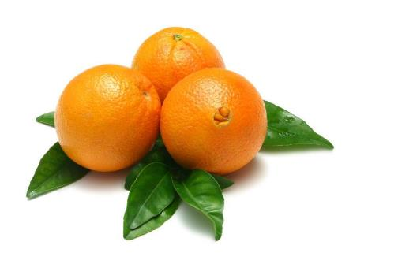
Orange varieties
Orange varieties include:
Valencia;
Navel;
Cara cara (sometimes called pink navel or red navel);
Lima.
Cara cara
Valencia
Navel

Slide 6
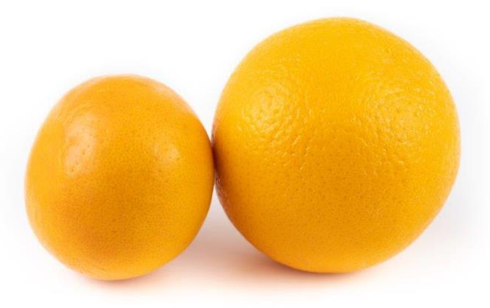

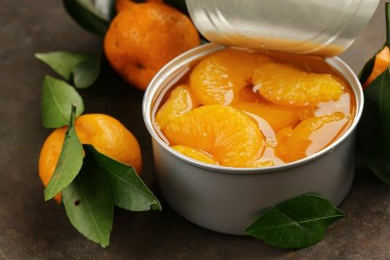
Oranges
Oranges can be purchased as:
fresh;
juiced;
canned.

Slide 7
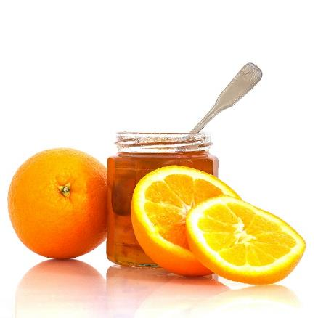
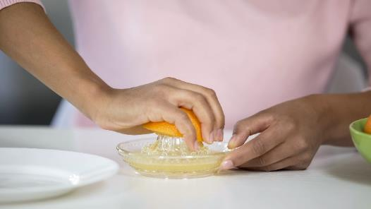


Dishes
Oranges can be eaten raw – just peel first. They can also be juiced!
Oranges can be used in lots of dishes.

Slide 8
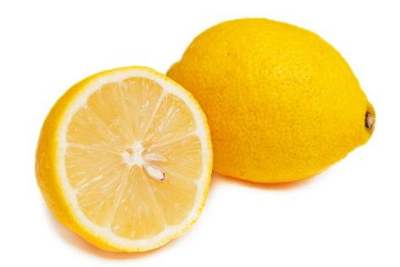
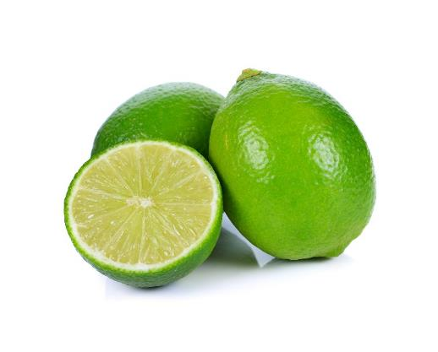
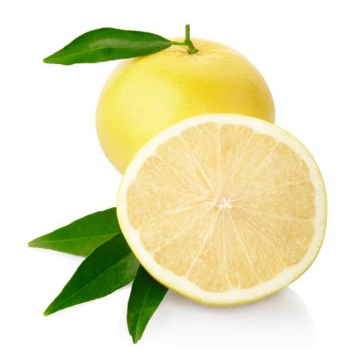
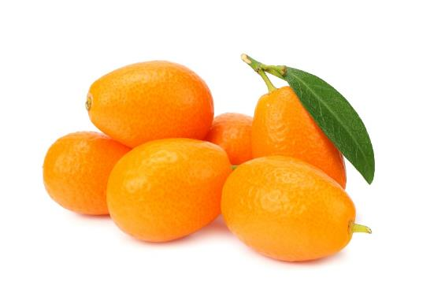
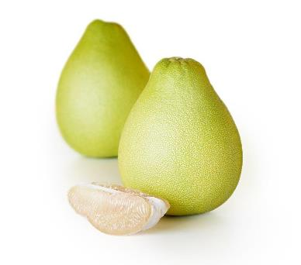
Similar
These are all known as citrus fruit.
Lemons, limes, grapefruit, pomelo and kumquats are similar to oranges.
Lemons
Limes
Kumquats
Grapefruits
Pomelo

Slide 9
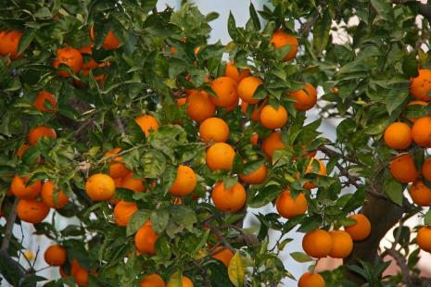

Summary
Oranges are grown for our food.
Oranges
Lots of dishes use oranges.

Slide 10
Oranges
For further information, go to:
www.foodafactoflife.org.uk

