Slide 1
Peas

Slide 2
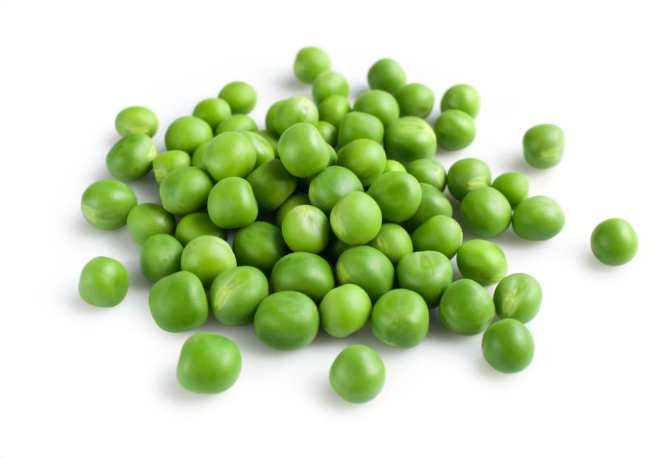
What are these?
These are peas, they are called ‘legumes’ (a vegetable).
Legumes are grown for their edible seeds, such as peas and beans.

Slide 3
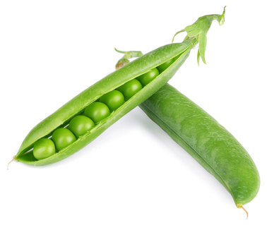
Where do peas come from?
Peas grow in the UK.
Peas are a plant (vegetable).
They grow above the ground – they are found in pods.

Slide 4
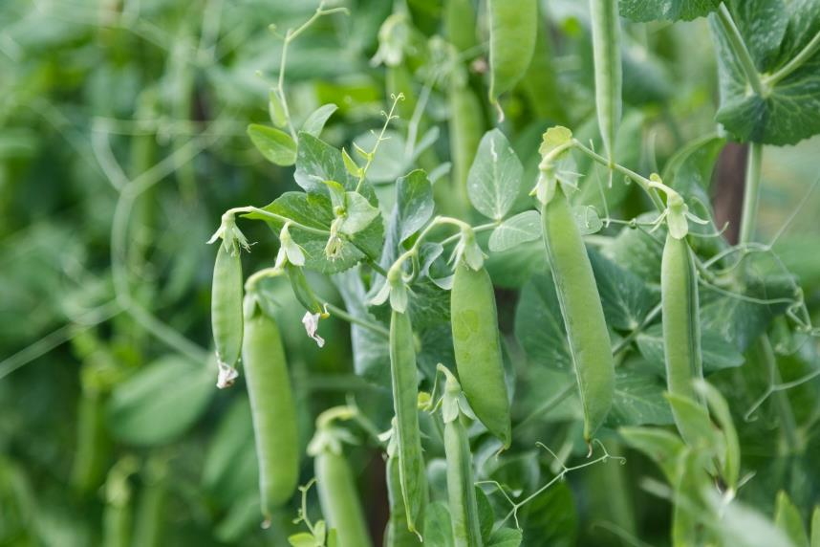
Where do peas come from?
The pods are picked when ready and the peas are removed.
They are harvested in the UK between June and August.

Slide 5
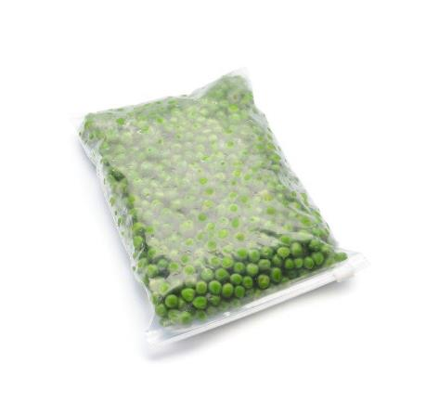

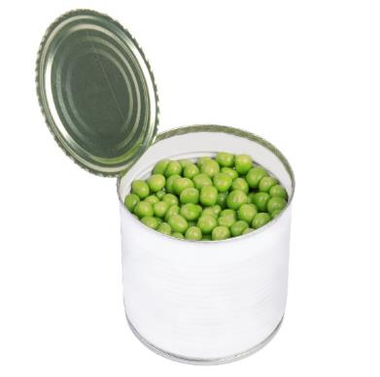
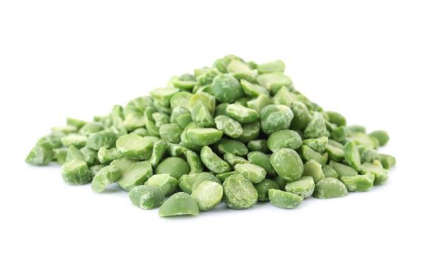
Peas
Peas can be purchased as:
fresh;
frozen;
dried;
canned.

Slide 6
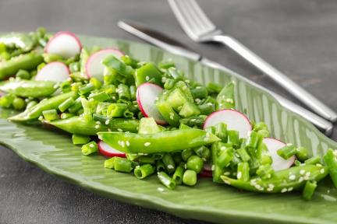
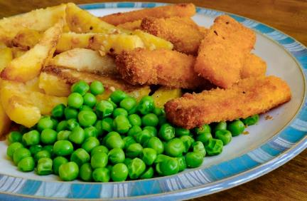
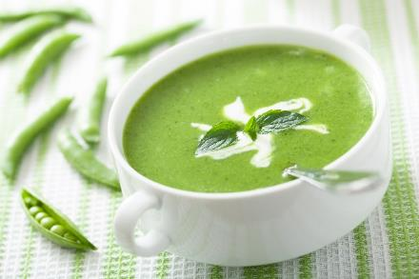
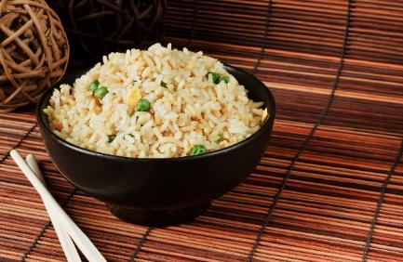
Dishes
Peas can be eaten raw – remove from the pod first.
Peas can be used in lots of dishes.

Slide 7
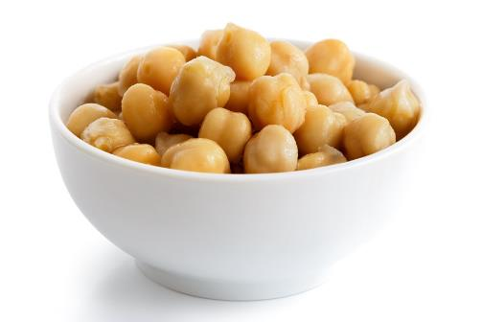
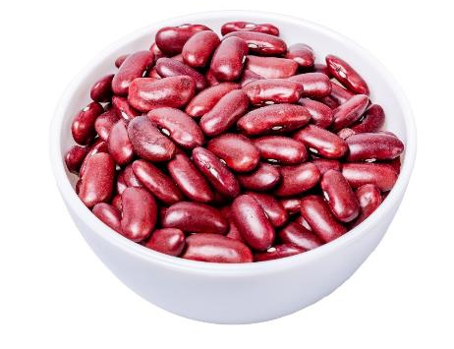
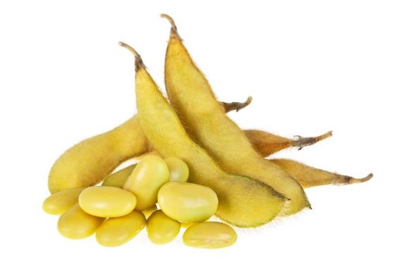
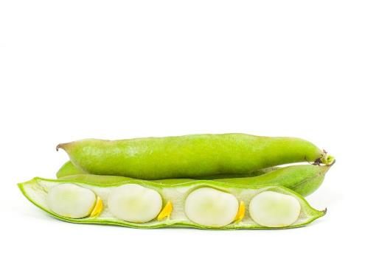
Similar
Chickpeas, red kidney beans, soy beans and lima beans are similar to peas.
They all belong to a family called legumes.
Chickpeas
Kidney beans
Soy beans
Lima beans

Slide 8



Summary
Peas are grown for our food.
Peas
Lots of dishes use peas.

Slide 9
Peas
For further information, go to:
www.foodafactoflife.org.uk

