Slide 1
Plums

Slide 2
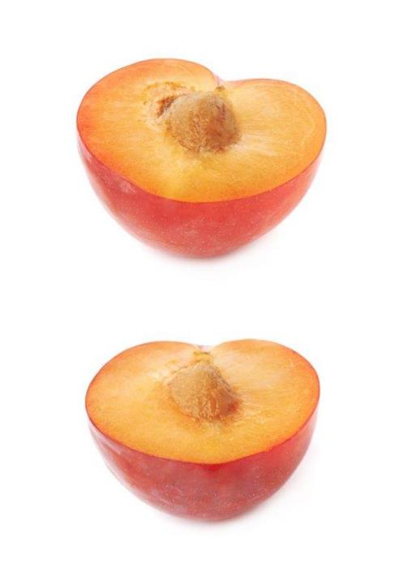
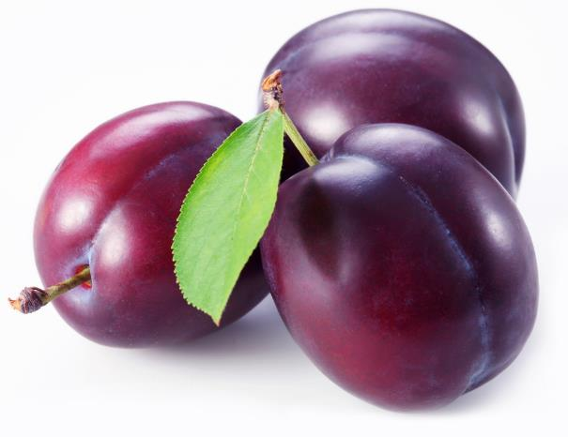
What are these?
These are plums, known as a ‘stone’ fruit.
Stone fruit are those that have a large, hard ‘stone’ in the middle of them that is not eaten.

Slide 3
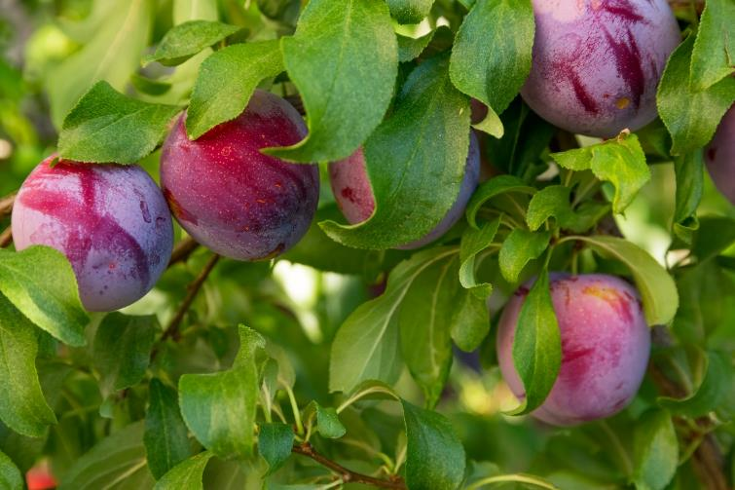
Where do plums come from?
Plums grow in the UK.
Plums are a plant and grow on a tree.
Plums are the fruit from the tree.
Plums have a hard ‘stone’ in the middle.

Slide 4

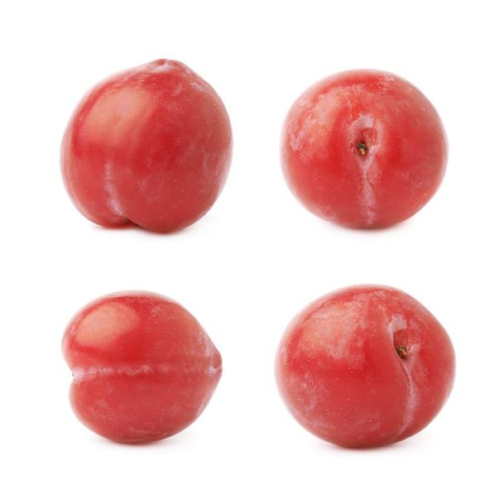
Plum types
There are lots of different types plum.
They have different names, such as:
Victoria;
Opal;
Czar.

Slide 5
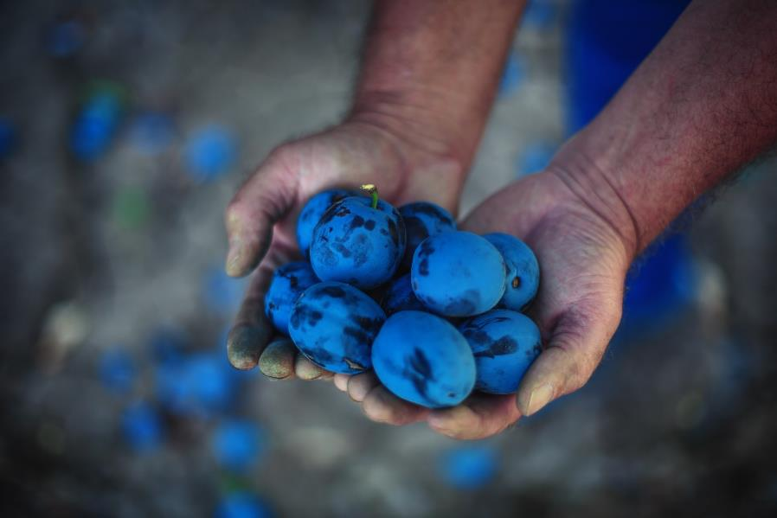
Harvesting
Plums are pulled off the tree when ready (ripe).
Plums are usually in season around August to October in the UK.

Slide 6
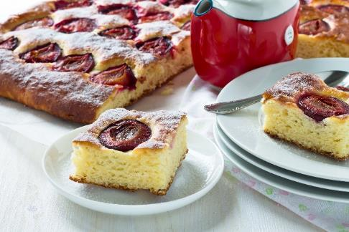

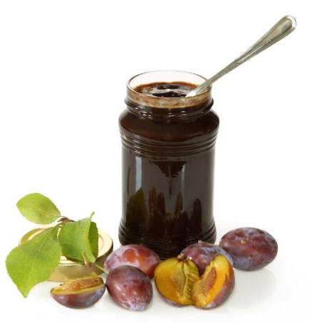
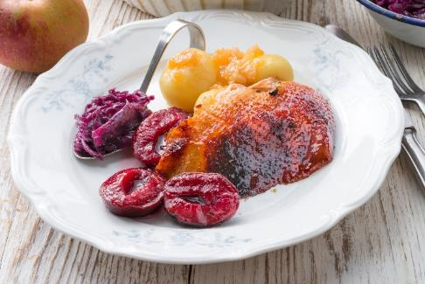
Dishes
Plums can be eaten raw – just wash first and remove the stone.
Plums can be used in lots of dishes.

Slide 7
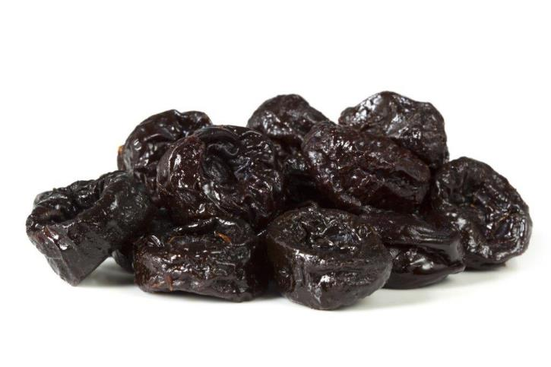
Prunes
Sweet black plums are often dried to create prunes.

Slide 8
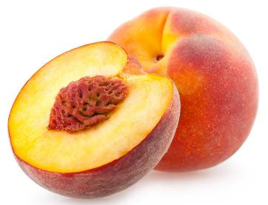
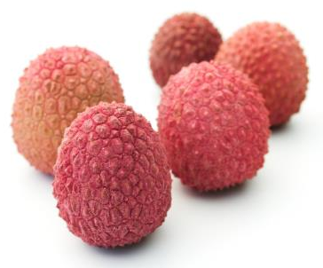
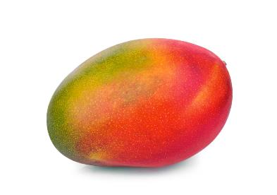
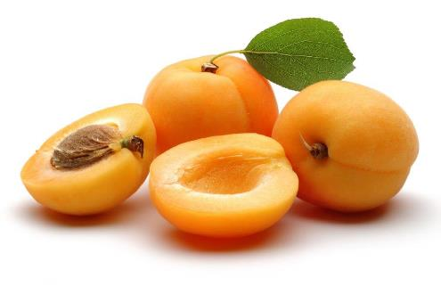
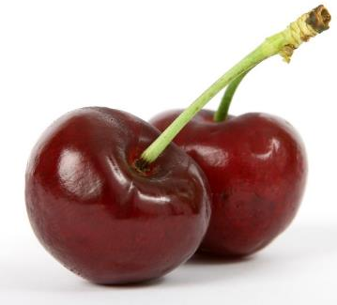
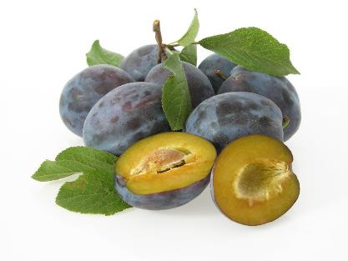
Similar
Peaches, cherries, lychee, damson, apricot and mango are similar to plums.
They are fruits with a central stone.
Peaches
Lychees
Mango
Apricots
Damsons
Cherries

Slide 9

Summary
Plums are grown for our food.
Plums
Lots of dishes use plums.

Slide 10
Plums
For further information, go to:
www.foodafactoflife.org.uk

