Slide 1
Tomatoes

Slide 2
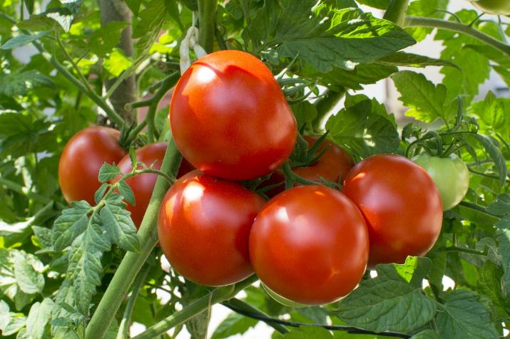
What are these?
These are tomatoes.
Tomatoes are a savoury ‘fruit’, but are more commonly known as a vegetable.
The fruit of a plant is created after its flowers have been pollinated.
Many fruits are sweet, but some fruits are not and are usually used like a vegetable in food.

Slide 3
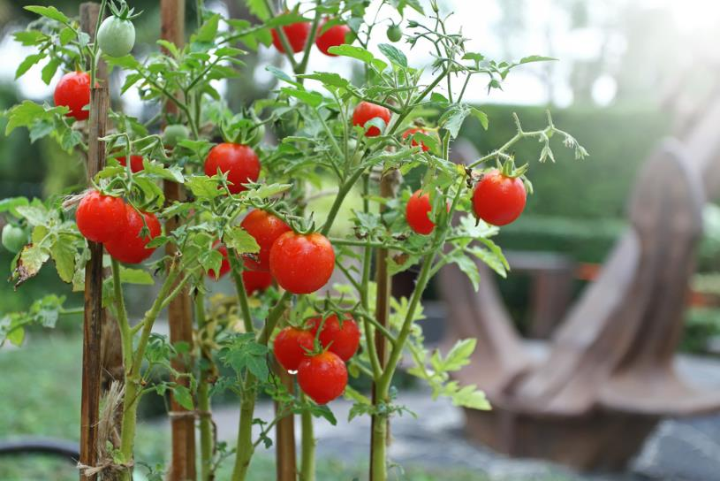
Where do tomatoes come from?
Tomatoes are from a plant.
They grow above the ground.
They are the fruit of the plant.

Slide 4
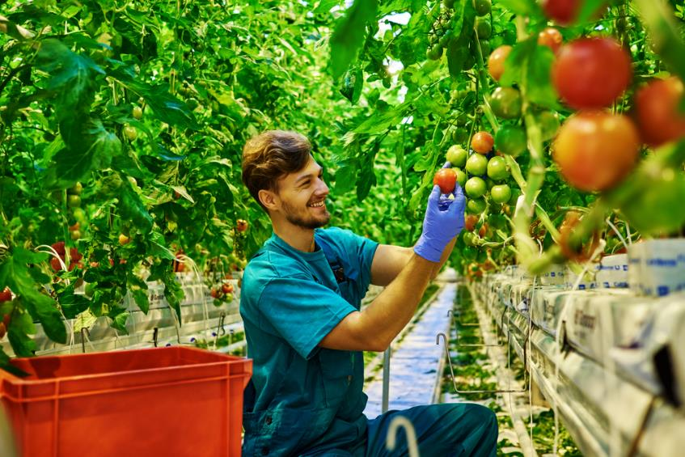
Harvesting
Tomatoes are picked when ready (often as they change colour from green to red).

Slide 5
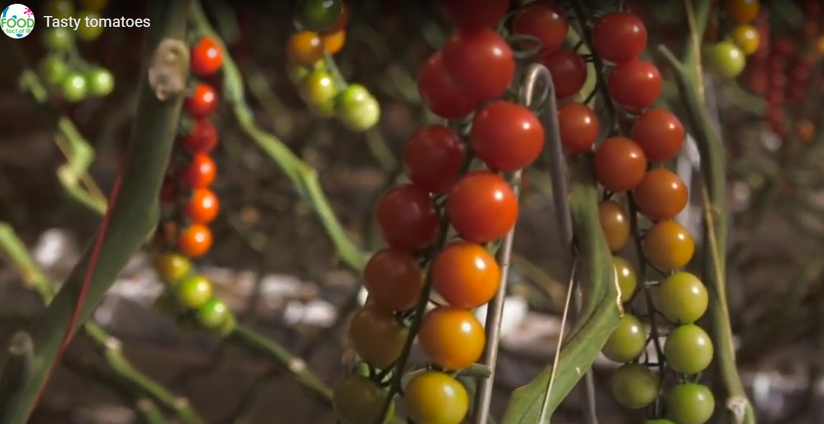
Harvesting
Watch this video about tomatoes.
Then answer the Tasty tomatoes quiz.
Click on the picture above to watch the video.

Slide 6
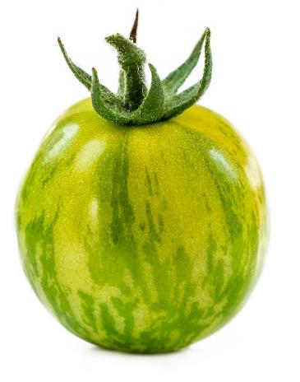
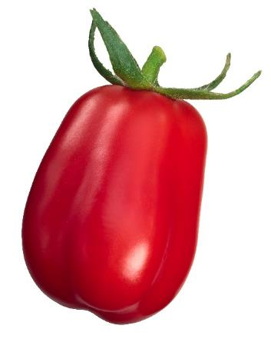
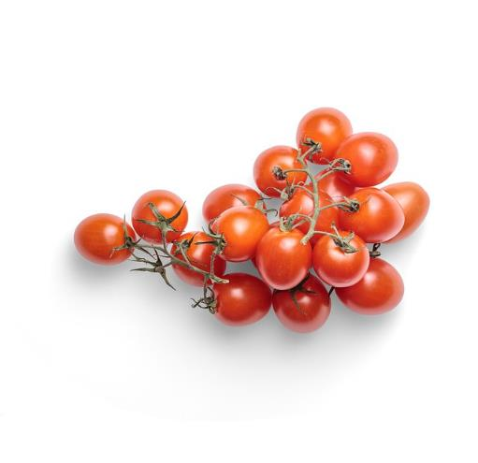
Tomato varieties
There are lots of different types tomatoes.
They have different names, such as:
Cherry;
San marzano;
Green zebra.
Green zebra
San Marzano
Cherry

Slide 7
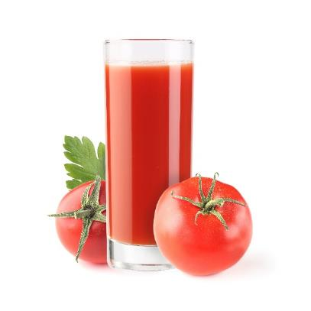
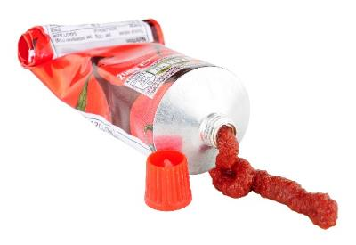
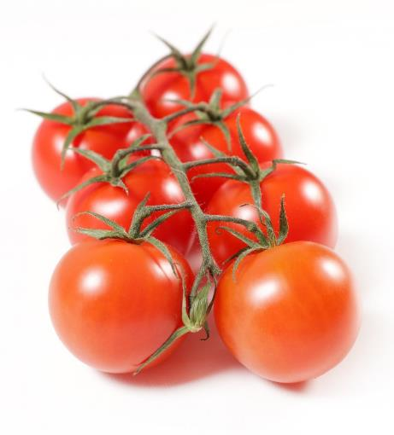
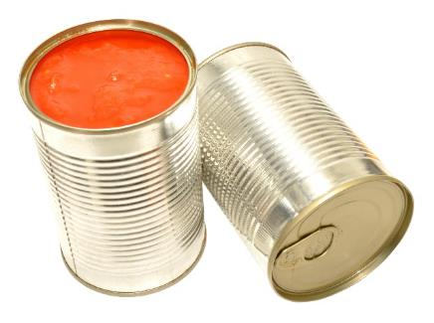
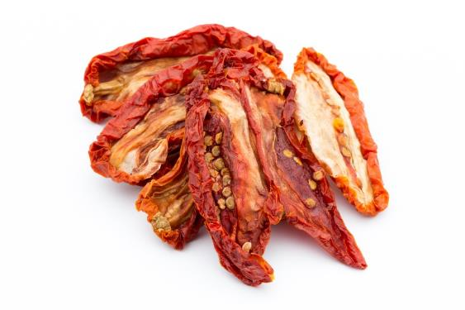
Tomatoes
Tomatoes can be purchased as:
fresh;
canned;
pureed;
juiced;
dried.

Slide 8
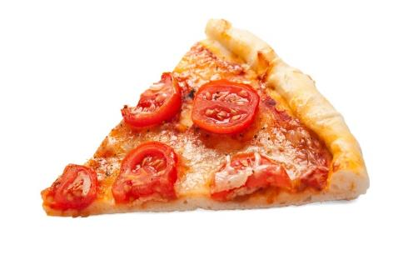
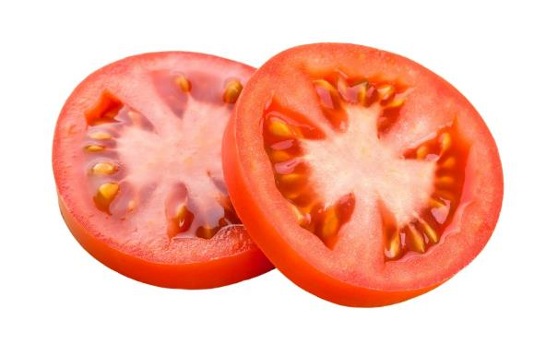
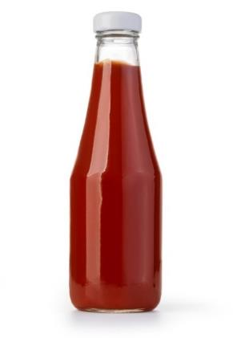
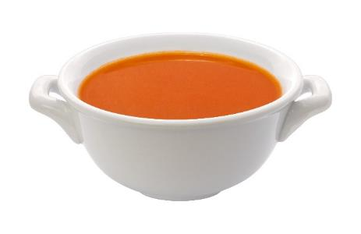
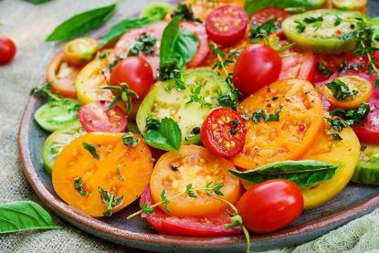
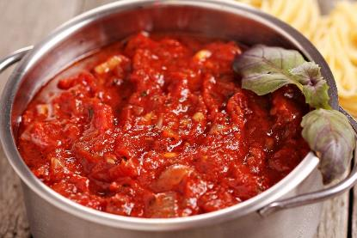
Dishes
Tomatoes can be eaten raw – just wash first.
Tomatoes can be used in lots of dishes.

Slide 9
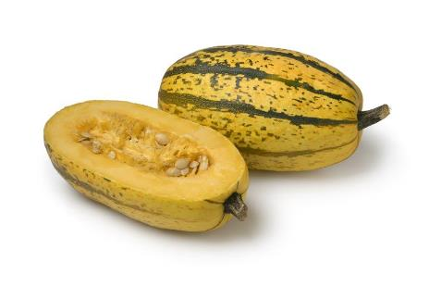
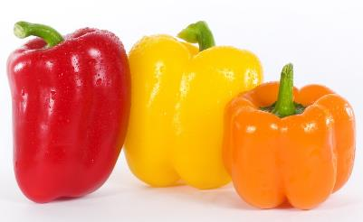
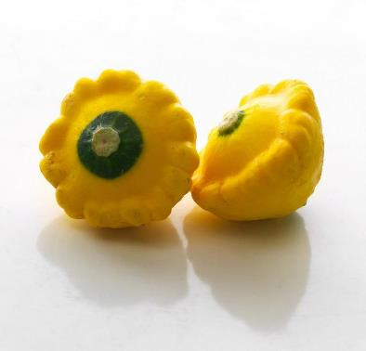
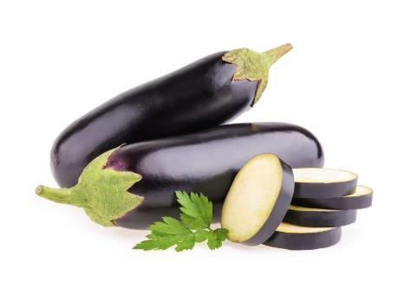
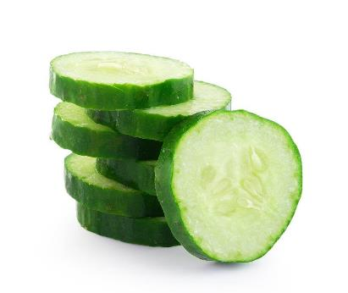
Similar
Peppers, cucumbers, aubergine and squash are similar to tomatoes.
They are the ‘fruit’ of a plant, but are eaten as a ‘vegetable’.
Spaghetti squash
Peppers
Yellow scallop squash
Aubergine
Cucumber

Slide 10



Summary
Tomatoes are grown for our food.
Tomatoes
Lots of dishes use tomatoes.

Slide 11
Tomatoes
For further information, go to:
www.foodafactoflife.org.uk

