Slide 1
The science of bread making

Slide 2
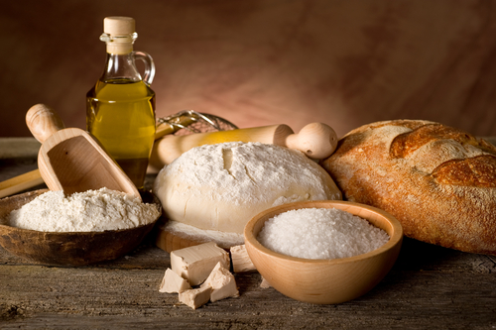
Basic ingredients
The basic ingredients of bread are:
flour;
yeast (to make the bread rise);
salt (to add taste and aid proving);
fat (sometimes added to make the loaf lighter and extend shelf life);
water.
All white bread commercially sold in the UK is made with white flour fortified with calcium, iron and B vitamins. It is a legal requirement to fortify flour in the UK.

Slide 3
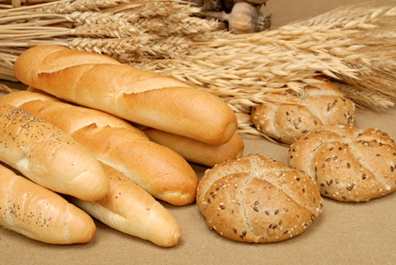
Yeast
Almost all breads today are leavened, which means that a substance has been added to the dough to start fermentation and make it rise.
The most popular and widely known leavening ingredient is yeast.

Slide 4
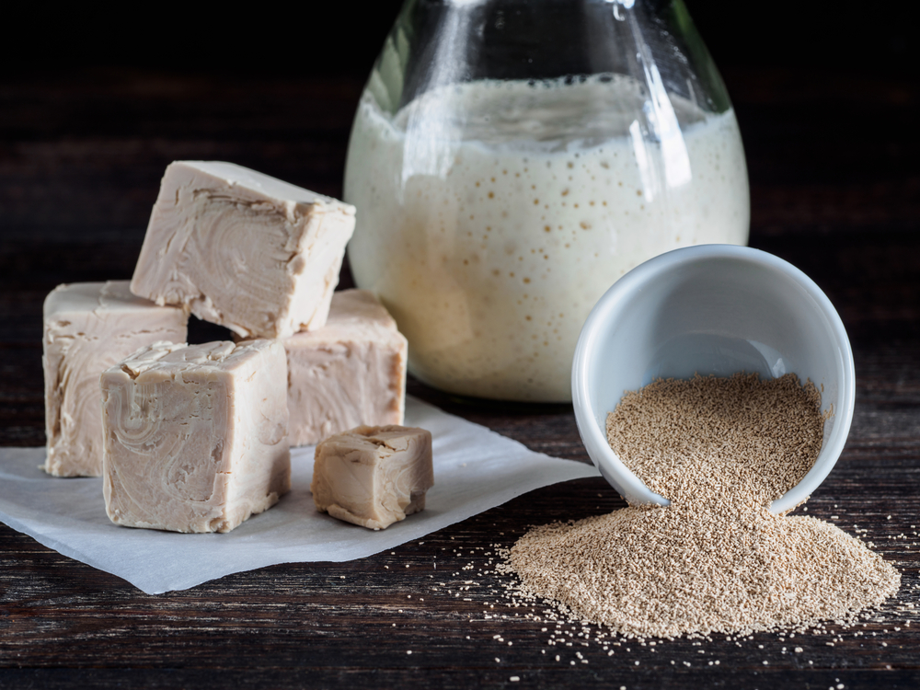
Yeast
Yeast is a micro-organism, one of the tiniest forms of life. The air around us is full of thousands of different kinds of yeast. If it is given warm, damp surroundings and starchy or sweet matter, it will start to multiply.
As the yeast multiplies, it turns starches and sugars to alcohol and produces carbon dioxide gas. It is this gas that adds the air into the dough, and makes it increase in size.
Yeast must be mixed with a warm liquid before adding it to flour. If the liquid is too cool, the yeast won't multiply; if it is too hot (over 43°C), the yeast will be killed.

Slide 5
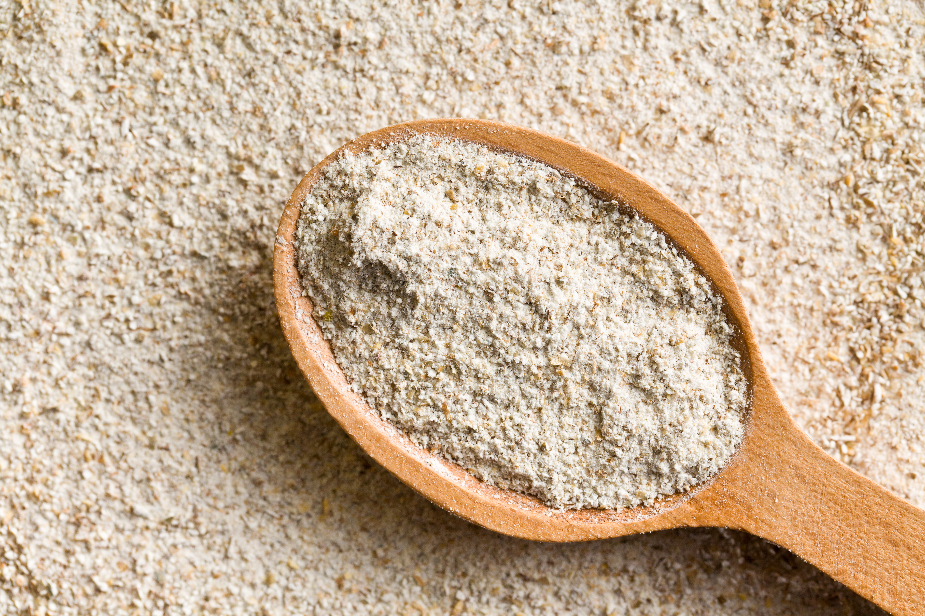
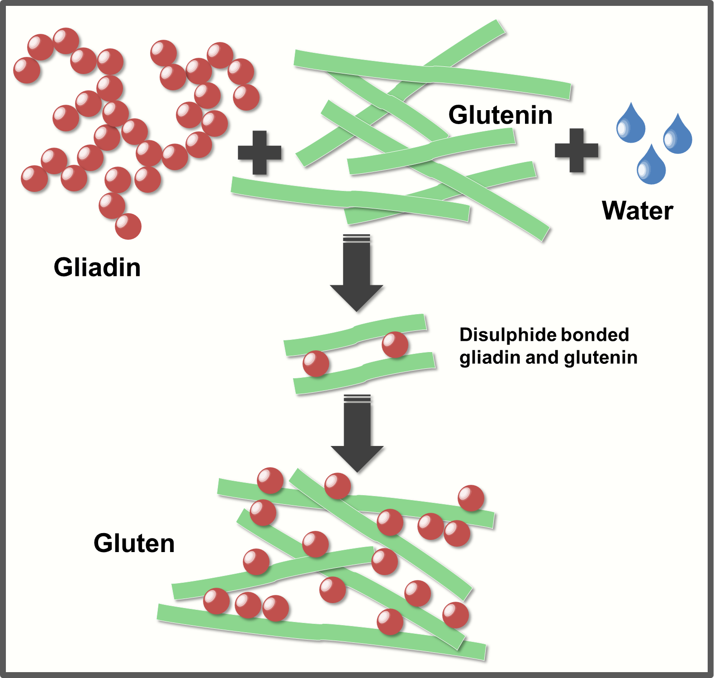
Flour
The important protein found in flour is gluten.
Gluten is vital when making bread, as it forms a supporting structure, which prevents the bread from collapsing and also provides an elastic (springy) and chewy texture in baked goods.
Gluten is formed from two classes of proteins, gliadins and glutelins, which are commonly found in grains, such as wheat, rye, and barley. In order to form gluten, water needs to be mixed with the gliadin and glutelin proteins, resulting in a dough.
The dough is then kneaded to make the gluten strong and long.

Slide 6
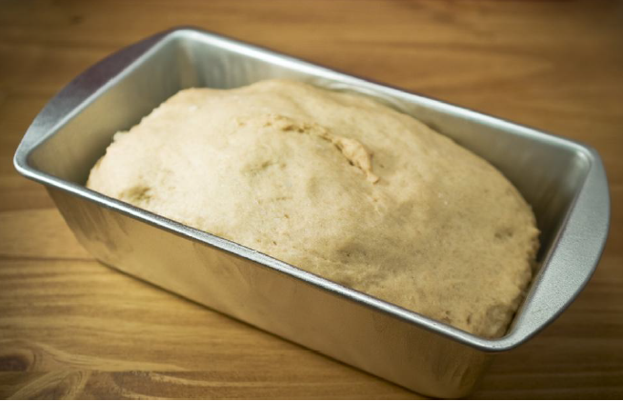
The stages of baking
All mixtures made with yeast are prepared in several distinct stages:
Ingredients are mixed to make a dough.
Dough is kneaded to help the protein (gluten) soften and strengthen the dough.
The dough is left to rise (or 'prove') to double its original volume, as the yeast cells multiply and produce carbon dioxide gas.
The dough is knocked back to remove the large air bubbles produced by the yeast. This ensures a more even texture and a better rise. Large bubbles would make large holes in the finished bread.

Slide 7
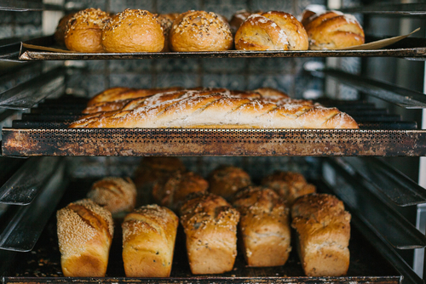
The stages of baking
The dough is shaped and may be put in a tin.
It is then covered and left to rise, or prove, again. When proved, the dough will be light, puffy and doubled in size.
The dough is ready to be baked. A hot oven (230°C, 450°F, gas mark 8) is needed to kill off the yeast cells.
The baked bread should be well risen, golden and crisp and should sound hollow when you tap it on the base. (The change in colour is called dextrinization.)

Slide 8
The science of bread making
For further information, go to:
www.foodafactoflife.org.uk

