Slide 1
See and eat – Vegetables Support for early years

Slide 2
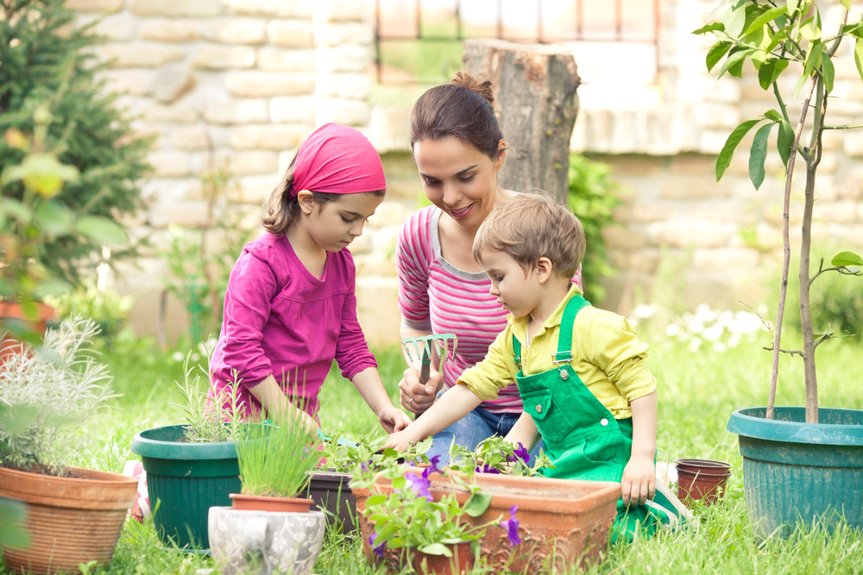
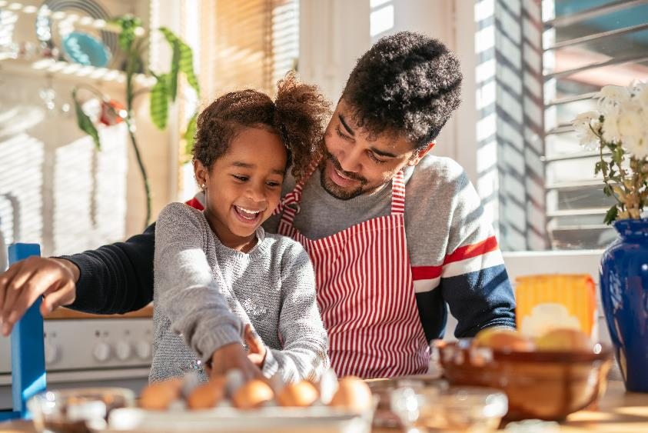
Why vegetables?
Eating plenty of different types of vegetables is important for health - eating habits developed at an early age can track into later life.
The preschool years are an important time for children to explore and experience a wide variety of vegetables (and other food) to set them on the right course for a lifetime of enjoying a healthy and varied diet.
Vegetables contain vitamins, minerals and fibre. Vitamins and minerals have lots of different jobs in the body and we need them to stay well. Fibre helps waste food move through the body to keep our digestive system healthy. Different vegetables contain different vitamins and minerals and amounts of fibre - this is why it is important to eat a variety of different vegetables.

Slide 3
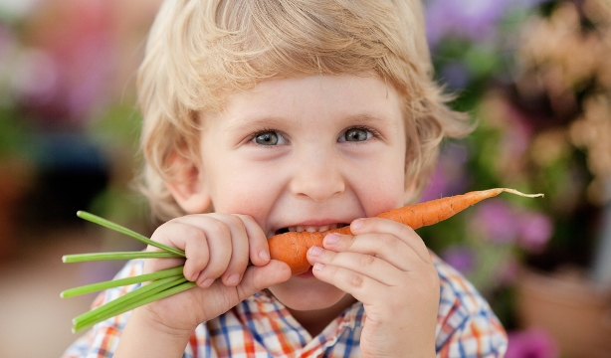
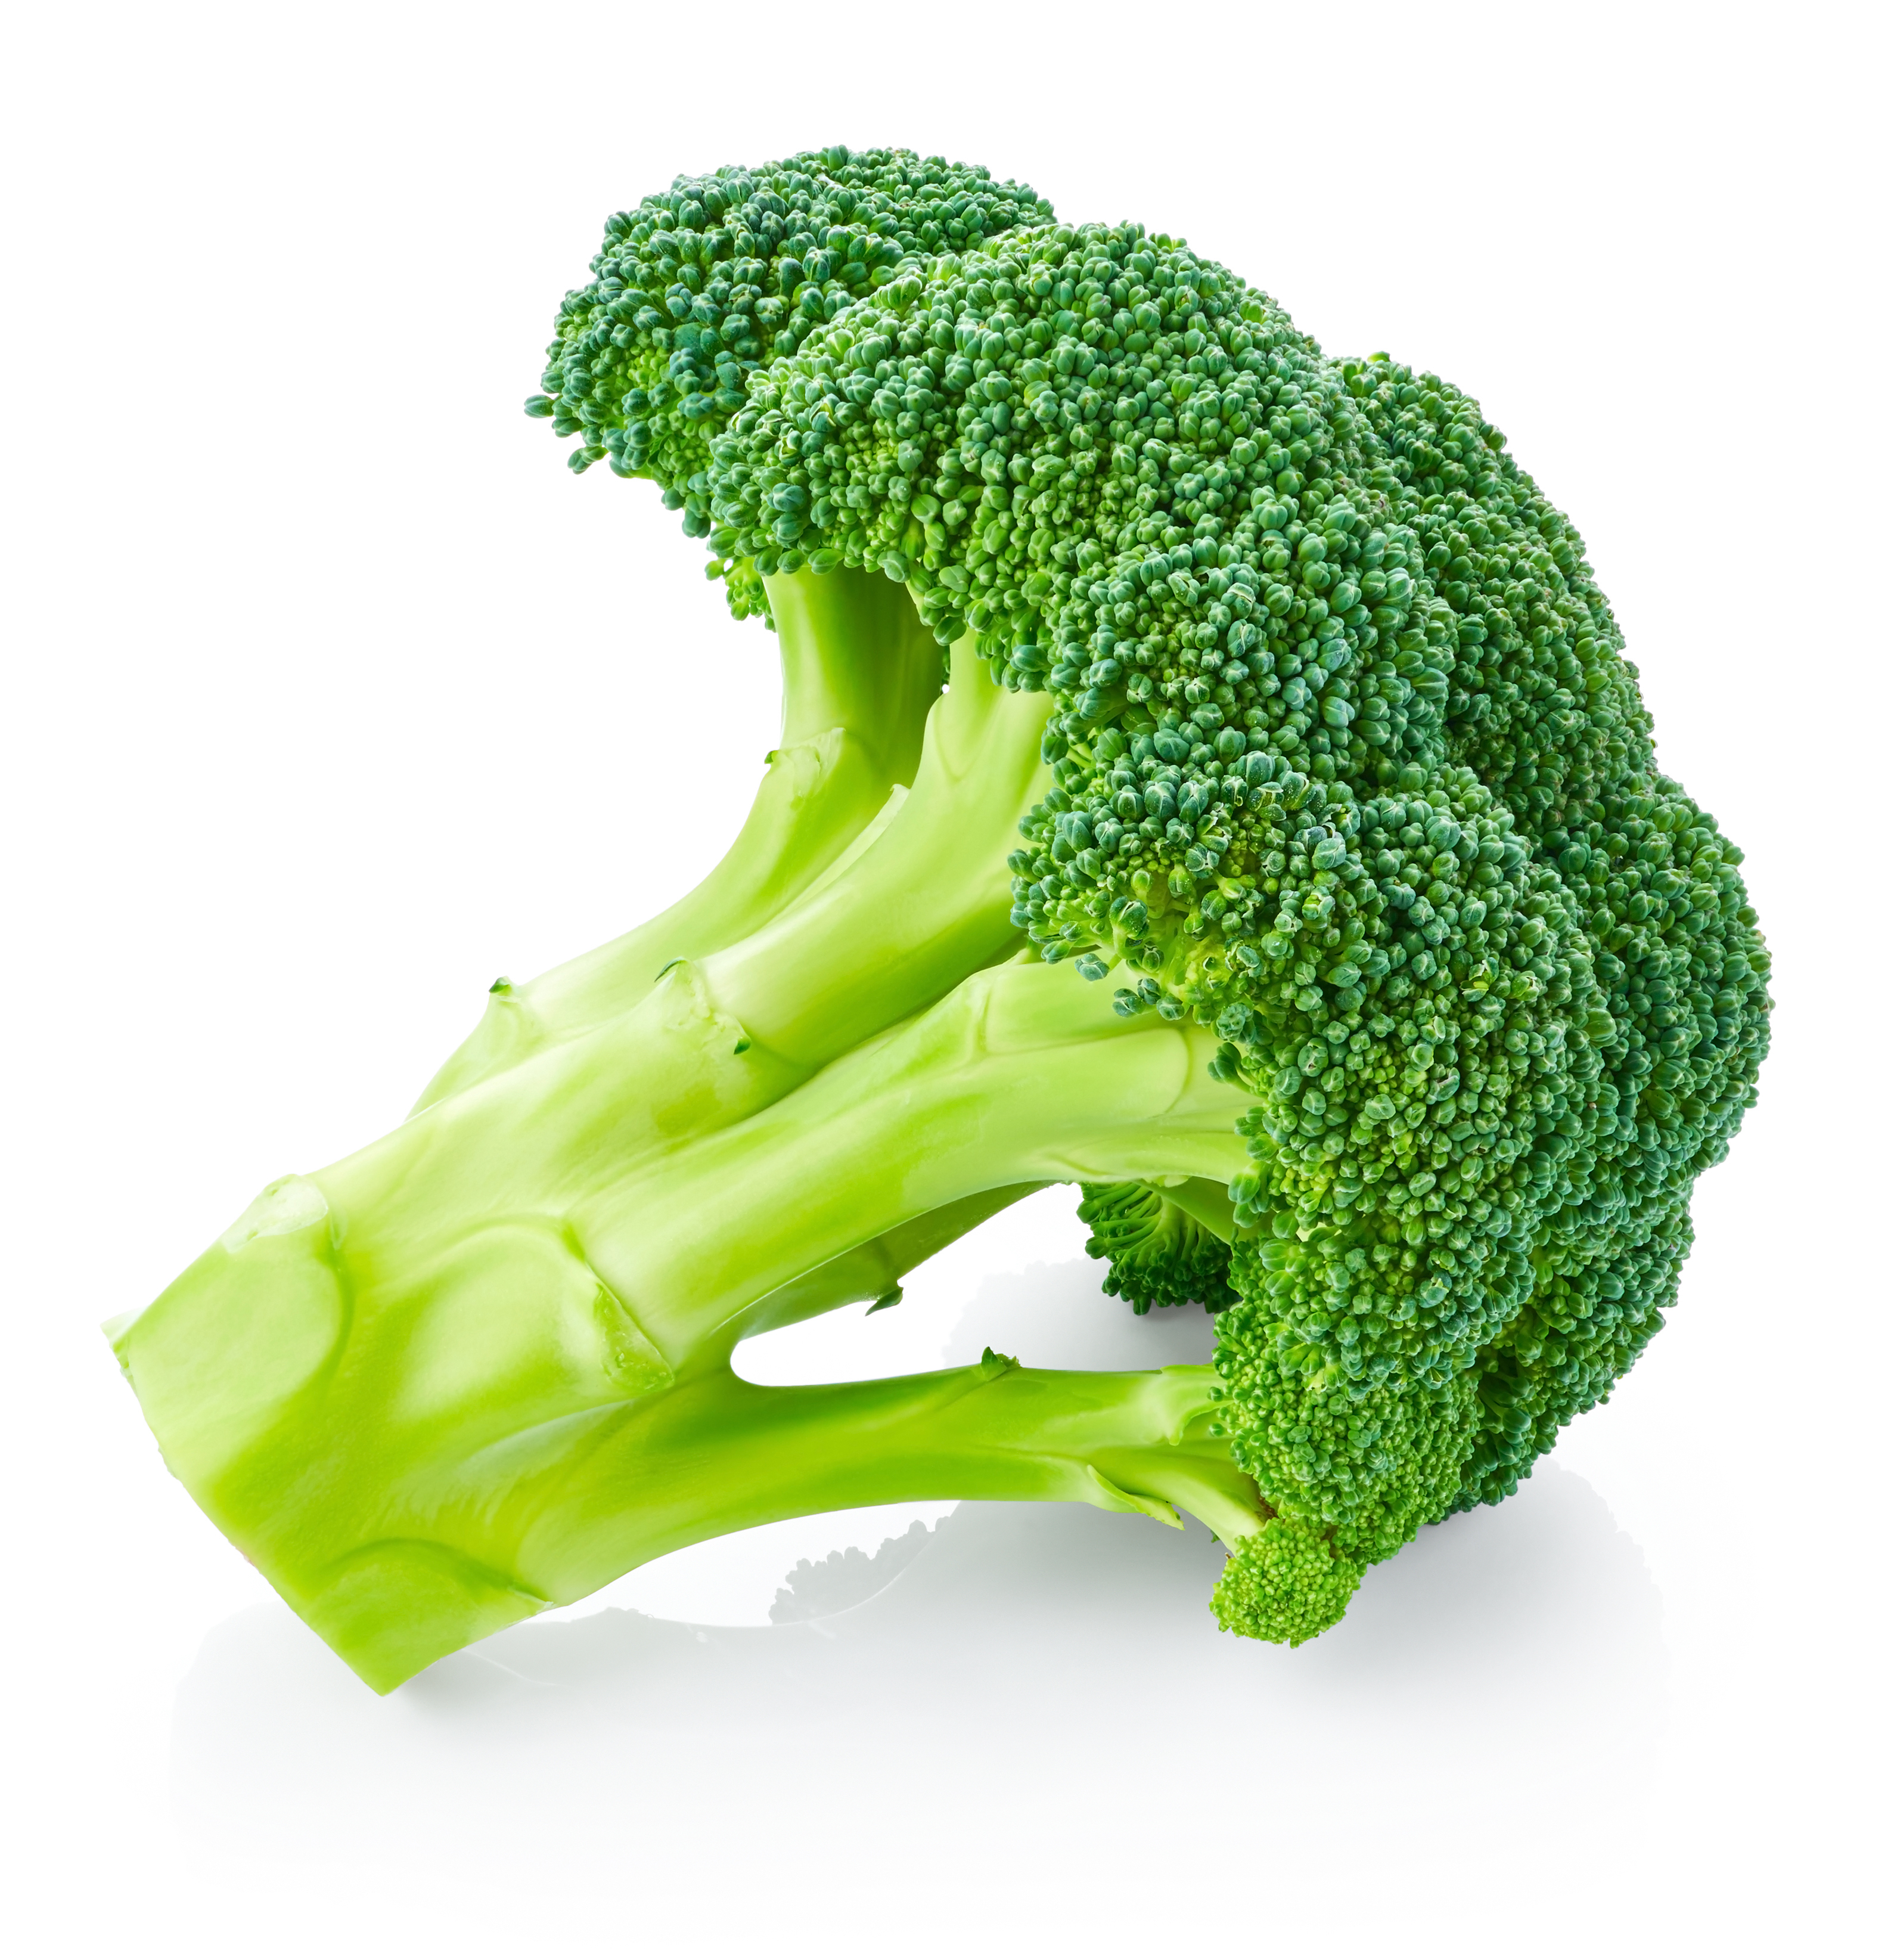
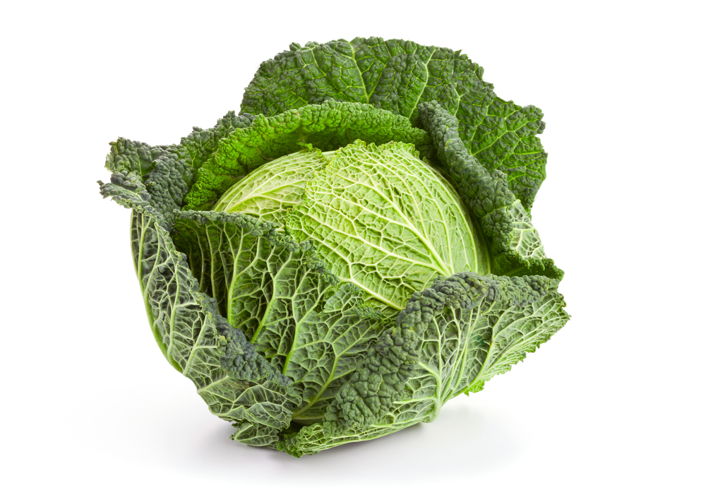
Getting children to eat their veg
Young children are often naturally cautious about new foods and it can take many attempts to get them to try something different.
It can be even more difficult with vegetables because they are less sweet than fruit and some types, such as broccoli and cabbage, have a naturally bitter taste which young children are more sensitive to than older children and adults.

Slide 4
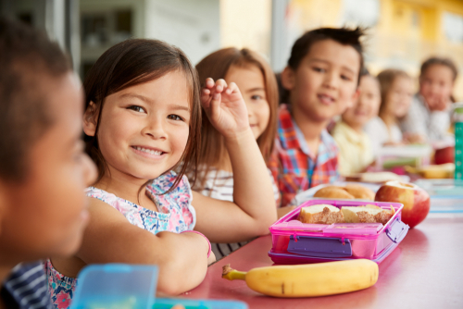
Eating habits
The preschool years are an important time for children to explore and experience a wide variety of vegetables (and other food) to set them on the right course for eating well as they grow up.
Sometimes offering vegetables at mealtimes and running tasting activity may not be enough!
Studies show that the best way to get children to eat more vegetables is to keep offering them over and over again (e.g. 10 or more times), but repeatedly buying, preparing and providing vegetables that are then rejected can be a challenge.
So, what else can be done?

Slide 5
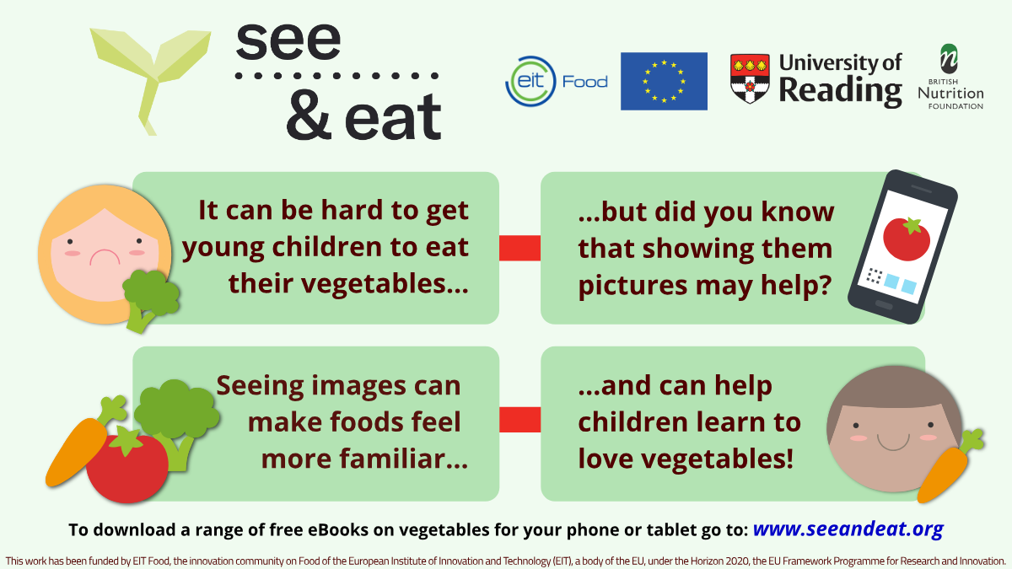
See & Eat
The See & Eat project is an exciting new way to get young children to eat vegetables!
The project is based on research from the University of Reading and is designed to help out parents and carers who might be having a hard time with children rejecting vegetables.

Slide 6
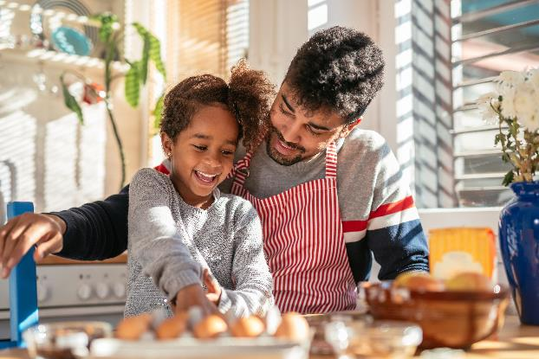
What’s the research?
Research undertaken by Reading University showed that looking at simple picture books of where vegetables come from, how they grow, are sold in shops, prepared and look when they are ready to eat, can help preschool children learn to like vegetables that they haven’t tried before or didn’t previously like.
The psychology behind this is that seeing images of a food can make it feel more familiar and can help reduce the natural anxiety that many young children have about trying new food, meaning they may then accept different vegetables more readily.

Slide 7
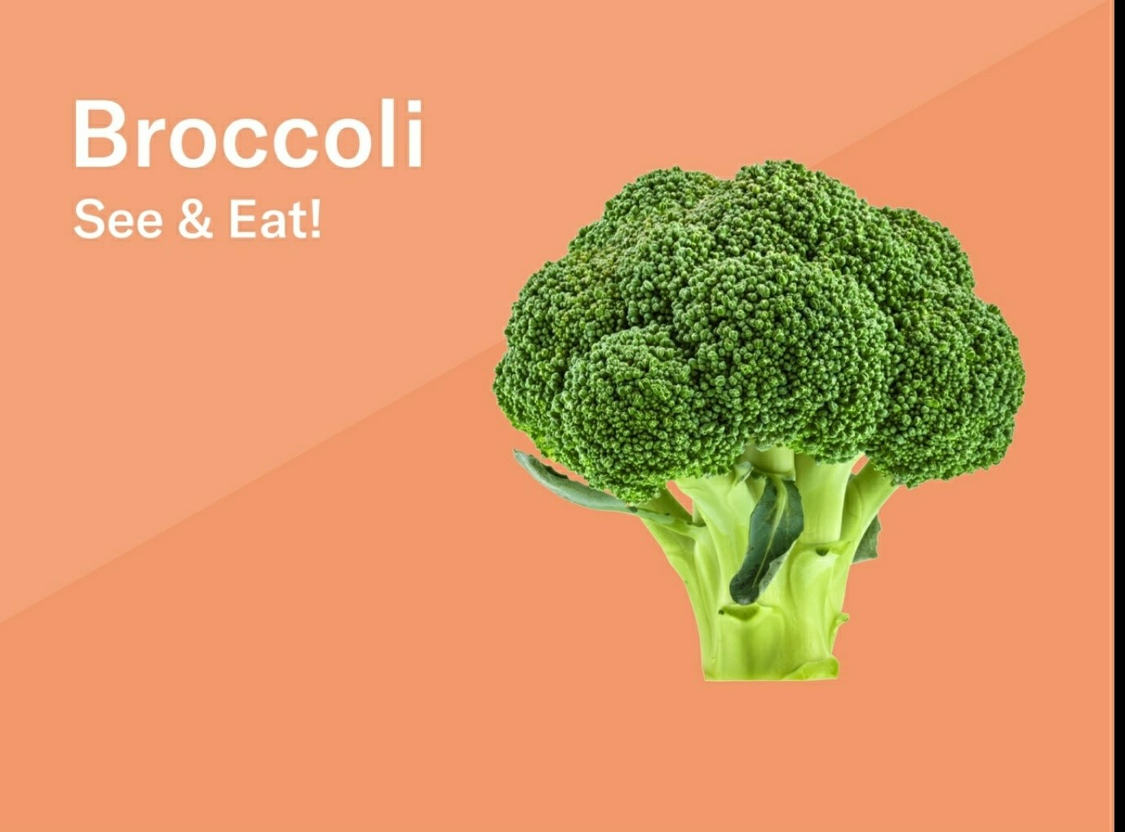
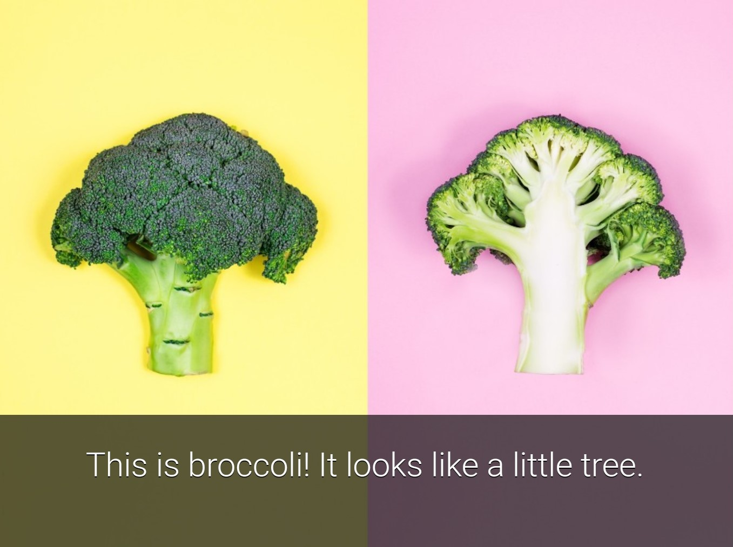
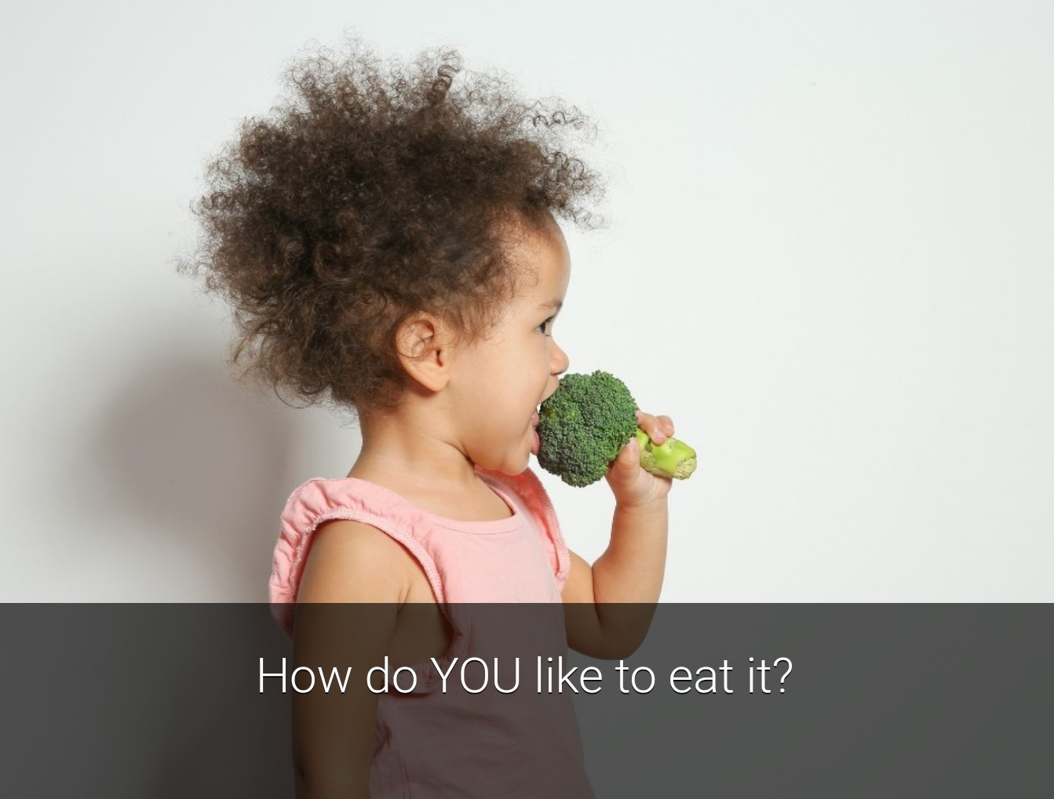
eBooks
Based on these findings, the See & Eat project, led by psychologists at the University of Reading, created 24 eBooks, each exploring a different vegetable, e.g. aubergines, butternut squash, spinach and sweet potato.
Each eBook comprises a set of images and accompanying text that show the journey of a vegetable ‘from farm to fork’. This allows children to not only see the vegetable, but to have a basic understanding of how it is grown and what it looks like in meals and snacks.
All the details about how to access the free eBooks, plus additional activities and resources to use with these, can be found here: https://www.seeandeat.org/

Slide 8
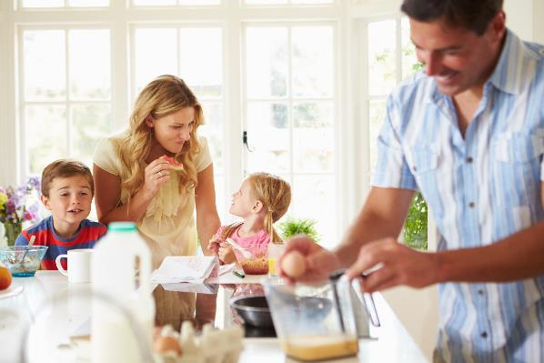
Support for parents/carers
Although not always easy, there are lots of things you can try that have been shown to help young children learn to like vegetables. Our parent/carer leaflet for some practical tips.
Helping children become more familiar with different vegetables by looking at pictures of them, learning about how they grow and are served, can make them more likely to try and enjoy different vegetables. There are lots of activity ideas below that you can use. Read our Parent/carer information sheet to see how these activities can be used.
For more information about feeding pre-school children, click here.

Slide 9
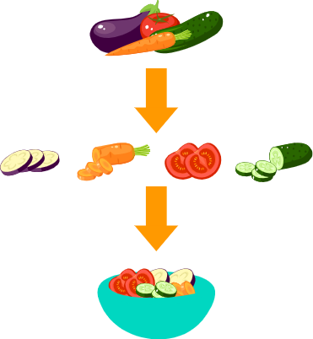
Tasting vegetables
Tasting sessions can be a great way to introduce young children to a variety of vegetables.
Taking place outside of usual meal occasions, tasting sessions allow children to approach new food in a different way, with time to explore the flavours and textures in a relaxed situation with other children and encouraging adults.
Organise a small selection of vegetables for tasting – three will work well.
Cut the vegetables into small sample sized pieces and present these in an attractive way, e.g. in colourful bowls.
Give each child their own plate and allow them to serve their sample onto the plate with a spoon. (Make it a ‘grown-up’ experience!)

Slide 10
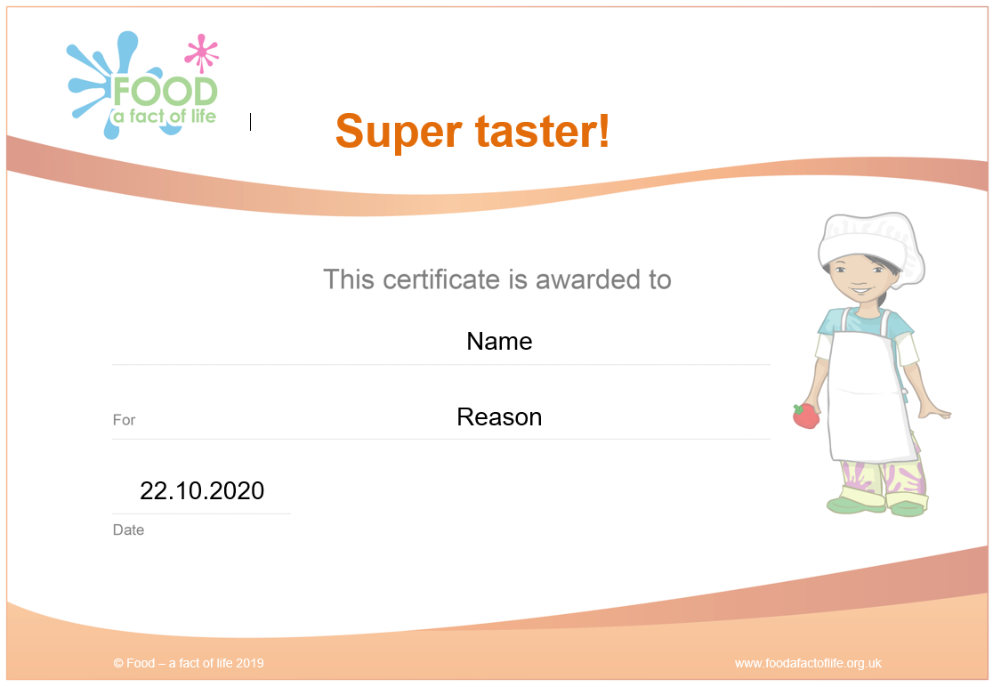
Tasting vegetables
Model how to taste the vegetables – look at, smell and taste each sample, describe what you notice. Try one vegetable at a time and have a sip of water between each type.
Make sure it is a positive experience. Be encouraging and enthusiastic. Praise children who are willing to try samples.
Do not force children to try any of the vegetables, just provide encouragement.
Use the My food book resource to allow children to record their tasting experience using smiley faces and drawings.
Award children with the Alisha or Ronnie Supertaster certificate for trying the vegetables.

Slide 11
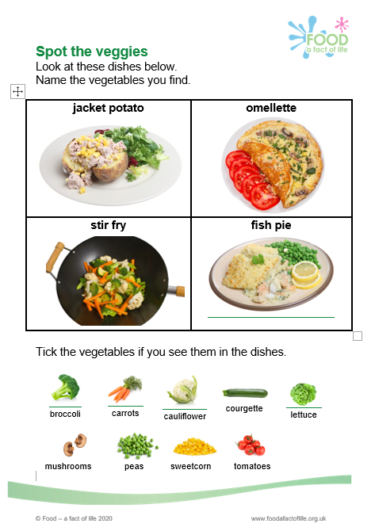
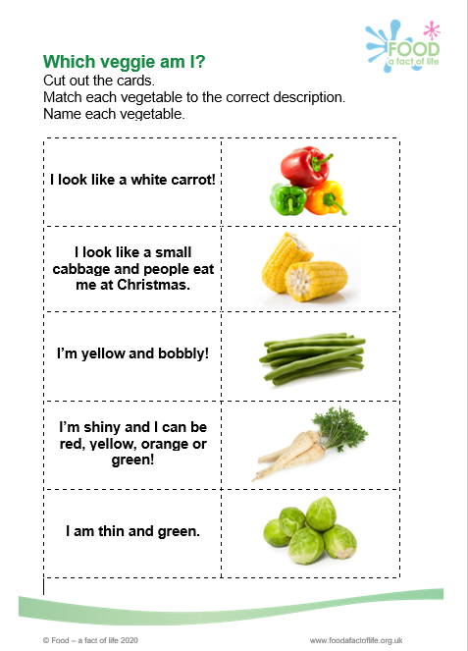
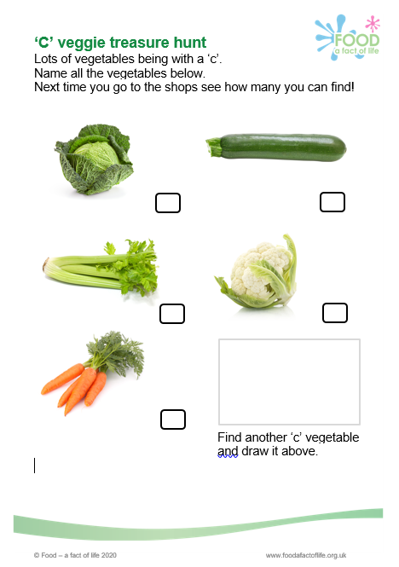
Resources to support: Parents
Parent/carer information sheet
Spot the veggies
Veggie treasure hunt
Veggie taster
Which veggie am I?
Veg and letter matching
Veggie stories
Veggie bingo

Slide 12
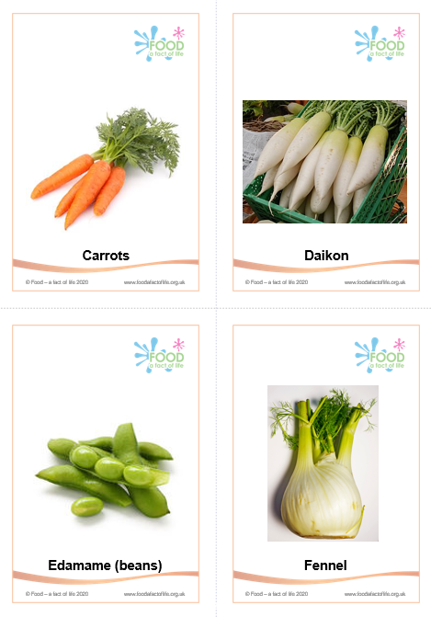
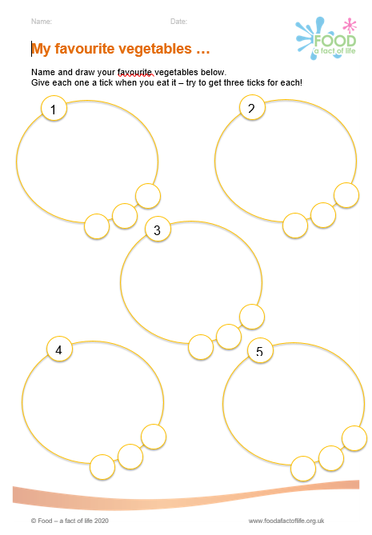
Resources to support: Early year settings
Literacy and numeracy
Vegetables A to Z cards – a set of 26 cards, each with a letter of the alphabet. These can be used in a variety of ways, from introducing new vegetates to children to teaching the alphabet!
4 times 5 veg – this activity shows five different vegetables on four cards. The cards can be used as a matching game; they could be hidden around a room for children to find one of each or all four.
My favourite vegetable – children have to name and draw five different vegetables. They have to tick each image each time they eat the vegetable. This helps to reinforce eating vegetables.

Slide 13
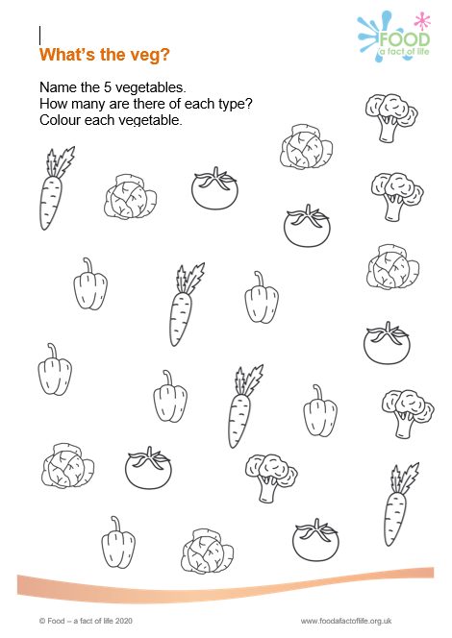
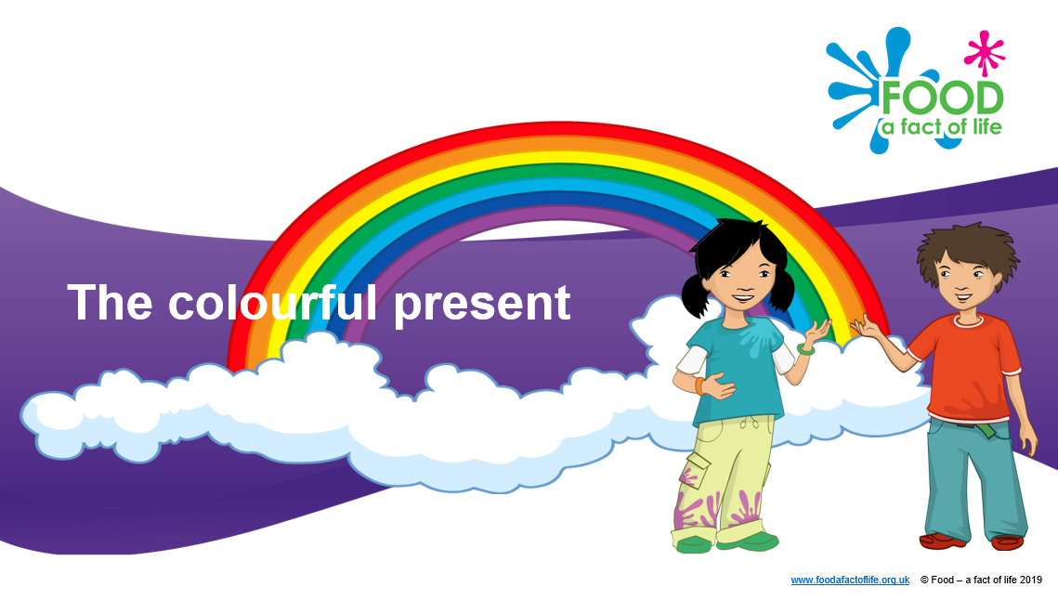
Resources to support: Early year settings
Literacy and numeracy
The lonely sprout – children are asked to help the lonely sprout through drama and play!
What’s the veg – the worksheets comprises five different vegetables. Children need to name each, and state how many there are of each type on the sheet. They can also colour each vegetable.
Take inspiration from the Colourful present story! Use the story and focus on vegetables. There are lots of resources to support too!

Slide 14
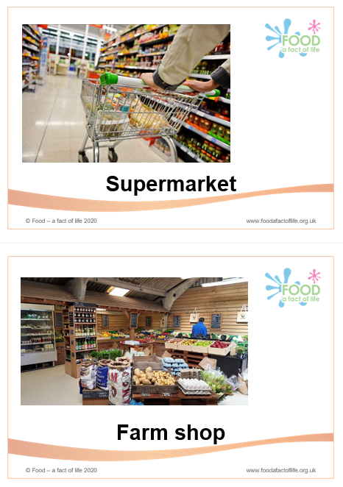
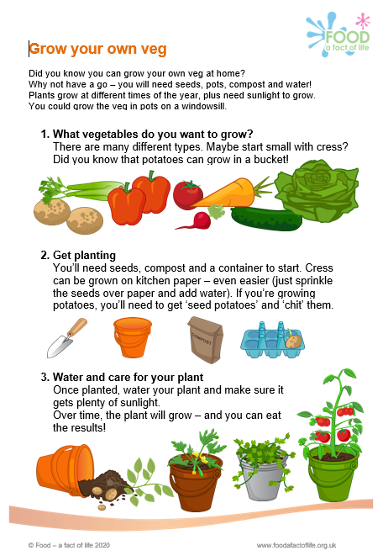
Resources to support: Early year settings
The world around us
Where we buy vegetables cards – a set of five cards showing different places vegetables can be purchased. A useful stimulus to start discussion or to make into a display.
Grow your own veg – a starter’s guide to growing vegetables! There’s also additional support here. Why not grow potatoes? Use ‘The bucket garden’ story as a springboard to get growing!

Slide 15
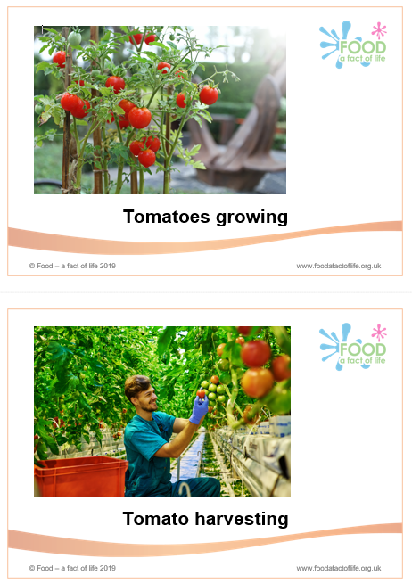
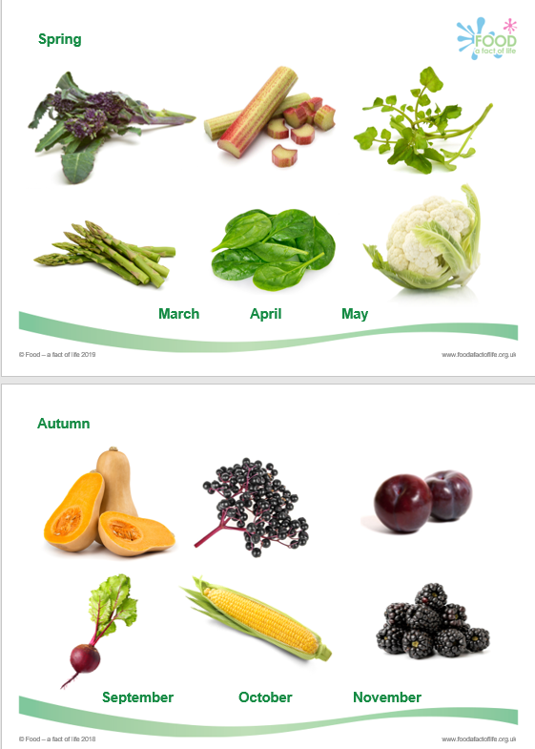
Resources to support: Early year settings
The world around us
Vegetable journeys – follow the journey from farm to for with carrots, potatoes and tomatoes. Why not create your own vegetable journey?
Seasons – use this section of resources to introduce the seasons to children. Explore which vegetables are in season at different times of the year.

Slide 16
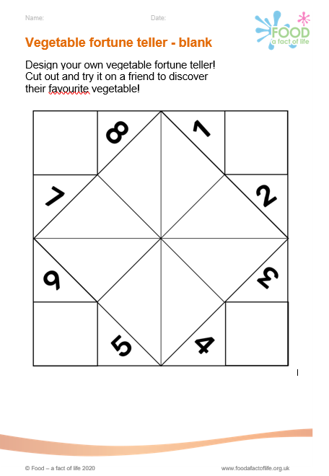
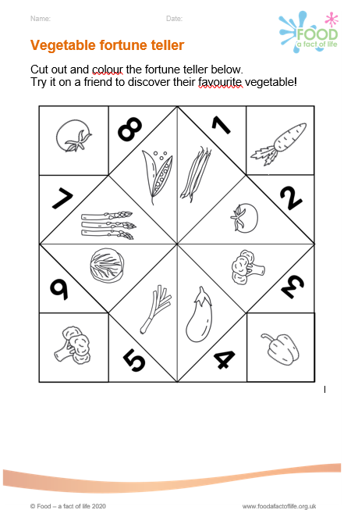
Resources to support: Early year settings
Creativity
If I were a vegetable – a fun activity where children imagine themselves as a vegetable! What type would they be and why? Children are tasked to draw the vegetable.
Vegetable fortune teller (blank and complete) – children can make their own or use an example to discover their favourite vegetable! Get creative with pencils and pens! (Click here to see how.)

Slide 17
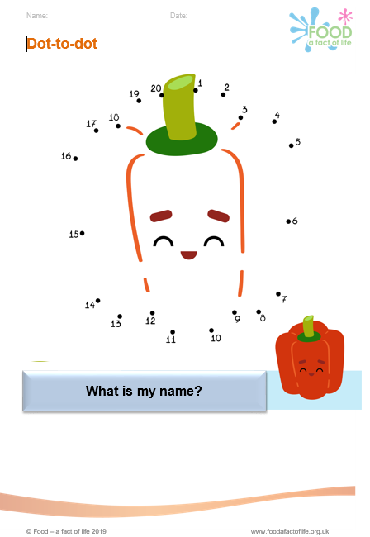
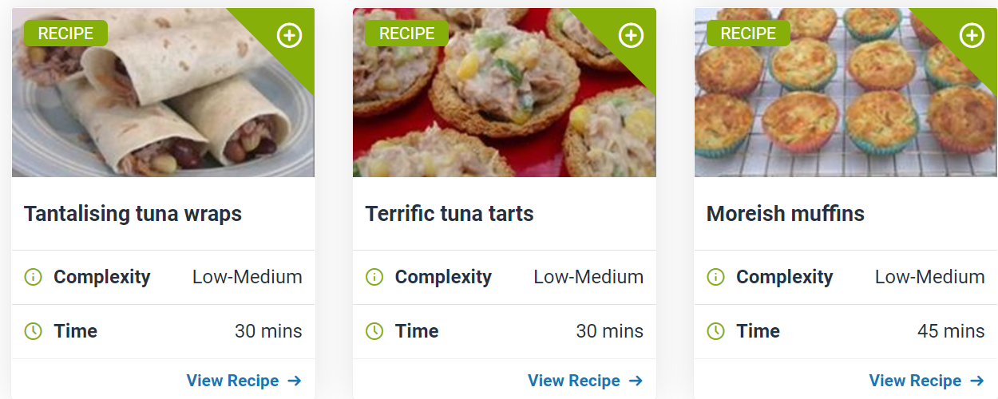
Resources to support: Early year settings
Creativity
Vegetable dot-to-dot – a selection of vegetable dot-to-dot, just print and use! There’s broccoli, carrot, onion, pepper, potato, pumpkin, raddish and tomato.
Get cooking! If you want to prepare and make something with vegetables, take a look at our advice here. There are also lots of recipes to search here.

Slide 18
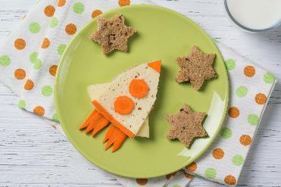
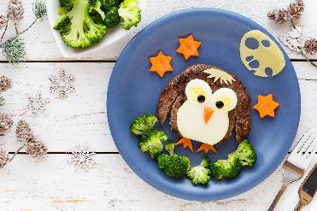
Further support
Getting young children to eat a wide variety of vegetables might be a challenge at times!
Taking multiple approaches such as running tasting sessions, offering a wide variety of vegetables at meal and snack times, using visual vegetable-based resources, such as the eBooks, and providing guidance for parents/carers will go a long way to helping young children on their journey to having a healthy varied diet now, and in the future.
www.seeandeat.org
www.foodafactoflife.org.uk

Slide 19
See and eat - Vegetables
For further information, go to:
www.foodafactoflife.org.uk

