Slide 1
The growing year

Slide 2
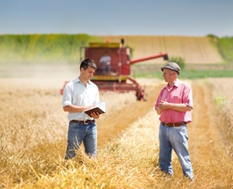
The growing year
A farmer has different jobs to do at different times of the year to successful grow wheat.
Let’s find out more…

Slide 3
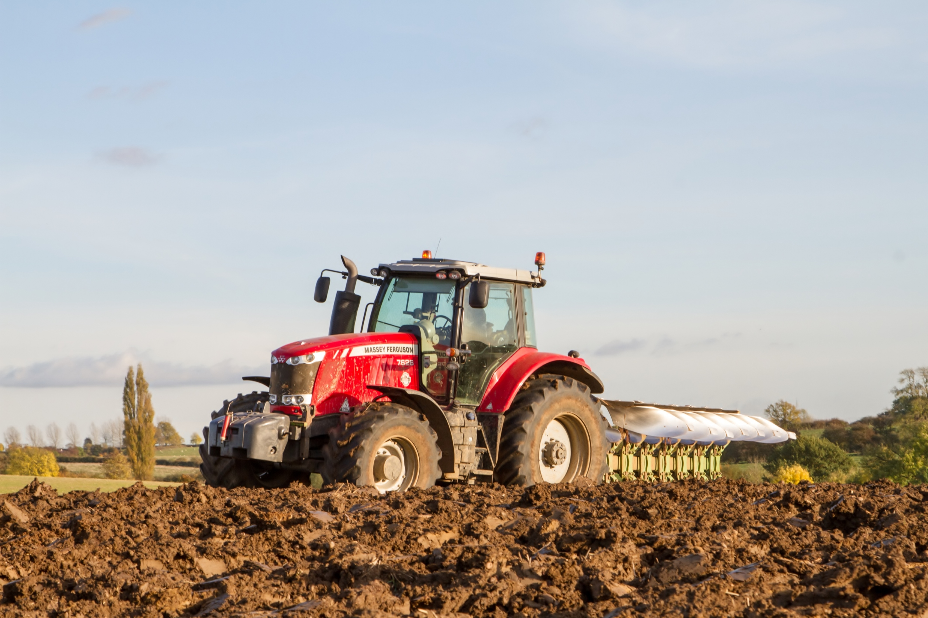
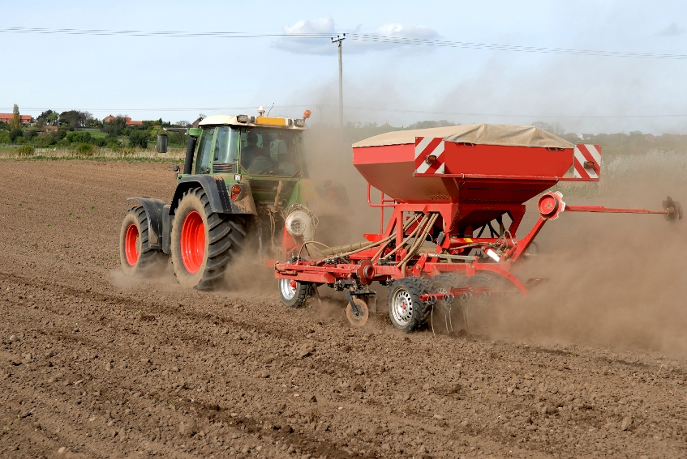
Autumn
The farmer ploughs the field and sows the wheat seeds. Wheat is sown in the autumn. Wheat seeds need water, warmth, light and fertiliser to grow well.

Slide 4
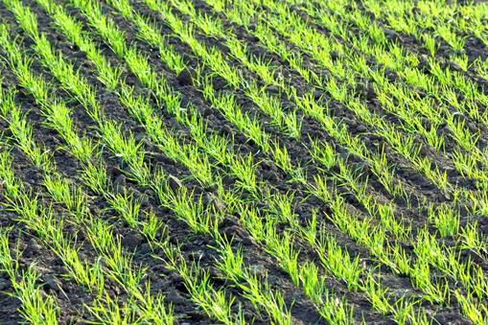
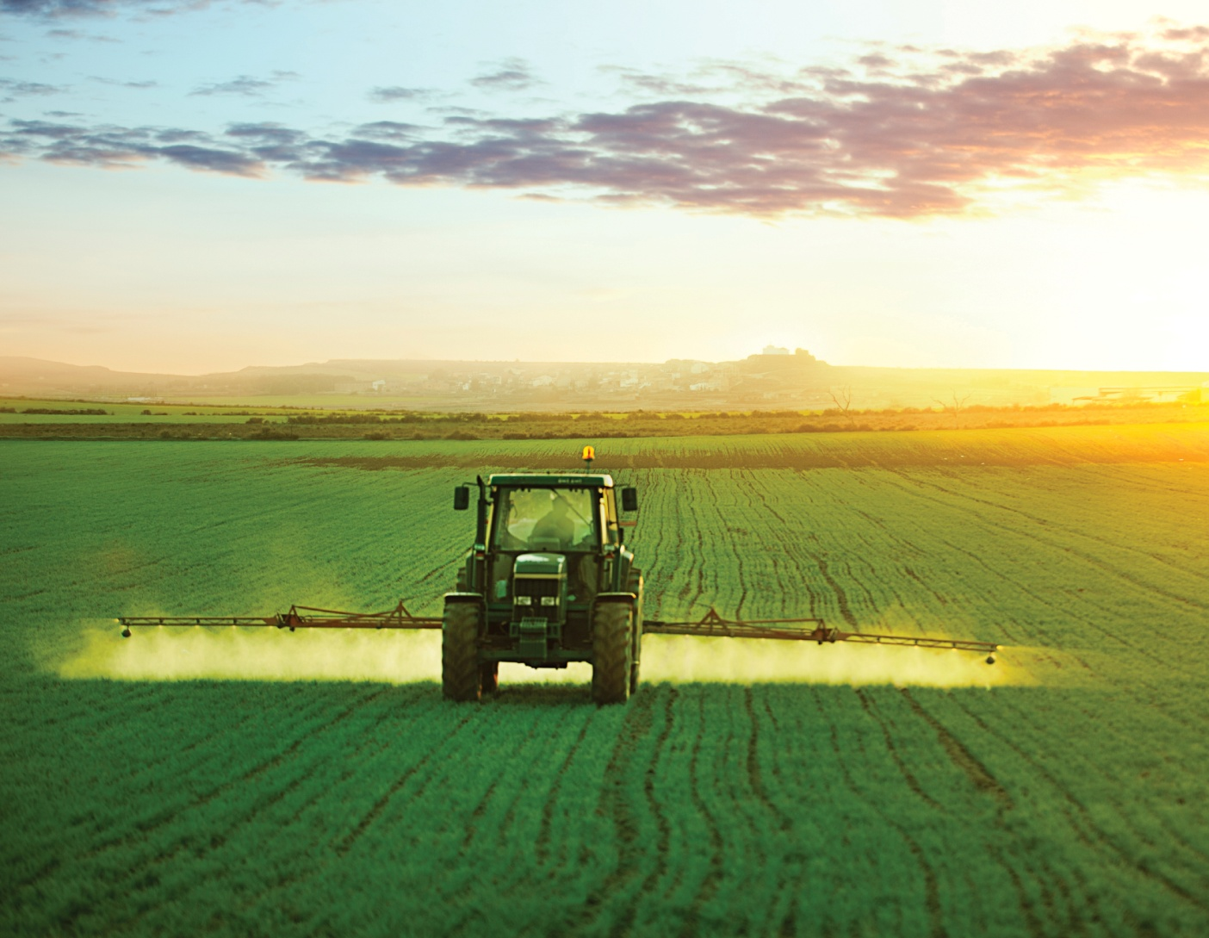
Winter
The plants grow slowly during the winter and look like a field of grass. The farmer sprays the wheat plants to protect them against weeds, disease and pests.

Slide 5
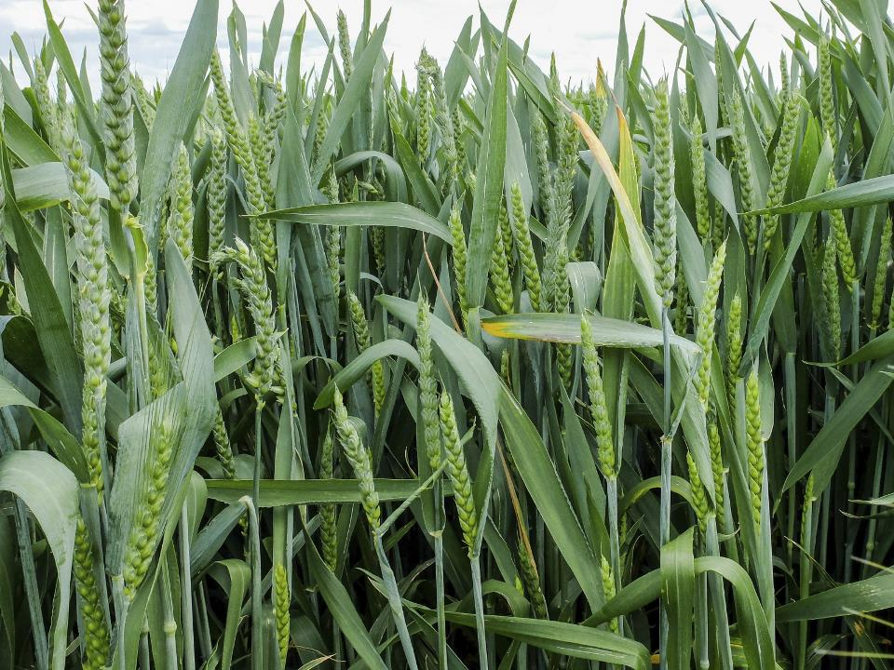
Spring
In spring, the plants grow fast and produce ears of grain which are green. Each ear contains around 45-50 grains of wheat.

Slide 6
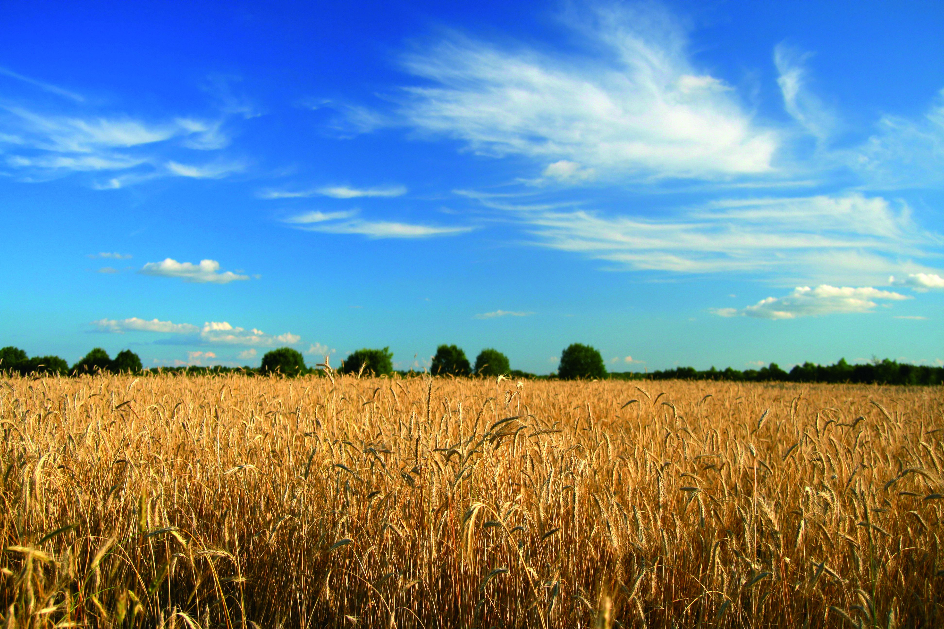
Summer
In the summer the grains of wheat ripen. When the grains are ripe, they are harvested by a combine harvester.

Slide 7
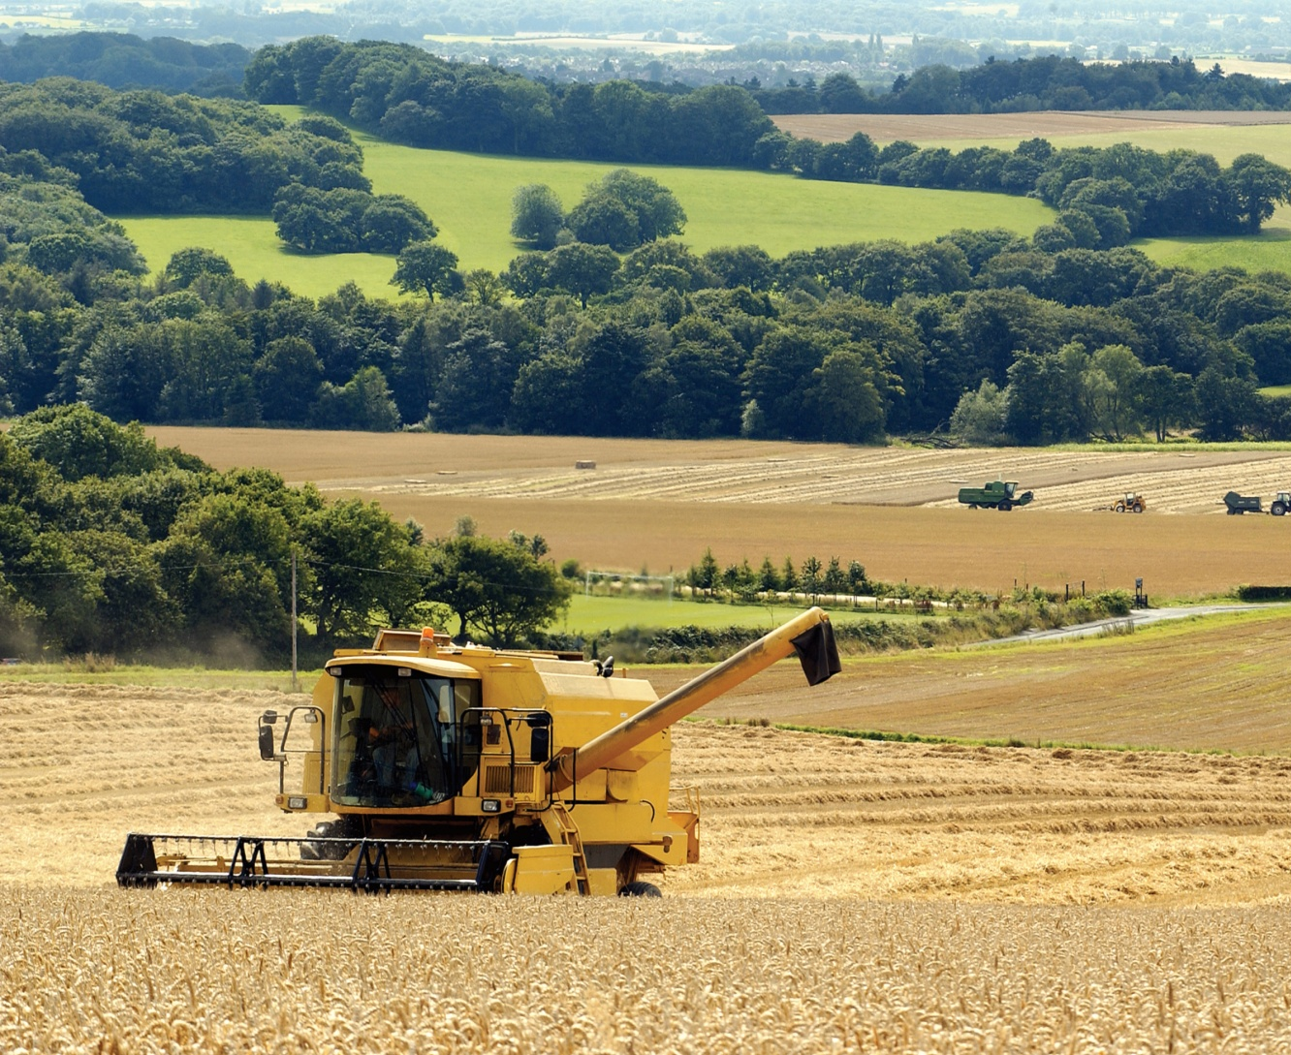
Summer
The combine harvester removes the grain from the wheat plant and drops the wheat stalks and husks (called chaff) back on to the field.

Slide 8
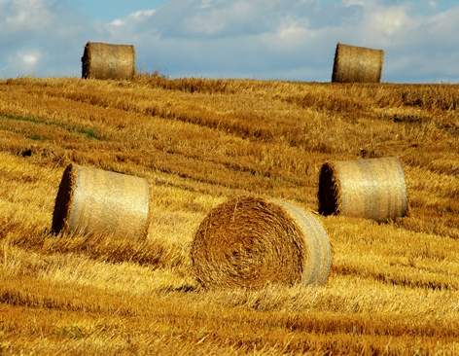
Summer
The chaff can be made into bales of straw and used for animal bedding, or ploughed in to the soil.

Slide 9
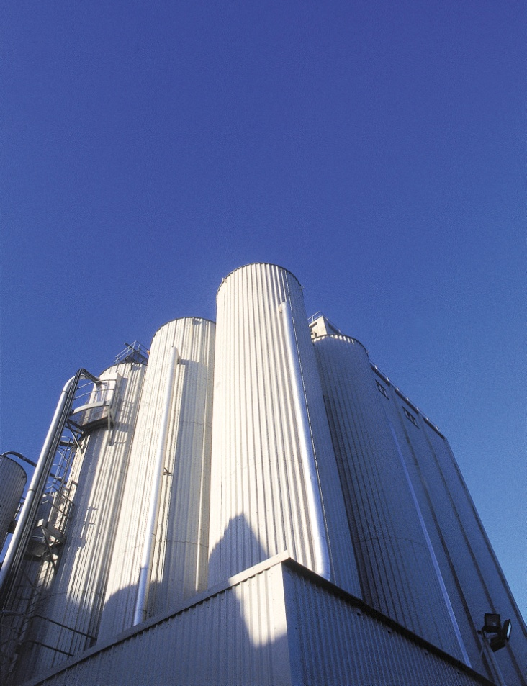
Storing
The grain is dried and stored before being sent to flour mills. Some grain may be kept by the farmer for live stock feed.

Slide 10
For further information, go to:
www.foodafactoflife.org.uk

