Slide 1
New ways with red meat
12/01/2021

Slide 2
Food trends
Comfort led: Slow cooked food becoming more popular as well as an increase in the use of slow cookers. More economical beef, lamb and pork cuts are ideal for use in the slow cooker, e.g. brisket, ribs, pork belly, lamb breast/belly, bone marrow, mutton, lamb shoulder, pork belly.
Increase in the use of offal and aged meat.
Increased popularity in global barbecue/fire cooking techniques.
Thrift rules: Upcycling surplus food and the popularity linked to the use of leftovers (including repurposing leftover dinner for lunch the following day, now very popular with those who can work from home).
Rediscovery of store cupboard ingredients with more of us experimenting with these ingredients too.
Increase in batch cooking.
Rise of the frozen food aisle (vegetables, fruit, herbs and meat).
Source: AHDB

Slide 3


Food trends
Cuisines to watch
Korean
Peruvian
East African (Ethiopian/Eritrean)
West African (Ghanaian and Nigerian)
Source: AHDB

Slide 4
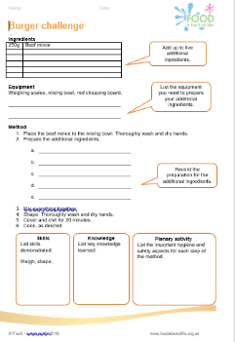
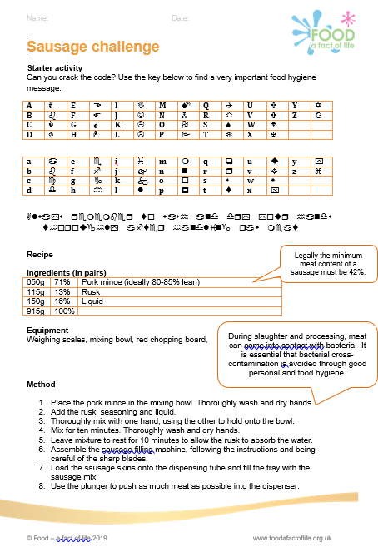
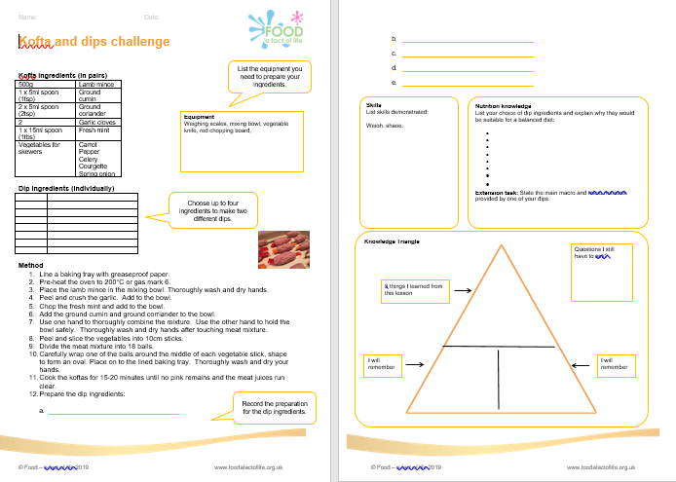
Food – a fact of life resources
Recipes, videos and activities
Over 300 tried and tested recipes.
Recipe videos.
Licence to Cook recipe videos.
Cooking session videos.
Meaty eats videos.
Red meat skills videos.
Gourmet Burger Builder

Slide 5
Food – a fact of life resources
Recipes – just a taster!
Beef
Latino beef
Beef and mozzarella meatballs
Piri piri burgers with Mediterranean vegetables
Individual steak and kidney pies
Spiced beef tartlets with chorizo
Lamb
Lamb shanks with plums
Lamb rissoles with spicy tomato dip
Meatball aloo ghobi
Moussaka stuffed aubergine with cheesy soufflé sauce
Bubble and squeak lamb brunch
Lamb cupcakes
Pork
Pork chops with sage, garlic and lemon
Pork and beetroot tarts with blue cheese
Stuffed pork fillet
Pork, lime and mint stuffed pepper tabbouleh
Pork and beans
Pork jambalaya
Pork Thai bites
Offal
Pan fried liver with onion and bacon
Devilled lamb kidneys on toast
Braised oxtail with star anise
Stuffed braised lamb heart
Pressed ox tongue salad
Crumbed pork liver

Slide 6
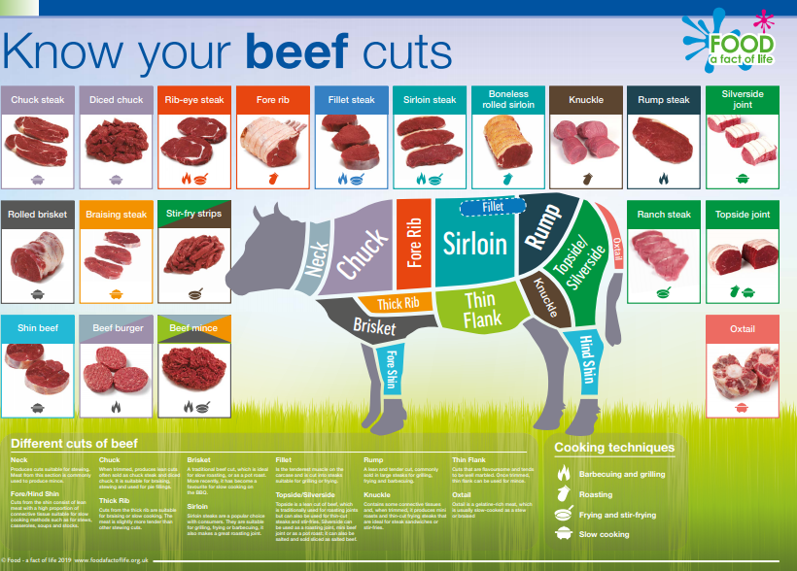
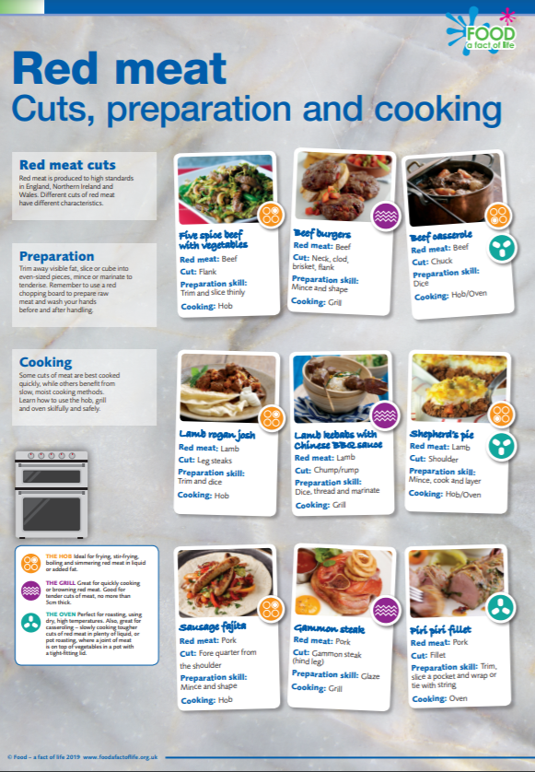
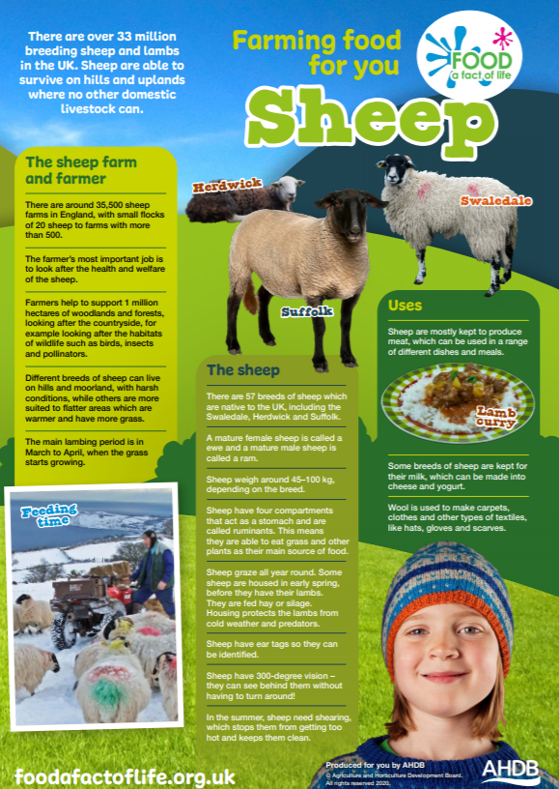
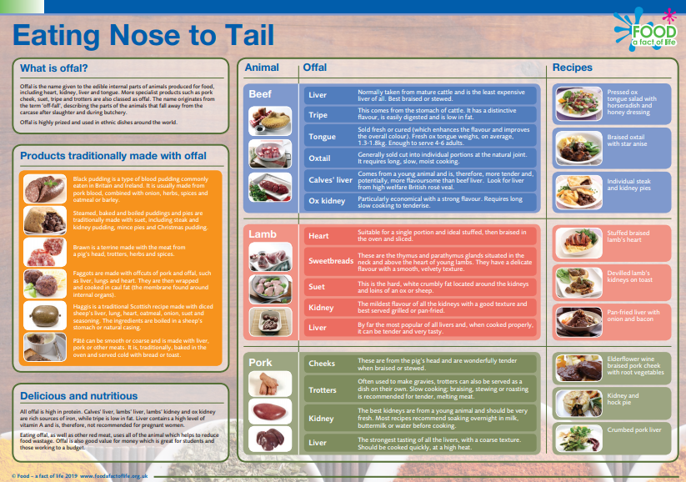
Red meat resources
Activities around red meat – from farm to fork
Food commodities:
5-7 Years
7-11 Years
11-14 Years
14 – 16 Years

Slide 7
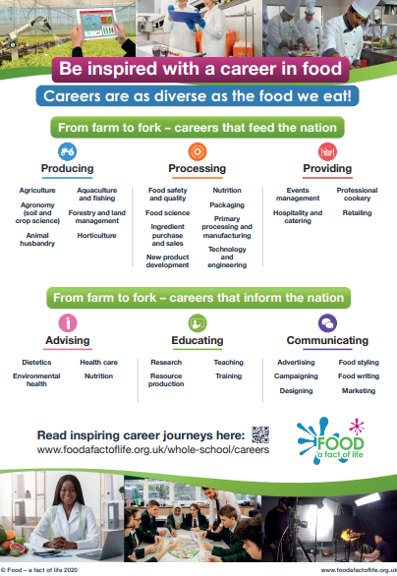
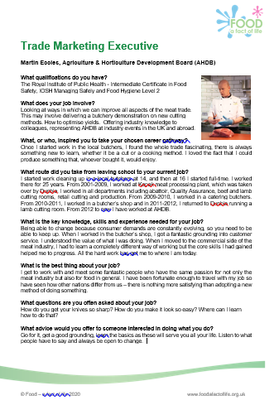
Careers in ‘food’
A downloadable poster and inspiring case studies about careers within ‘food’, covering those that 'feed the nation' and 'inform the nation'.
Careers in ‘food’

Slide 8
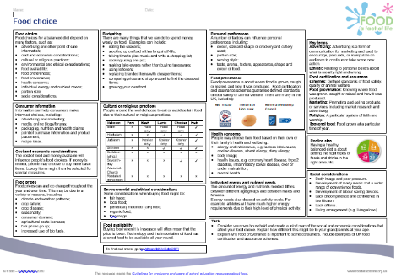
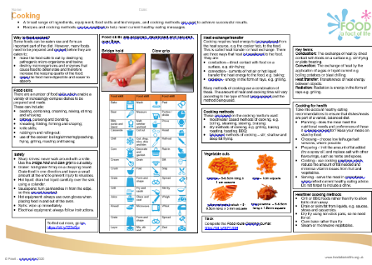
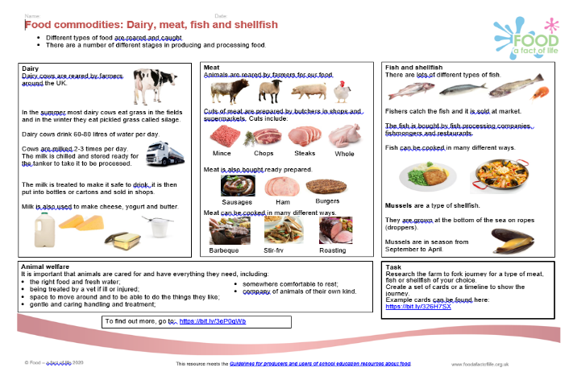
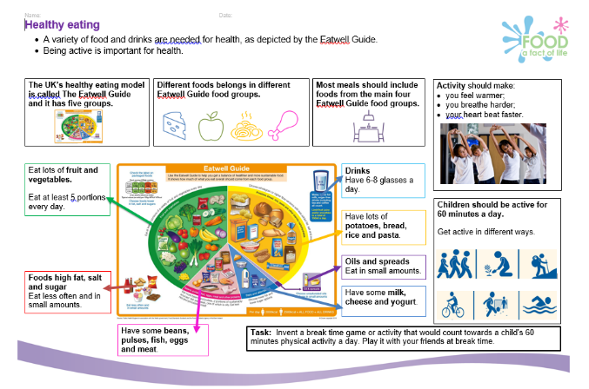
Knowledge organisers
Knowledge organisers available for 5-7 Years, 7-11 Years, 11-14 Years and 14-16 Years.

Slide 9
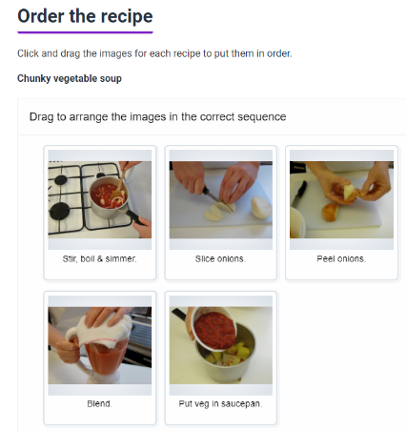
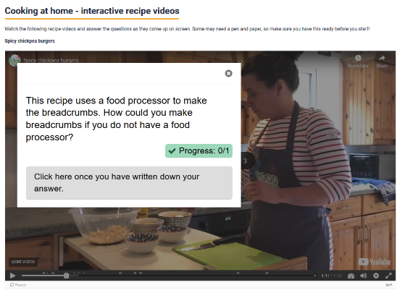
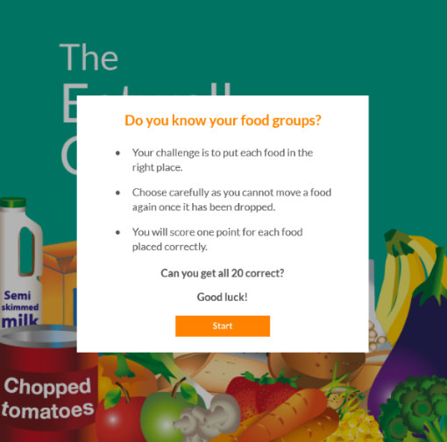
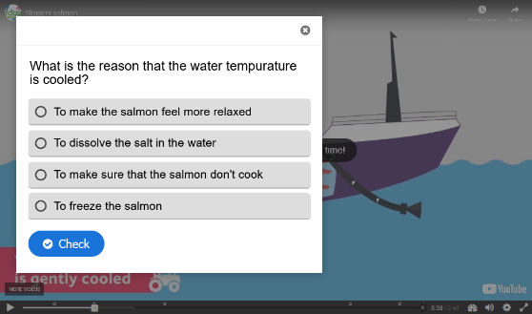
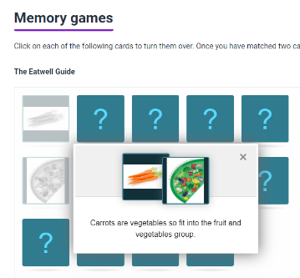
Interactive resources

Slide 10
Other sources of information and support
Agriculture and Horticulture Development Board (AHDB)
AHDB: Red meat and health
British Nutrition Foundation: Consumption of red and processed meat
NHS: Red meat in your diet
https://www.simplybeefandlamb.co.uk/
https://www.lovepork.co.uk/

Slide 11
New ways with red meat
For further information, go to:
www.foodafactoflife.org.uk

