Slide 1
Tomatoes

Slide 2
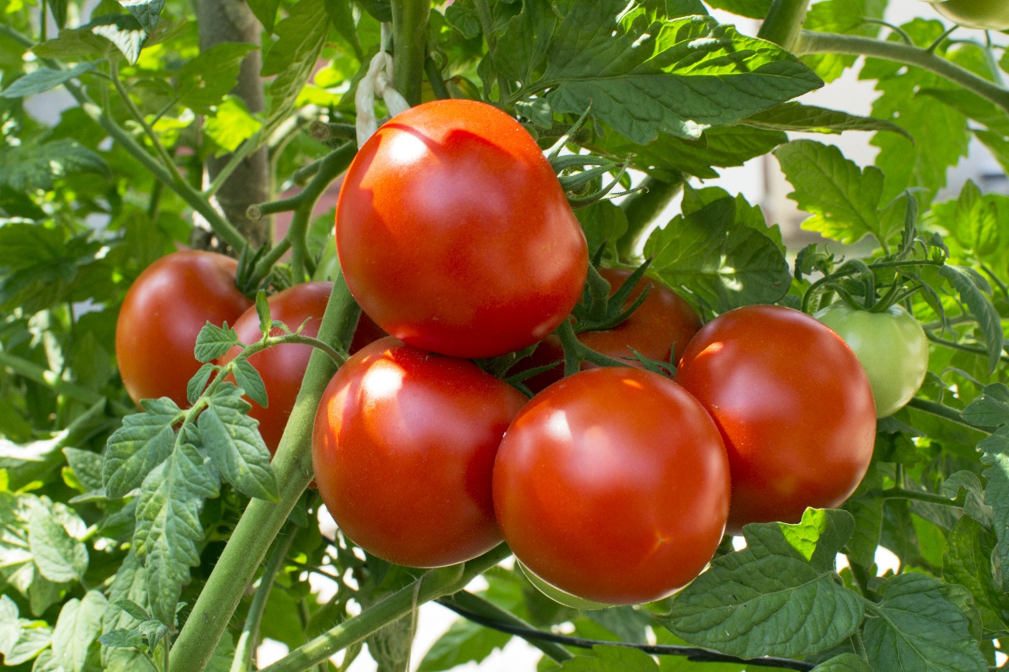
What are these?
These are tomatoes.
Tomatoes are a fruit, but are more commonly known as a vegetable.

Slide 3
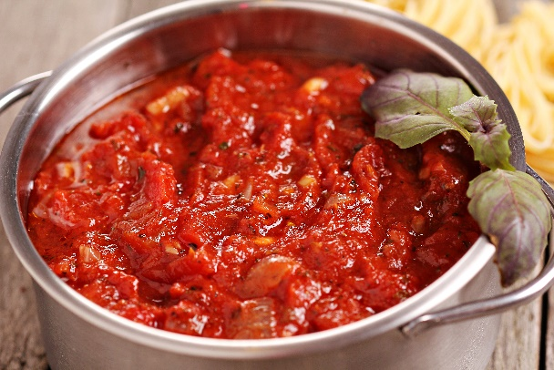
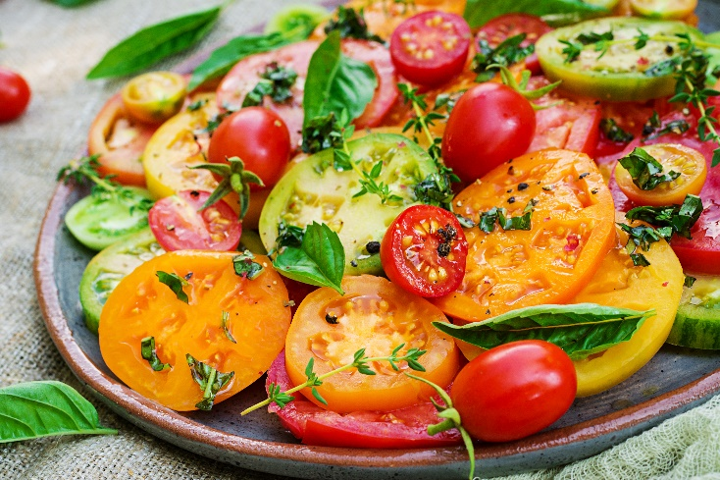
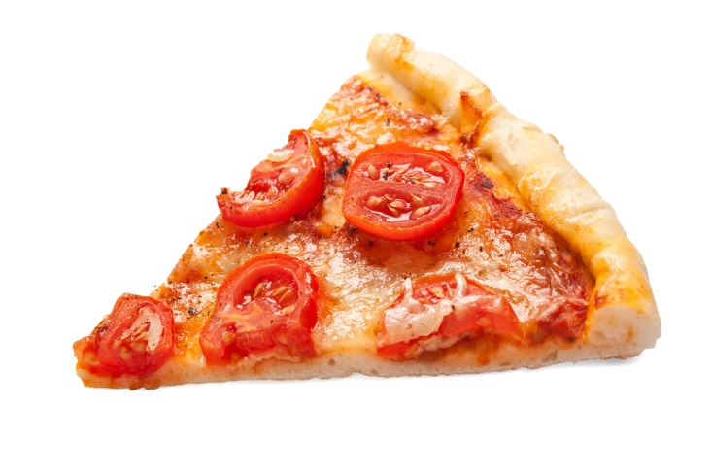
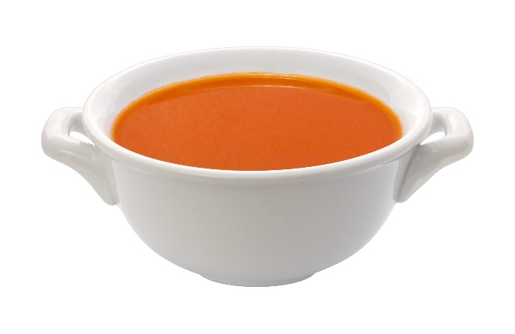
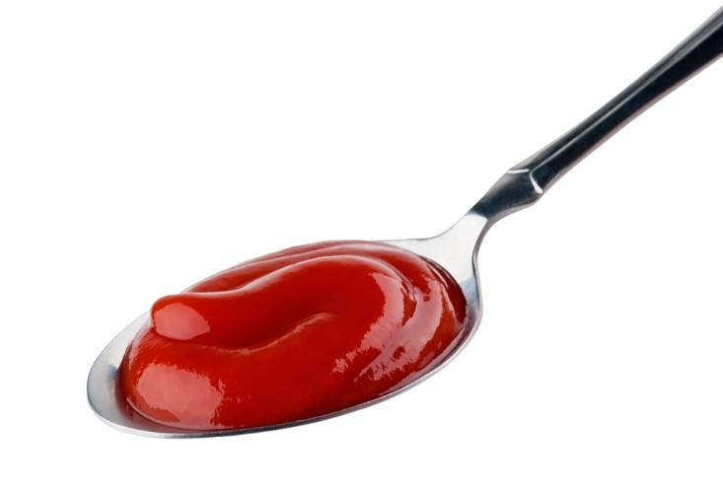
What are these?
What are they made from?
They are all made with tomatoes.

Slide 4
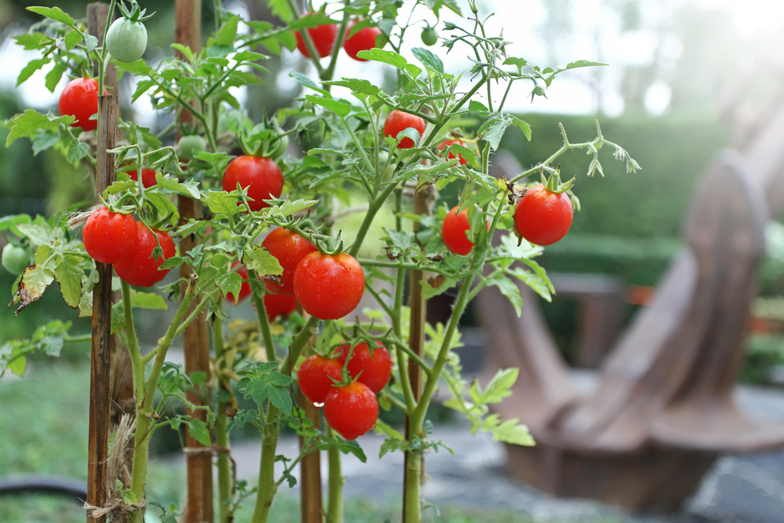
Where do tomatoes come from?
Tomatoes are from a plant.
They grow above the ground.
They are the fruit of the plant.

Slide 5
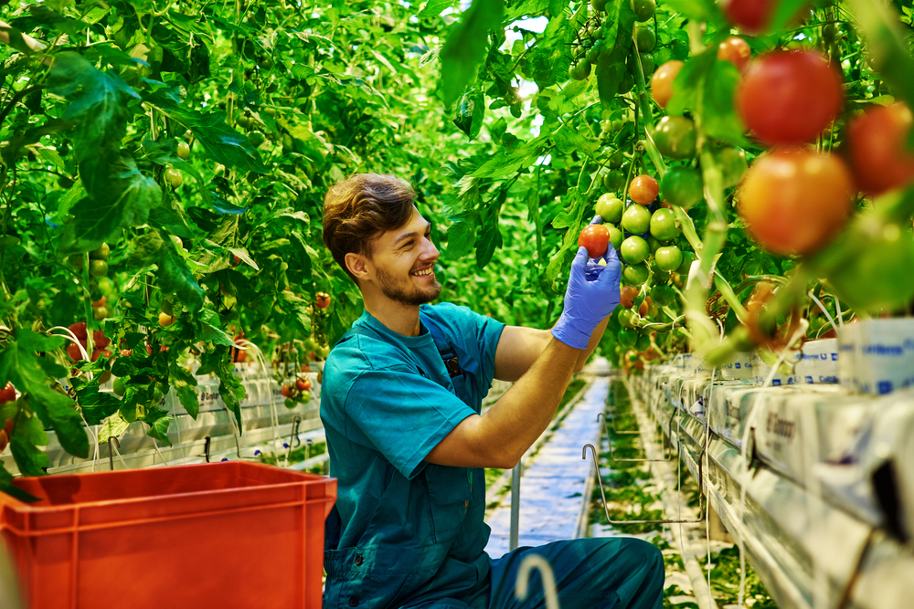
Where do tomatoes come from?
Tomatoes are picked when ready (often as they change colour from green to red).
Have you seen tomatoes growing before?

Slide 6
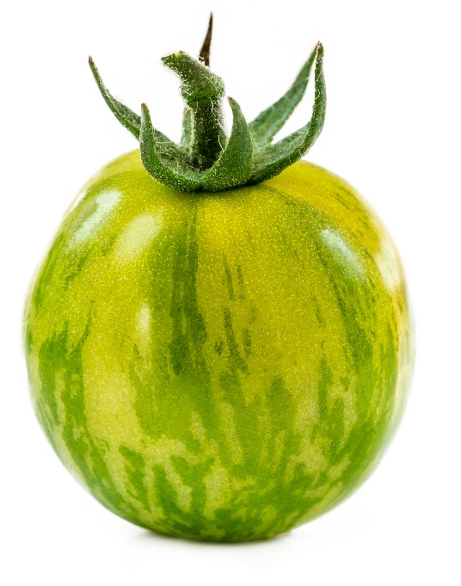
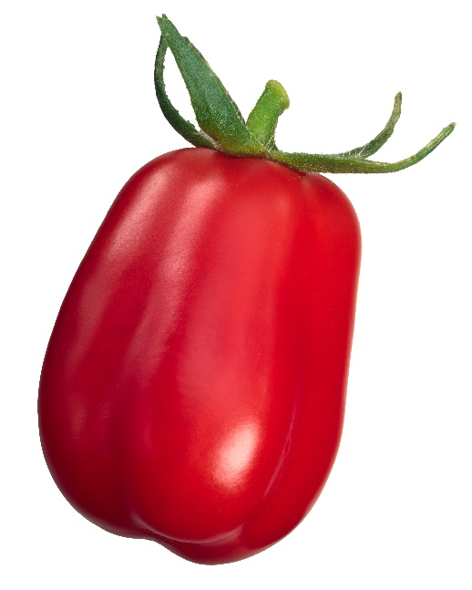
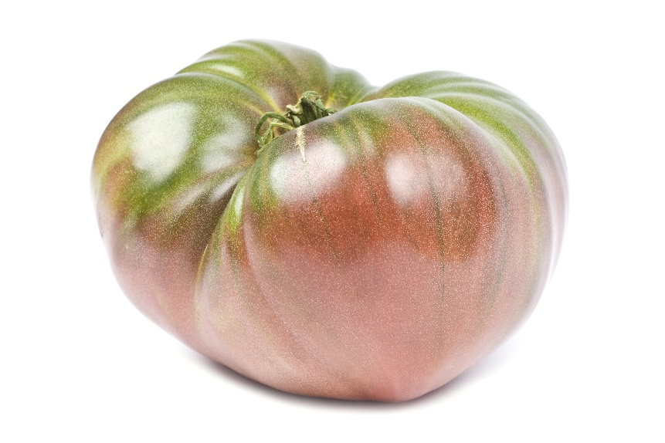
Tomato varieties
There are lots of different types tomatoes.
They have different names, such as:
cherry;
san marzano;
green zebra.

Slide 7
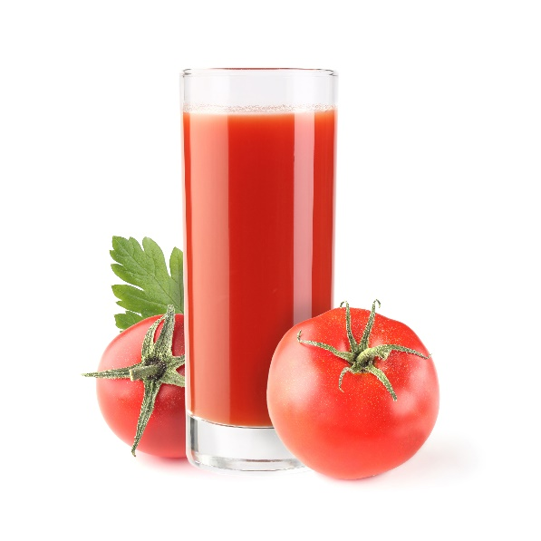
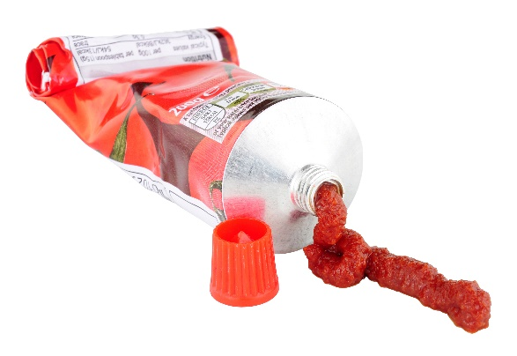
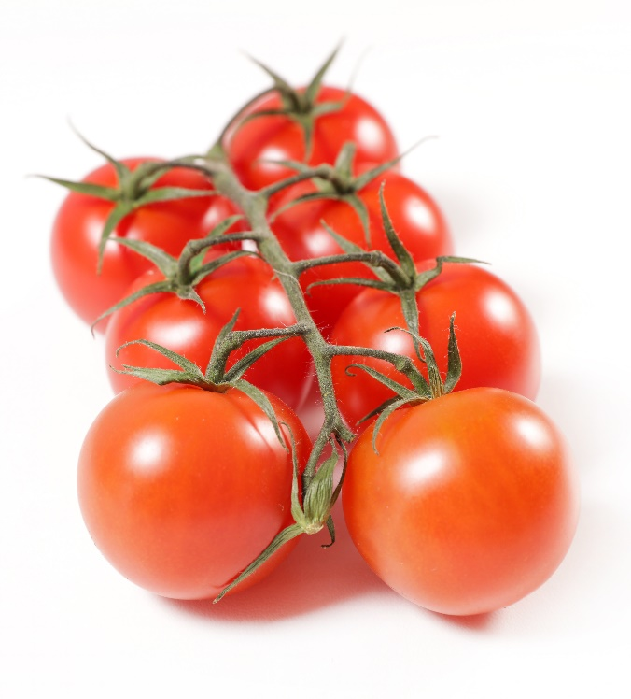
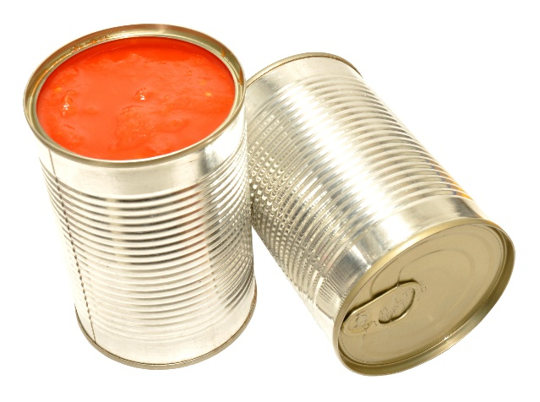
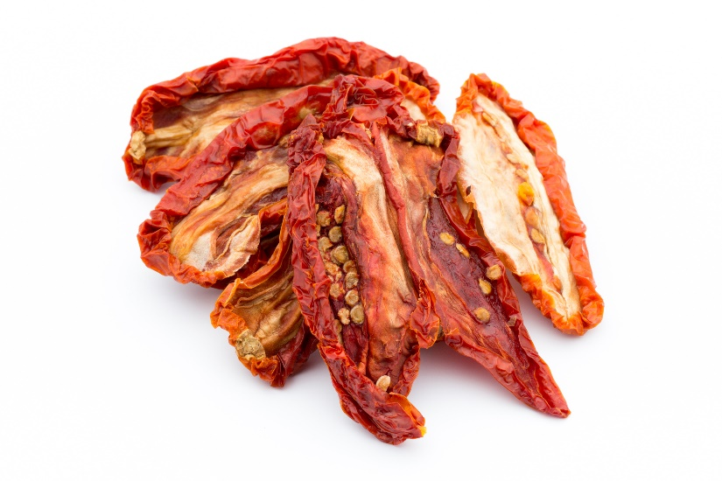
Tomatoes
Tomatoes can be purchased as:
fresh;
canned;
pureed;
juiced;
dried.

Slide 8

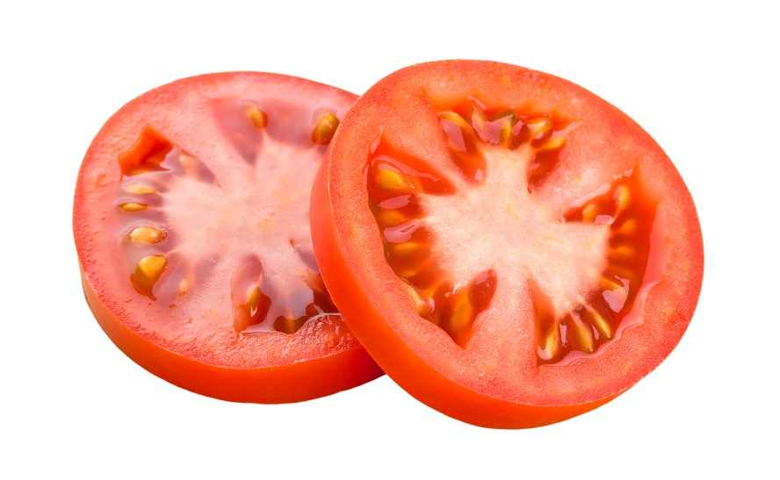
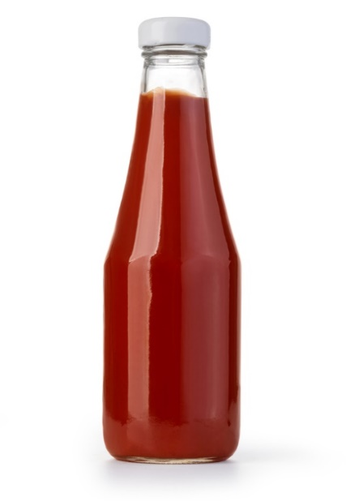

Dishes
Tomatoes can be eaten raw – just wash first.
Tomatoes can be used in lots of dishes.

Slide 9
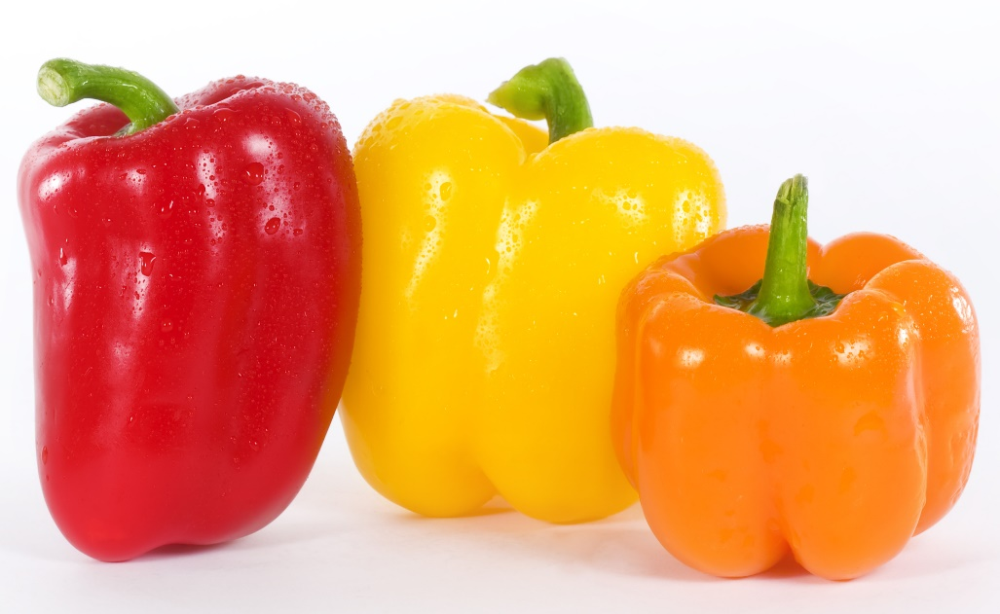
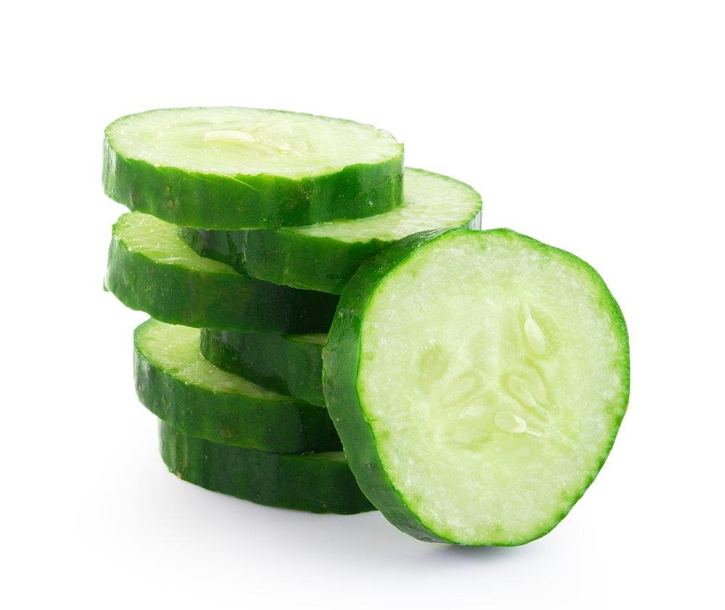
Similar
Peppers and cucumbers are similar to tomatoes.
They are the ‘fruit’ of a plant, but are eaten as a ‘vegetable’.

Slide 10



Summary
Tomatoes are grown for our food.
Tomatoes
Lots of dishes use tomatoes.

Slide 11
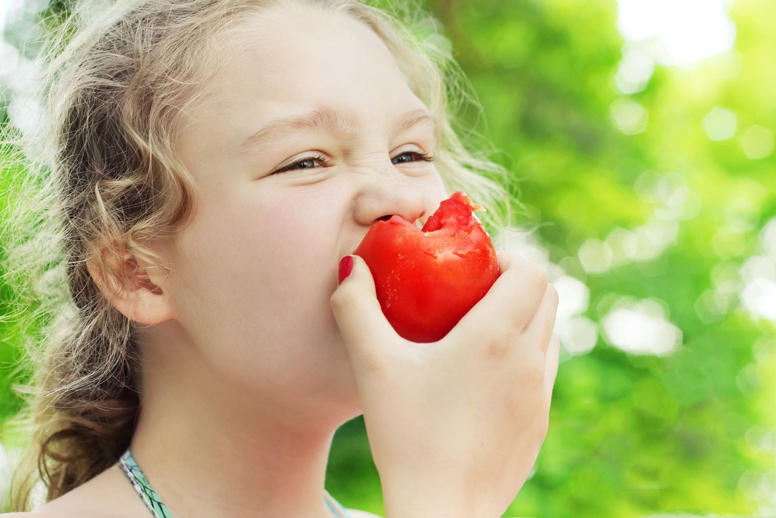
Do you like tomatoes?

Slide 12
Tomatoes
For further information, go to:
www.foodafactoflife.org.uk

