Slide 1
Apples

Slide 2
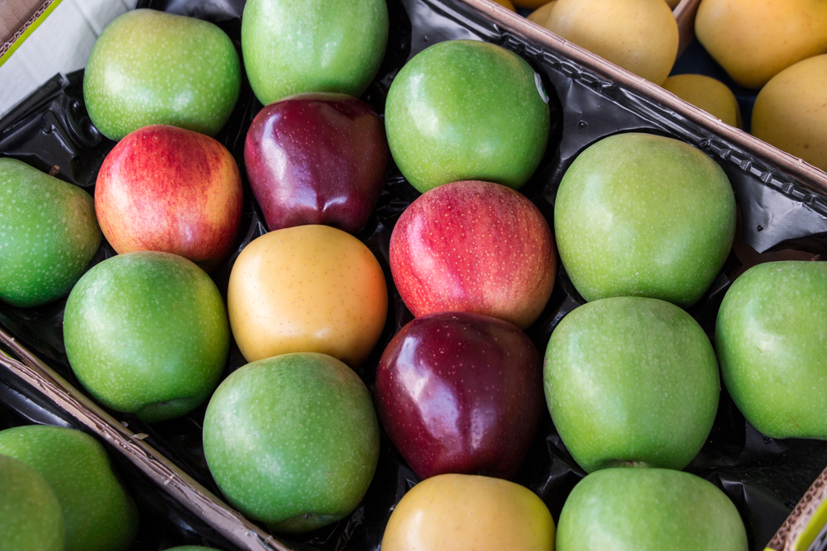
What are these?
These are apples.
Apples are a fruit.

Slide 3
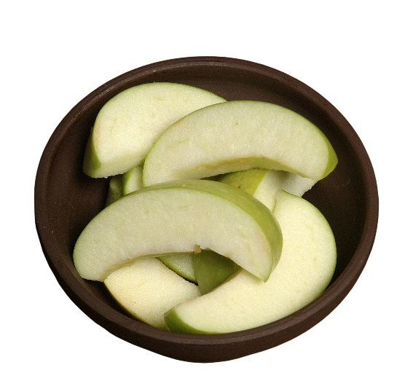
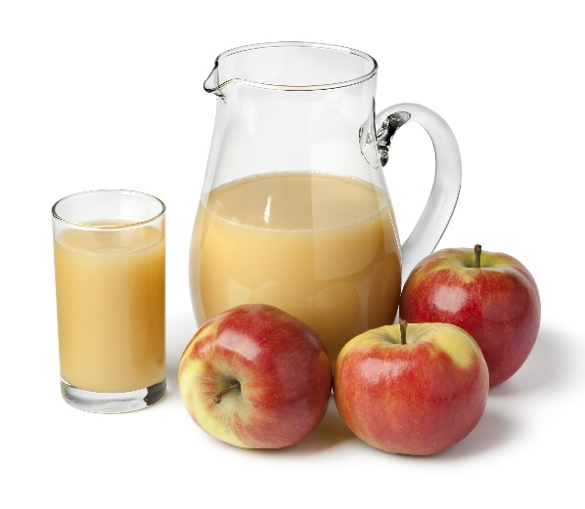
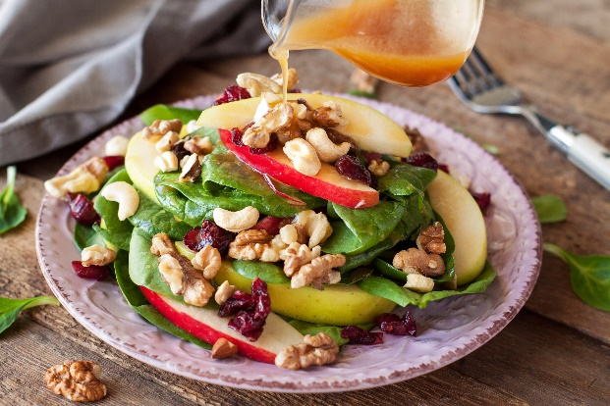
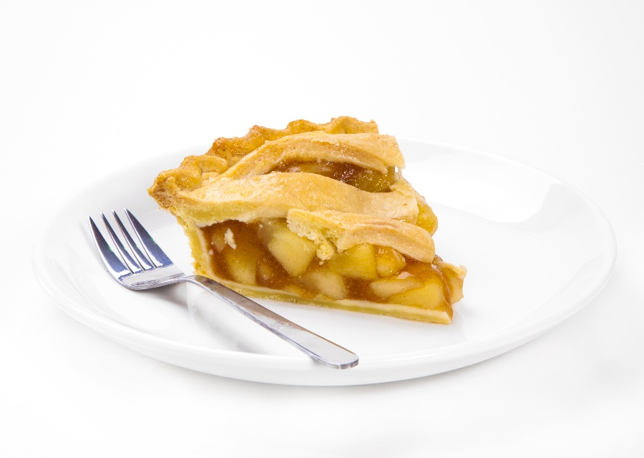
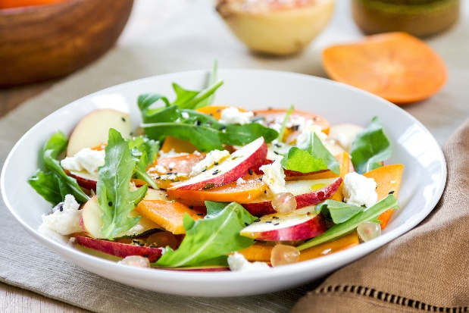
What are these?
They all use apples.

Slide 4
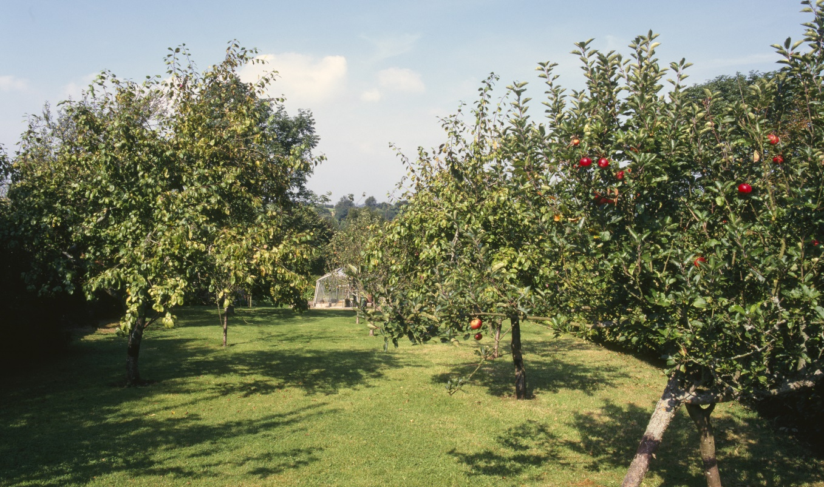
Where do apples come from?
Apples grow in the UK, as well as other countries.
Apples grow on a tree – they are from a plant.

Slide 5
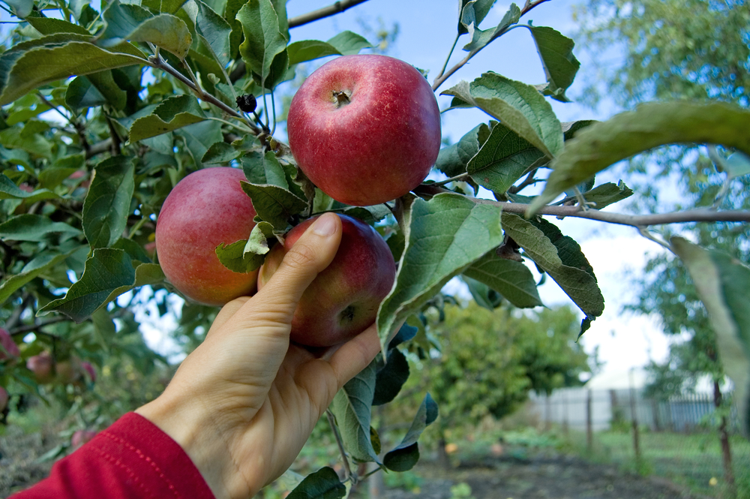
Where do apples come from?
Apples are picked from the tree when they are ready.
Have you seen apples growing before?

Slide 6
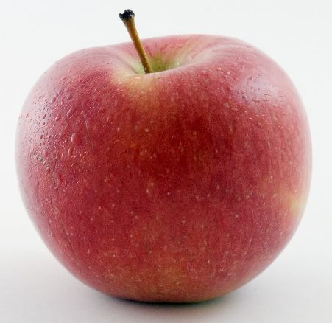
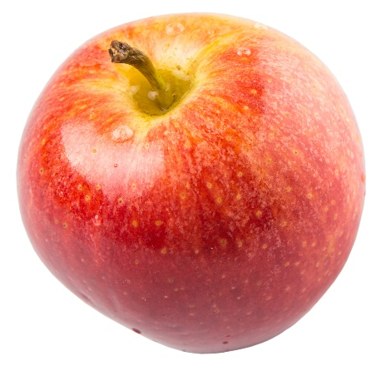
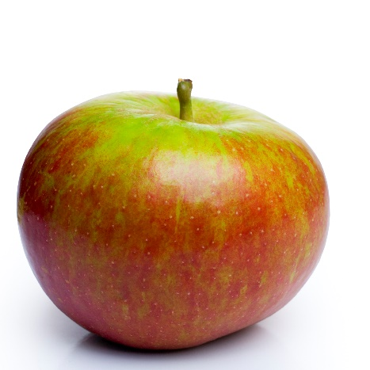
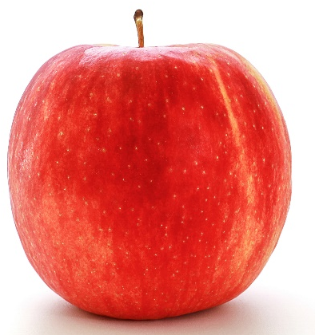
Apple varieties
There are lots of different types apple – 3,000 varieties in the UK!
They have different names, such as:
Braeburn;
Cox;
Jazz;
Royal gala.

Slide 7
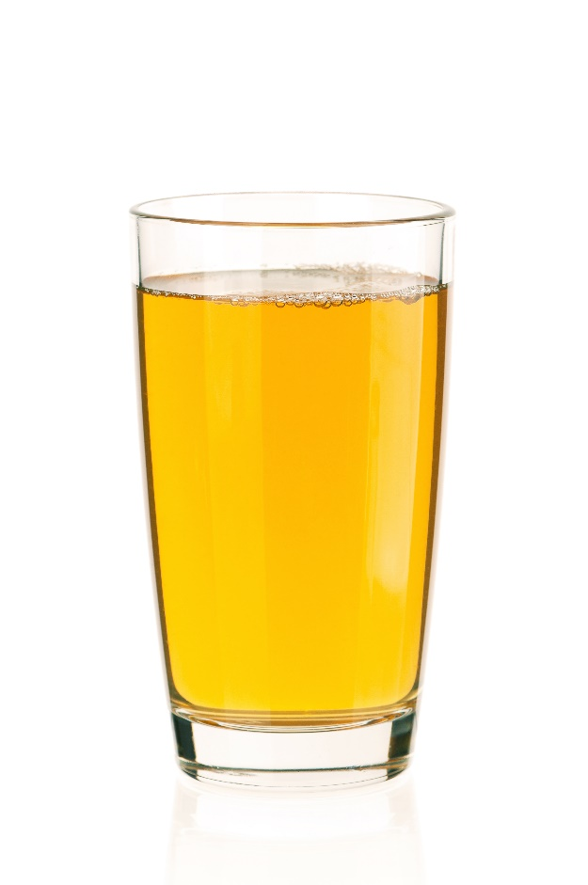
Apples
Apples can be purchased as:
fresh;
canned;
dried;
pureed;
juiced;
frozen (e.g. apple crumble).

Slide 8
Dishes
Apples can be used in lots of dishes.

Slide 9
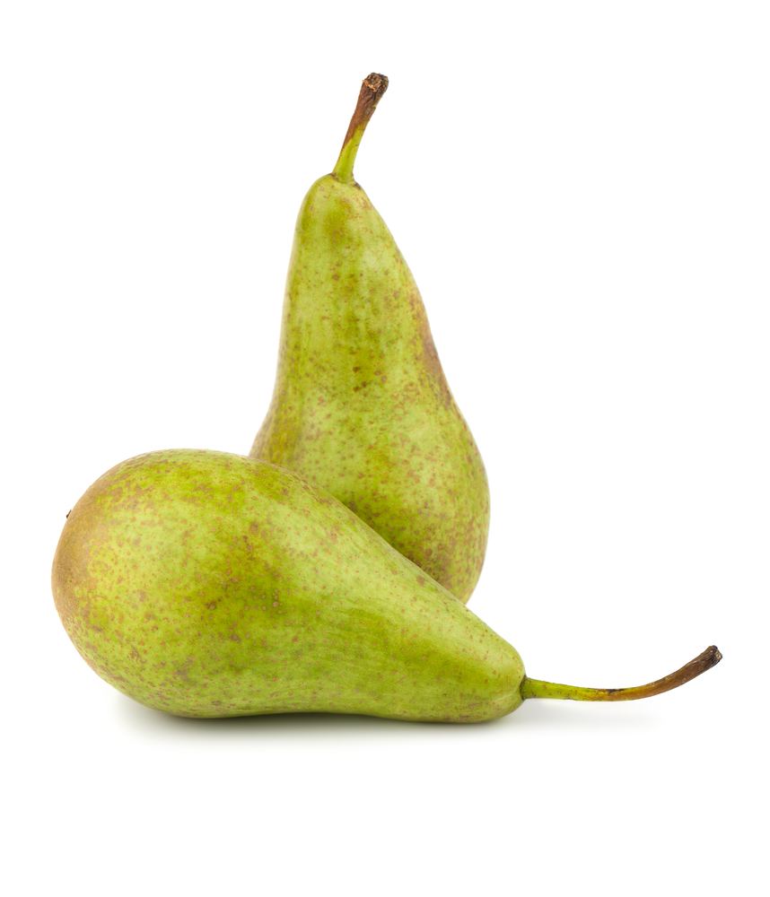
Similar
Pears are similar to apples.
They have a core which contain ‘pips’.

Slide 10


Summary
Apples are grown for our food.
Apples
Lots of dishes use apples.

Slide 11
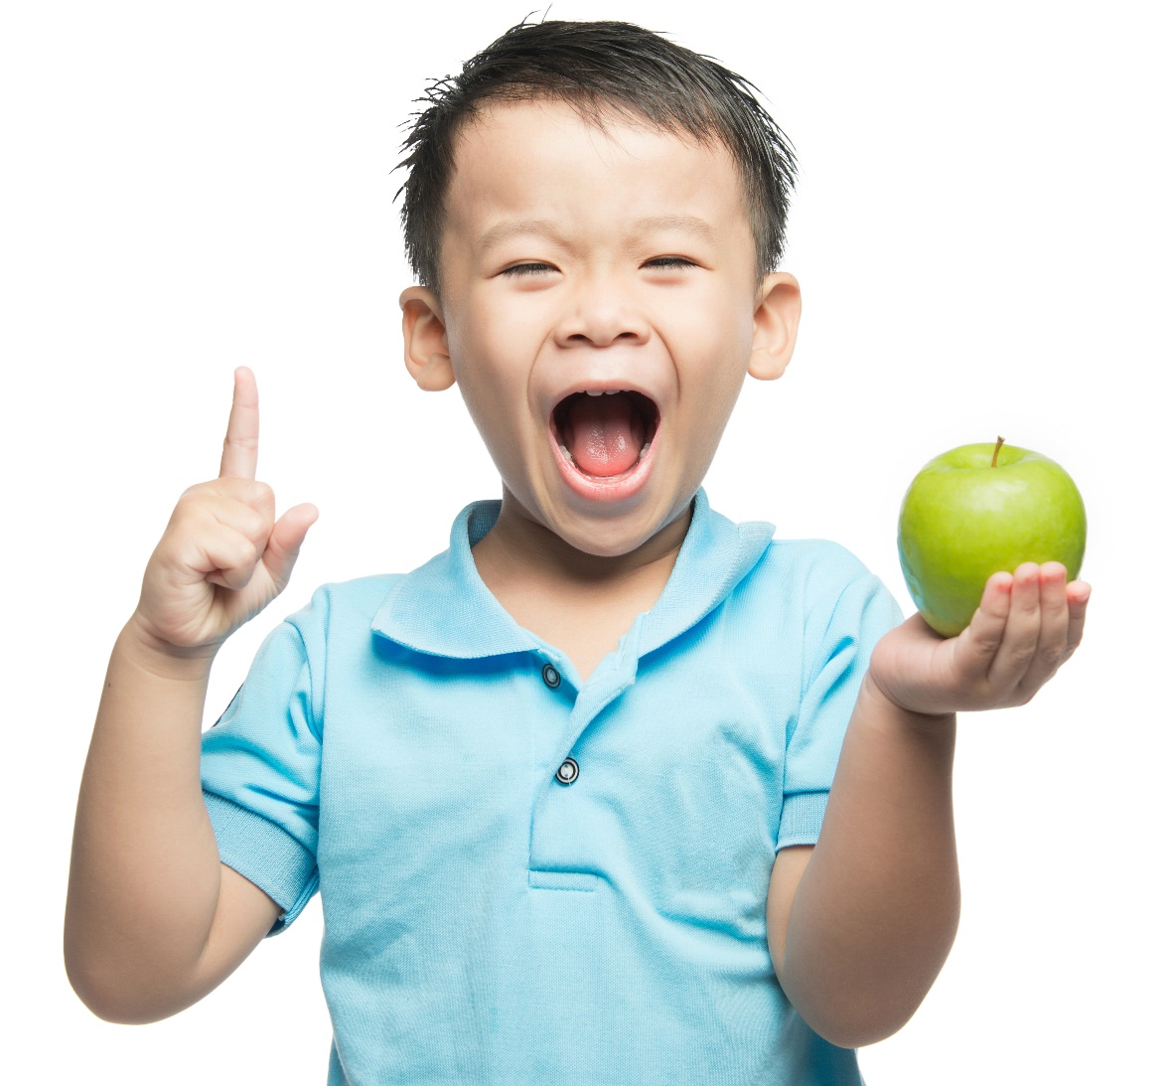
Do you like apples?

Slide 12
Apples
For further information, go to:
www.foodafactoflife.org.uk

