Slide 1
Bananas

Slide 2
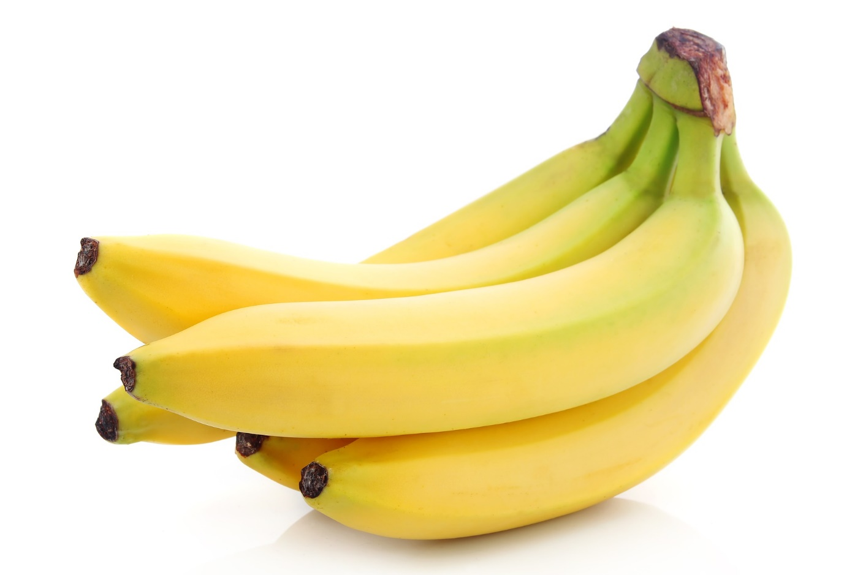
What are these?
These are bananas.
Bananas are a fruit.

Slide 3
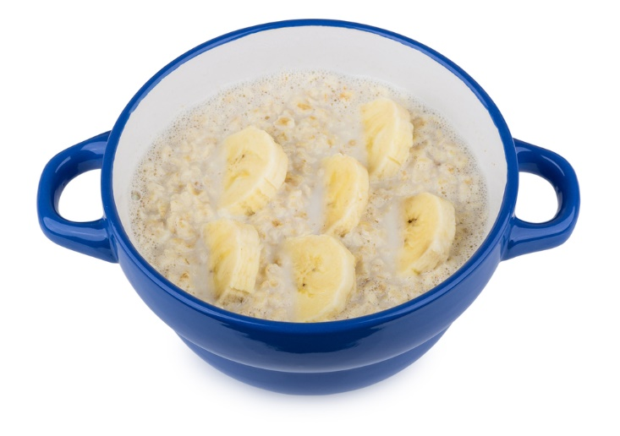
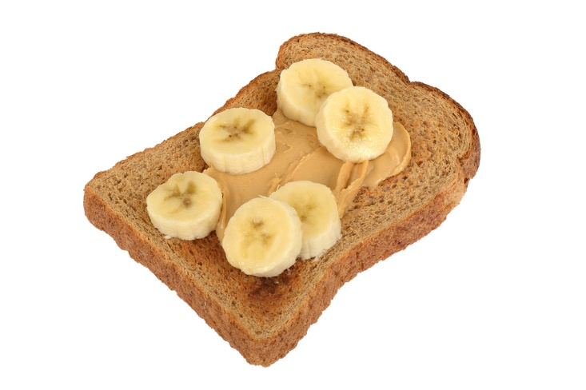
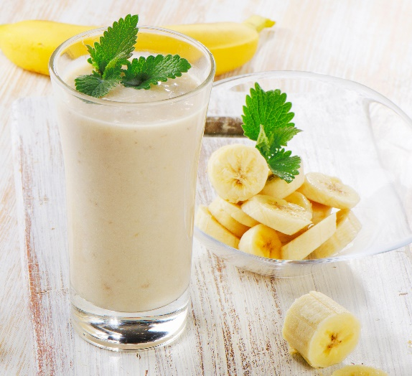
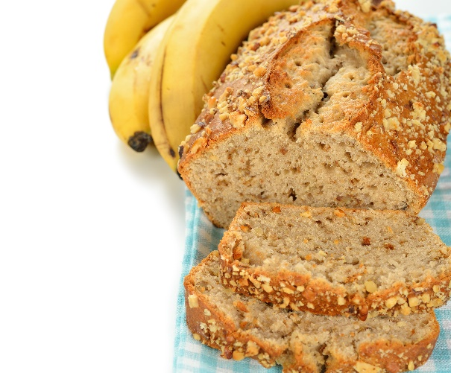
What are these?
They all use bananas.

Slide 4
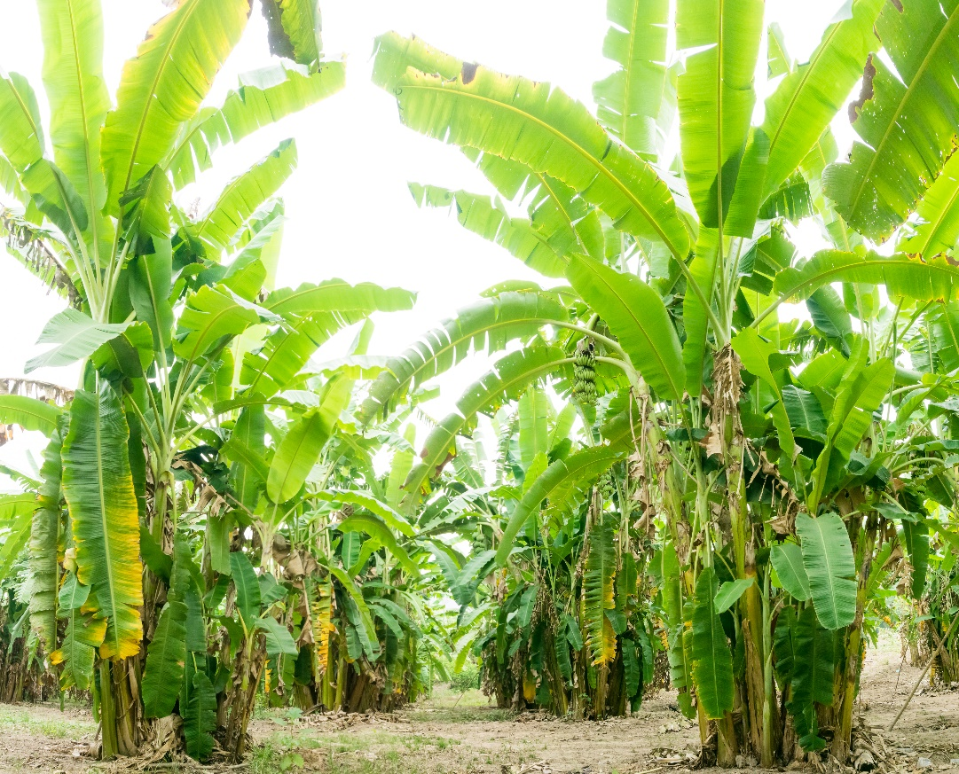
Where do bananas come from?
Bananas are from a plant.
They grow above the ground.
They are known as ‘fleshy’ fruit.
They are grown in hot climates.

Slide 5
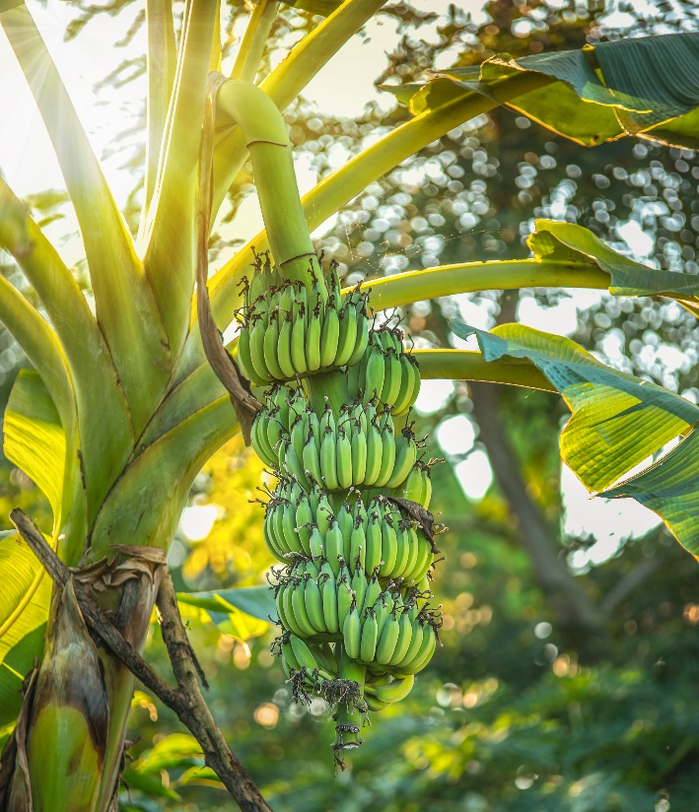
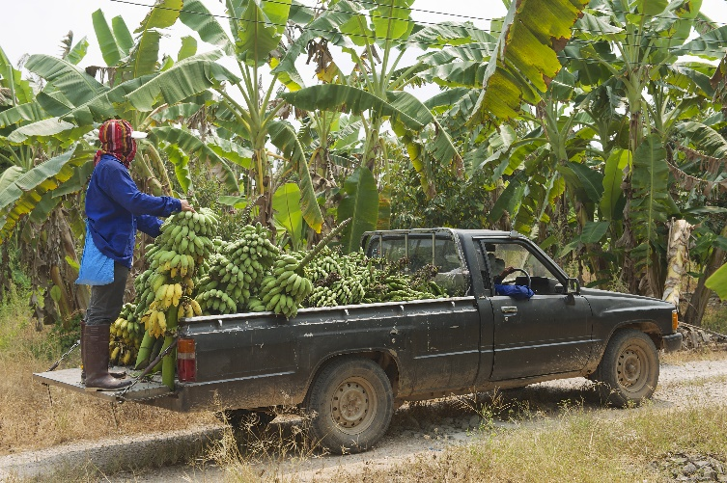
Where do bananas come from?
Bananas are picked when they are ready (ripe).
Have you seen bananas growing before?

Slide 6


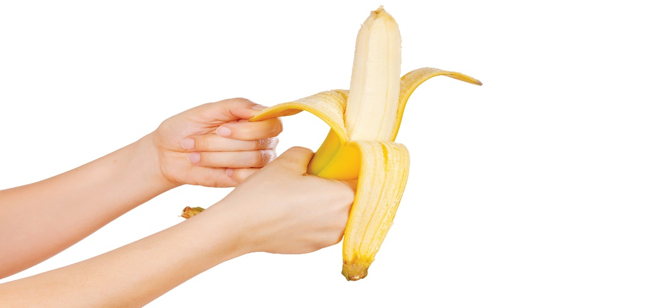
Dishes
Bananas can be eaten raw – just peel first.
Bananas can be used in lots of dishes.

Slide 7
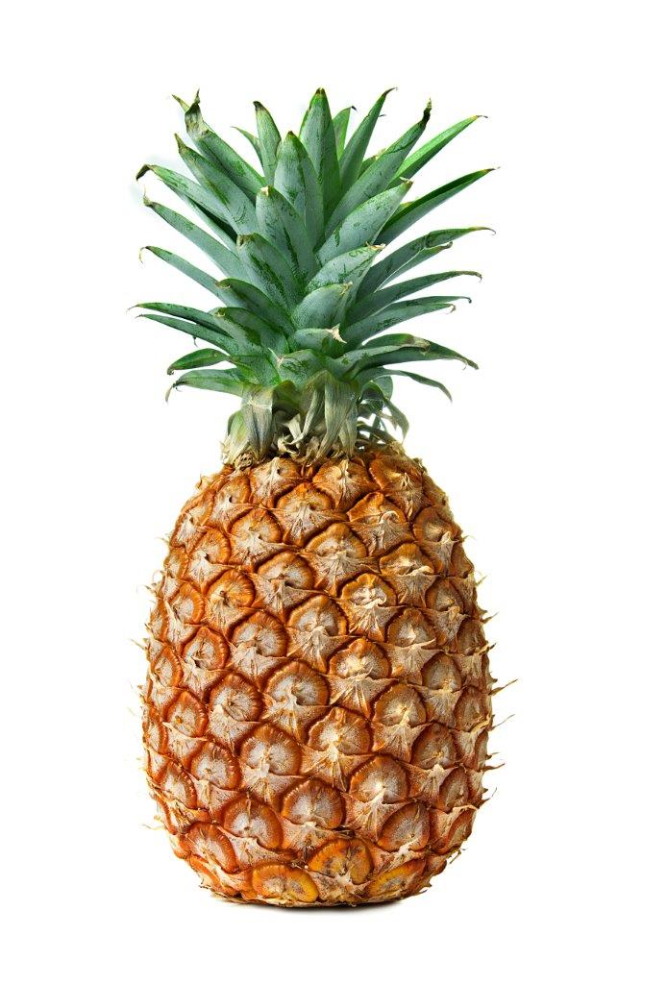
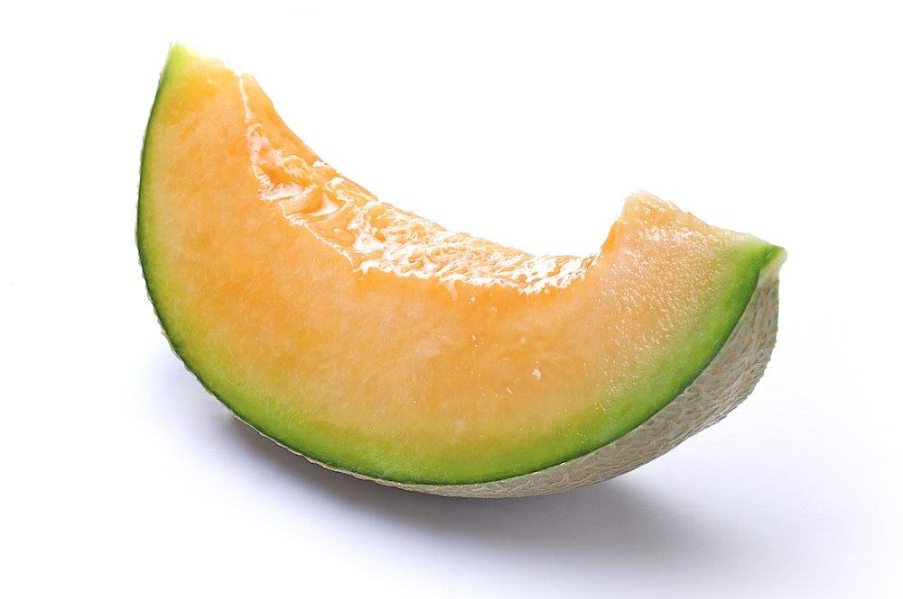
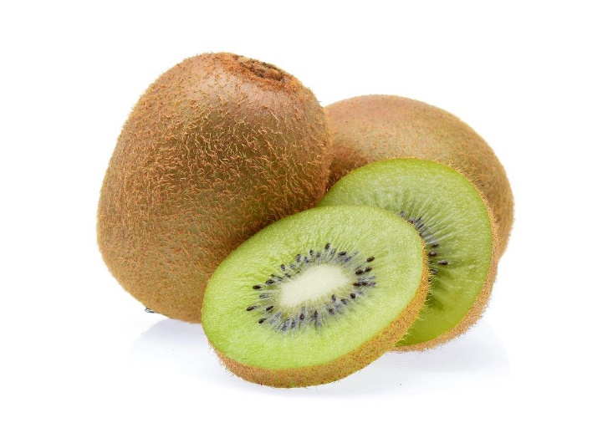
Similar
Kiwi, pineapple and melons are similar to bananas.
They are all known as ‘fleshy’ fruits.

Slide 8
Summary
Banana are grown for our food.
Bananas
Lots of dishes use bananas.

Slide 9
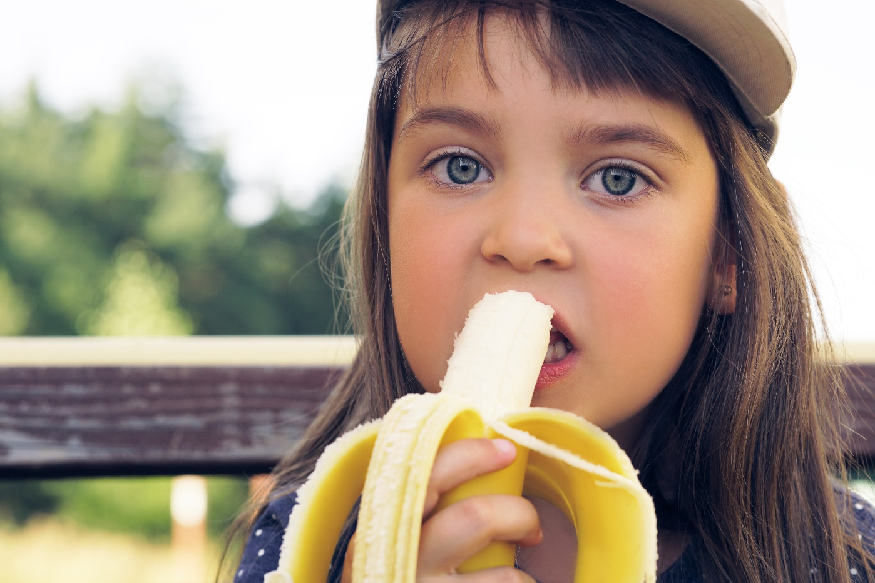
Do you like bananas?

Slide 10
Bananas
For further information, go to:
www.foodafactoflife.org.uk

