Slide 1
Carrots

Slide 2
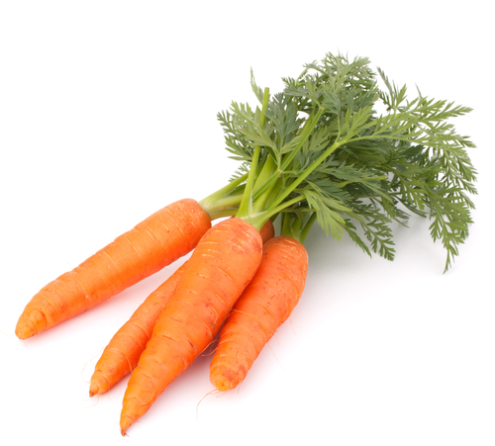
What are these?
These are carrots.
Carrots are a vegetable.

Slide 3
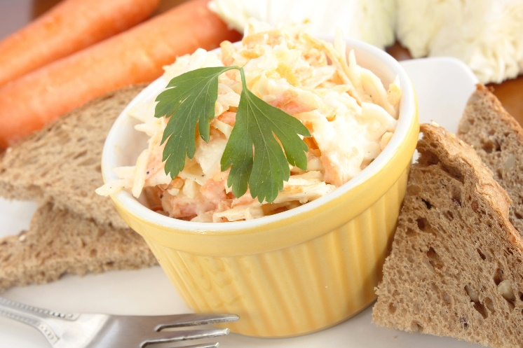
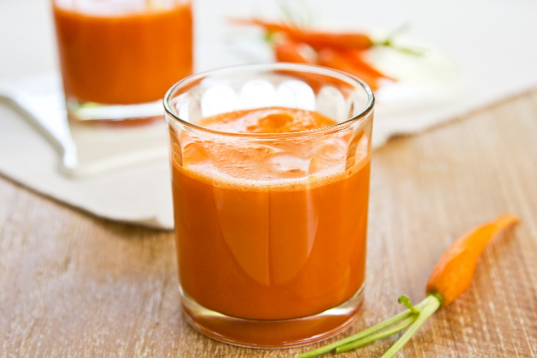
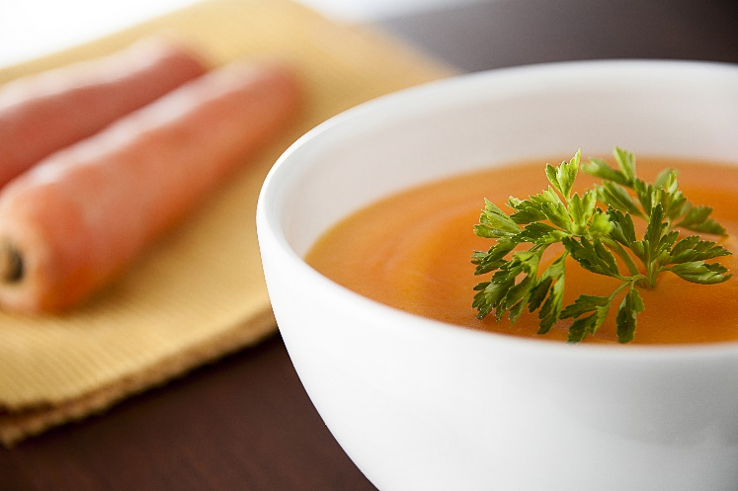
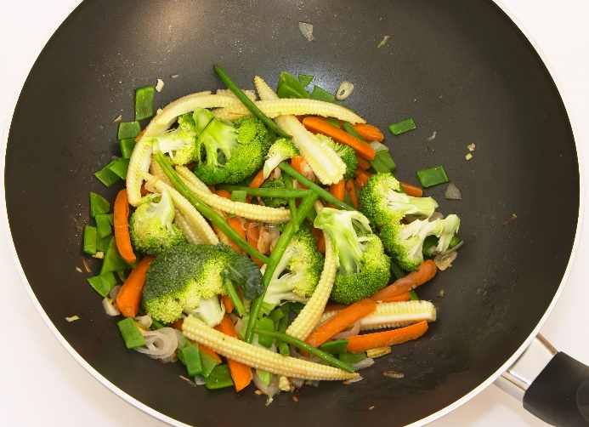
What are these?
They all use carrots.

Slide 4
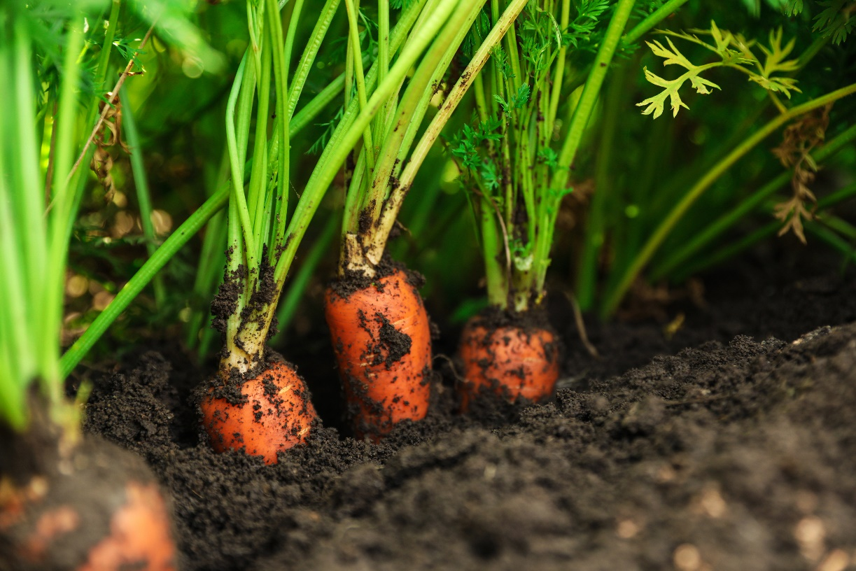
Where do carrots come from?
Carrots grow in the UK.
Carrots are a plant.
They grow under the ground.
Carrots are the roots of the plant.

Slide 5
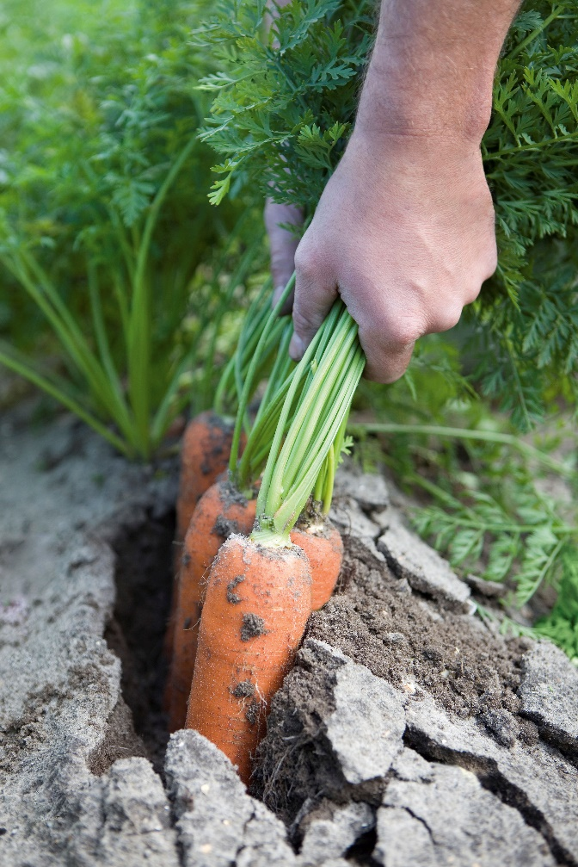
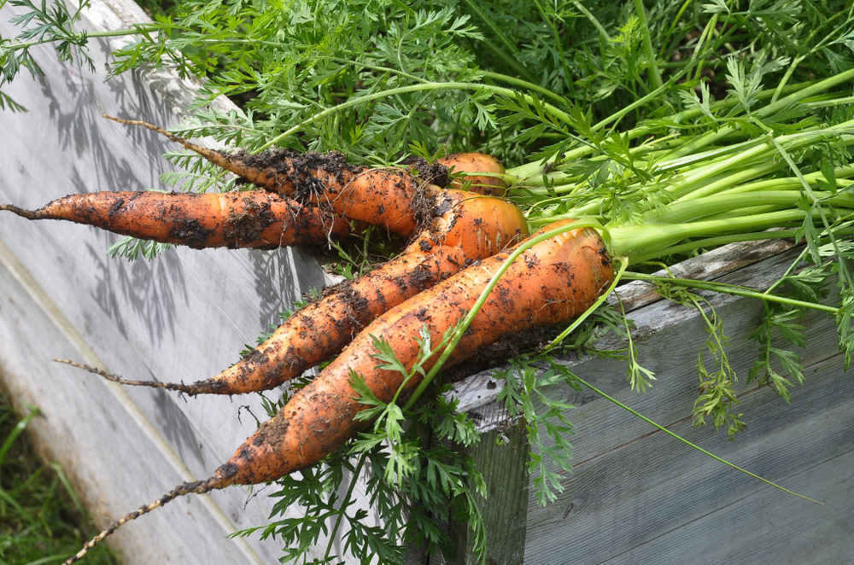
Where do carrots come from?
Carrots are pulled up from the earth when ready.
Have you seen carrots growing before?

Slide 6
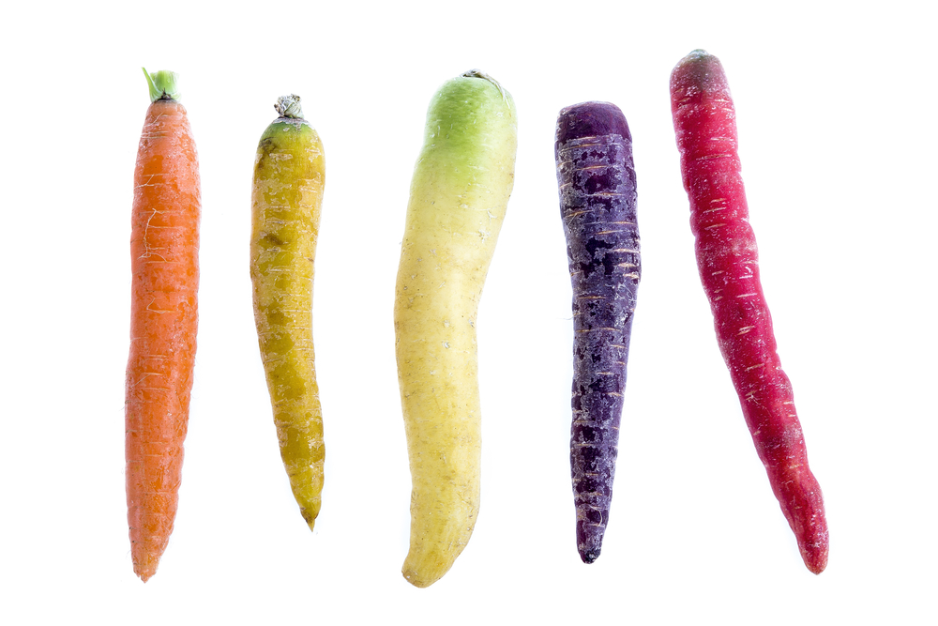
Carrot varieties
There are lots of different types carrots. There are 44 varieties around the world.
They have different names, such as:
Chanteray;
Danvers;
Nantes.

Slide 7
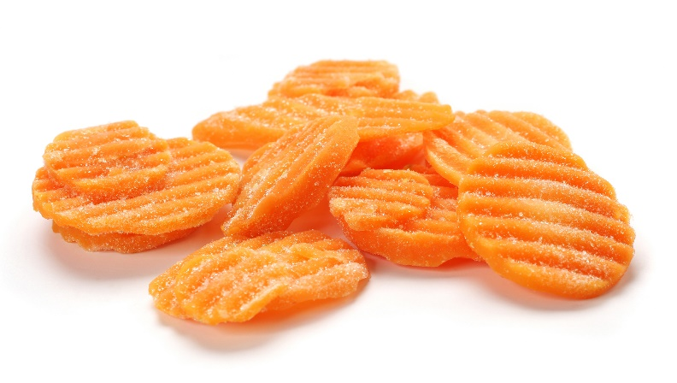
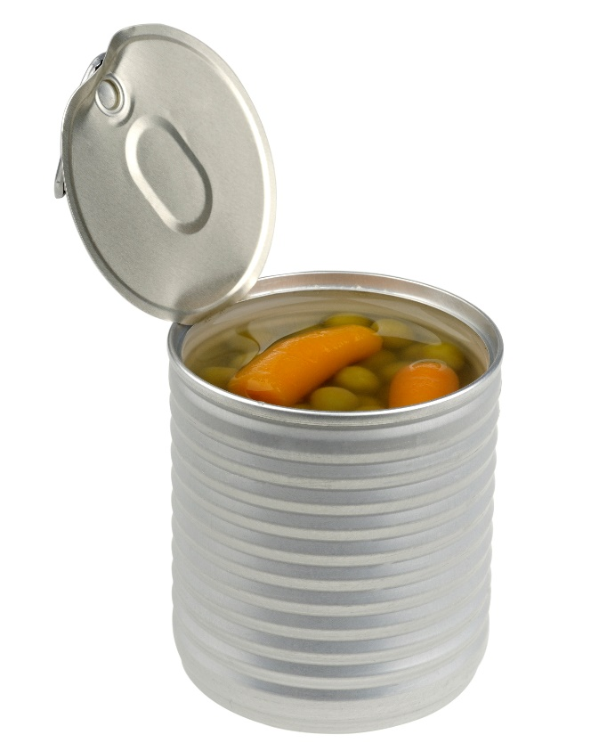
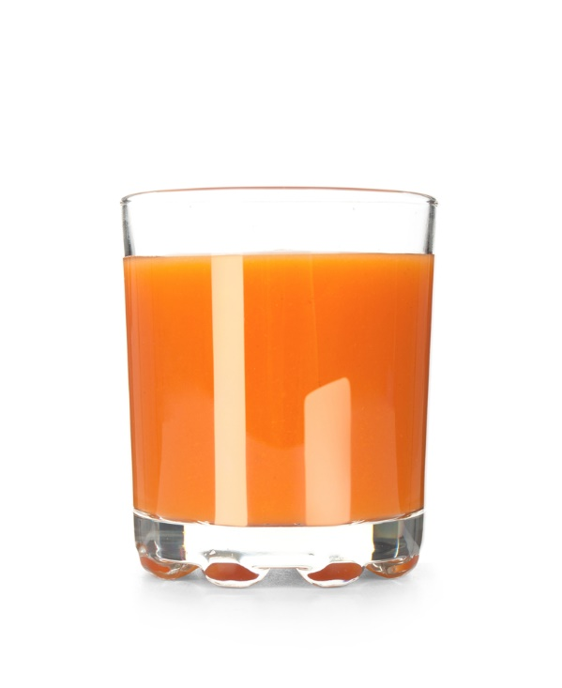
Carrots
Carrots can be purchased as:
fresh;
canned;
juiced;
frozen.

Slide 8
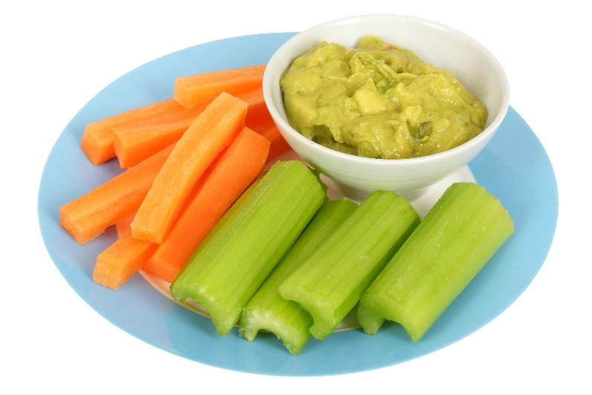
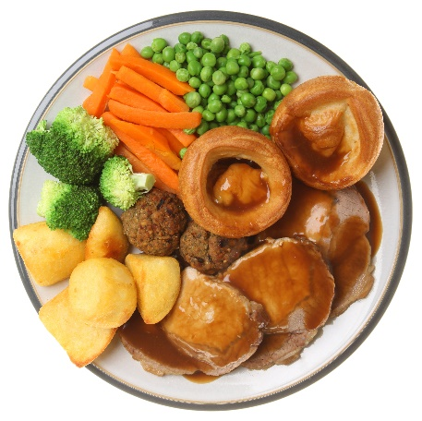
Dishes
Carrots can be eaten raw – just peel and wash first.
Carrots can be used in lots of dishes.

Slide 9
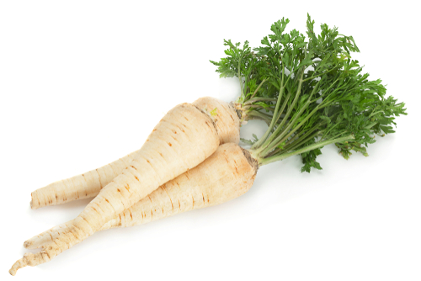
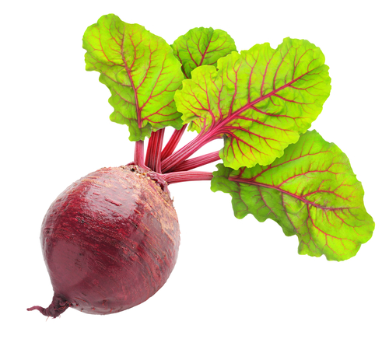
Similar vegetables
Parsnips and beetroot are similar to carrots.
They are all roots of a plant.

Slide 10


Summary
Carrots are grown for our food.
Carrots
Lots of dishes use carrots.

Slide 11
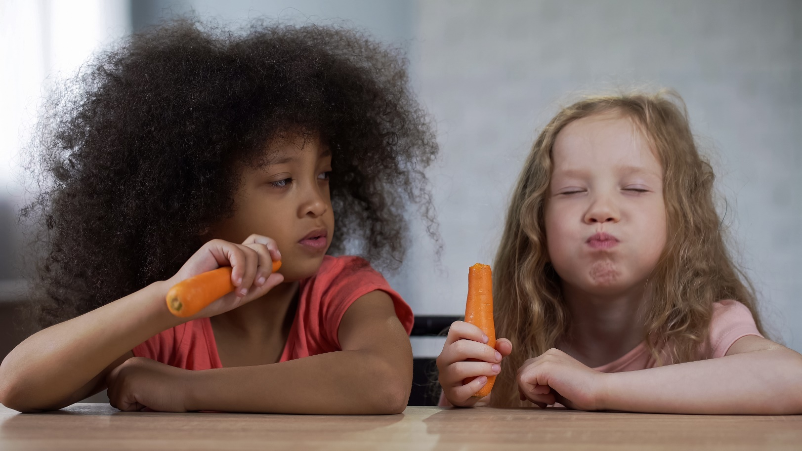
Do you like carrots?

Slide 12
Carrots
For further information, go to:
www.foodafactoflife.org.uk

