Slide 1
Celery

Slide 2
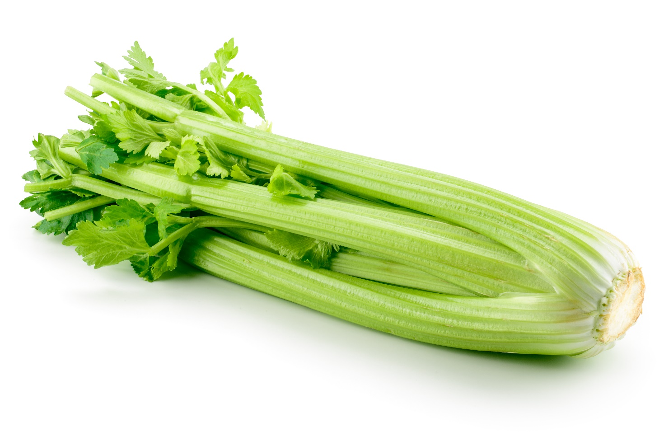
What is this?
This is celery.
Celery is a vegetable.

Slide 3
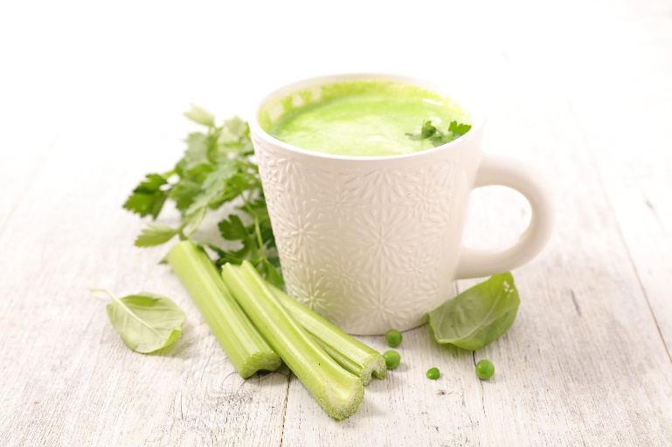
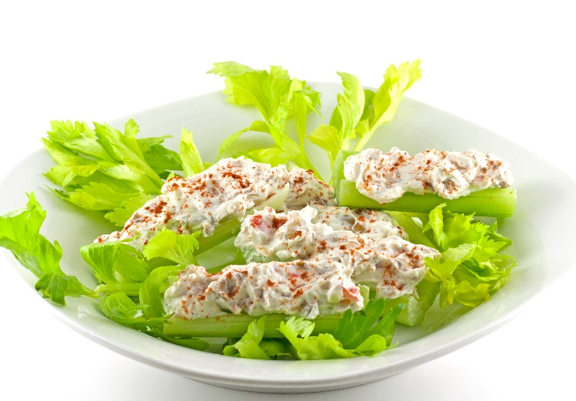
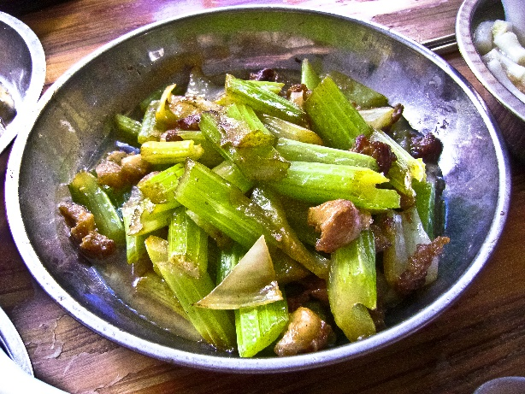
What are these?
They all use celery.

Slide 4
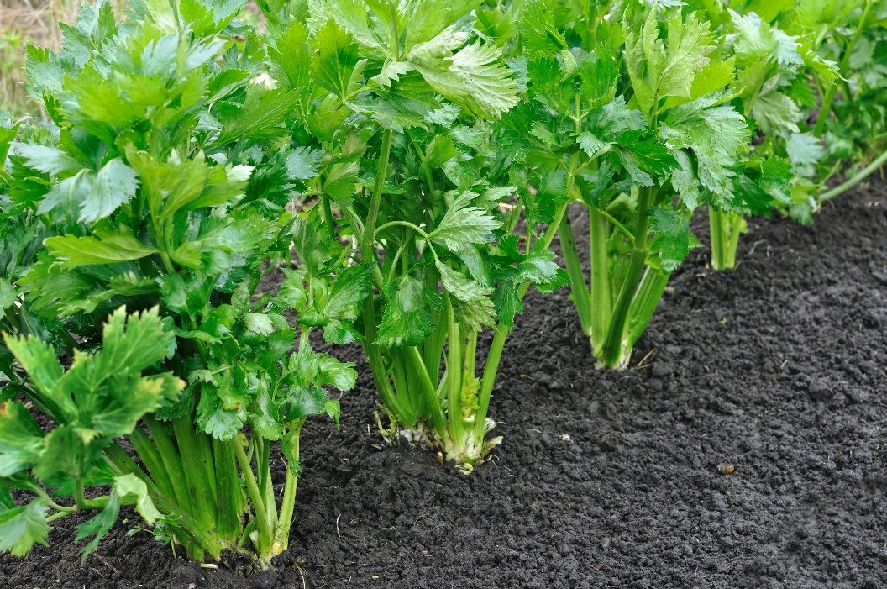
Where does celery come from?
Celery grows in the UK.
Celery is a plant.
It grows above the ground.
Celery is the stem (stalk) of the plant.

Slide 5
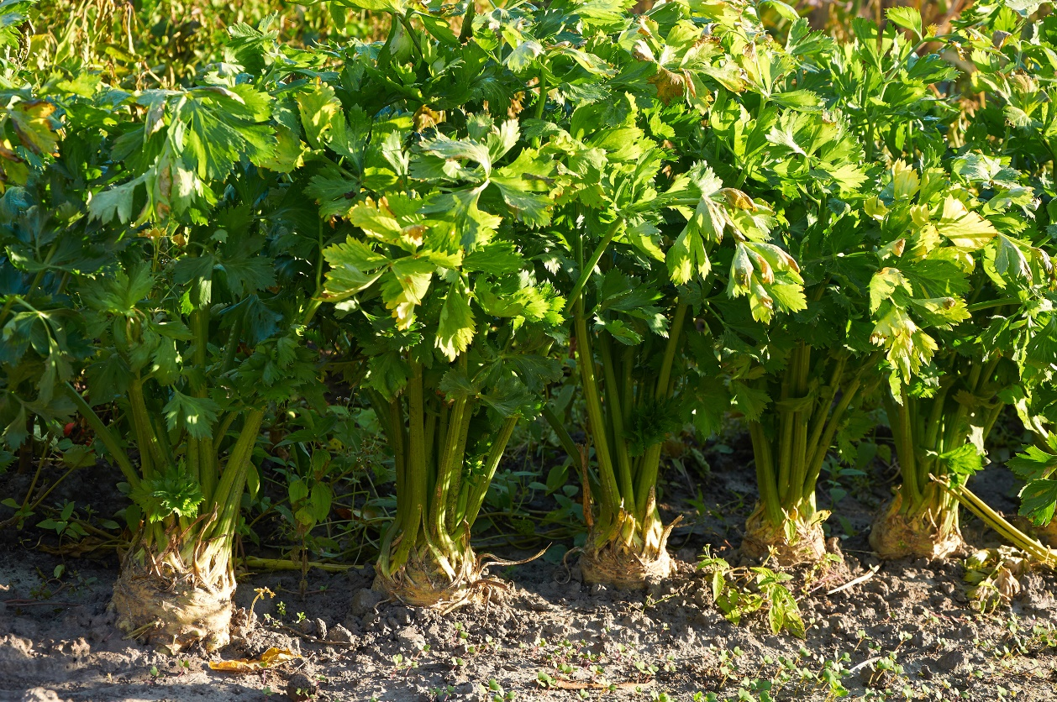
Where does celery come from?
Celery is grown in a garden or in a field.
It grows above the ground.
Have you seen celery growing before?

Slide 6
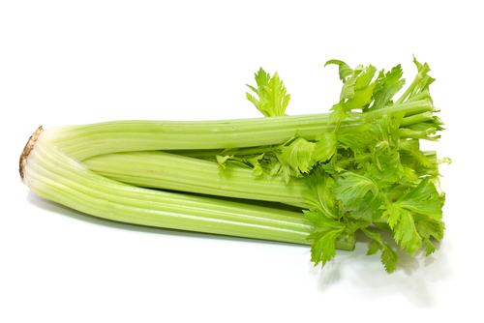
Celery
Celery is purchased fresh.

Slide 7
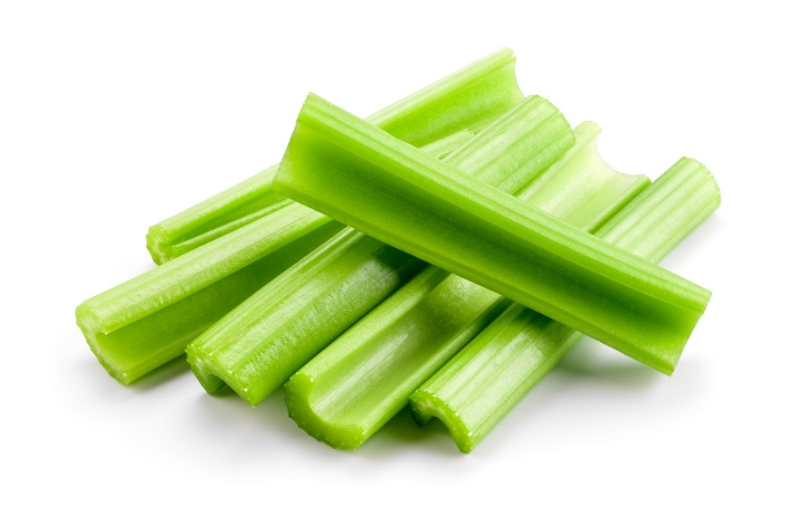
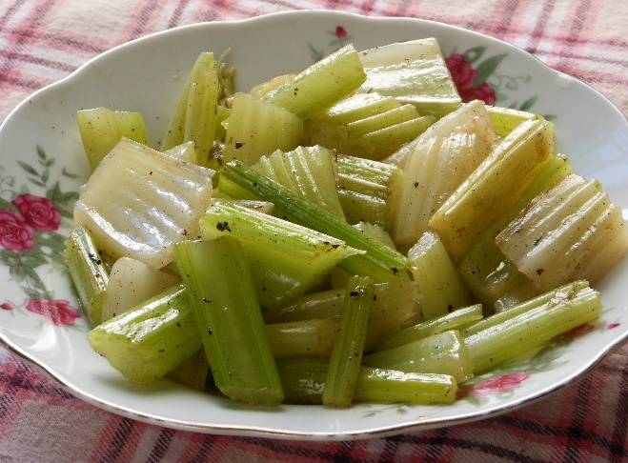
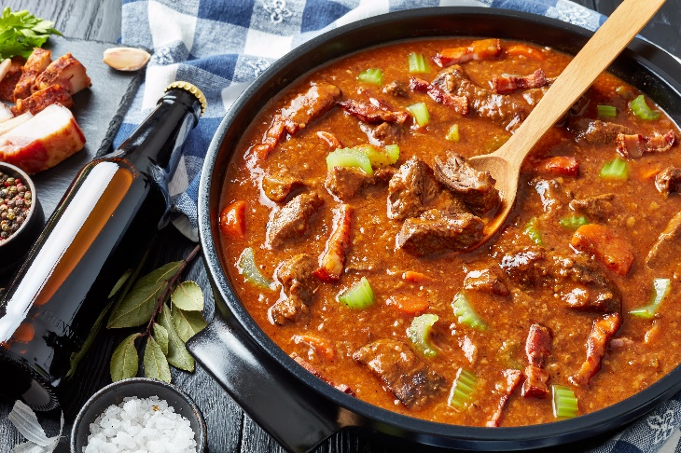

Dishes
Celery can be eaten raw – just wash first.
Celery can be used in many dishes.

Slide 8
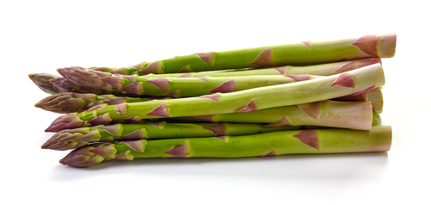
Similar
Asparagus is similar to celery.
They are the stem (stalk) of a plant.

Slide 9


Summary
Celery is grown for our food.
Celery
Lots of dishes use celery.

Slide 10
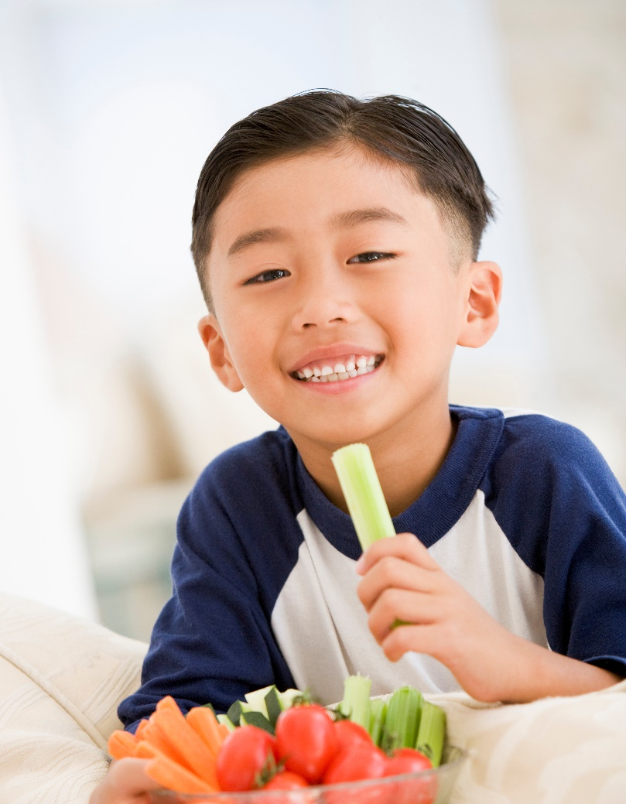
Do you like celery?

Slide 11
Celery
For further information, go to:
www.foodafactoflife.org.uk

