Slide 1
Lettuce

Slide 2
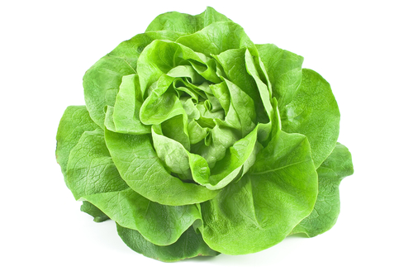
What is this?
This is a lettuce.
Lettuce is a vegetable.

Slide 3
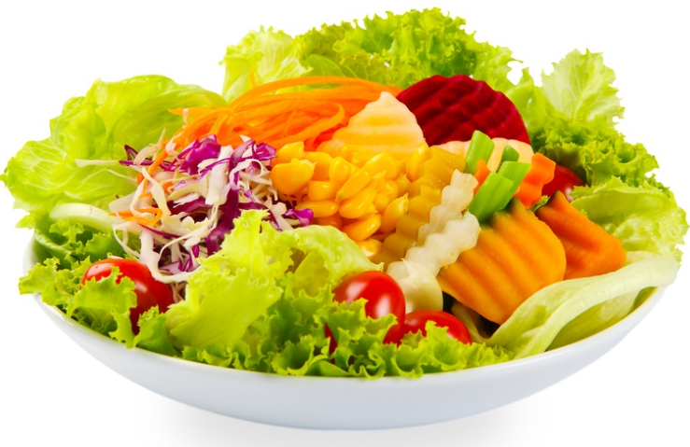
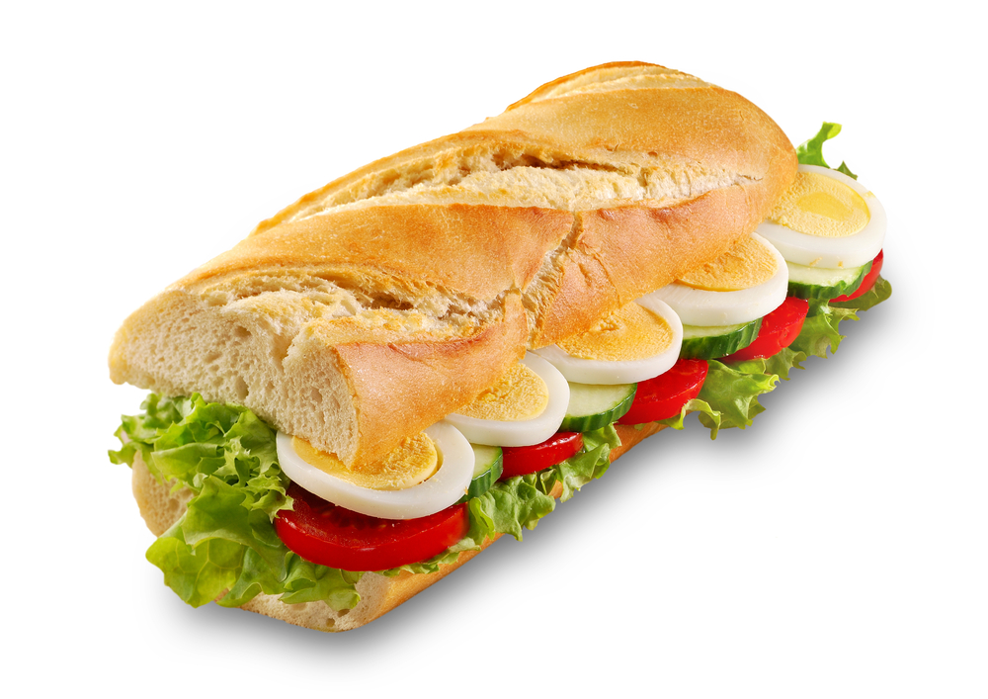
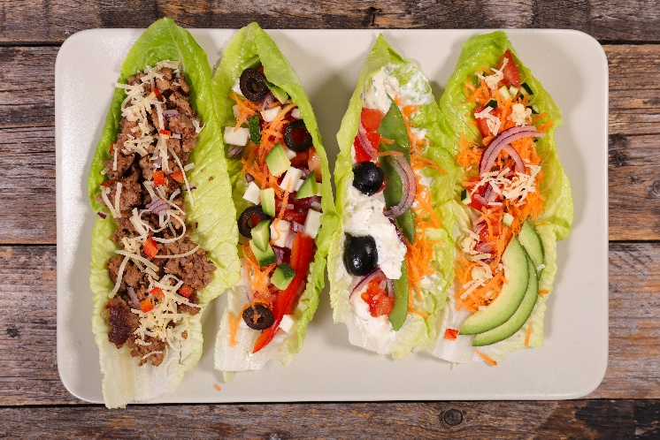
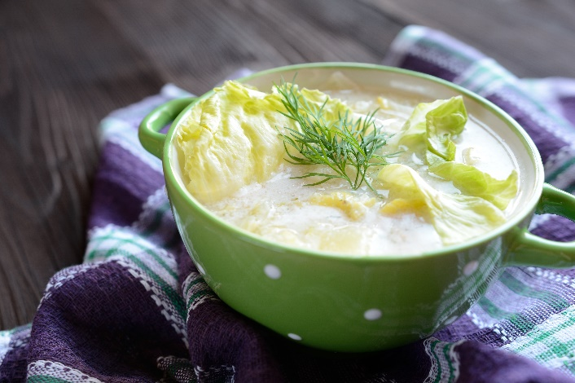
What’s in these?
They all use lettuce.

Slide 4
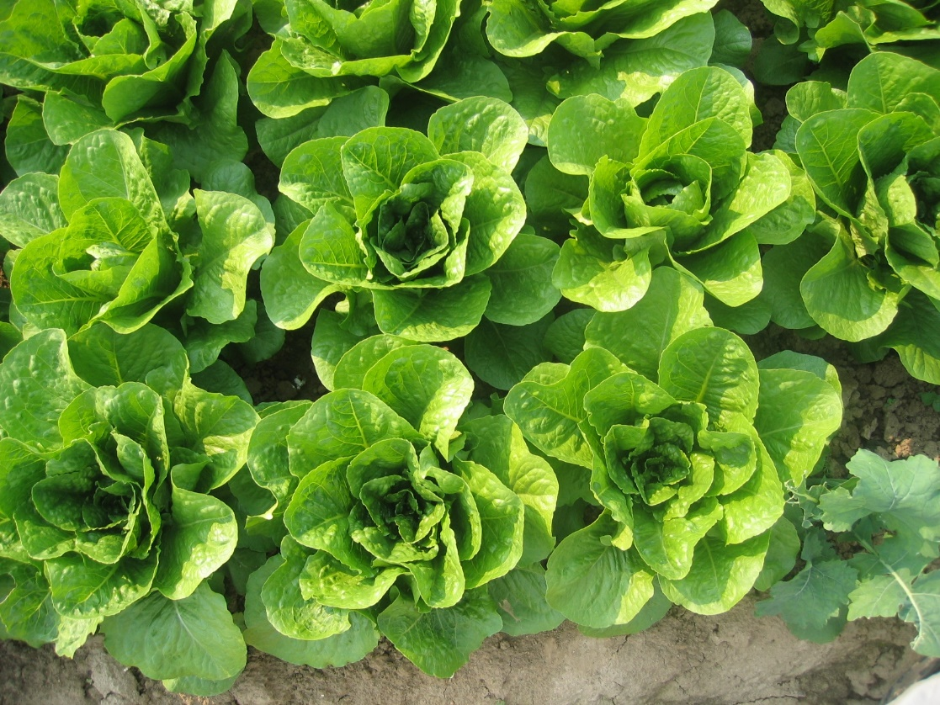
Where does lettuce come from?
Lettuce grows in the UK.
Lettuce is a plant.
They grow above the ground.
Lettuce is the leaves of the plant.

Slide 5
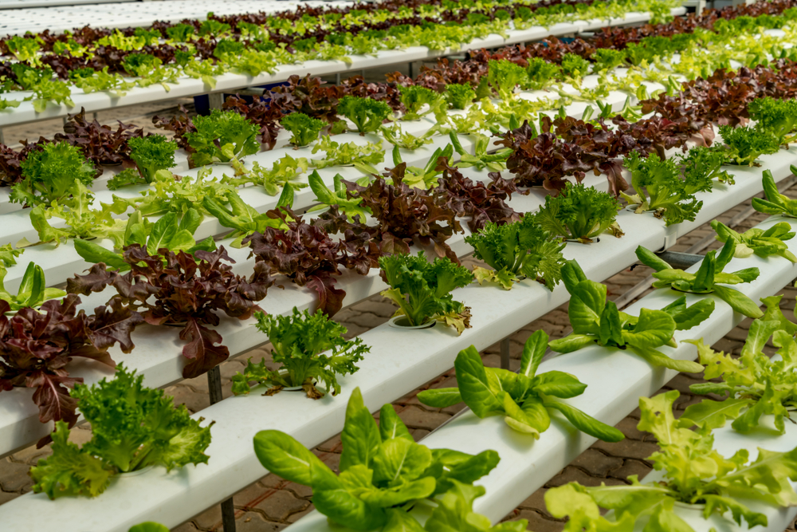
Where do lettuces come from?
Lettuce is picked when ready from a garden or field.
Have you seen lettuce growing before?

Slide 6
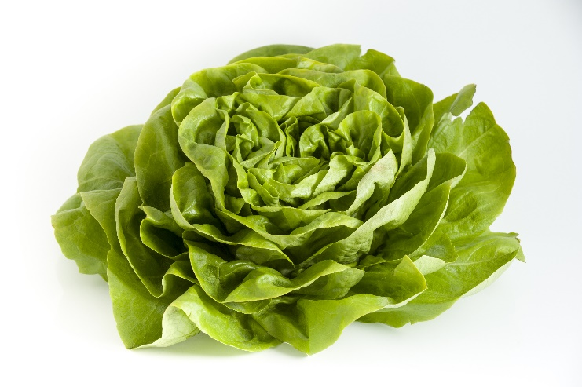
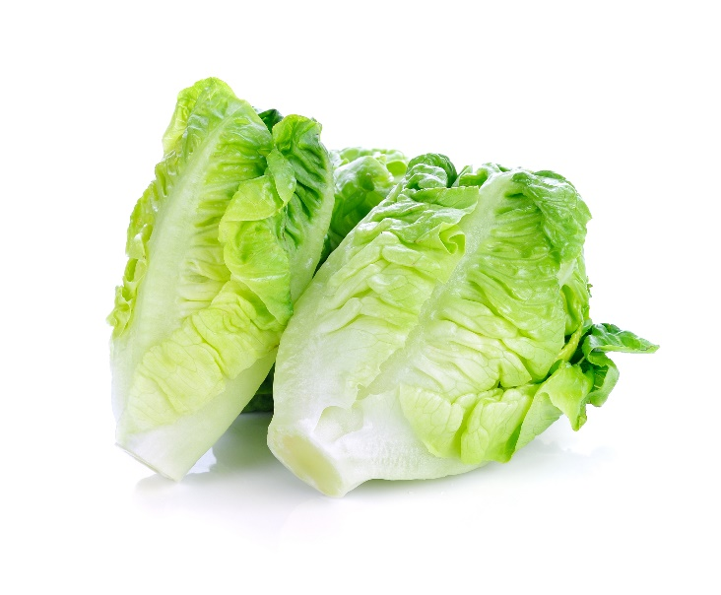
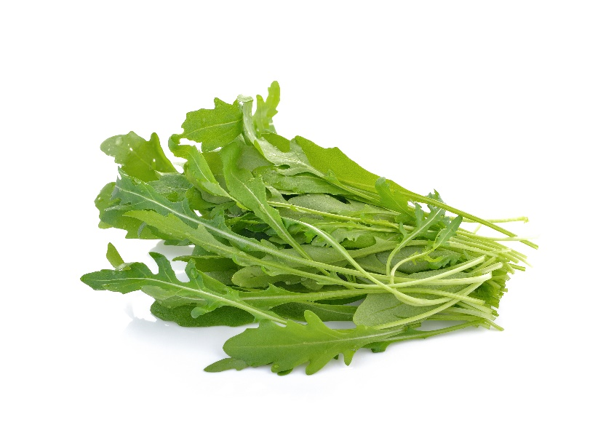
Lettuce varieties
There are lots of different types lettuce.
They have different names, such as:
butterhead;
cos;
rocket.

Slide 7
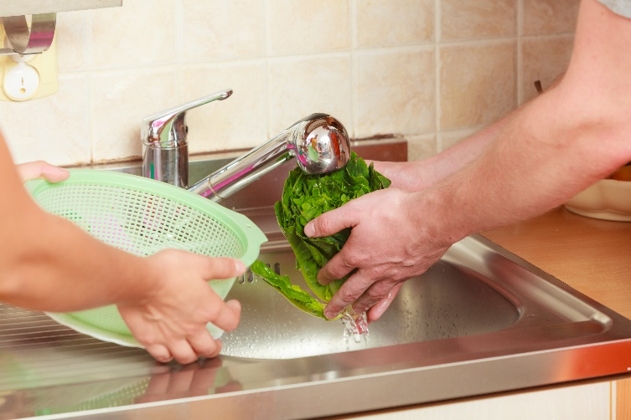

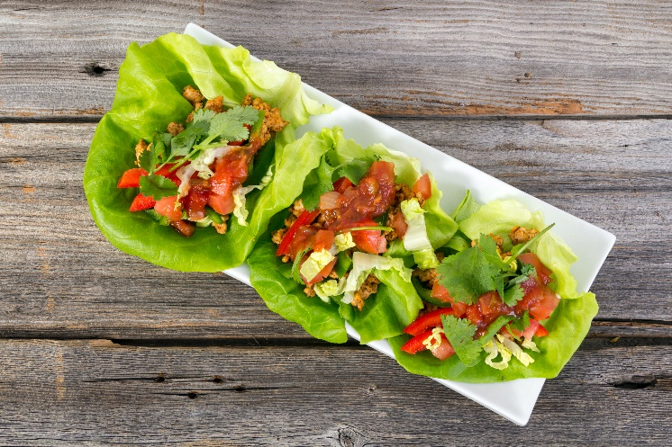
Dishes
Lettuce is eaten raw – just wash first.
Lettuce can be used in lots of dishes.

Slide 8
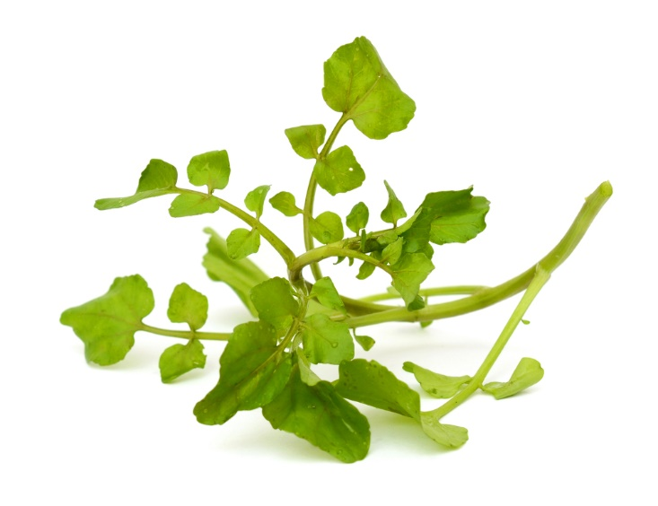
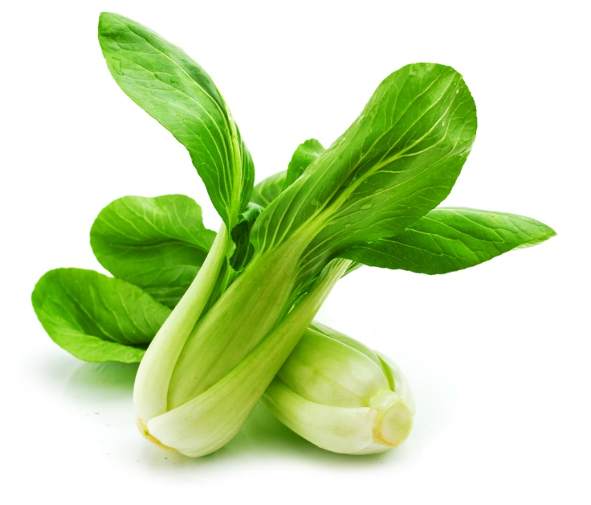
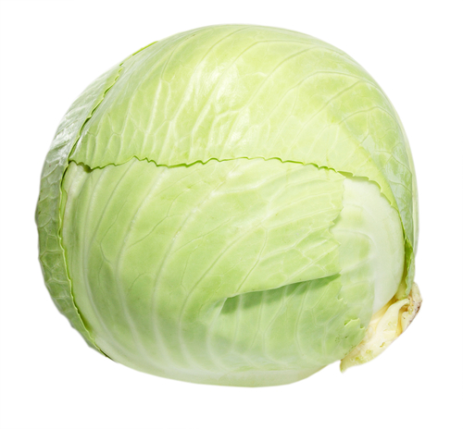
Similar
Spinach, cabbage, watercress and pak choi are similar to lettuce.
They are all leaves of a plant.

Slide 9



Summary
Lettuce is grown for our food.
Lettuce
Lots of dishes use lettuce.

Slide 10
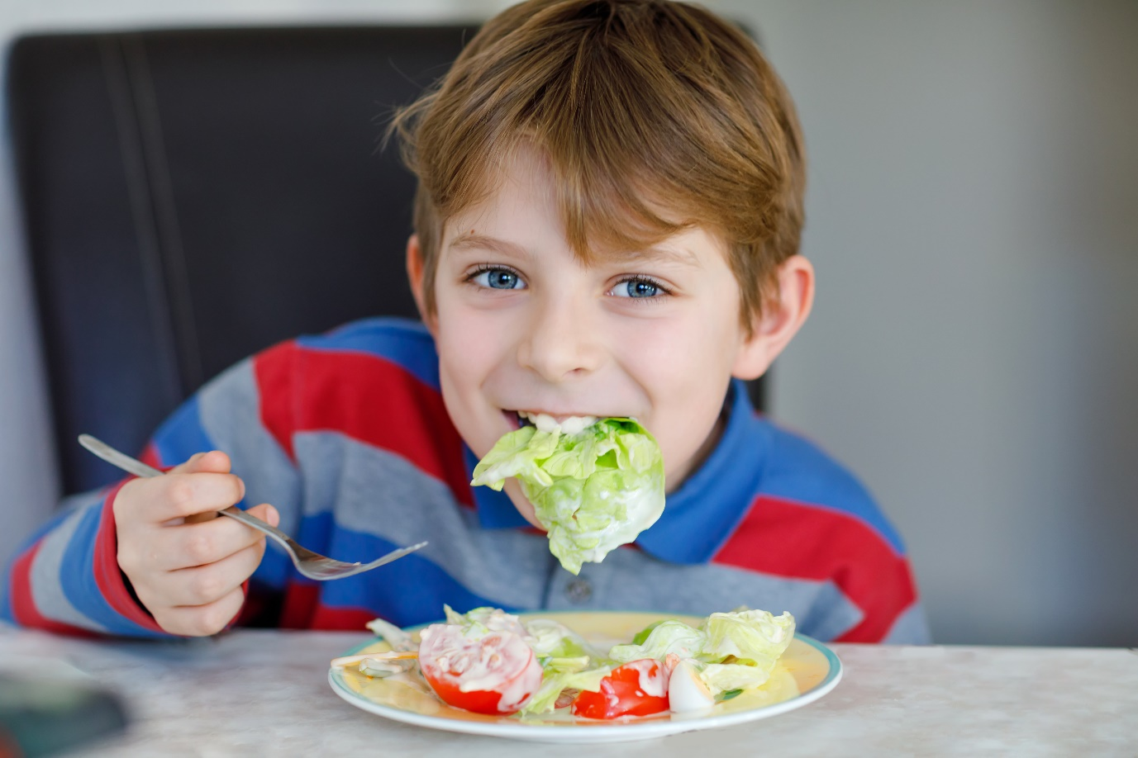
Do you like lettuce?

Slide 11
Lettuce
For further information, go to:
www.foodafactoflife.org.uk

