Slide 1
Mushrooms

Slide 2
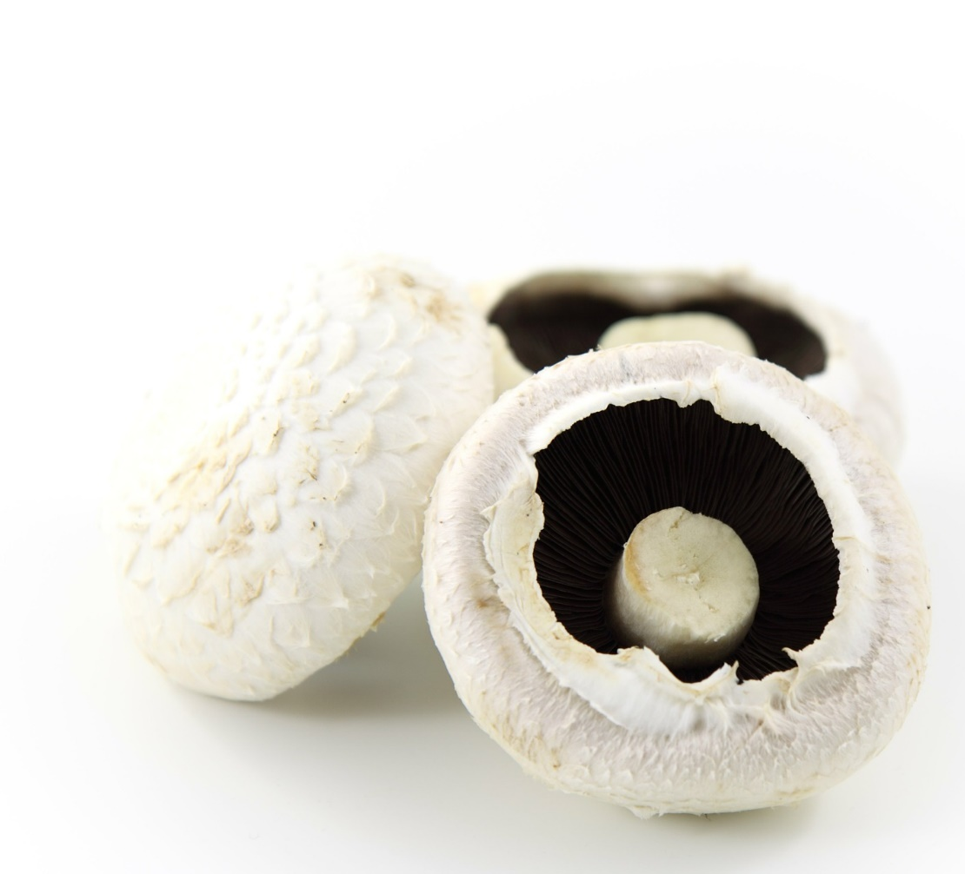
What are these?
These are mushrooms.
Mushrooms are a plant*.
*At this age, mushrooms have been labelled as a vegetables – they are type of fungi, which are not plants.
Notes:
At this age, mushrooms have been labelled as a vegetables – they are type of fungi, which are not plants.

Slide 3
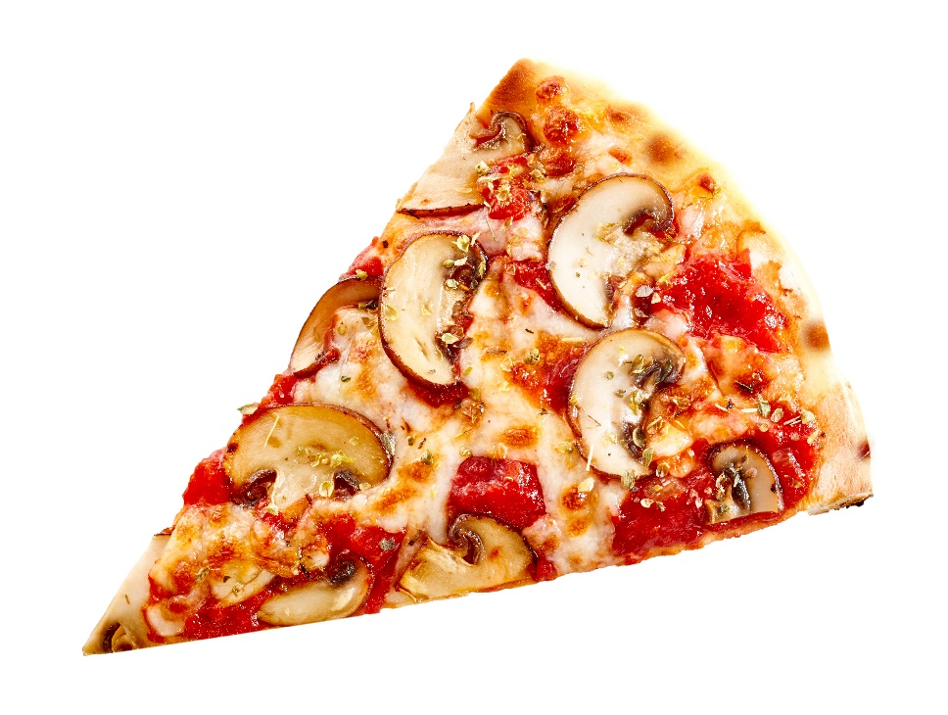
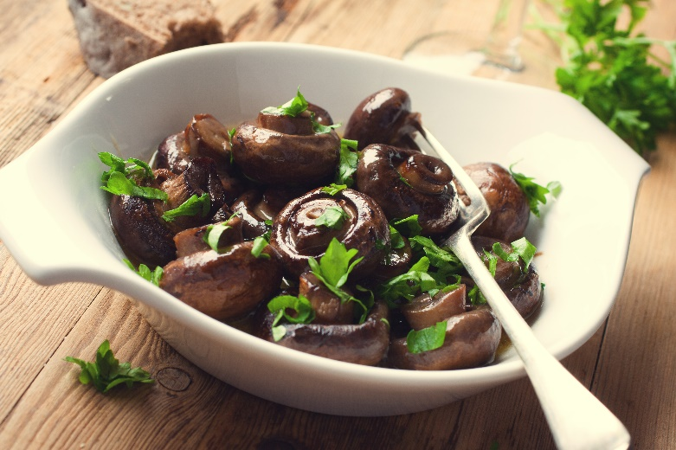
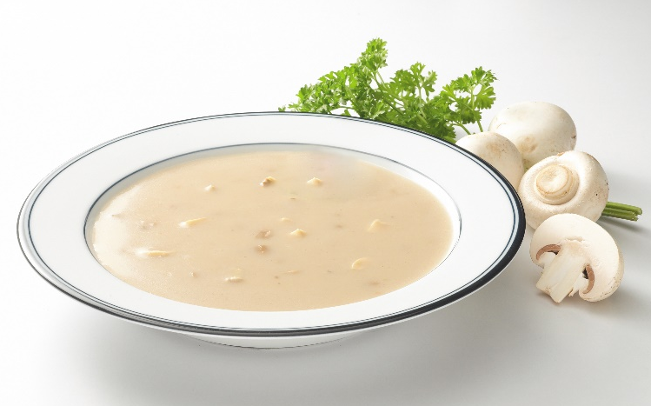
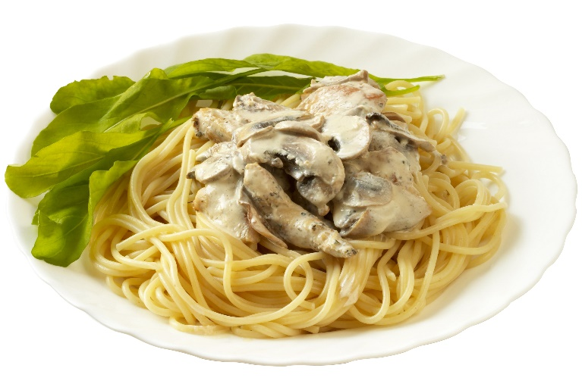
What are these?
They all use mushrooms.

Slide 4
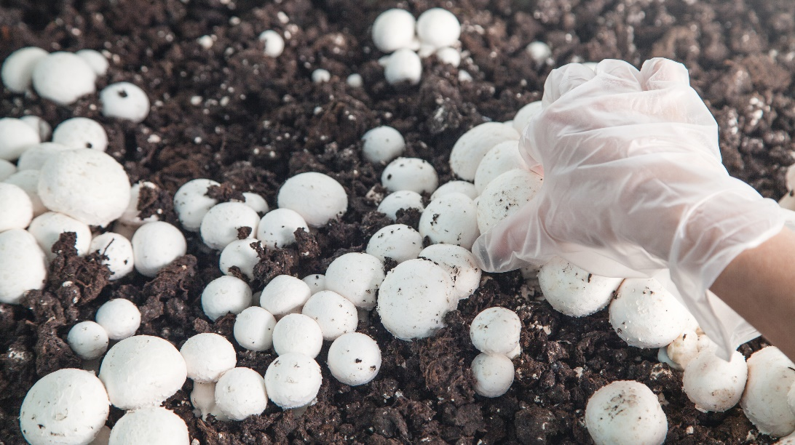
Where do mushrooms come from?
Mushrooms grow in the UK.
Mushrooms grow on soil/compost.
They grow above the ground.
In the wild, they may grown around trees.

Slide 5
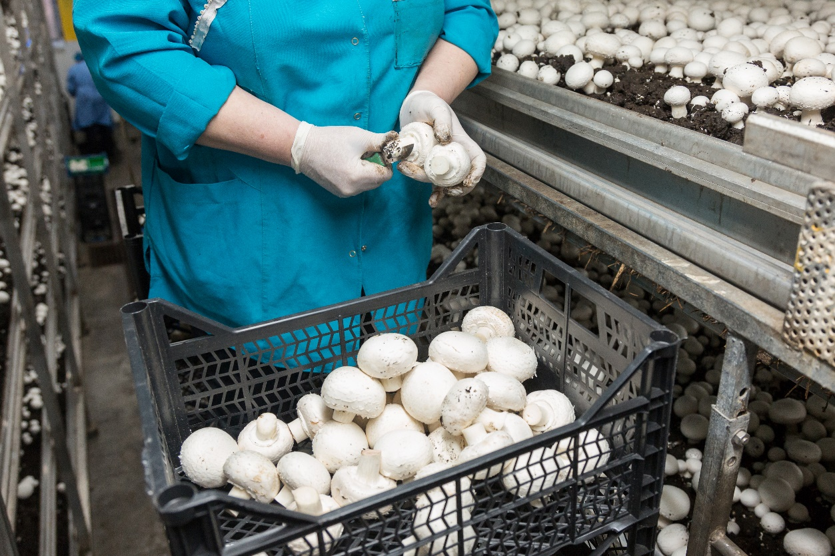
Where do mushrooms come from?
Mushrooms are picked when ready.
Have you seen mushrooms grow before?

Slide 6
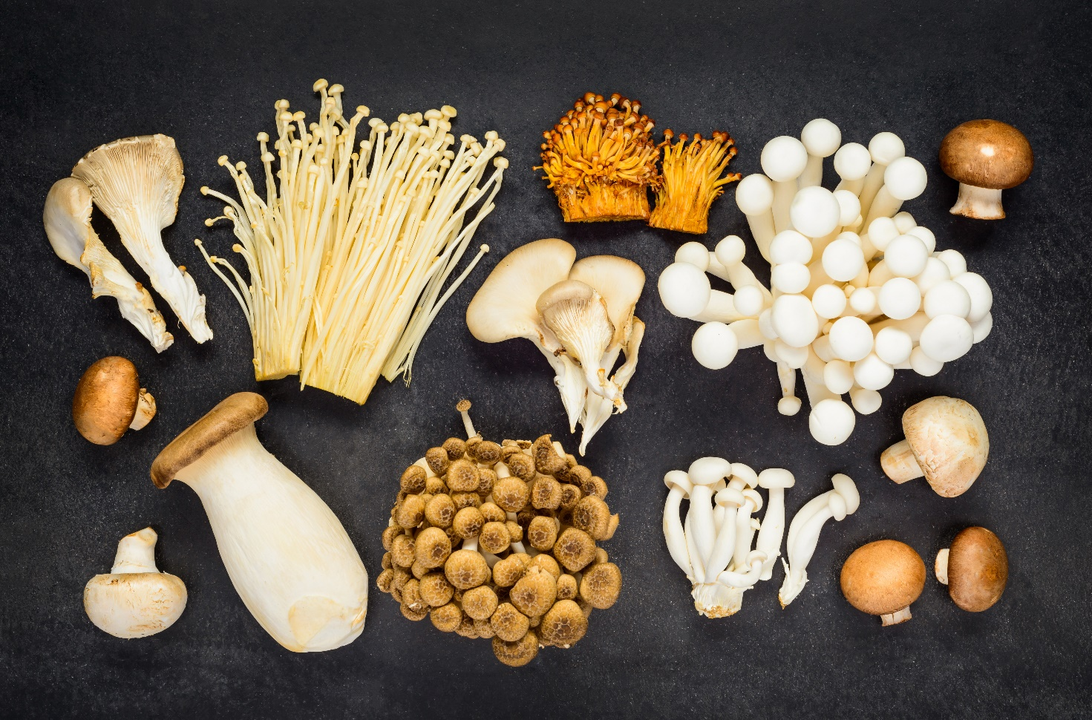
Mushroom varieties
There are lots of different types mushrooms.
They have different names, such as:
button;
chestnut;
oyster.

Slide 7

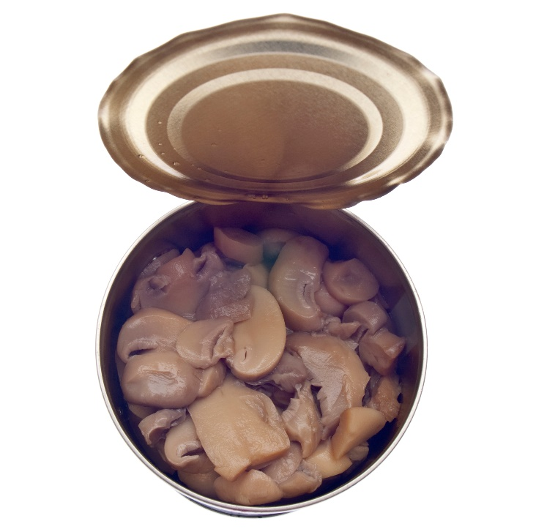
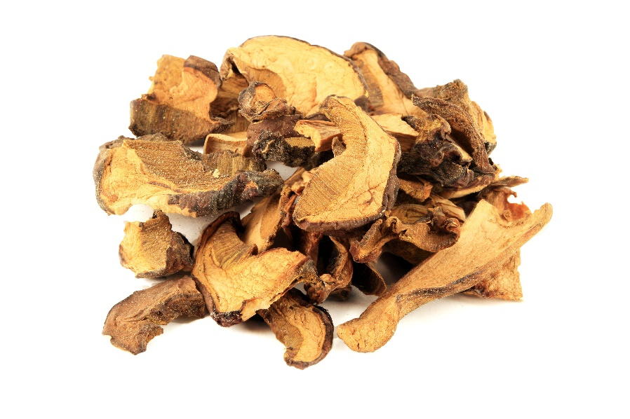
Mushrooms
Mushrooms can be purchased as:
fresh;
canned;
frozen;
dried.

Slide 8
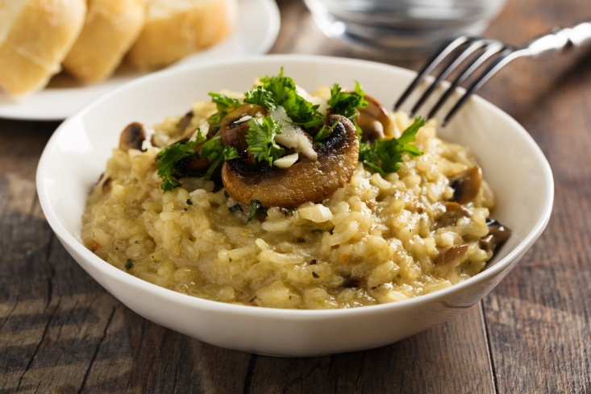
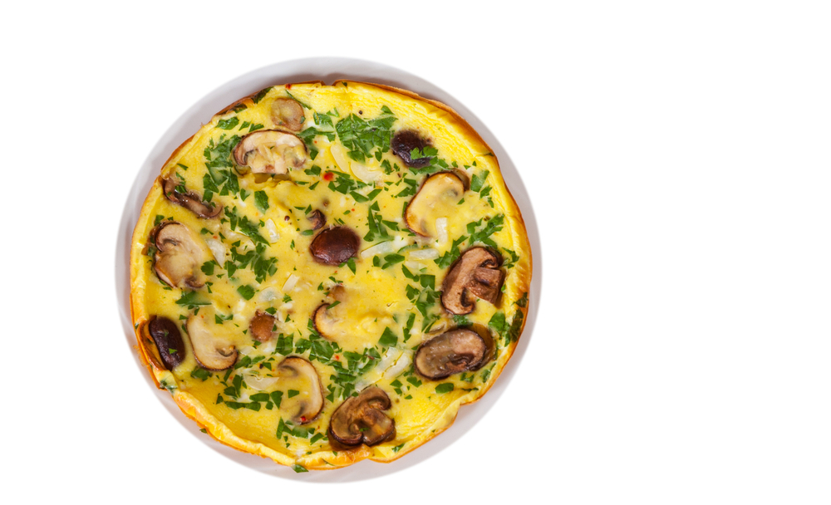
Dishes
Mushrooms can be eaten raw – just wipe first.
Mushrooms can be used in lots of dishes.

Slide 9

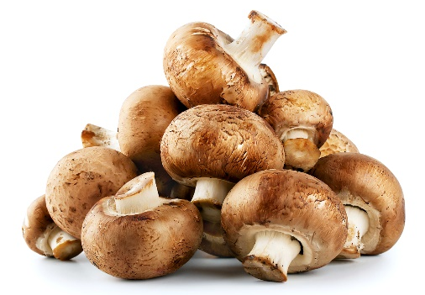
Summary
Mushrooms are grown for our food.
Mushrooms
Lots of dishes use mushrooms.

Slide 10
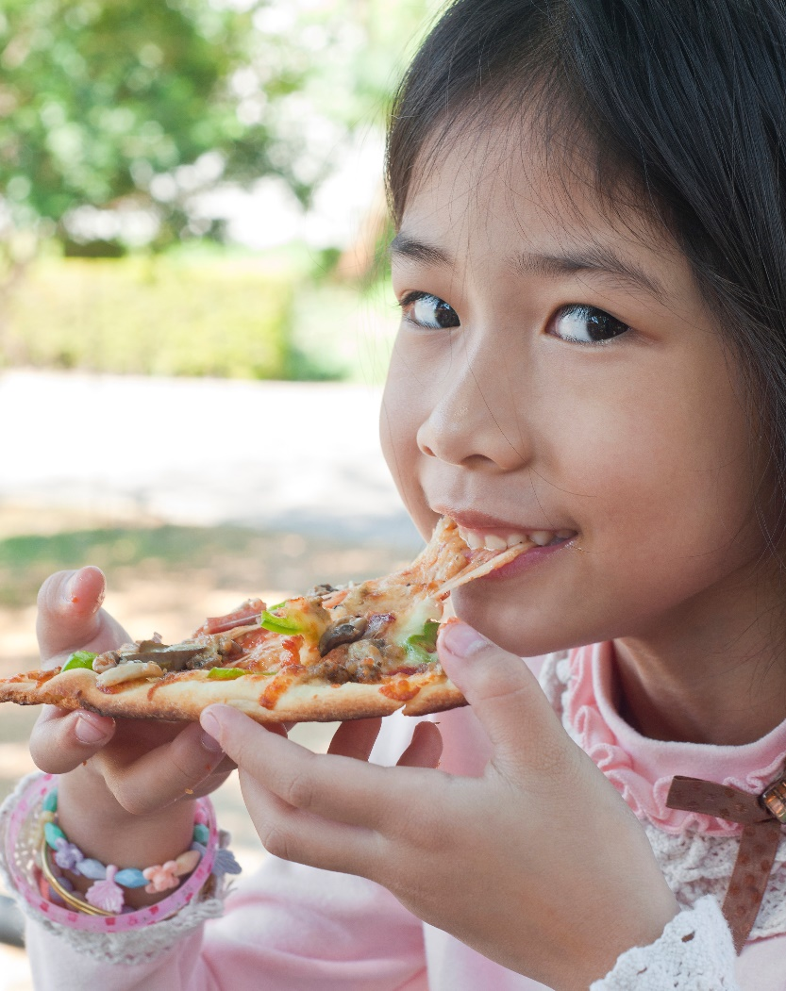
Do you like mushrooms?

Slide 11
Mushrooms
For further information, go to:
www.foodafactoflife.org.uk

