Slide 1
Onions

Slide 2
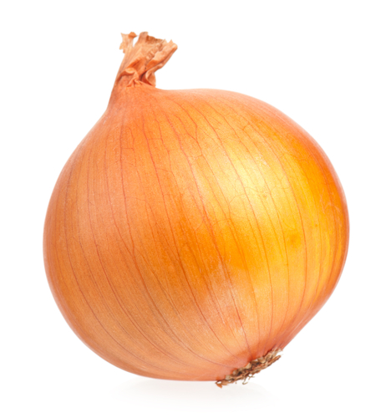
What is this?
This is an onion.
Onions are a vegetable.

Slide 3
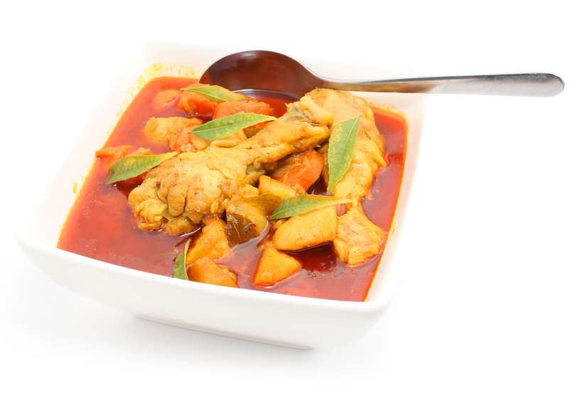
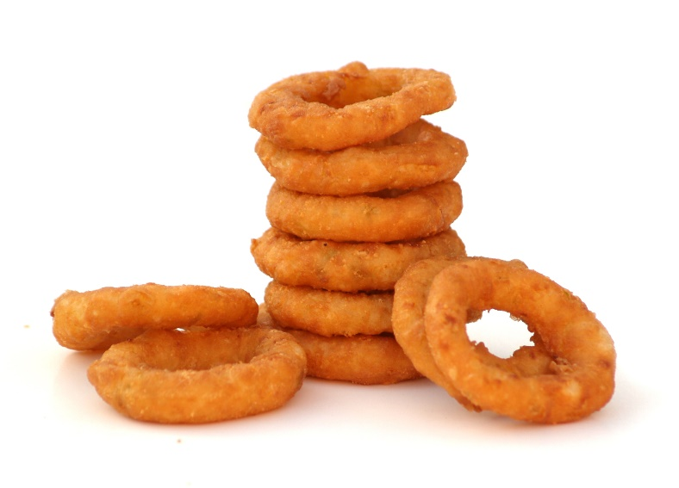
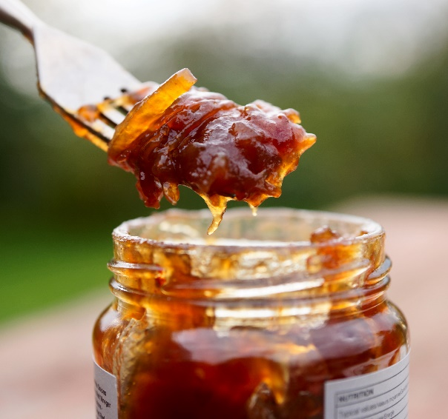
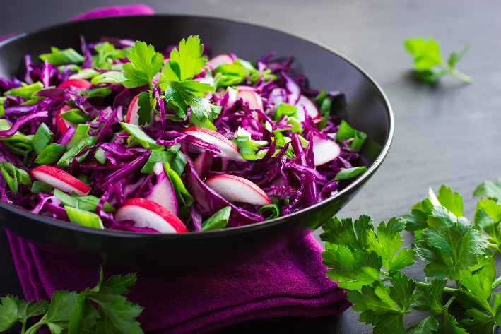
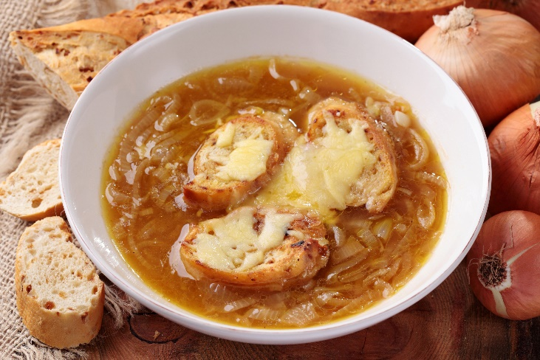
What are these?
What are they made with?
They all use onions.

Slide 4
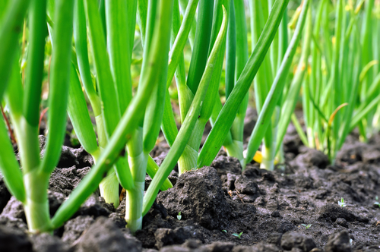
Where do onions come from?
Onions grow in the UK.
Onions are a plant.
Onions grow under the ground.
Onions are the bulb of the plant.

Slide 5
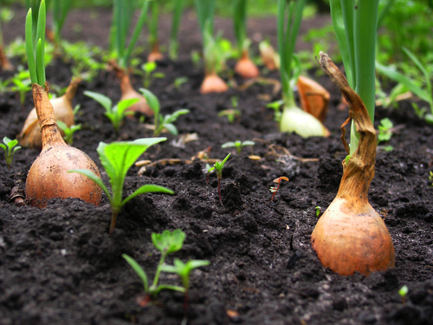
Where do onions come from?
Onions are pulled up from the ground when ready.
Have you seen onions growing before?

Slide 6

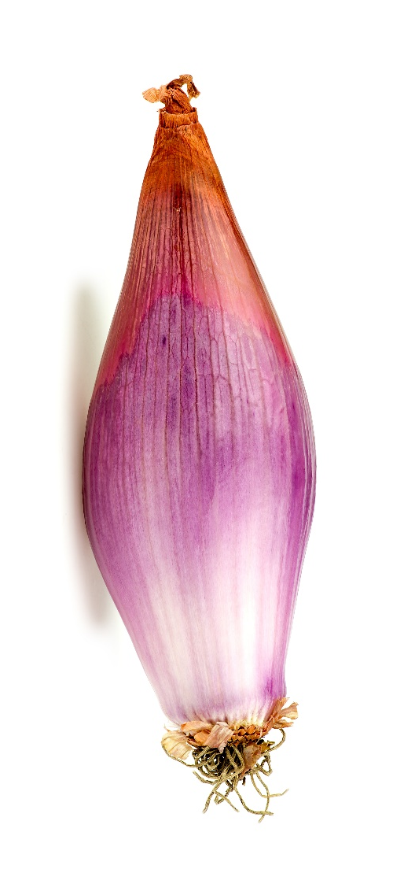
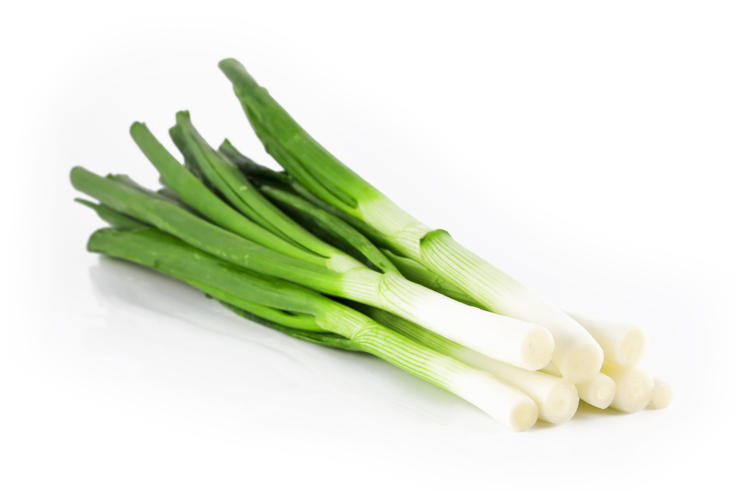
Onion varieties
There are 21different types of onion.
They have different names, such as:
Cipollini;
Spring onion;
Cocktail.

Slide 7
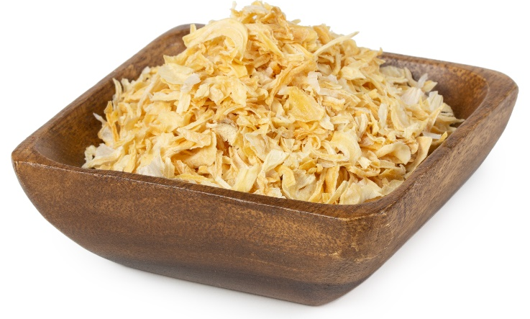
Onions
Onions can be purchased as:
fresh;
frozen;
dried.

Slide 8
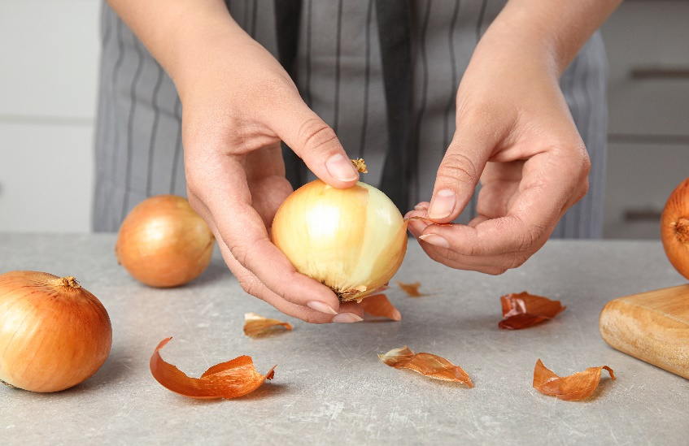
Dishes
Onions can be eaten raw – just peel first.
Onions can be used in many dishes.

Slide 9
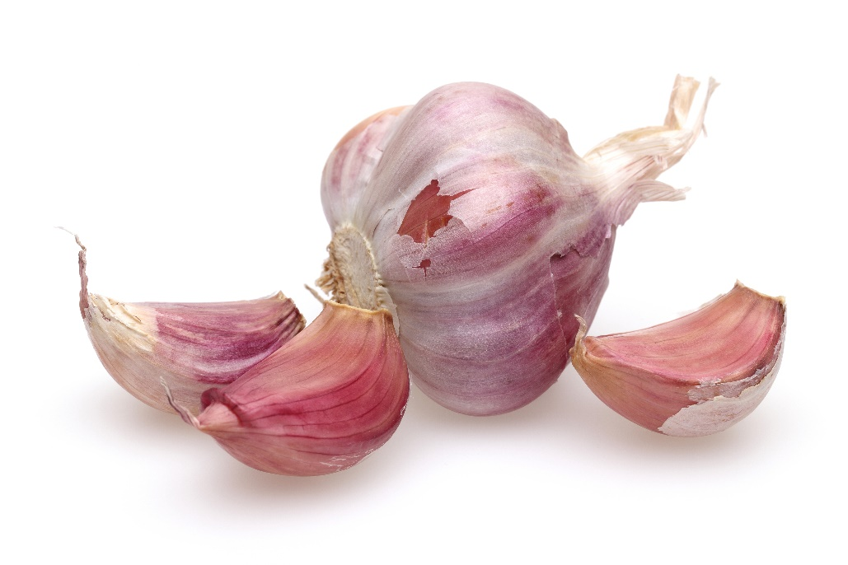
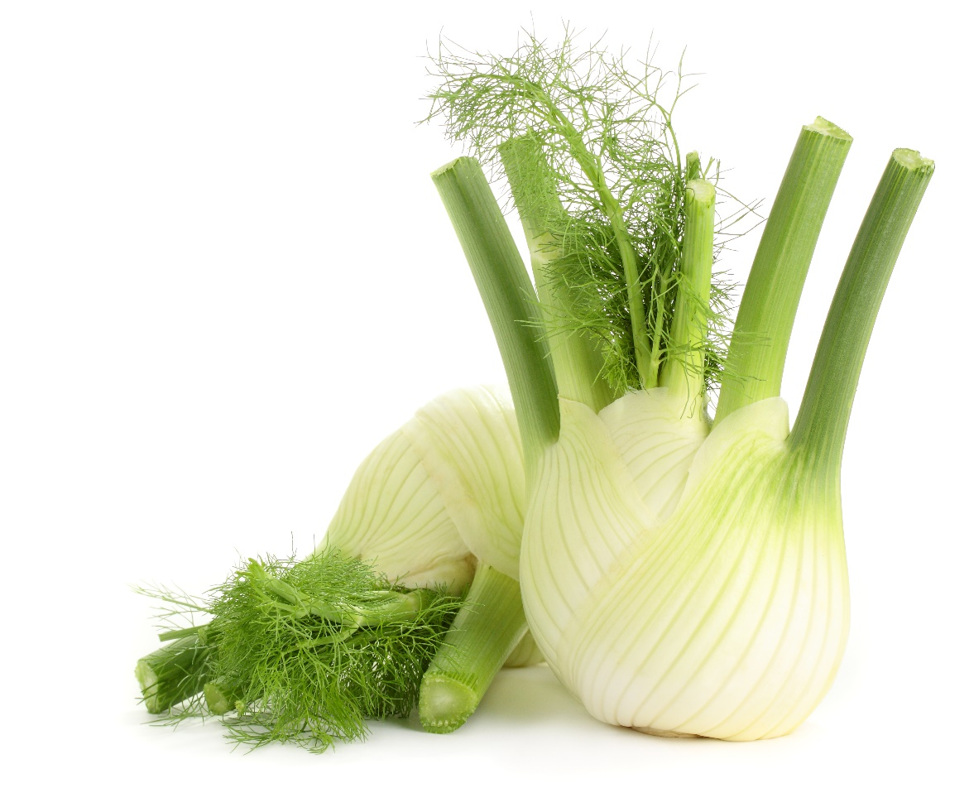
Similar
Garlic and fennel are similar to onions.
They are all bulbs.

Slide 10
Summary
Onions are grown for our food.
Onion
Lots of dishes use onions.

Slide 11
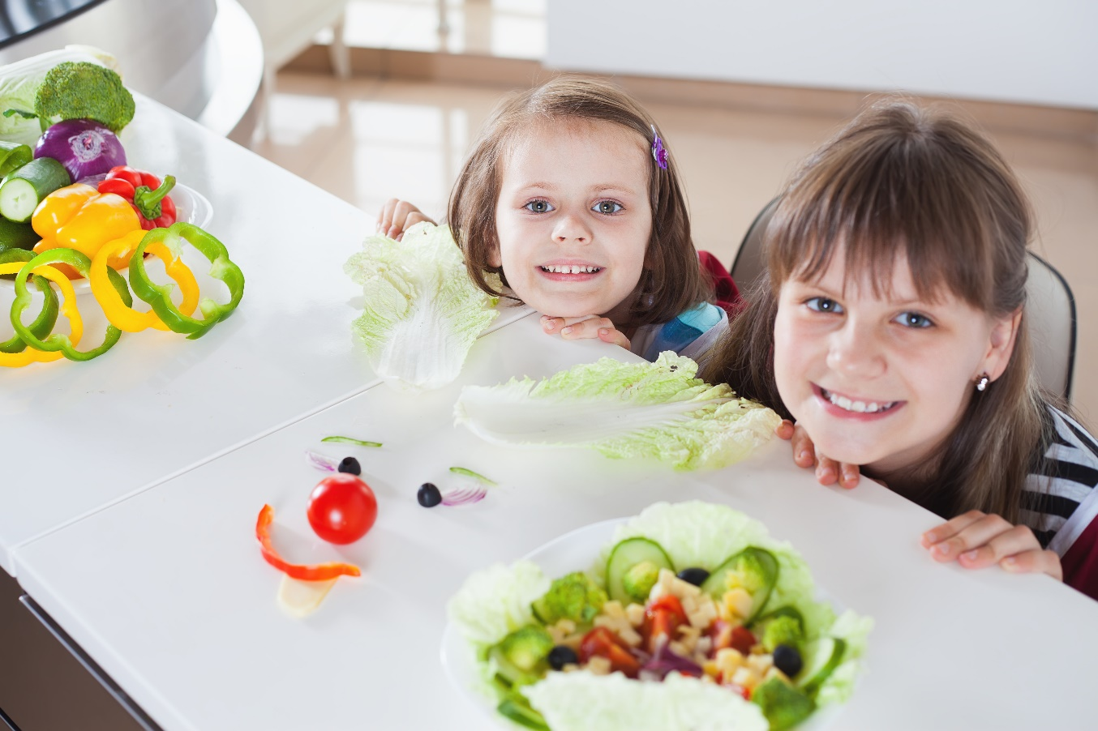
Do you like onions?

Slide 12
Onions
For further information, go to:
www.foodafactoflife.org.uk

