Slide 1
Oranges

Slide 2
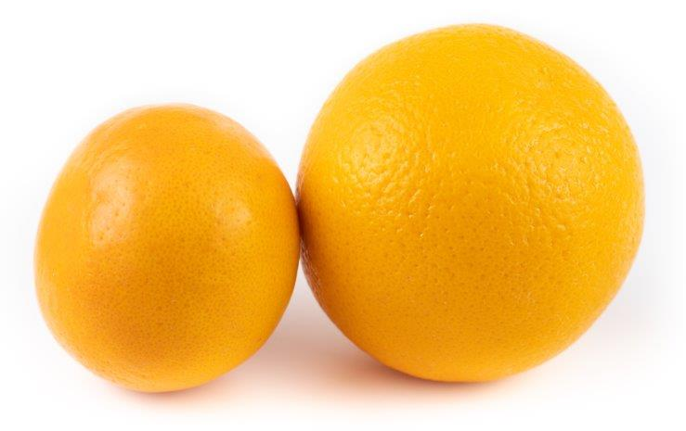
What are these?
These are oranges.
Oranges are a fruit.

Slide 3
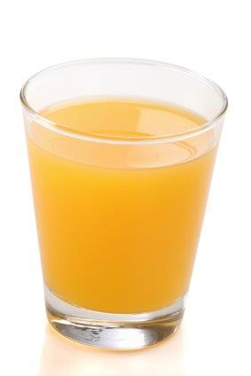
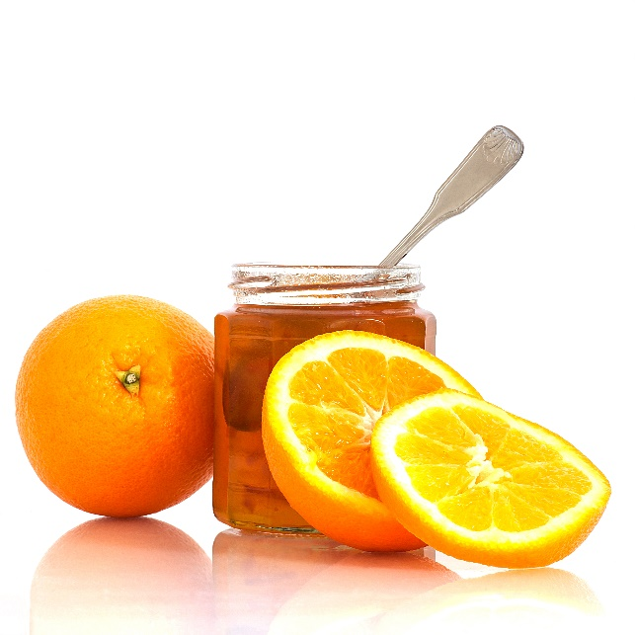
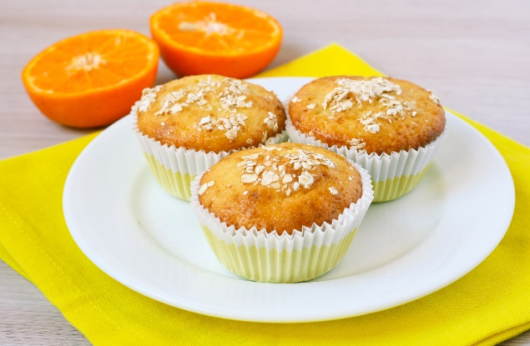
What are these?
What are they made with?
They all use oranges.

Slide 4
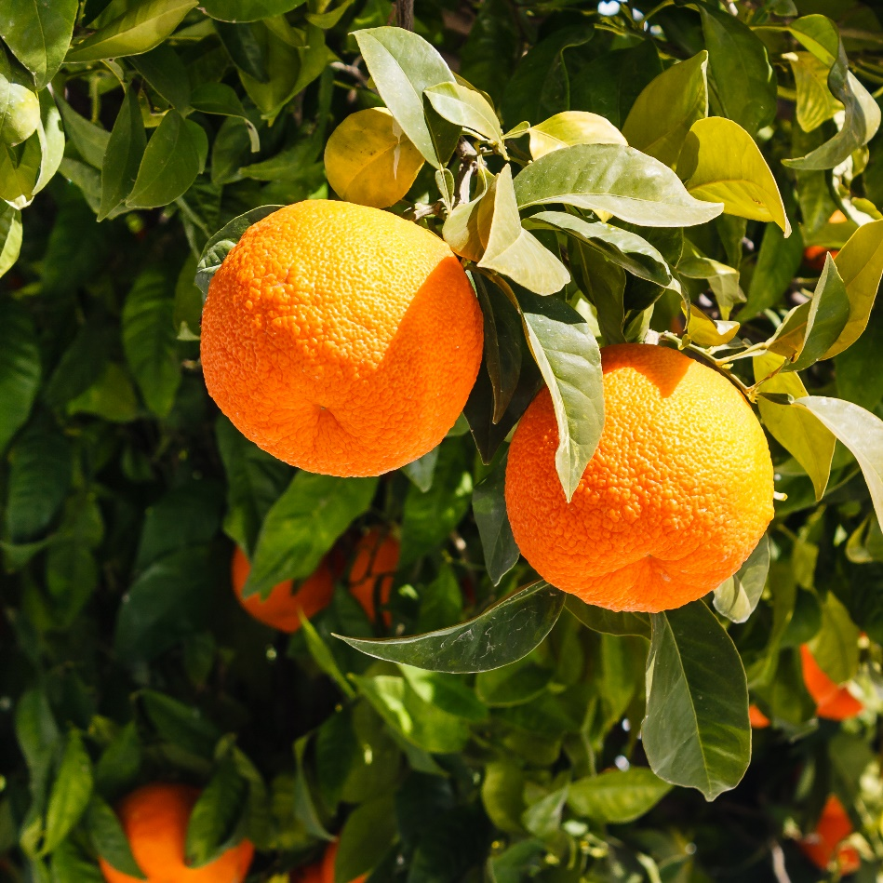
Where do oranges come from?
Oranges grow in warm climates.
Oranges are from a plant.
They grow above the ground.
They are known as ‘citrus’ fruit.

Slide 5
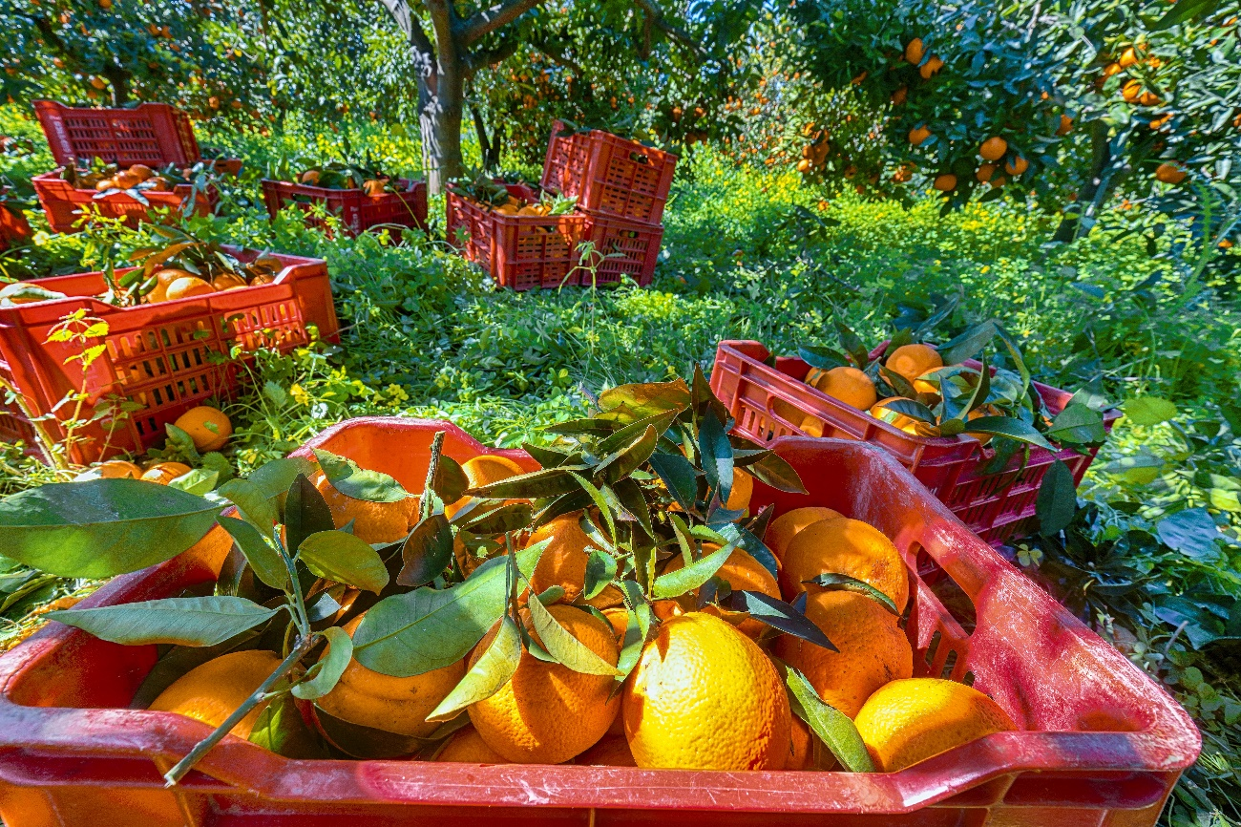
Where do oranges come from?
Oranges are picked when they are ready (ripe).
Have you seen oranges growing before?
There are over 600 varieties of orange around the world.

Slide 6
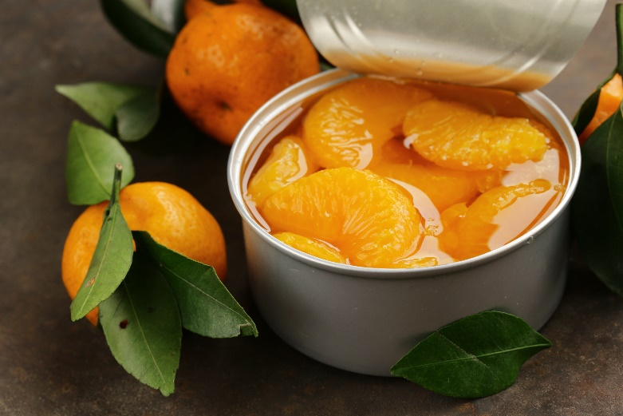
Oranges
Oranges can be purchased as:
fresh;
juiced;
canned.

Slide 7
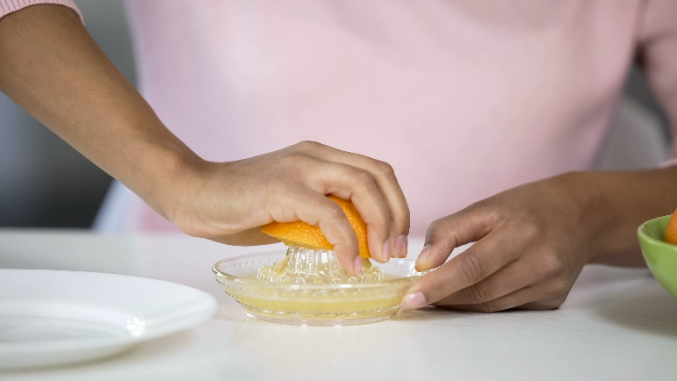
Dishes
Oranges can be eaten raw – just peel first. They can be juiced!
Oranges can be used in lots of dishes.

Slide 8
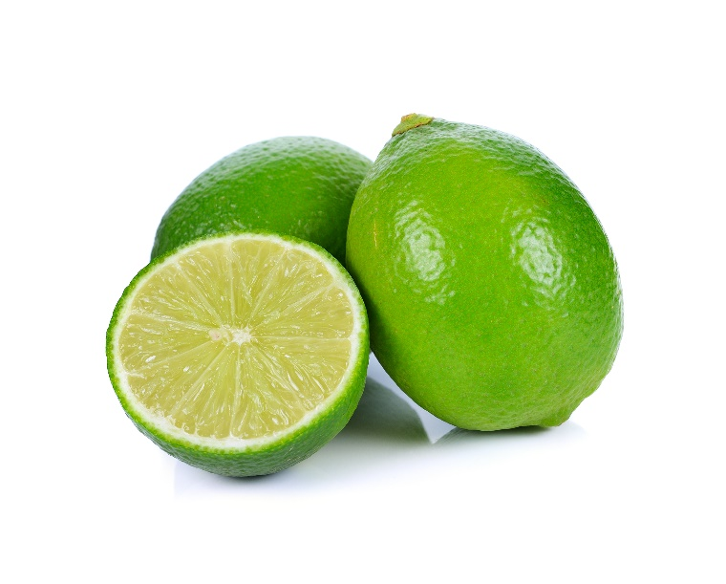
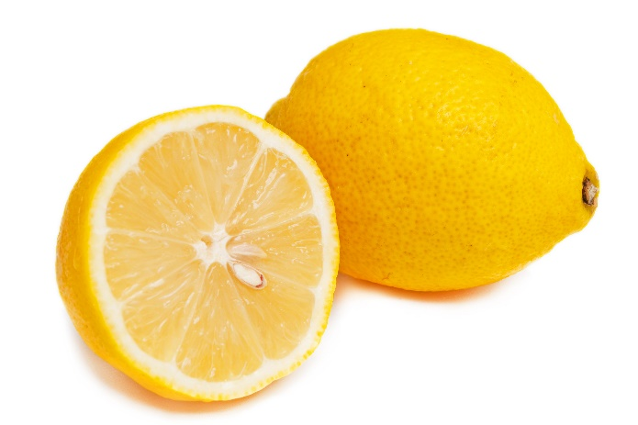
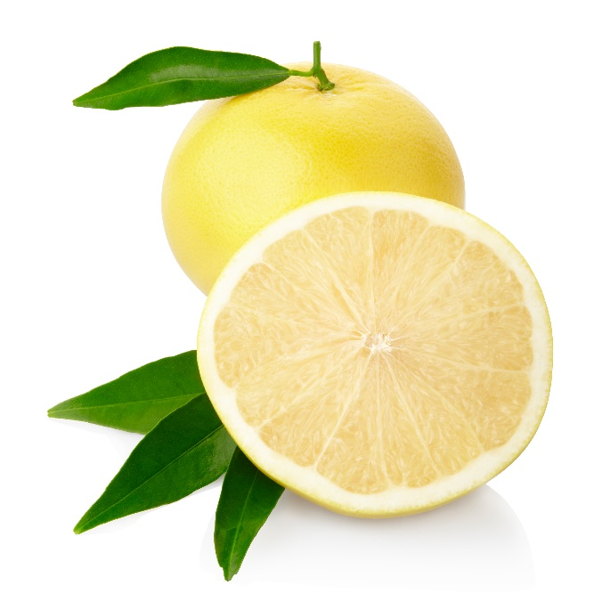
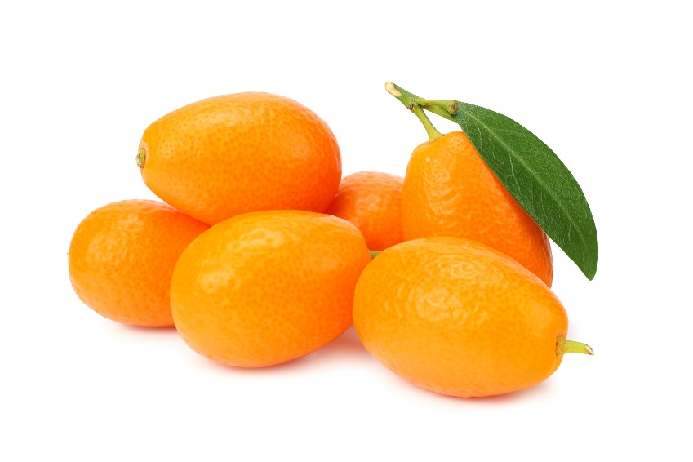
Similar
Lemons, limes, grapefruit and kumquats are similar to oranges.
They are all known as ‘citrus’ fruits.

Slide 9
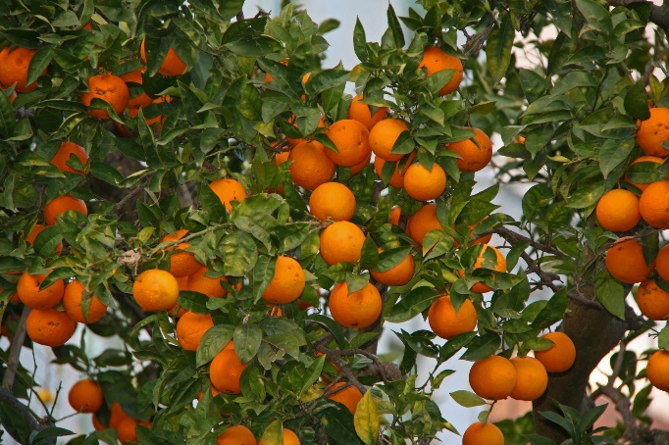
Summary
Oranges are grown for our food.
Oranges
Lots of dishes use oranges.

Slide 10
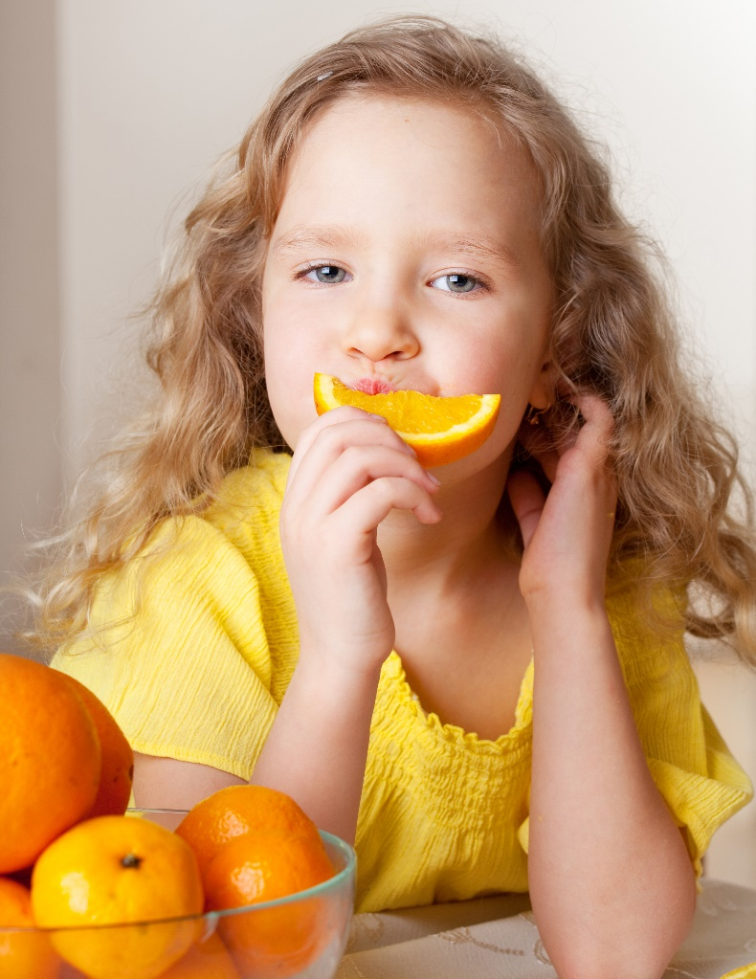
Do you like oranges?

Slide 11
Oranges
For further information, go to:
www.foodafactoflife.org.uk

