Slide 1
Plums

Slide 2
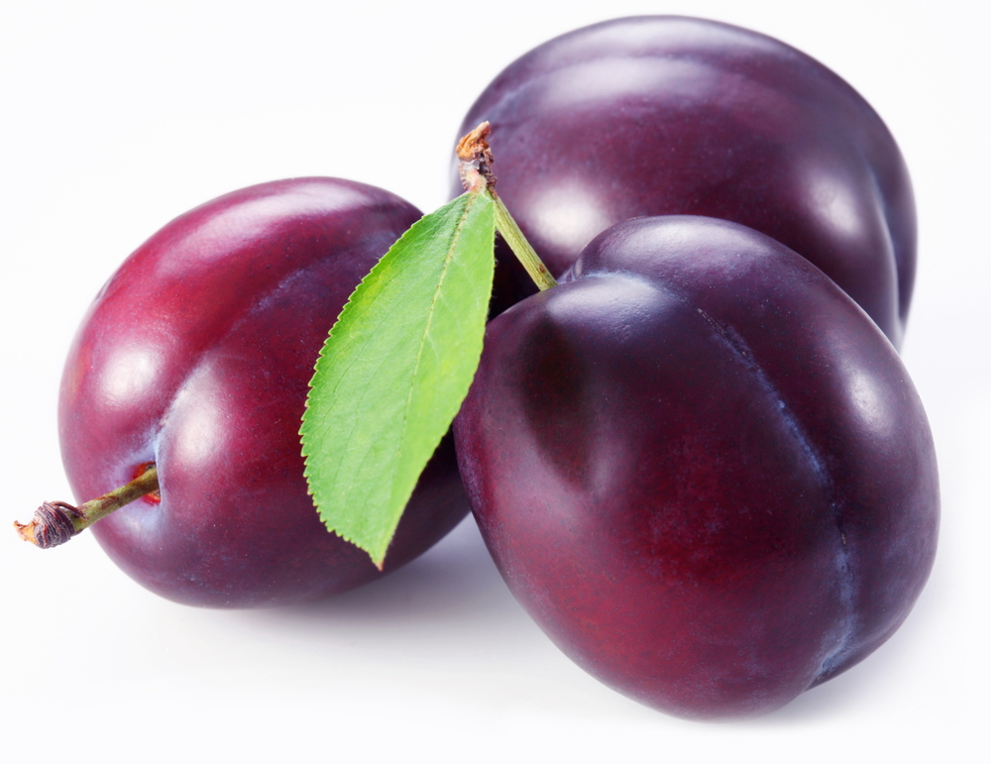
What are these?
These are plums.
Plums are a fruit.

Slide 3
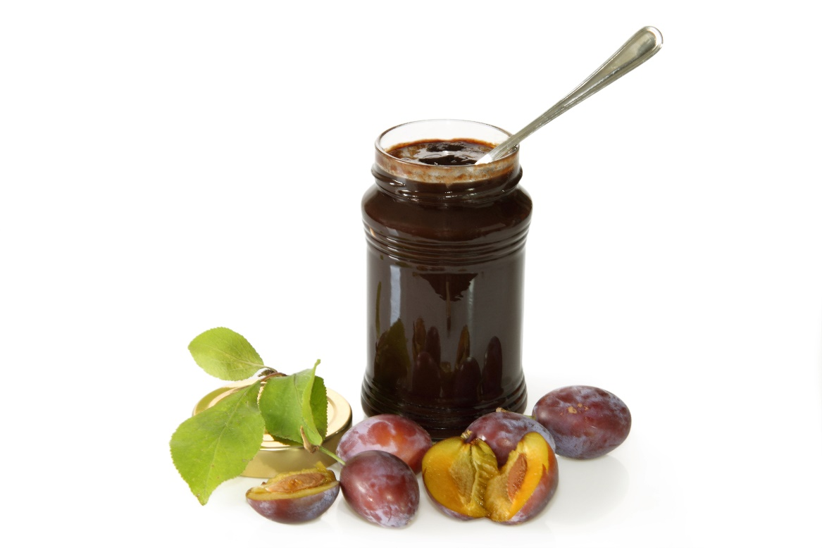
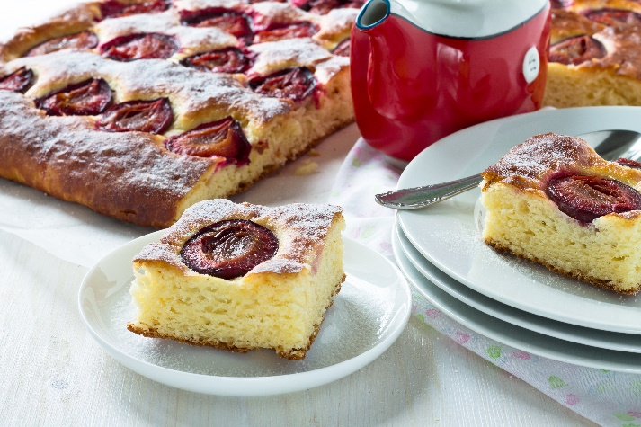
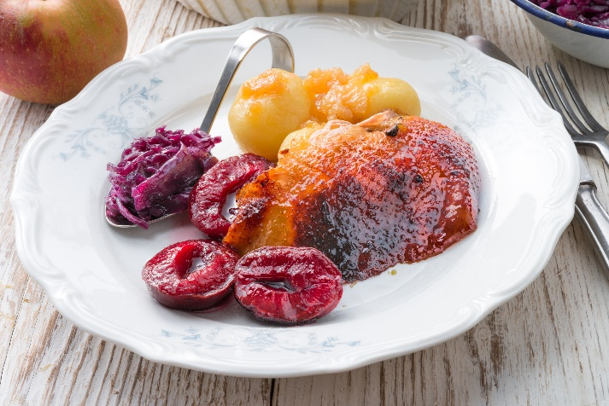
What are these?
They are all use plums.

Slide 4
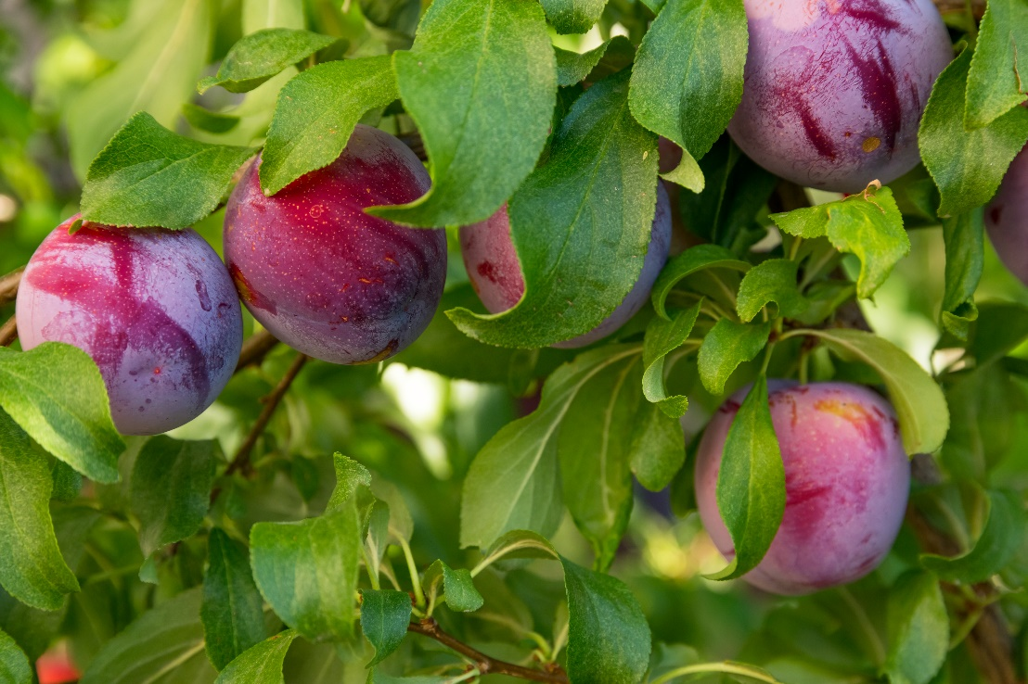
Where do plums come from?
Plums grow in the UK.
Plums are a plant and grow on a tree.
Plums are the fruit from the tree.
Plums have a hard ‘stone’ in the middle.

Slide 5
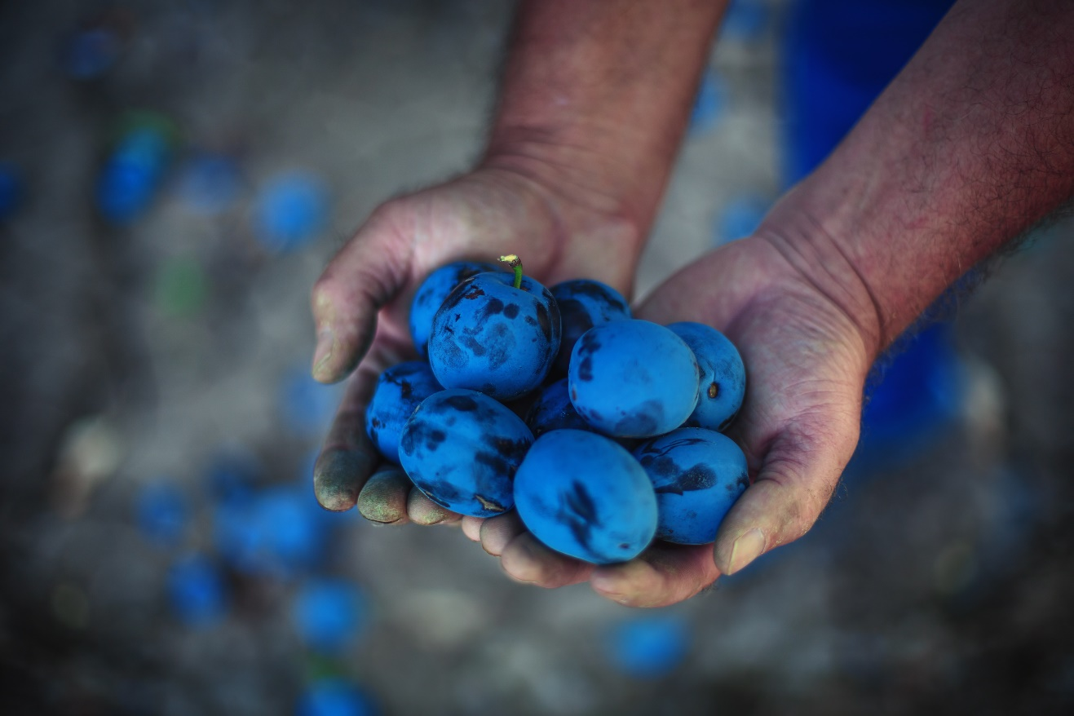
Where do plums come from?
Plums are pulled off the tree when ready (ripe).
Have you seen plums growing before?

Slide 6
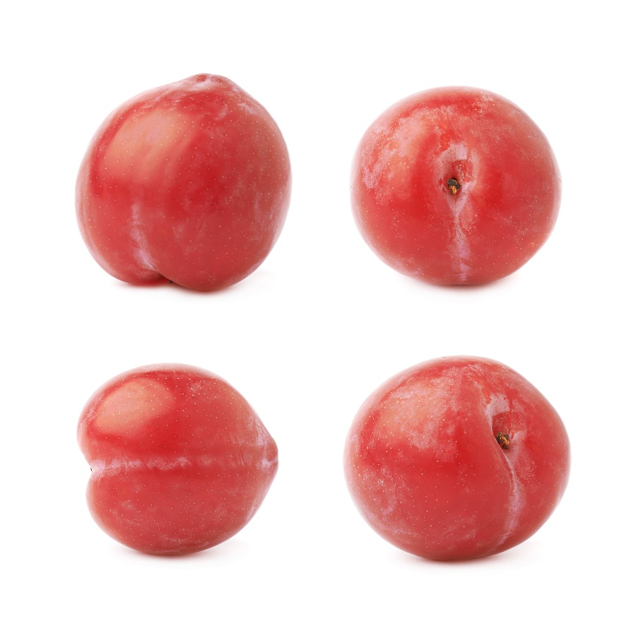

Plum types
There are lots of different types plum.
They have different names, such as:
Victoria;
Opal;
Czar.

Slide 7
Dishes
Plums can be eaten raw – just wash first and remove the stone.
Plums can be used in lots of dishes.

Slide 8
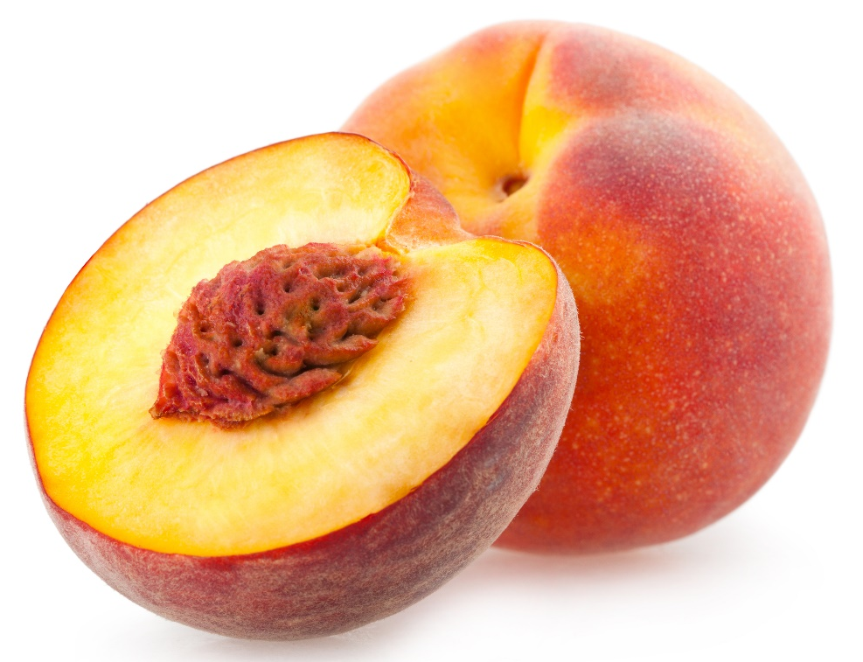
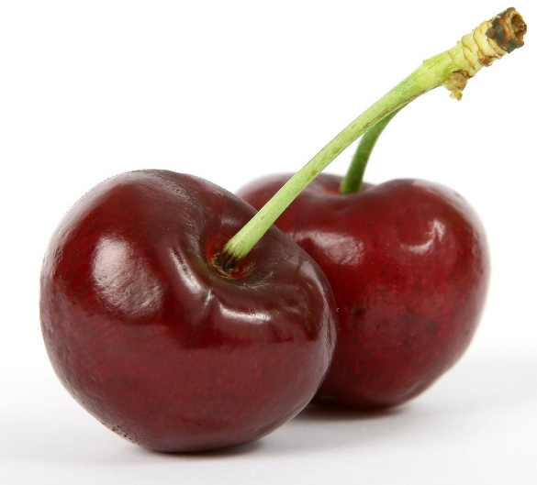
Similar
Peaches and cherries are similar to plums.
They all have a hard ‘stone’ in the middle.

Slide 9

Summary
Plums are grown for our food.
Plums
Lots of dishes use plums.

Slide 10
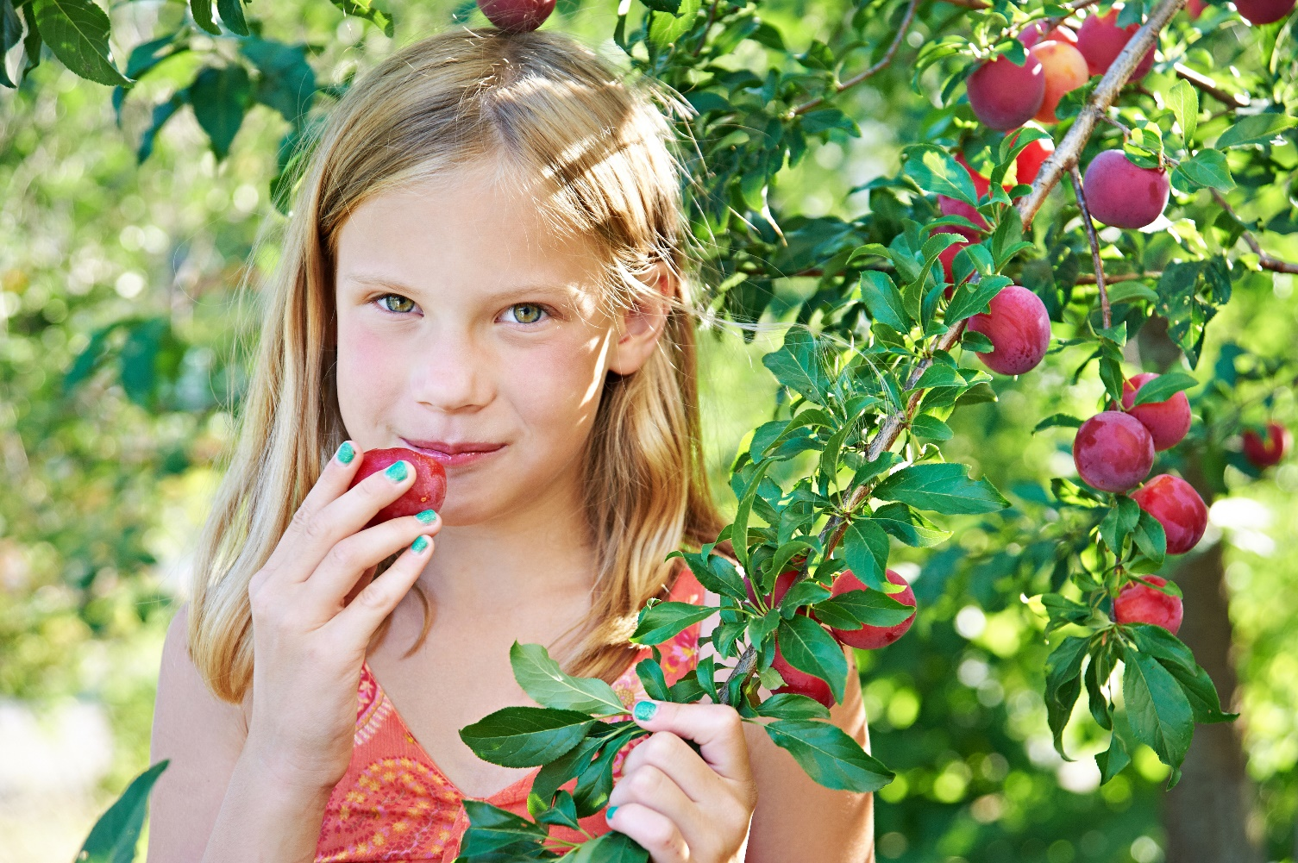
Do you like plums?

Slide 11
Plums
For further information, go to:
www.foodafactoflife.org.uk

