Slide 1
Raspberries

Slide 2
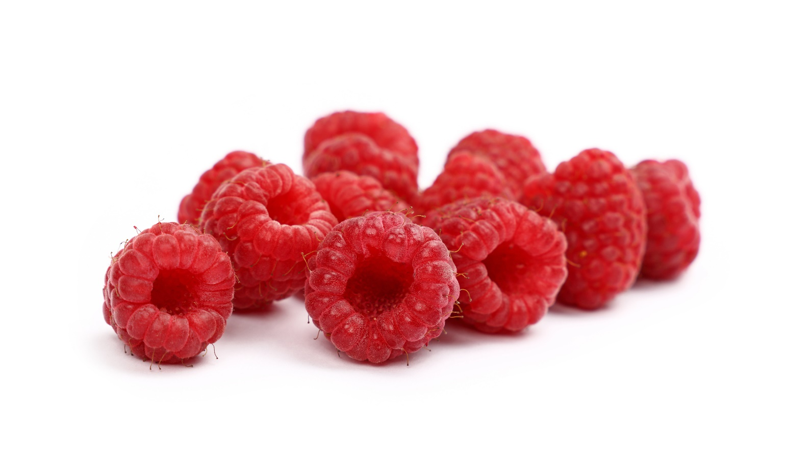
What are these?
These are raspberries.
Raspberries are a fruit.

Slide 3
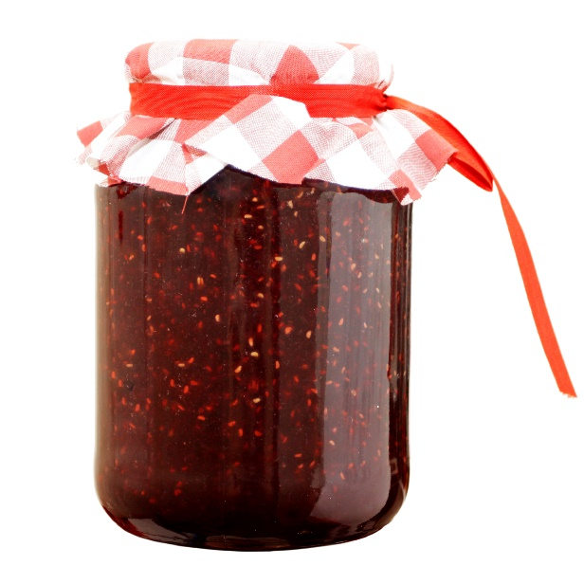
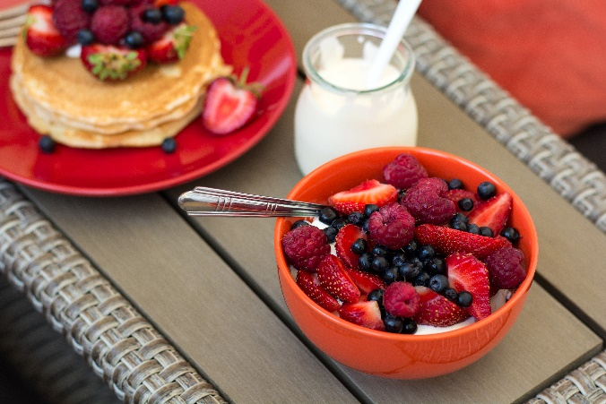
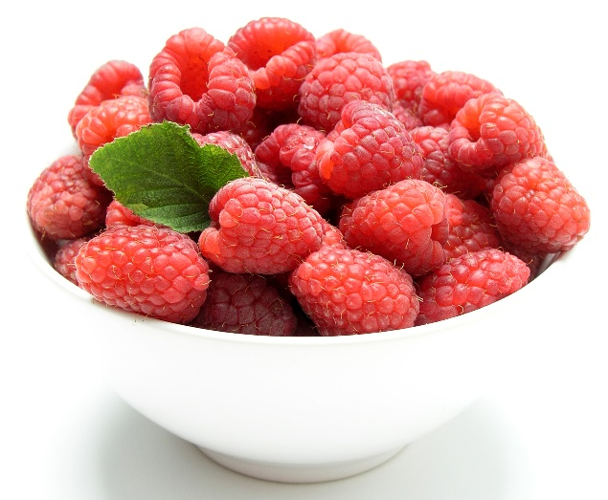
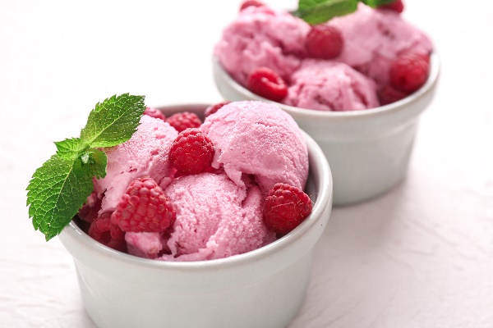
What are these?
They all use raspberries.

Slide 4
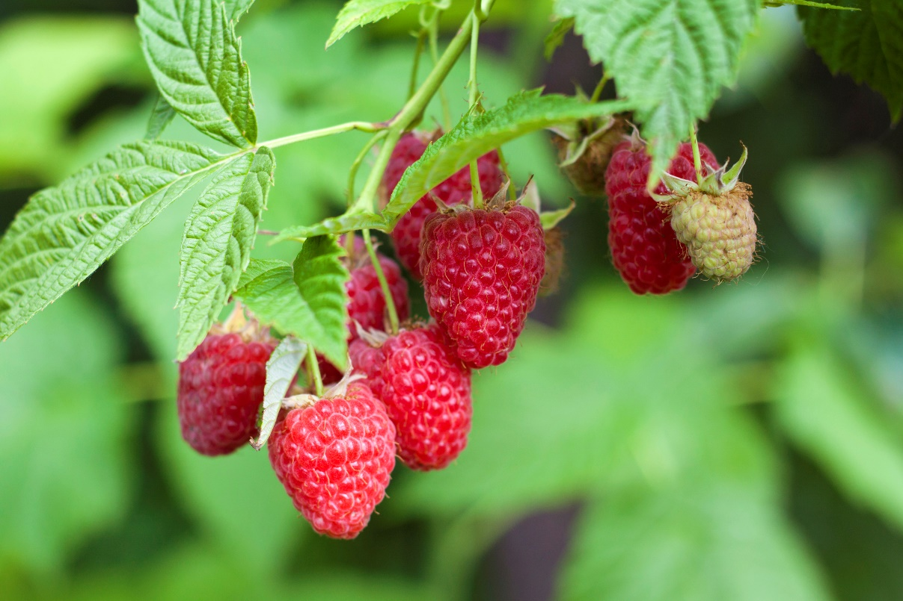
Where do raspberries come from?
Raspberries grow in the UK.
Raspberries are from a plant.
They grow above the ground.
Raspberries contain small seeds.

Slide 5
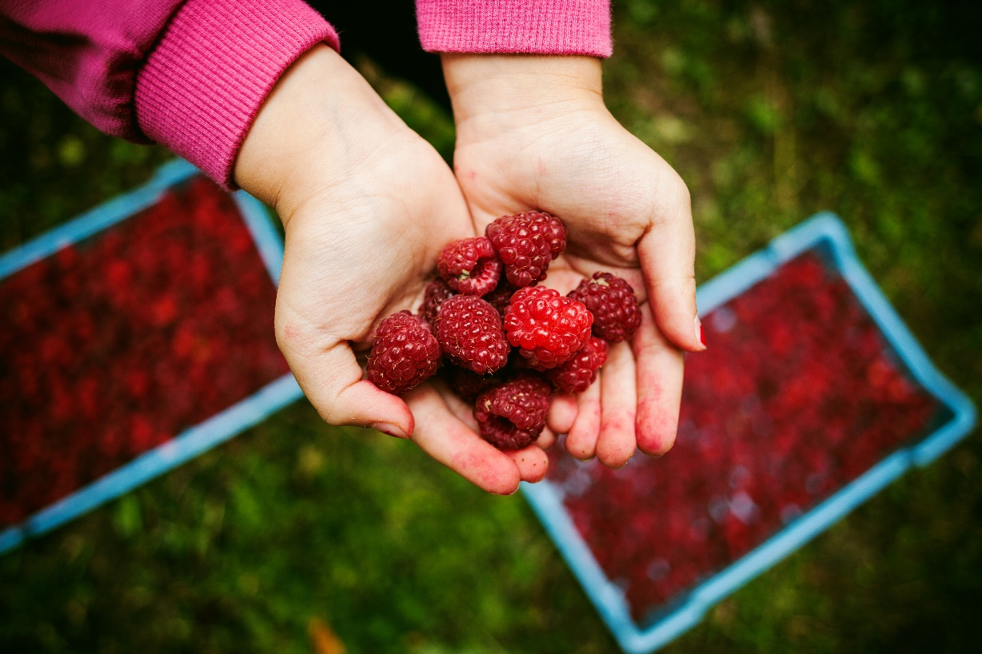
Where do raspberries come from?
Raspberries are picked when they are ready (ripe).
Have you seen raspberries growing before?

Slide 6
Raspberries
Raspberries can be purchased:
fresh;
frozen;
canned.

Slide 7
Dishes
Raspberries can be eaten raw – just wash first.
Raspberries can be used in lots of dishes.

Slide 8
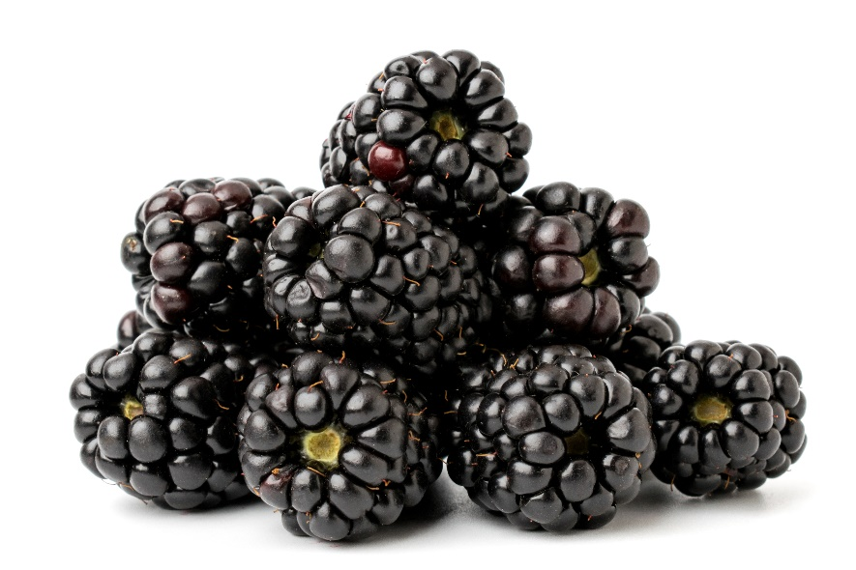
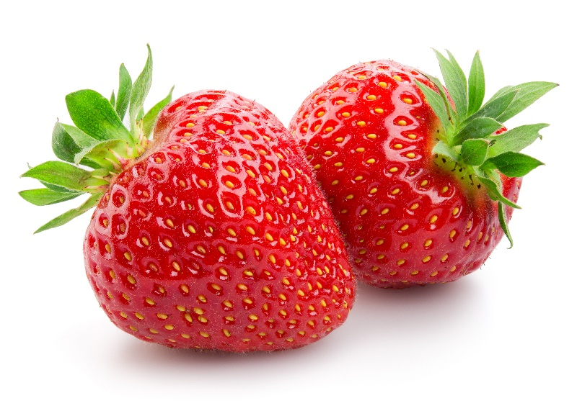
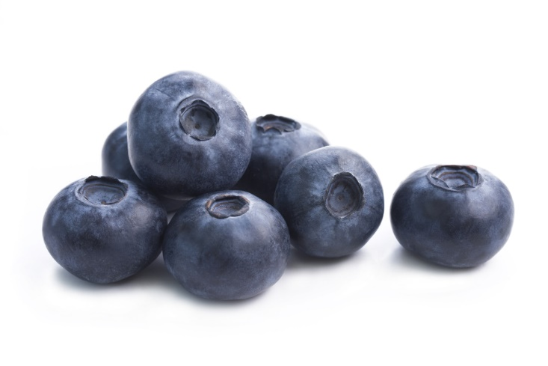
Similar
Blackberries, strawberries and blueberries are similar to raspberries.
They are all known as ‘berries’ (a fruit).

Slide 9

Summary
Raspberries are grown for our food.
Raspberries
Lots of dishes use raspberries.

Slide 10
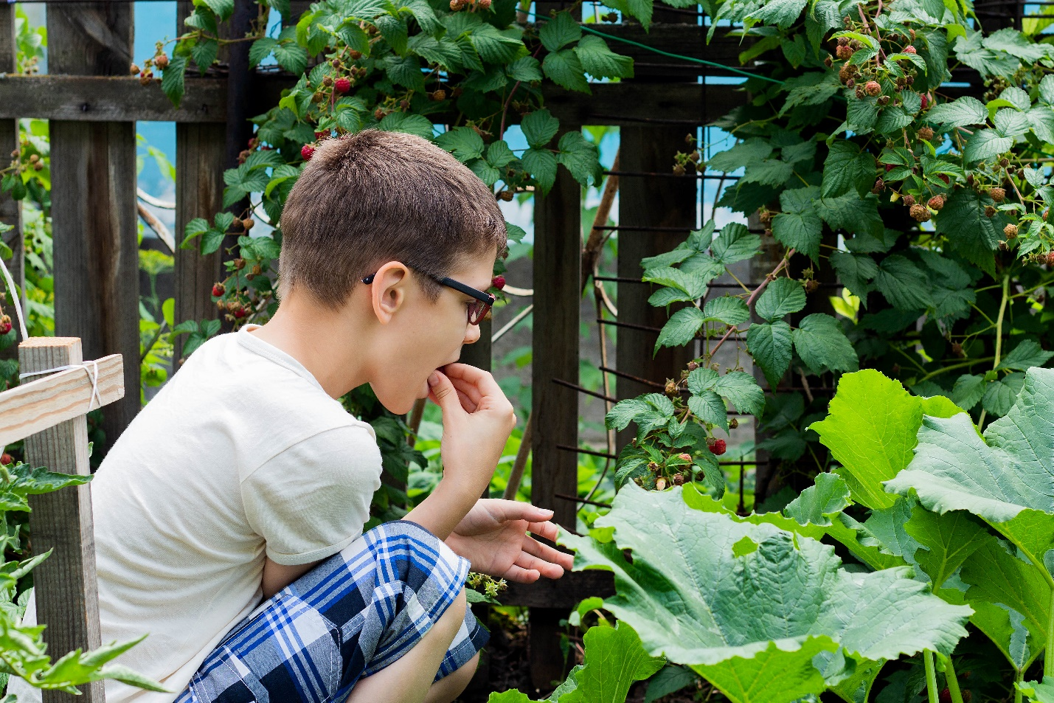
Do you like raspberries?

Slide 11
Raspberries
For further information, go to:
www.foodafactoflife.org.uk

