Slide 1
Eggs

Slide 2
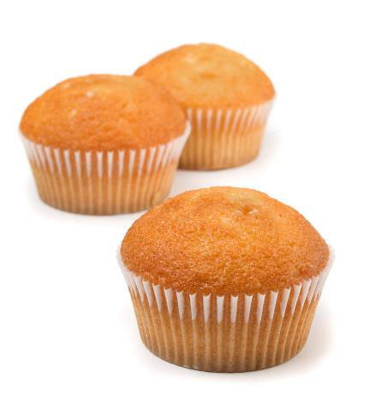

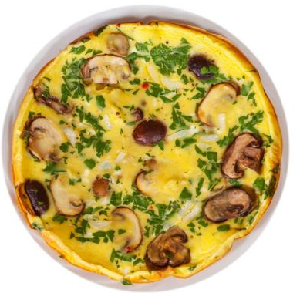
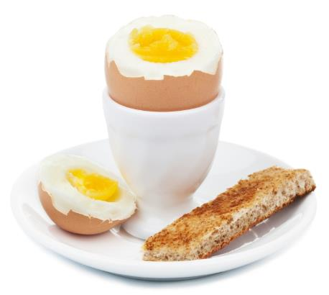
What do these have in common?
They all include egg.

Slide 3
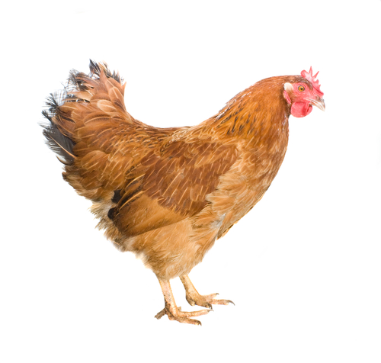
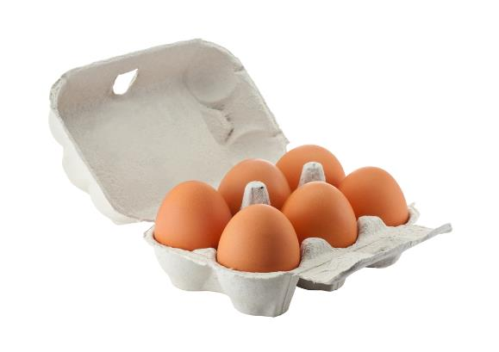
Where do eggs come from?
Eggs come from a hen.
Hens are reared to provide eggs.

Slide 4
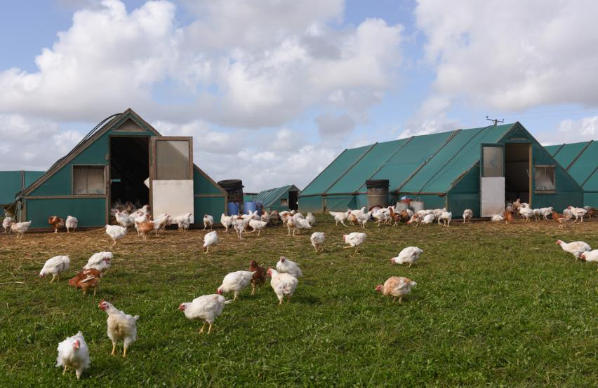
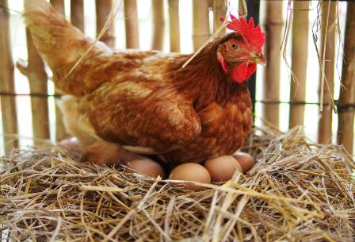
Where are the hens reared?
Hens are reared on farms.
Hens lay the eggs.

Slide 5
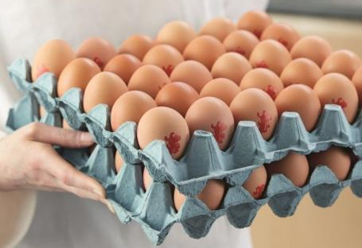
Eggs in the UK
13.1 billion eggs are eaten each year in the UK.
All UK eggs are stamped with the ‘lion’ mark – showing that they are safe to eat.

Slide 6
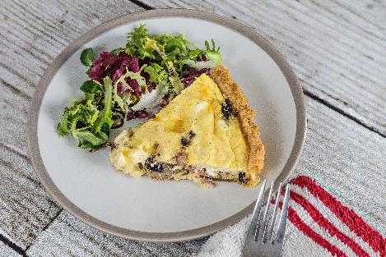

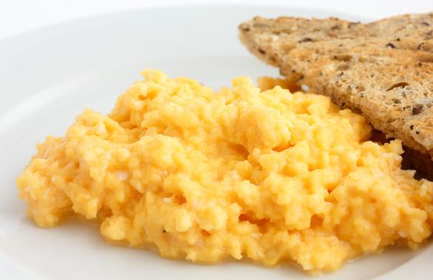
Meals
Eggs can be used in lots of meals.

Slide 7


Summary
Hens are reared to provide eggs.
Eggs
Lots of meals are made with eggs.

Slide 8
Eggs
For further information, go to:
www.foodafactoflife.org.uk
This resource meets the Guidelines for producers and users of school education resources about food.

