Slide 1
Eggs

Slide 2
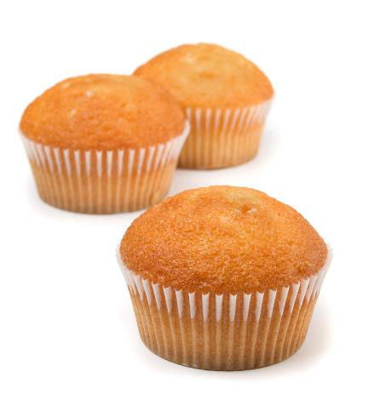
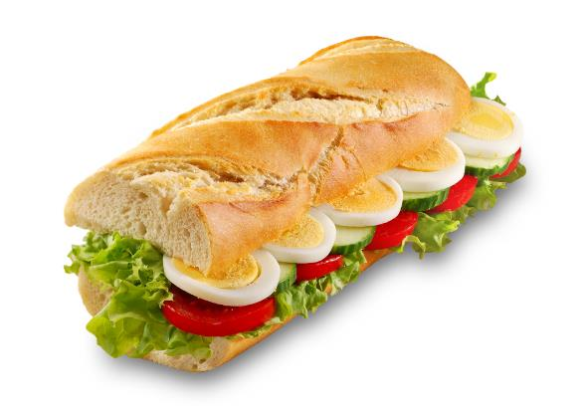
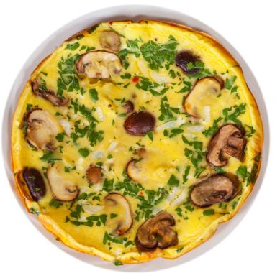
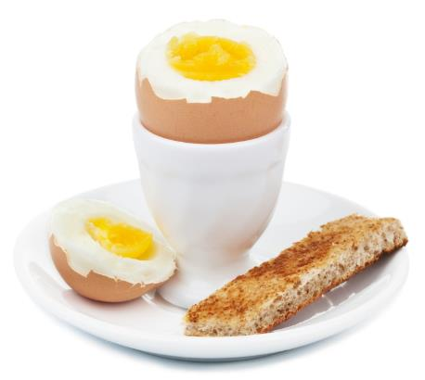
What do these have in common?
They all include egg.

Slide 3
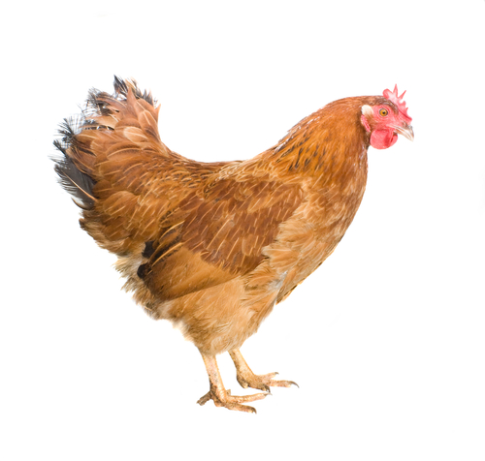
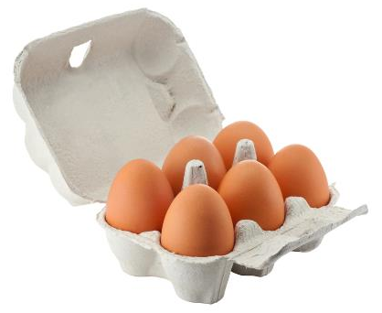
Where do eggs come from?
Eggs come from a hen.
Hens are reared in three different ways to provide eggs in the UK.

Slide 4
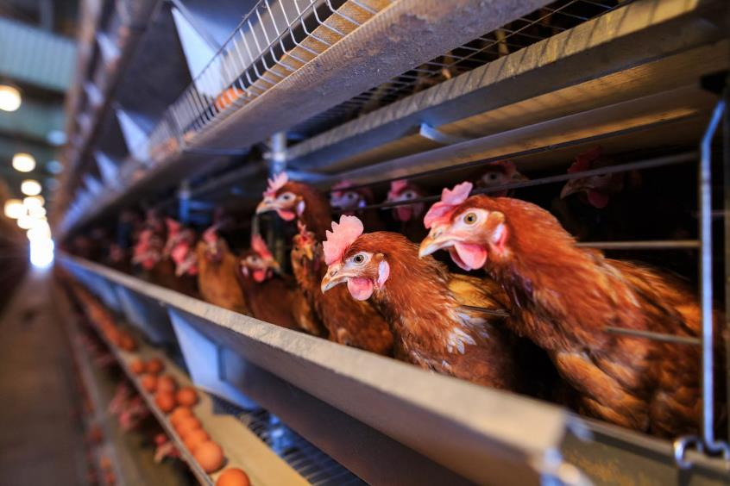
Enriched colony cage egg production
Between 40-80 hens share an enriched colony cage.
The space allows the bird to perch, lay their eggs and scratch.
Food and water is provided, and the temperate and light is controlled.

Slide 5
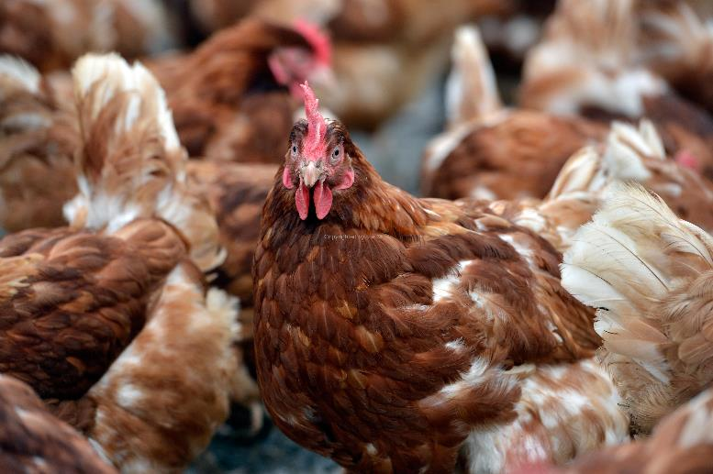
Barn egg production
Hens are able to move freely around the barn.
There are nest boxes and perches for the hens.
Food and water is provided, and the temperate and light is controlled.

Slide 6
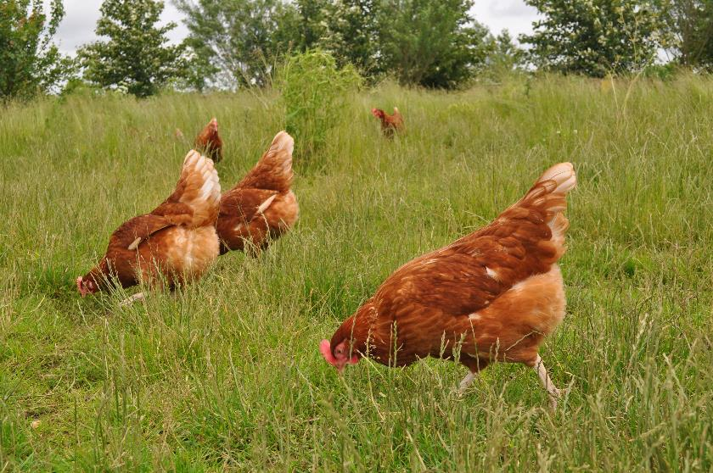
Free range egg production
Hens live in large barns and have access to the outside at all times.
There are nest boxes and perches for the hens in the barns.
Around one-third of the ground is used for scratching and dust bathing.

Slide 7
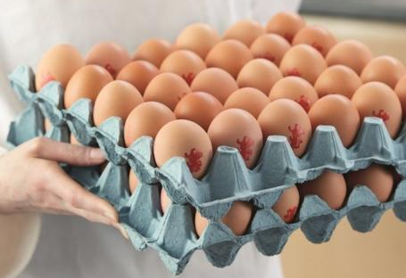
Eggs in the UK
13.1 billion eggs are eaten each year in the UK.
90% of UK eggs are stamped with the ‘lion’ mark – showing that they are safe to eat.

Slide 8
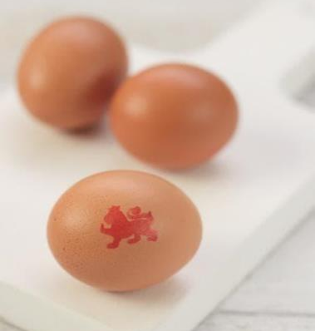
Eggs sizes
Eggs are sold in four different sizes:
Very large (73g +)
Large (63-73g)
Medium (53-63g)
Small (53g + under)
Hens naturally lay a range of sized eggs as they get older. Mixed weight boxes are now available which contain different sized eggs.

Slide 9

Parts of an egg
Yolk
Eggs have three main parts:
White
Shell

Slide 10

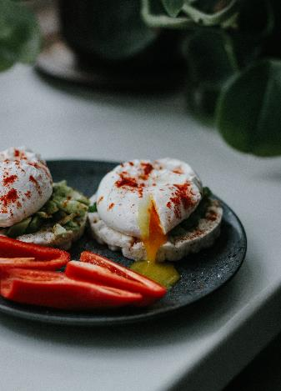
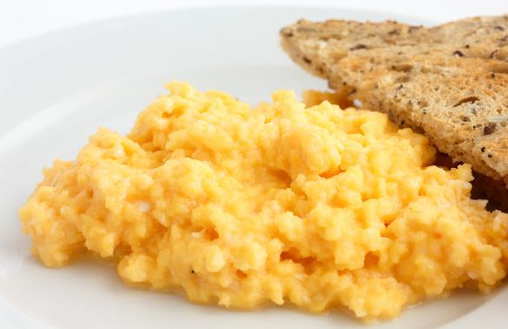
Uses of eggs
Eggs can be boiled, poached, fried or scrambled.

Slide 11
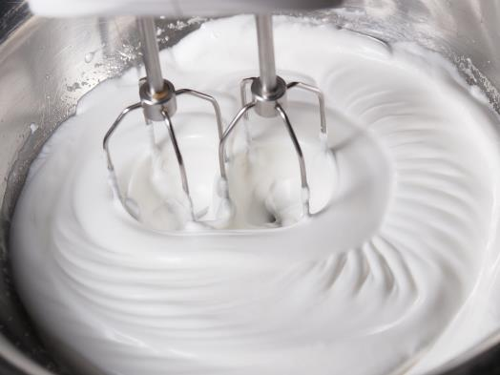
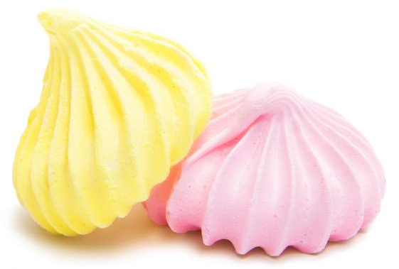
Uses of eggs
The white of an egg can be whisked to make a foam.
This can be used to make meringues.

Slide 12
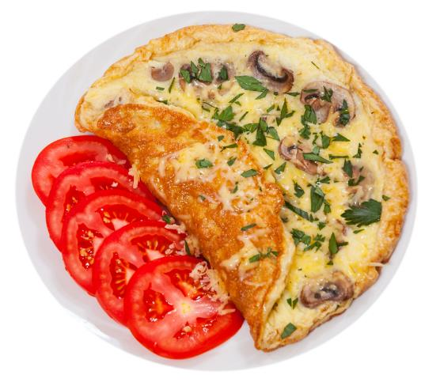
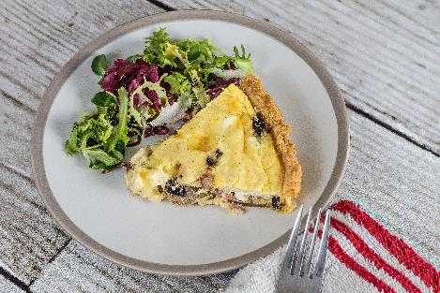
Uses of eggs
Eggs are used to make omelettes and quiches – where the egg sets.

Slide 13

Uses of eggs
Eggs are used to make cakes, which helps the mixture to rise.

Slide 14

Summary
Hens are reared to provide eggs.
Eggs
Lots of meals are made with eggs.

Slide 15
Eggs
For further information, go to:
www.foodafactoflife.org.uk
This resource meets the Guidelines for producers and users of school education resources about food.

